Slide 1
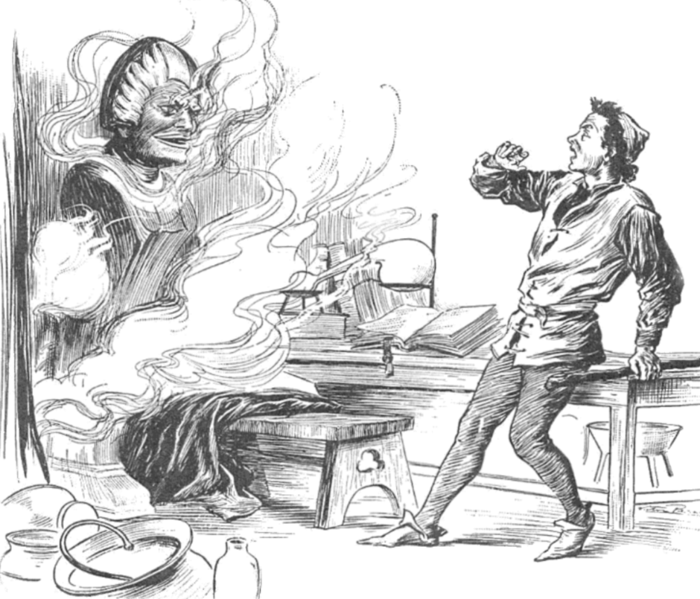
BRAZEN HEAD
ANSH MITTAL
CSE(DATA SCIENCE)
4TH SEMESTER (2nd year)
SECTION-B
Roll no:2201331540041

Slide 2
PROBLEM STATEMENT
A legendary automaton in the early modern period whose ownership was ascribed to late medieval scholars.
This chatbot, originally credited as witchcraft and magical, aims not only to answer as its original response of "yes" and "no", but also believes in answering in around 90 characters of text.

Slide 3
Literature Review
The first account of a talking head used to give its owner answers to his questions appears in William of Malmesbury's c. 1125 History of the English Kings, in a passage where he collects various rumours surrounding the polymath Pope Sylvester II, who was said to have travelled to Al-Andalus and stolen a tome of secret knowledge, whose owner he was only able to escape through demonic assistance.
He was said to have cast the head of a statue using his knowledge of astrology. It would not speak until spoken to, but then answered any yes/no question put to it.

Slide 4
AI-tech
Trained on large amounts of data and use ML to intelligently generate a wide range of non-scripted, conversational responses to human text.

Slide 5
TECHNOLOGIES USED
HTML
CSS
JAVASCRIPT
Python

Slide 6
MONETIZATION POLICY
VIA GOOGLE ADS

Slide 7
Bibliography
Google.com
Wikipedia
ChatGPT 3.5
Google Bard
Google Colab AI assistant
GeeksforGeeks

