Slide 1
HUFFMAN COMPRESSOR/DECOMPRESSOR
MADE BY:
AVINASH TIWARI(3230)
DHEERAJ KUMAR(3237)

Slide 2
Data compression
Data compression is the process of modifying, encoding or converting the bits structure of data in such a way that it consumes less space on disk. It enables reducing the storage size of one or more data instances or elements. Data compression is also known as source coding or bit-rate reduction.

Slide 3
Why Data Compression?
Make optimal use of limited storage space.
Save time and help to optimize resources
Compression frees up drive space and closes memory gaps, reducing the time needed to locate data on a drive. Speed up backups. Compressed files transfer faster and use less bandwidth than their uncompressed counterparts.

Slide 4
Data Compression Methods
Data compression is about storing and sending a smaller number of bits.
There’re two major categories for methods to compress data
Lossless method
Lossy method

Slide 5
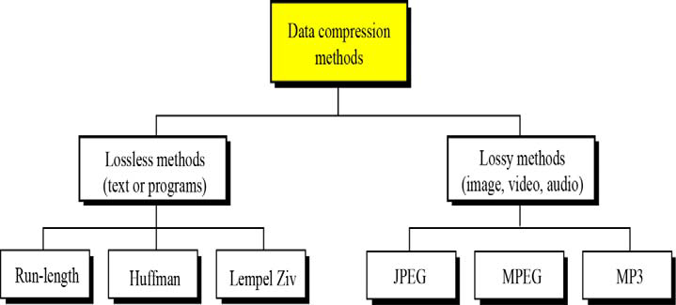

Slide 6
Lossless Compression Methods
In lossless methods, original data and the data after compression and decompression are exactly the same.
Redundant data is removed in compression and added during decompression.
Lossless methods are used when we can’t afford to lose any data: legal and medical documents, computer programs.

Slide 7
Lossy Compression Methods
Used for compressing images and video files (our eyes cannot distinguish subtle changes, so lossy data is acceptable).
These methods are cheaper, less time and space.
Several methods:
JPEG: compress pictures and graphics
MPEG: compress video
MP3: compress audio

Slide 8
Huffman Coding
An Application of Binary Trees and Priority Queues.
Proposed by Dr. David A. Huffman in 1952
“A Method for the Construction of Minimum Redundancy Codes”
Applicable to many forms of data transmission
Our example: text files

Slide 9
algorithm
Scan text to be compressed and tally occurrence of all characters.
Sort or prioritize characters based on number of occurrences in text.
Build Huffman code tree based on prioritized list.
Perform a traversal of tree to determine all code words.
Scan text again and create new file using the Huffman codes.

Slide 10
Building a Tree
Create binary tree nodes with character and frequency of each character
Place nodes in a heap
The lower the occurrence, the higher the priority in the heap
CHARACTER | A | B | C | D | E
FREQUENCY | 31 | 6 | 4 | 19 | 51

Slide 11
CHARACTER | A | B | C | D | E
FREQUENCY | 31 | 6 | 4 | 19 | 51
C 4
B 6
D19
A 31
E 51

Slide 12
BUILDING A TREE
While heap contains two or more nodes
Create new node
Remove first node and make it left subtree
Remove next node and make it right subtree
Frequency of new node equals sum of frequency of left and right children
Add the new node back into heap
Sort the heap again

Slide 13
CHARACTER | A | B | C | D | E
FREQUENCY | 31 | 6 | 4 | 19 | 51
10
D19
A 31
E 51
C 4
B 6

Slide 14
CHARACTER | A | B | C | D | E
FREQUENCY | 31 | 6 | 4 | 19 | 51
29
A 31
E 51
10
D19
C 4
B 6

Slide 15
CHARACTER | A | B | C | D | E
FREQUENCY | 31 | 6 | 4 | 19 | 51
60
E 51
29
A 31
10
D19
C 4
B 6

Slide 16
CHARACTER | A | B | C | D | E
FREQUENCY | 31 | 6 | 4 | 19 | 51
60
E 51
29
A 31
10
D19
C 4
B 6

Slide 17
CHARACTER | A | B | C | D | E
FREQUENCY | 31 | 6 | 4 | 19 | 51
E 51
60
29
A 31
10
D19
C 4
B 6

Slide 18
CHARACTER | A | B | C | D | E
FREQUENCY | 31 | 6 | 4 | 19 | 51
111
E 51
60
29
A 31
10
D19
C 4
B 6

Slide 19
Building a Tree
Remove the single node left in the queue.
This tree contains the new code words for each character.
Frequency of root node should equal number of characters in text.

Slide 20
Encoding the File
Perform a traversal of the tree to obtain new code words
Going left is a 0 going right is a 1
code word is only completed when a leaf node is reached

Slide 21
CHARACTER | A | B | C | D | E
FREQUENCY | 31 | 6 | 4 | 19 | 51
111
0
1
E 51
60
29
A 31
10
D19
C 4
B 6

Slide 22
CHARACTER | A | B | C | D | E
FREQUENCY | 31 | 6 | 4 | 19 | 51
111
0
1
E 51
60
0
1
29
A 31
0
1
10
D19
0
1
C 4
B 6

Slide 23
CHARACTER | CODE
A | 11
B | 1001
C | 1000
D | 101
E | 0

Slide 24
Encoding the File
Rescan text and encode file using new code words
Sample text :
AABCDEEEBA
A: 11
B:1001
C:1000
D:101
E:0
111110011000101000100111

Slide 25
Decoding the File
How does receiver know what the codes are?
Tree constructed for each text file.
Considers frequency for each file
Big hit on compression, especially for smaller files
Tree predetermined
based on statistical analysis of text files or file types
Data transmission is bit based versus byte based

Slide 26
DECODING THE FILE
Once receiver has tree it scans incoming bit stream
0 -> go left
1 -> go right

Slide 27
111
0
1
bit stream
111110011000101000100111
E 51
60
0
1
29
A 31
0
1
output :
AABCDEEEBA
10
D19
0
1
C 4
B 6

Slide 28
Results
Have we made things any better?
ASCII would take 8 * 111 = 888 bits
We need (2*31+4*6+4*4+3*19+1*51) 210 bits to encode the text
On calculation we save up to 72.35% memory in this case.

Slide 29
Data structures used
Array
Binary tree
Heap

Slide 30
Thank you

