Slide 1
ABCDom II figures

Slide 2
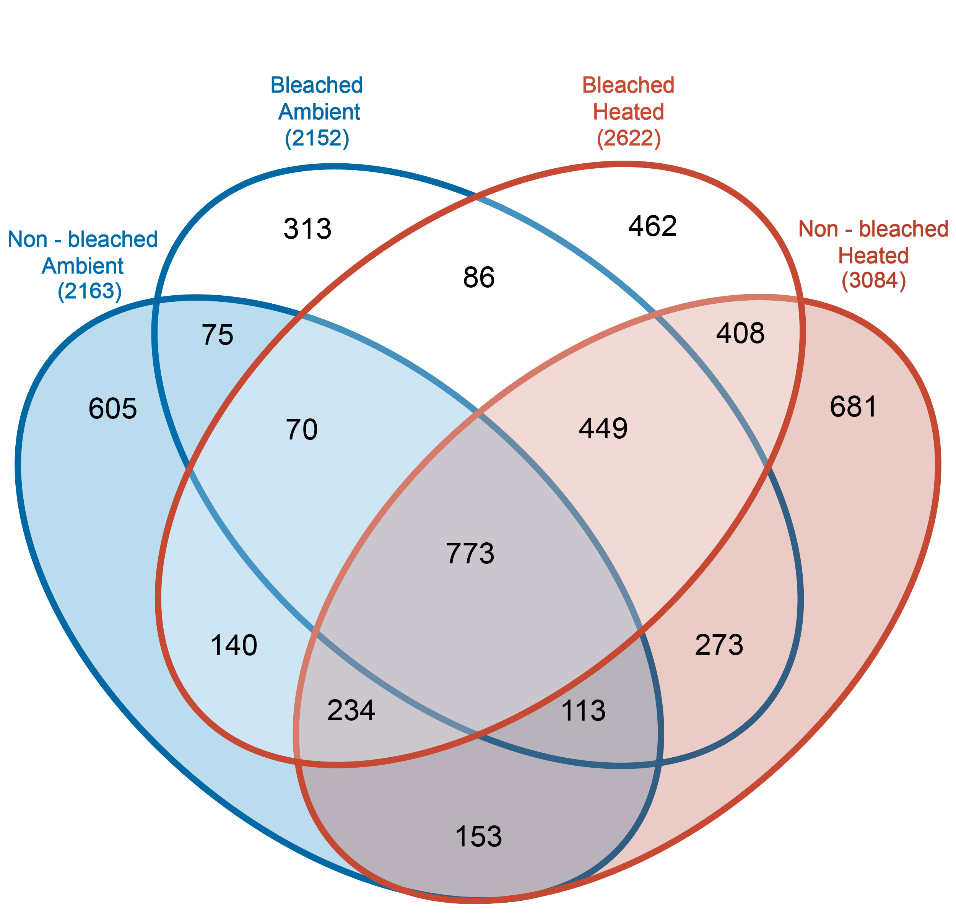
Figure 1: Venn diagram of exudate features in each treatment. Exudate features have at least a 2 fold higher average peak area in the treatment compared to the average peak area in the water controls. Most features are exuded in all treatments (773). There are potentially 449 general ”stress” features who are exuded by the corals in the stress treatments. Each treatment has their own uniquely exuded suite of features, who are potentially prodcuts of accumulated stress. Or somerthing like this.

Slide 3
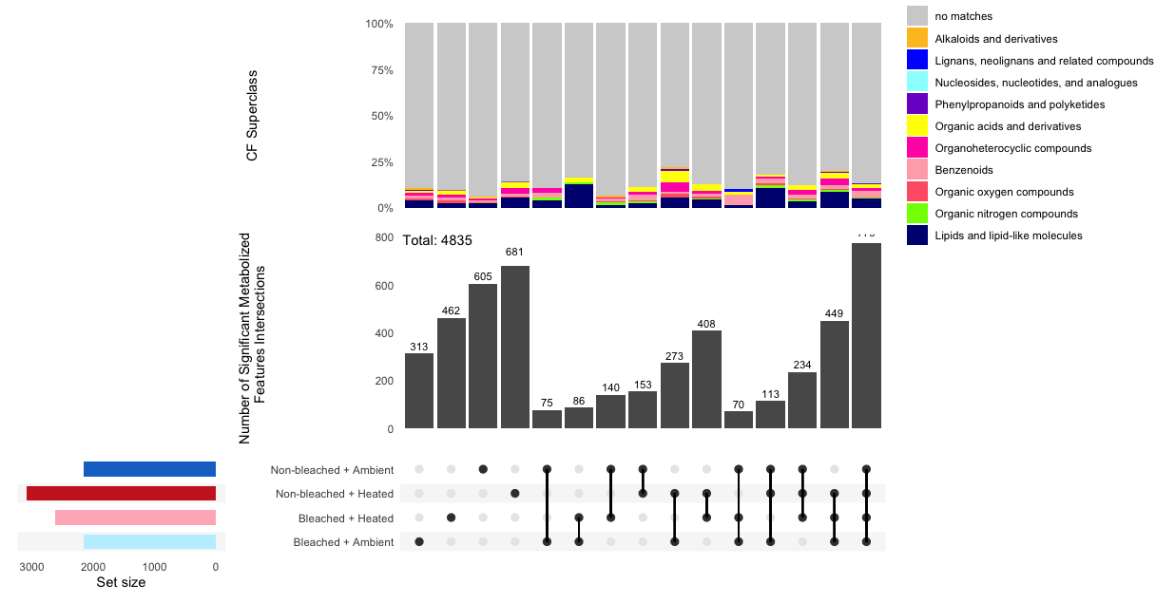
Upset plot (same as previous venn diagram) but with added information on SuperClass of the features beloning to each intersection.

Slide 4
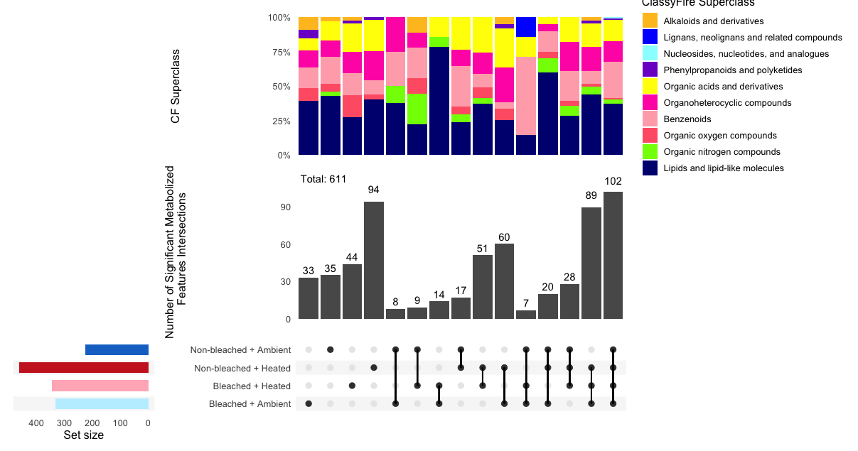
Upset plot of only the exudate features with an assigened Superclass. Phenylpropanoids and polyketides are only occuring in the stress treatments.
A quick google says that polyketides are plant molecules so maybe they come from the stressed symbionts?

Slide 5
Changing exudates over time

Slide 6
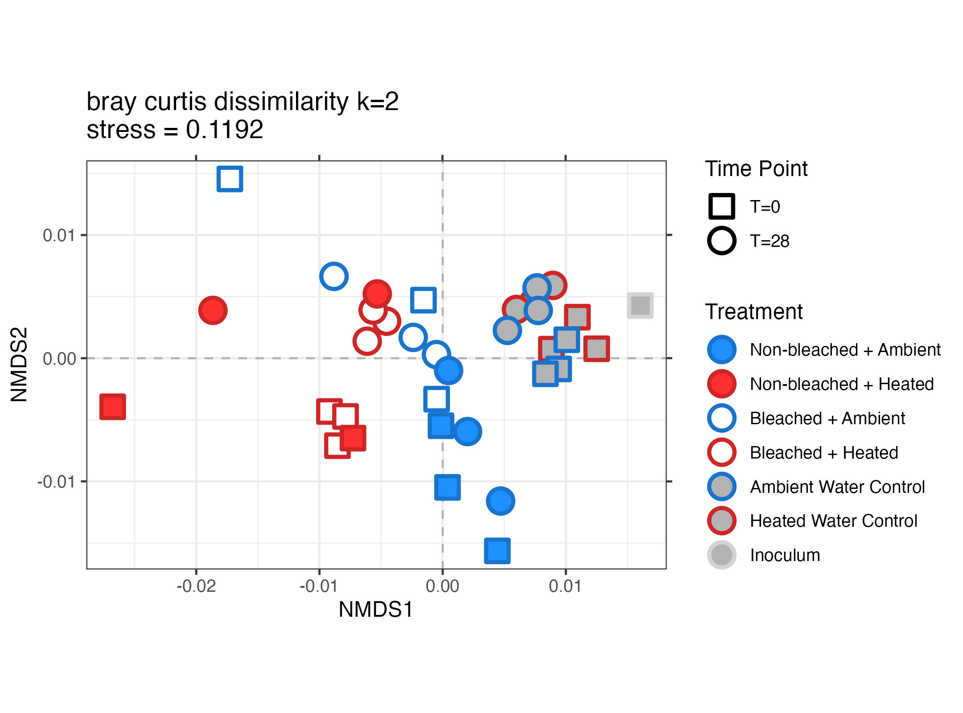
NMDS of bay curtis dissimilairty of our T0 samples and T36 – exometabolome -> exudate + ambient features
All Tend samples seem to move closer to the center, which is mostly “up” except for bleached ambient. Looks like the stuff that makes each treatment unique is being removed. But also that many of the same features are changed in similar ways.
T=36

Slide 7
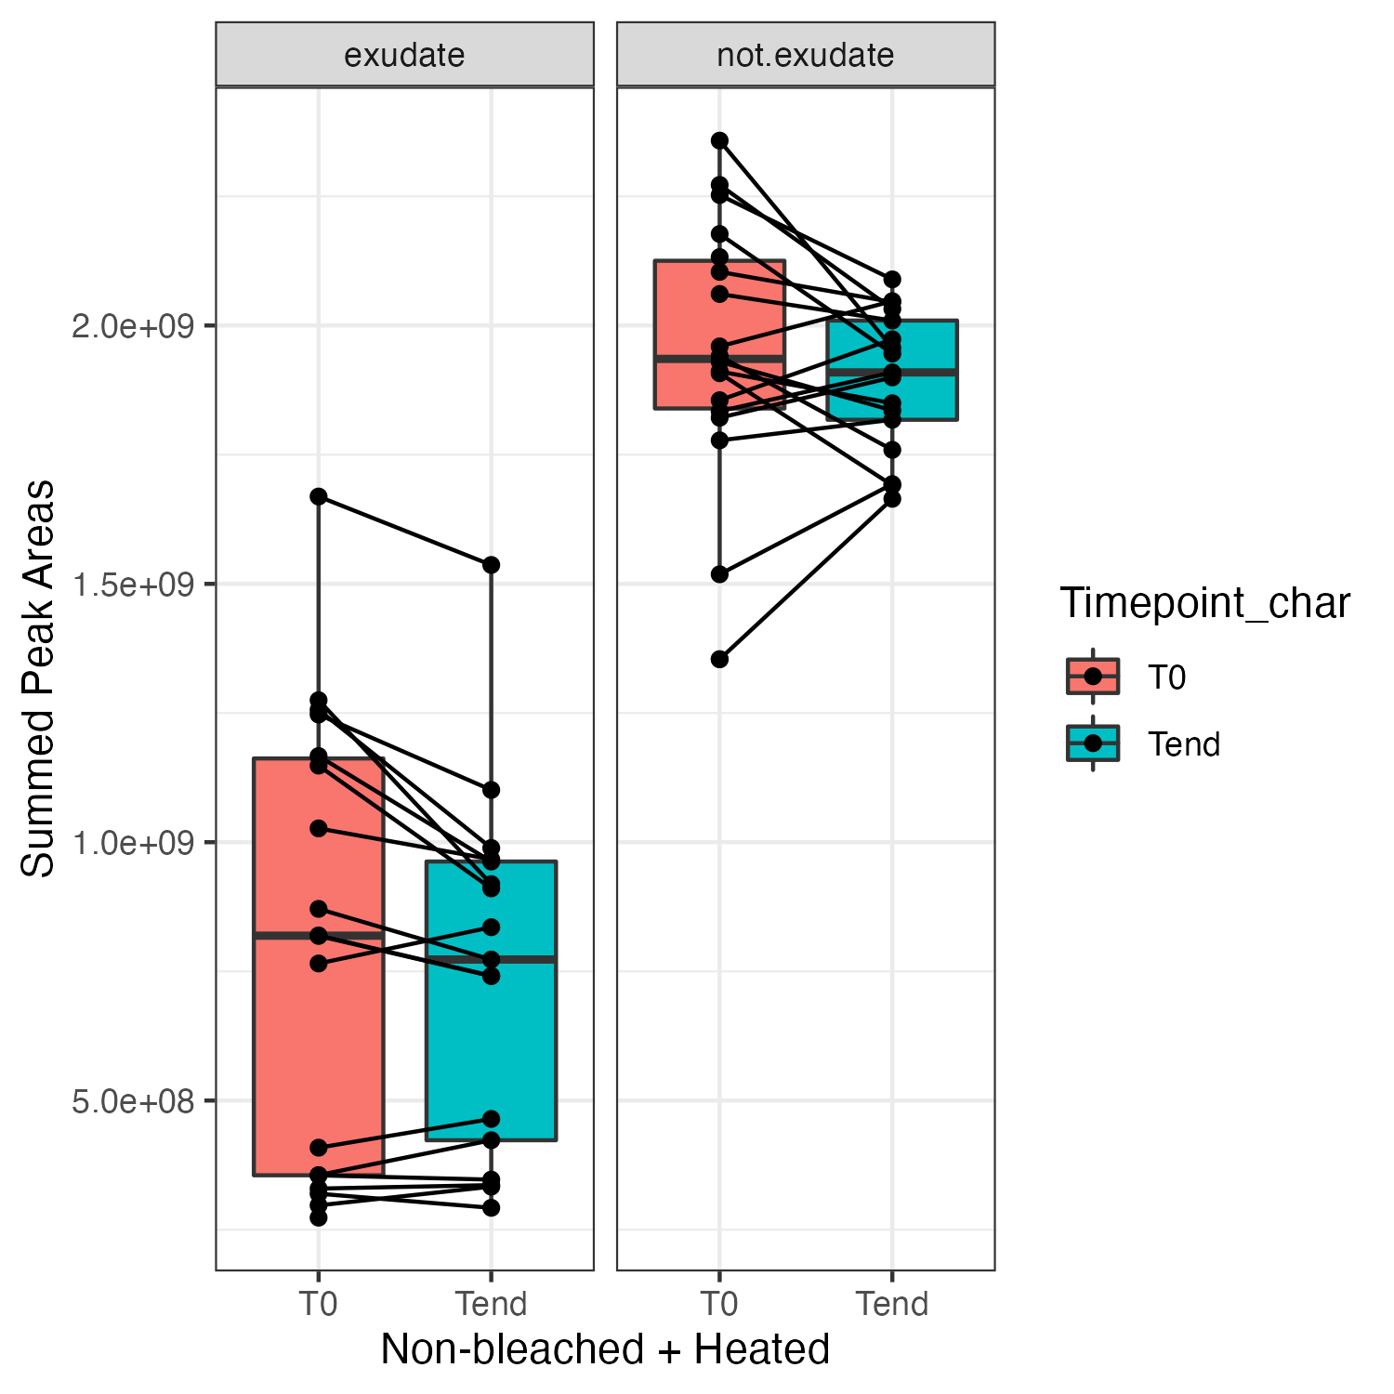
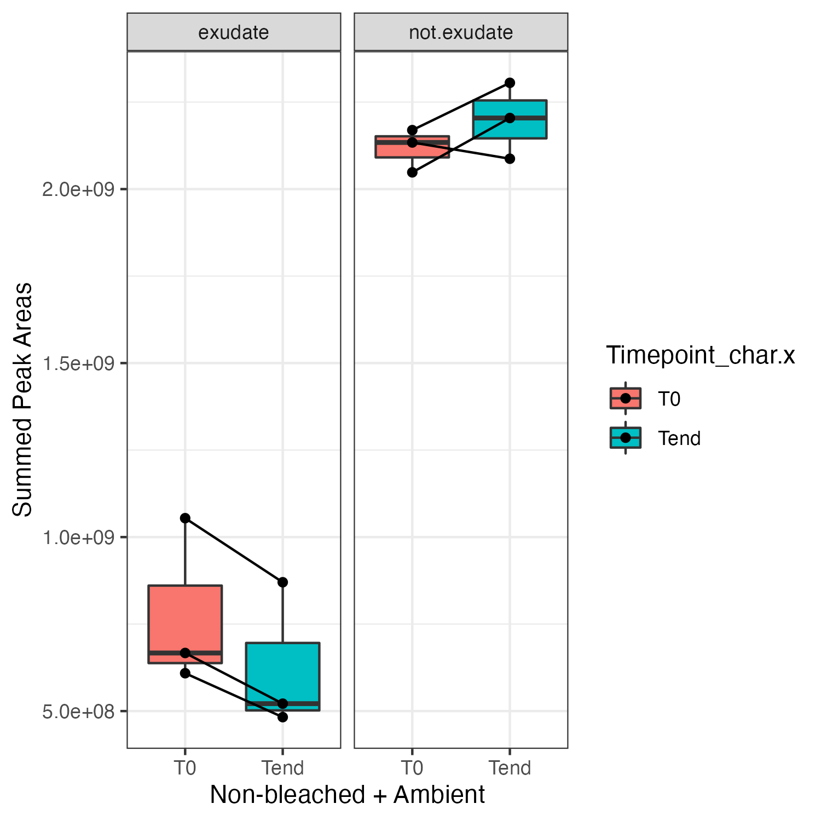
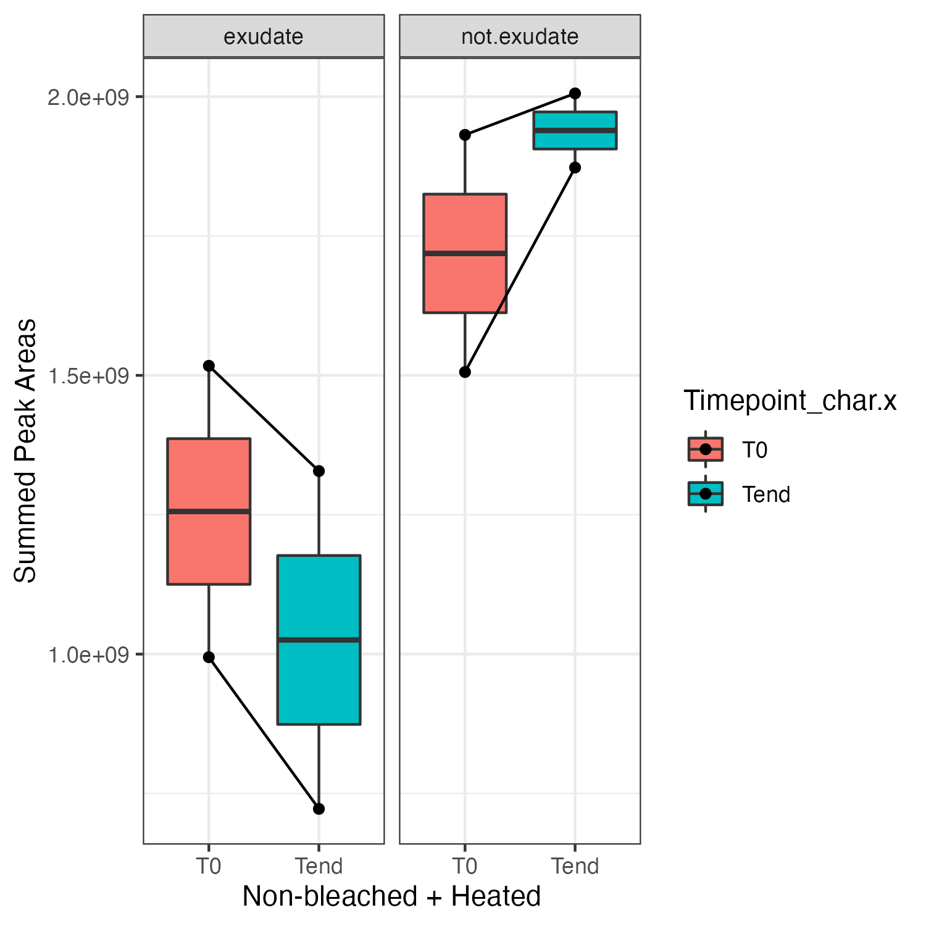
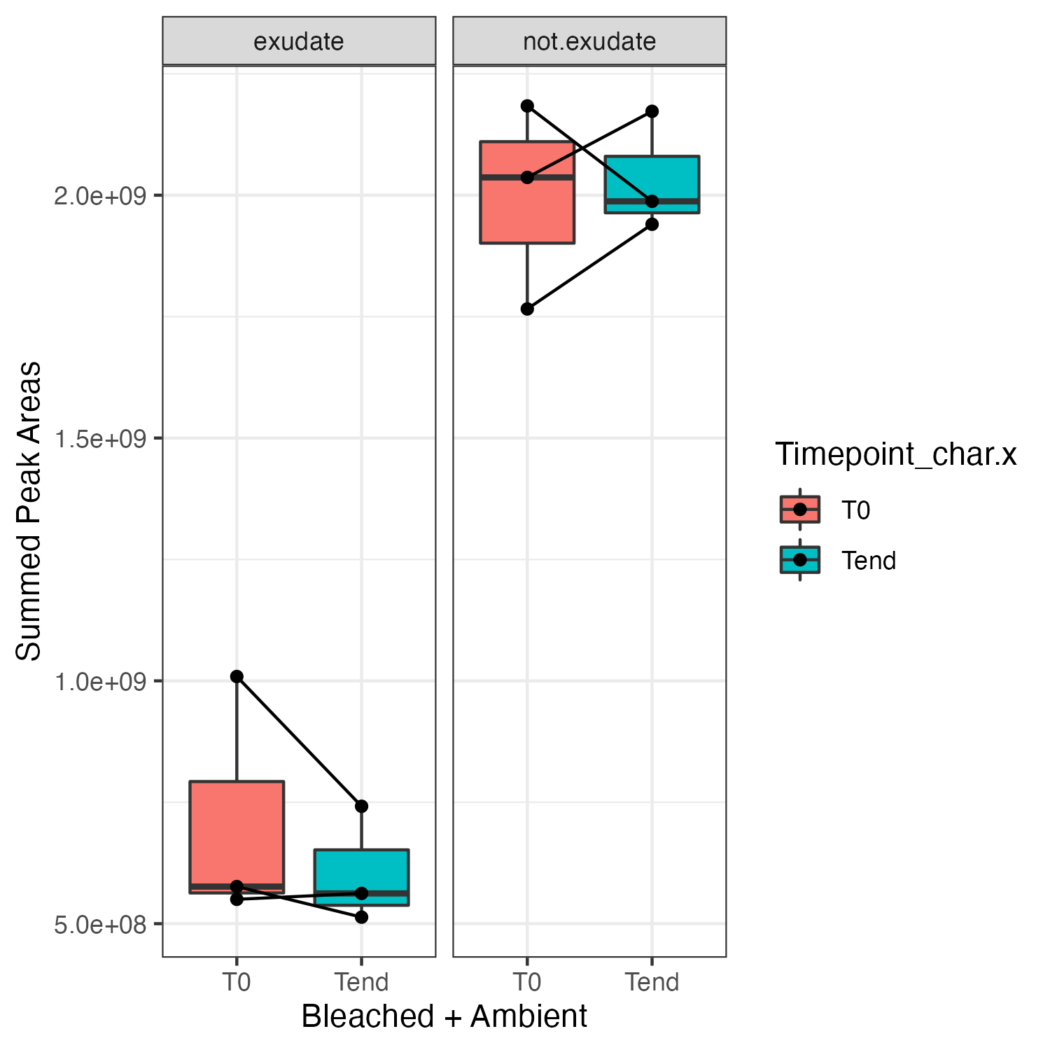
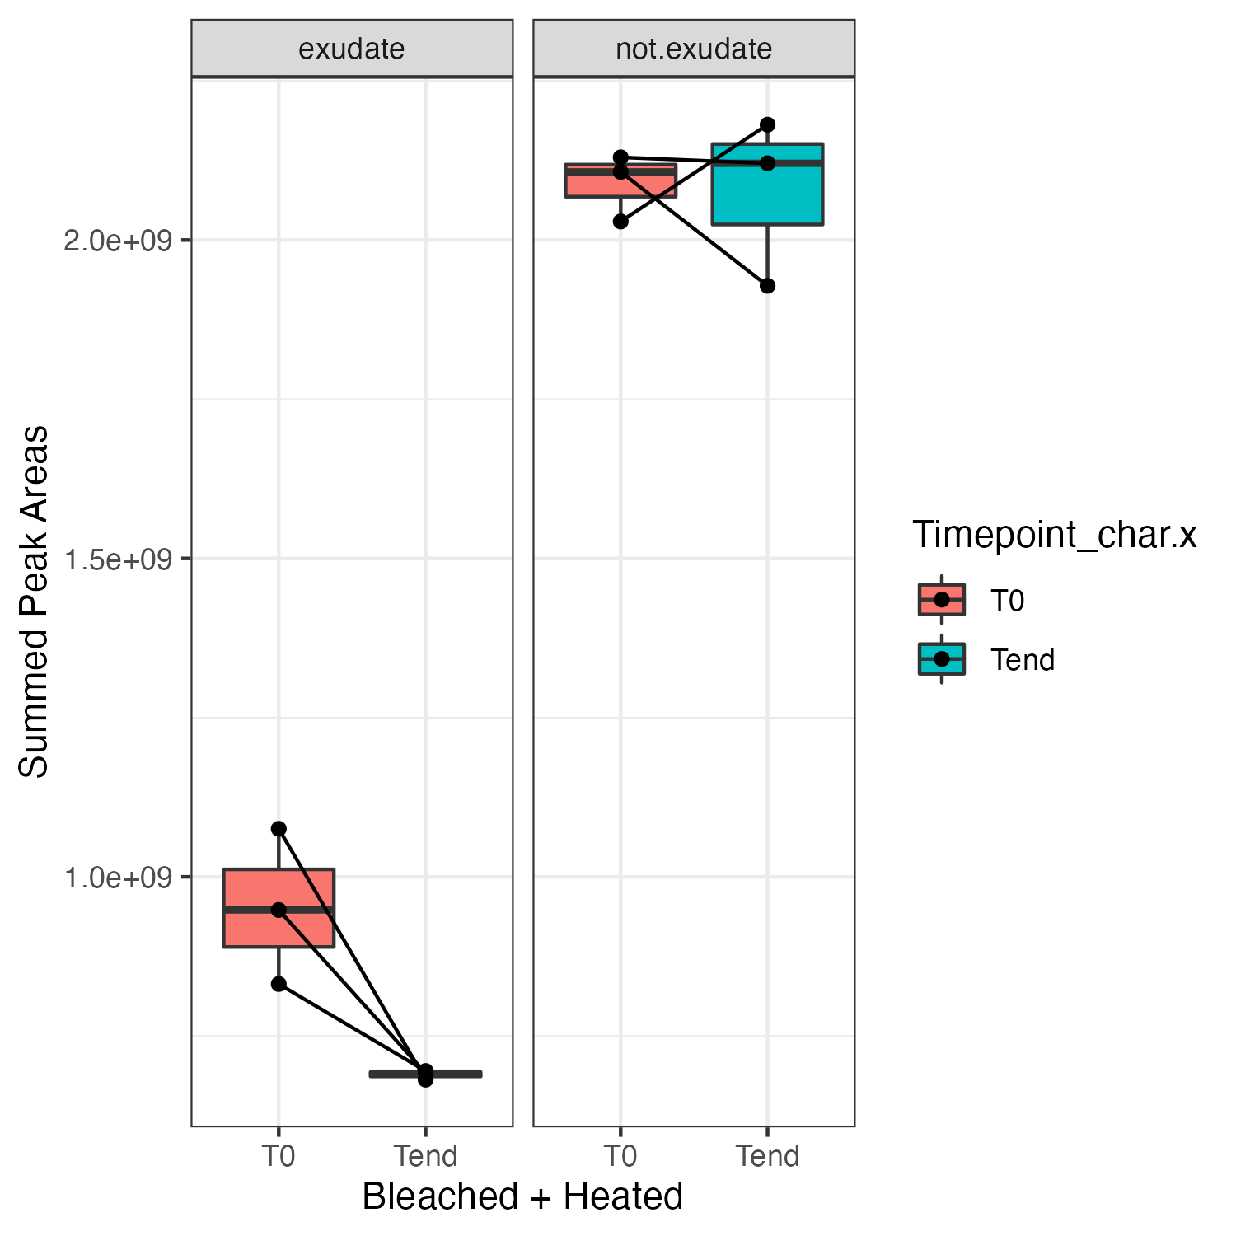
For each treatment the exudate features were determined and peak area’s summed to see if they change over time. When Split out over each treatment we see decreases of peak areas which indicates that these features are metabolized. Not exudate features often stay stable or increase. Small boxplots in top right show the change in all exudate features, in all sample sets.
T0 and Tend come form the same botlle -. Paired sample t-test.

Slide 8
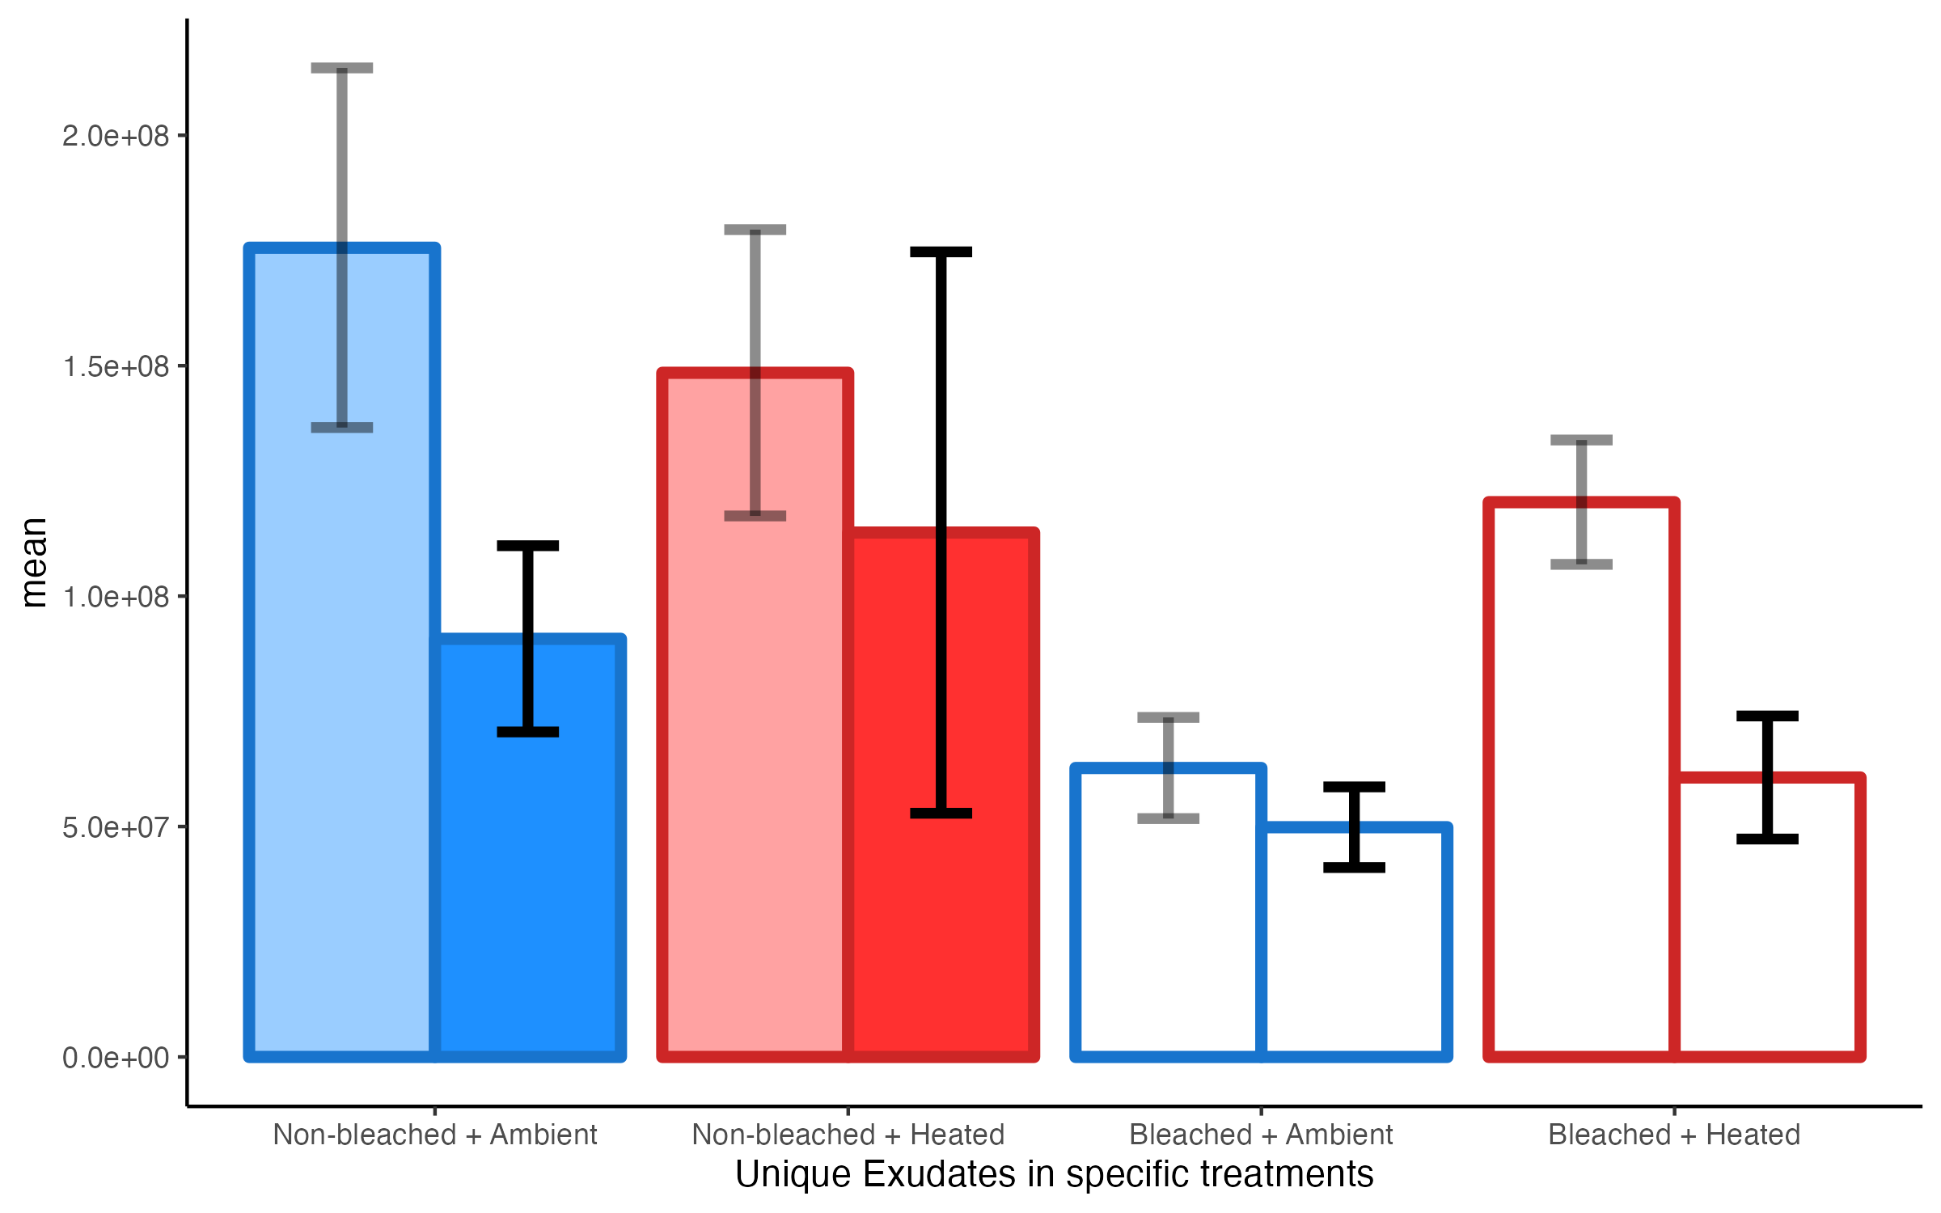
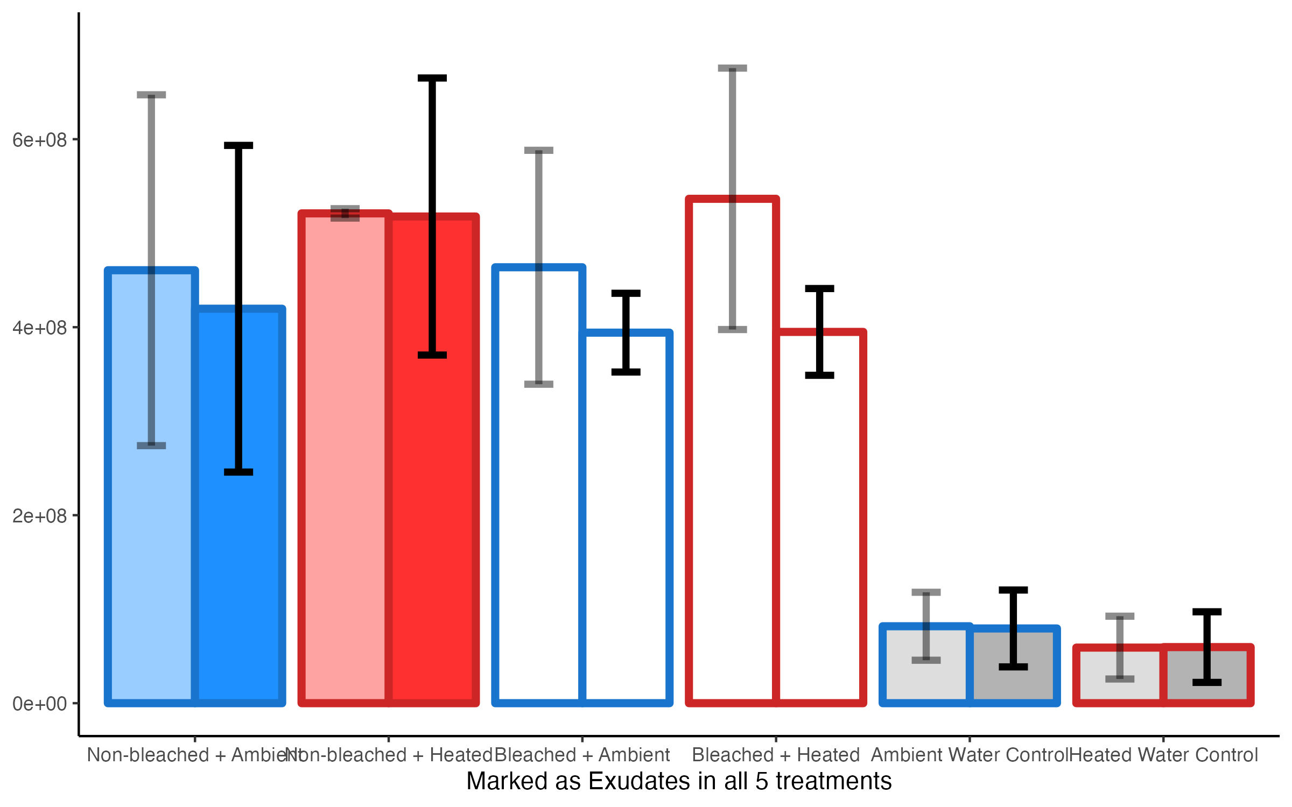

Slide 9
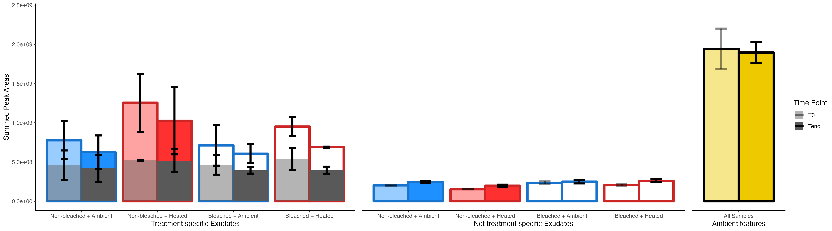
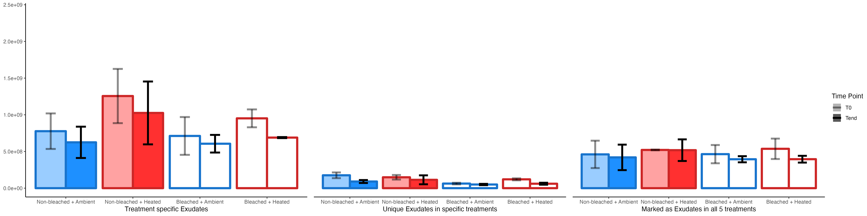
Now on a same scale. Bottom and top left are the same. But top left has bottom right overlapping (just like in MCSMAC) and if scaled unique treatments (bottom middle) don’t seem to differ that much especially compared to the shared exudats. Not treatment specific exudates are the features that are not exudates in that specific treatment, but are exudates in any of the other treatmetns.

Slide 10
And now?
I guess we can show that we find unique features that are exuded and drive the difference in the exometabolome (exuded+ambient features) in ABCDom1.
And taht these exuded features are being used in the 36 hours which explains the different microbial communities we find in ABCDom 1.

