Slide 1
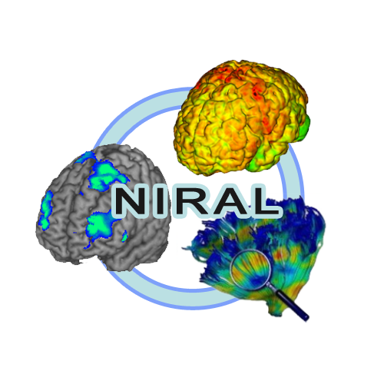
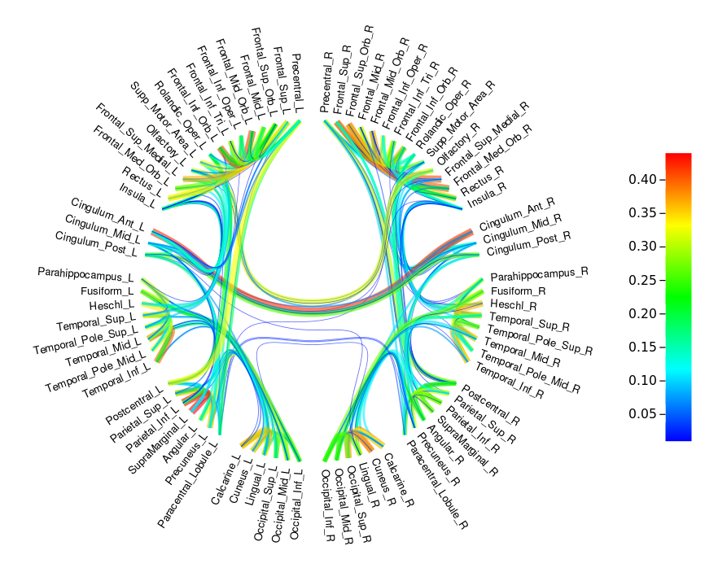
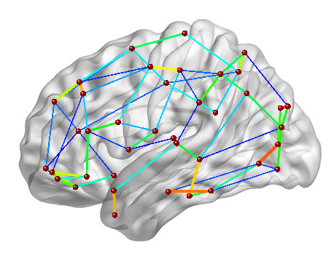
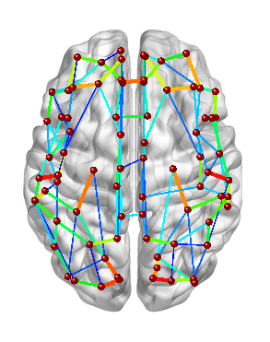
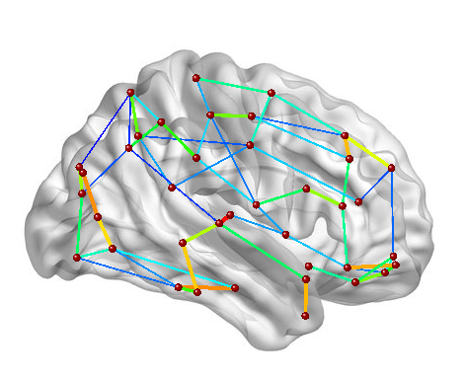
Brain Tractography Application
Tutorial
Circle visualization
Brain template visualization
To see brain connectivity

Slide 2
Brain Tractography Application
This is a web application with launch tractography scripts in background and allow the user to visualize the connectivity matrix within an interactive web interface.
Through this application the user can also to download the tractography output folder in order to save results on user system.

Slide 3
Brain Tractography Application
Application pipeline
Login, create account, reset password
Run tractography on one subject
View jobs launched
Visualization of the connectivity
Download outputs

Slide 4


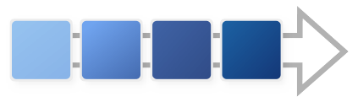
Brain Tractography Application
Tractography pipeline
Inputs
Outputs
All images and surface(s) are in diffusion space (DWI space)
DWI
T1
Connectivity
Matrix for visualization
Create input directory for bedpostX and convert dffusion data (.nrrd to .nii.gz with DWIConvert)
BedpostX (FSL tool) : Fitting of the probabilistic diffusion model on corrected data
Creation of surfaces for each brain regions (colored in a vtk file) and create a text file of seeds list (for tractography)
Tractography according to the seeds list (probtrackx2 FSL)
Brain mask
Description of
parcellation table
Output directory contains all files necessary in the tractography pipeline
Vtk surface(s) with labels
Parameters
BedpostX and probtrackx2 (FSL tools) parameters used are specified in the Documentation

Slide 5
Brain Tractography Application
Install/launch the apllication

Slide 6
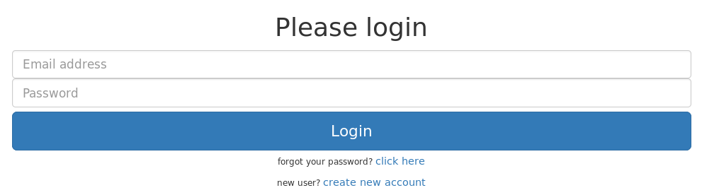

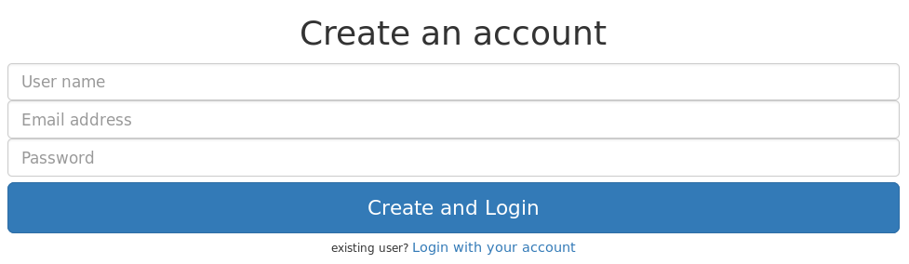
Brain Tractography Application
Home page : Login, create an account, reset password
Do you have an account ?
Click on create new account
You will be redirected to the page below
Enter your Email address and password and then click to Login button
No
Yes
Fill this form with : an username , a valid email address and a password and then click on Create and Login button
The password must contains 8 characters including one uppercase letter, one special character, one number and alphanumeric characters
Forget password ?
If you don't remember your password, fill the field Email Address in the Login page and then click on the link : click here.
An email will be sent to your email address containint a link. This link will redirect you to a reset page. In the page you need to type 2 times your password and then click on Reset and Login button
You still can return to the login page by clicking to Login with your account

Slide 7
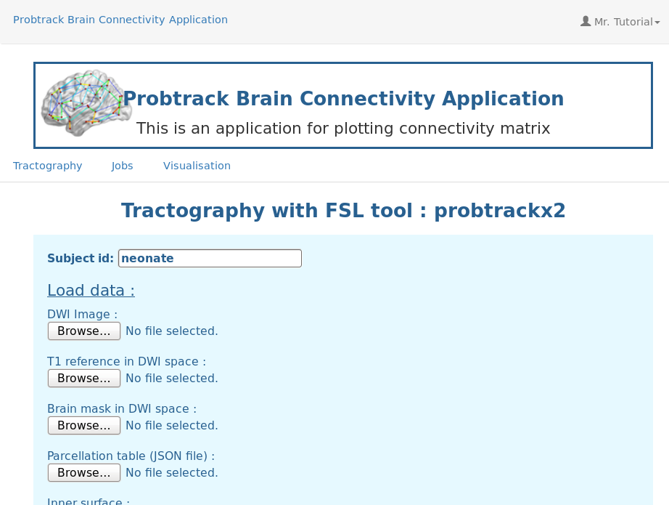
Brain Tractography Application
Application
At this point, you must be connected.
Otherwise, return to the last slide to be Login.
This application is composed of 3 tabs.
Tab 1 : Tractography
Launch a tractography on a subject
Tab 2 : Jobs
Summarize of all jobs launched by the user. You can see results, status, parameters etc.
Tab 3 : Visualisation
Here, you can visualize brain connectivity by uploading a matrix file (probtrackx2 output) and a description table (json file).
Preview of the application when you are Login.

Slide 8
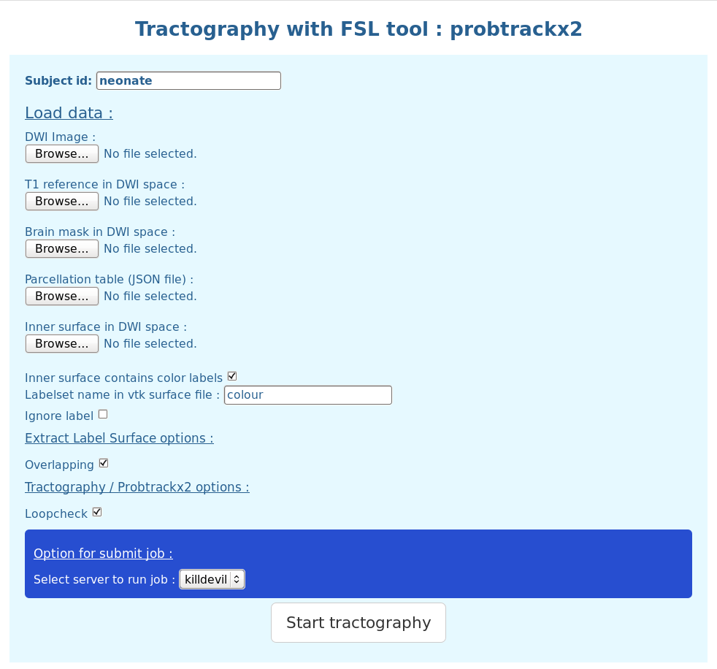

Brain Tractography Application
Run tractography on one subject – Tab 1
Now, let's try to run the tractography on one subject.
1. Specify an id for the subject and upload images
Specify the id/name of the subject (This id/name gonna be the name of the directory containing all outputs of the pipeline – default value : neonate)
Upload the DWI (diffusion) image – format : nnrd
Upload T1 image (must be on the space space as the DWI image → diffusion space) – format : nnrd
Upload brain mask ( in diffusion space ) – format : nnrd

Slide 9

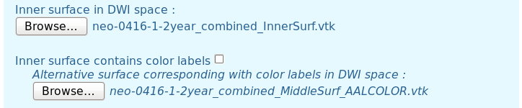
Brain Tractography Application
Run tractography on one subject - Tab1
2. Upload description table and surface(s) files
Upload the parcellation table (json file) – Details of the object
Upload the Inner surface (vtk file)
This surface contains labels for each regions ? Check the box if yes, unchecked if no (default : check)
If the surface doesn't contain labels, you must upload an other surface (same mesh) containing labels

Slide 10

Brain Tractography Application
Run tractography on one subject - Tab1
3. Parameters specific to the extraction of label surfaces in the whole brain surface
Fill the text field by the name of the labelset in the vtk file
If you want ignore a label in the vtk file, check to box “Ignore label” and enter the value/ID of the label to ignore
There is an additional option in the surfaces extraction : overlapping. If the checkbox corresponding to “Overlapping” is selected that mean each region overlaps the neighbours regions. (by default : selected)

Slide 11
Brain Tractography Application
Run tractography on one subject - Tab1
3. Tractography parameters and select server
Select loopcheck or not for the tractography computation
  Probtrackx2 help → Loopcheck: By default, we terminate pathways that loop back on themselves -i.e paths that travel to a point where they have already been.
Select derver where the tractography is computed – by default the fist server found is selected
Finally click on “Start tractography” button to submit the job to server selected before.
  During the job submission the button “Start tractography” is disabled and it will be usable again when the job is submit.

Slide 12
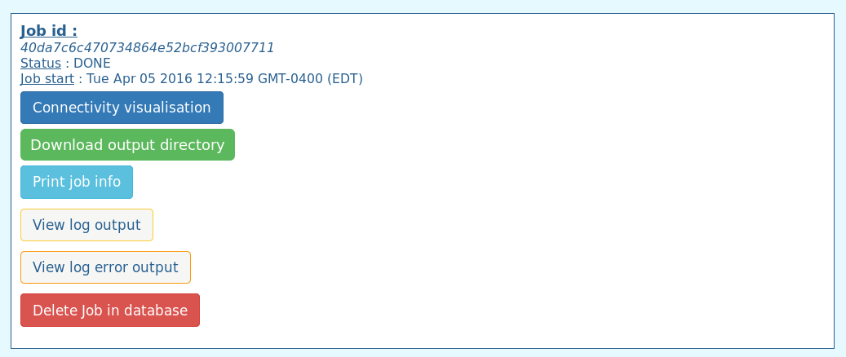

Brain Tractography Application
View jobs – Tab 2
This tab allow the user to have a summary of all jobs (tractography on one subject) he launched.
First, select which jobs to print by selecting a status. (Default : DONE)

Slide 13
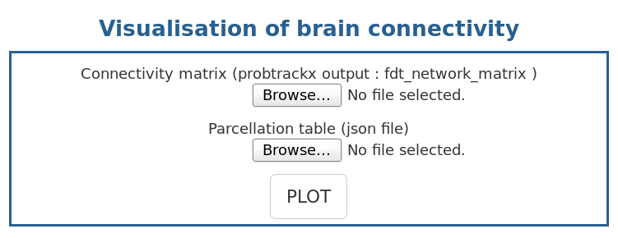
Brain Tractography Application
Visualize the connectivity matrix – Tab 3

Slide 14

Brain Tractography Application
Appendices
1 . Description table template - json file
This file is a description of the parcellation table.This json object is an array of objects defined like bellow :
{ //Object corresponding to one region – this example is based on the AAL90 parcellation table
"VisuOrder": 78, //This is the rank in the circle plotting
"MatrixRow": 1, // Rank in the connectivity matrix - first row = 1 = first column ( if = -1 not in the matrix )
"name": "Precentral_L", //Name of the region/seed
"VisuHierarchy": "seed.left.frontal.", //Hierachy of the seed (for circle plotting)
"coord": [ //Coordinates found in BrainNetViewer project - file Node_AAL90.node
-38.65, // X
-5.68, // Y
50.94 // Z
],
"labelValue": "131 44 78", //Value of the label in the vtk file
"AAL_ID": 1 // label/seed ID in the AAL90 table
}
Json file / Description table
[
{
Object 1 / Region 1
},
{
Object 2 / Region 2
},
…
{
Object N / Region N
}
]

Slide 15
Brain Tractography Application
Appendices
2. Connectivity visualisation
Tooltip
Threshold
Matrix average / max / min

