Slide 1

ScalarFiberAnalyzer Tutorial
By Haiwei Chen
Powerpoint Templates

Slide 2
Installation
The ScalarFiberAnalyzer is included as tool in the NIRAL DTIProcess Toolkit. To install the toolkit, please go to https://github.com/NIRALUser/DTIProcessToolkit and build the source code.
Software Dependencies:
Cmake (>= 3.2)
Qt (>= 5.0)
Python (>= 2.7)
DTIFiberTractStatistics
(see https://github.com/NIRALUser/DTIFiberTractStatistics)

Slide 3
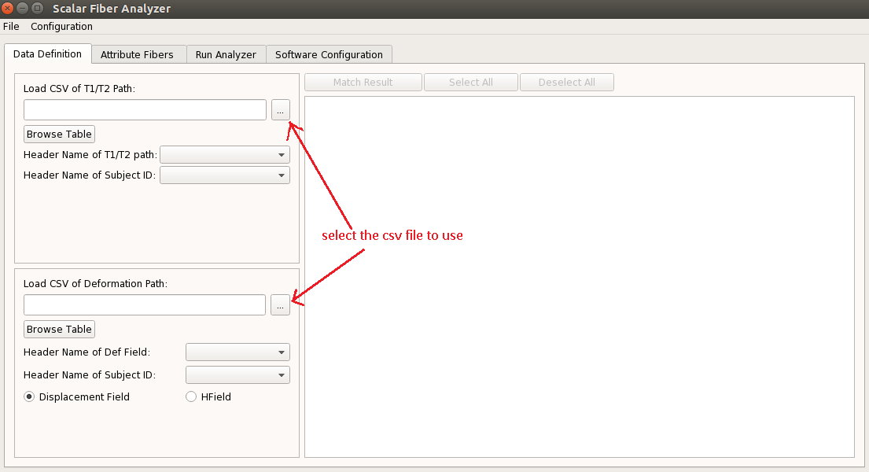
First time running the GUI

Slide 4
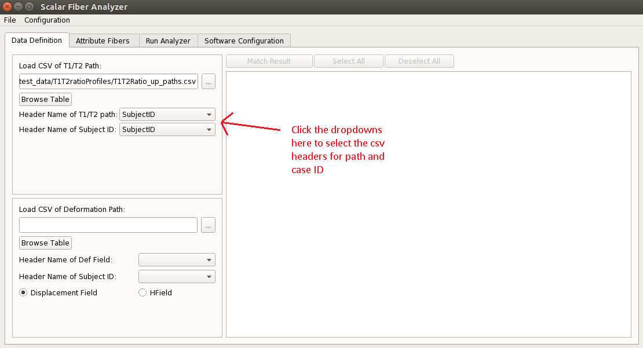
First time running the GUI

Slide 5
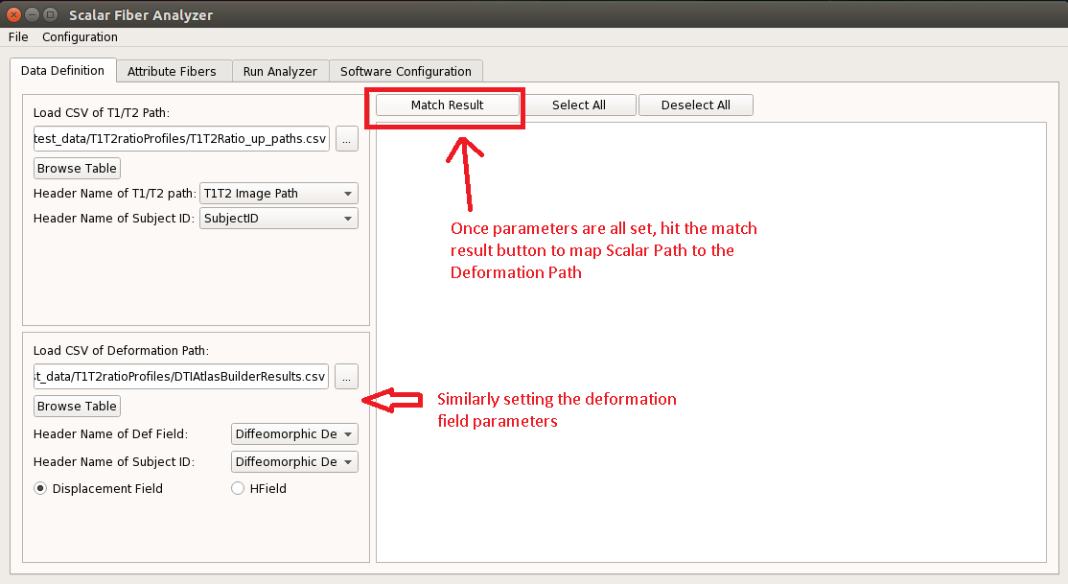
First time running the GUI

Slide 6
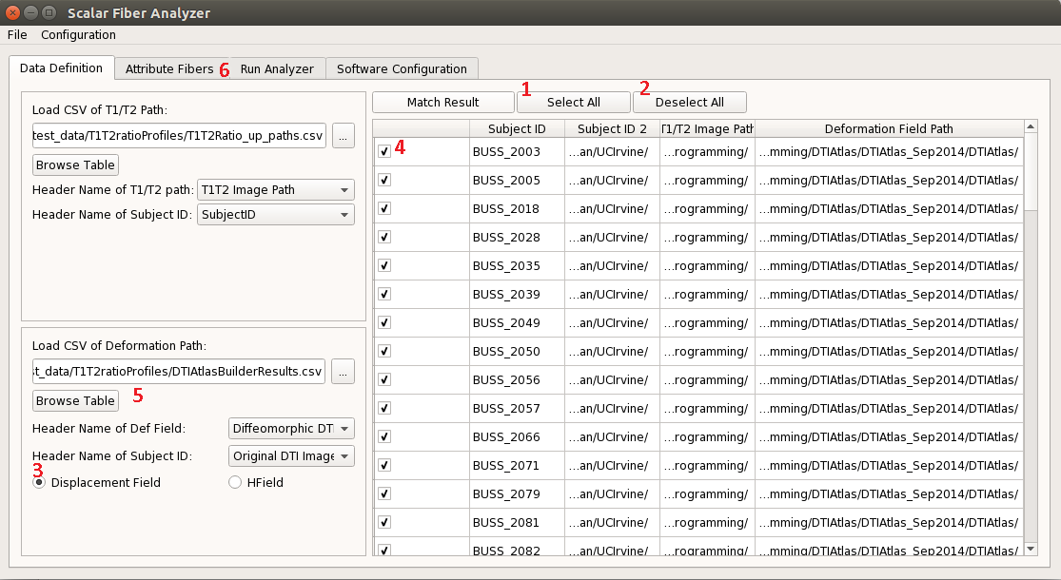
Selecting the Subject cases
1. Click here to select all the cases 2. Click here to deselct all the cases
3. Click the radio buttons to select what types the deformation field is
4. Click the checkbox on the left of each row if you want to select subjects individually
5. The browse table button provides a convenient way to see the content of the csv
6. After selection is done, click the Attribute Fibers tab to move on to next step

Slide 7
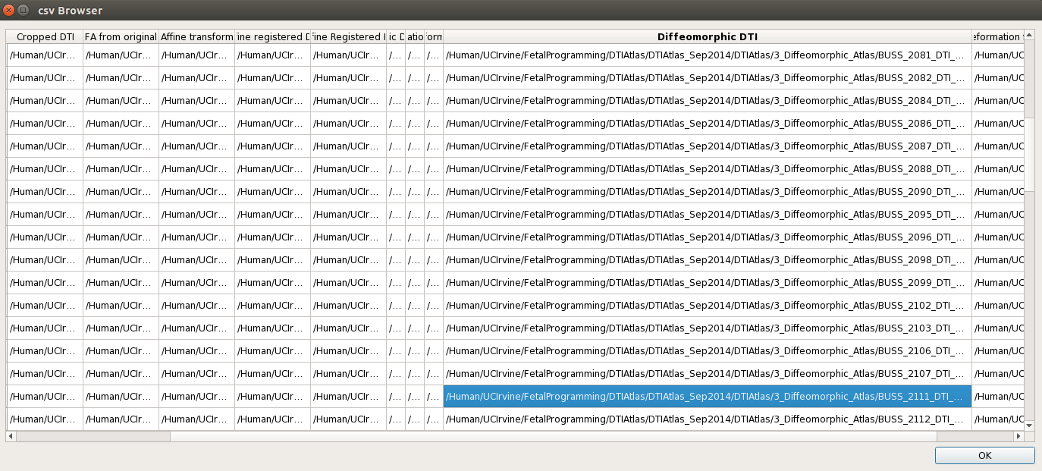
Browsing CSV
If each box is too small to see the full text, you can expand the window by dragging one of the edges. You could also drag each header tab at the top row to expand an individual header.

Slide 8
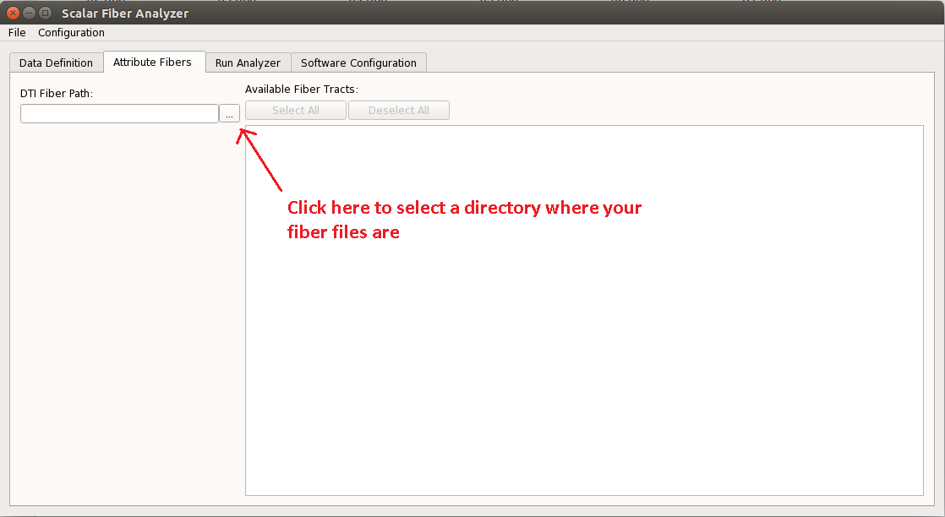
Selecting Fibers

Slide 9
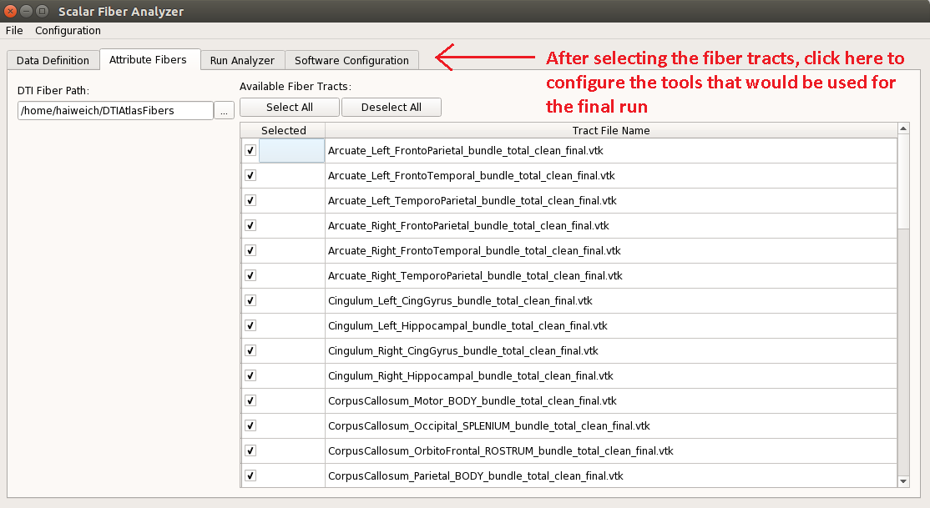
Selecting Fibers

Slide 10
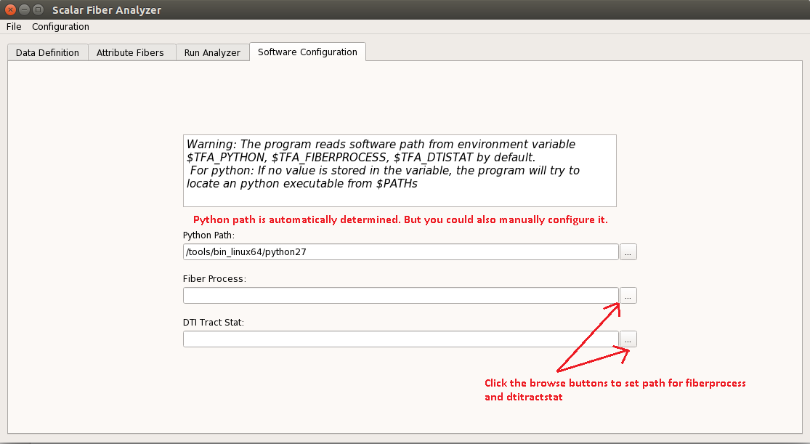
Configuration
The fiberprocess module is available at: https://github.com/NIRALUser/DTIProcessToolkit
The dtitractstat module is available at: https://github.com/NIRALUser/DTIFiberTractStatistics

Slide 11
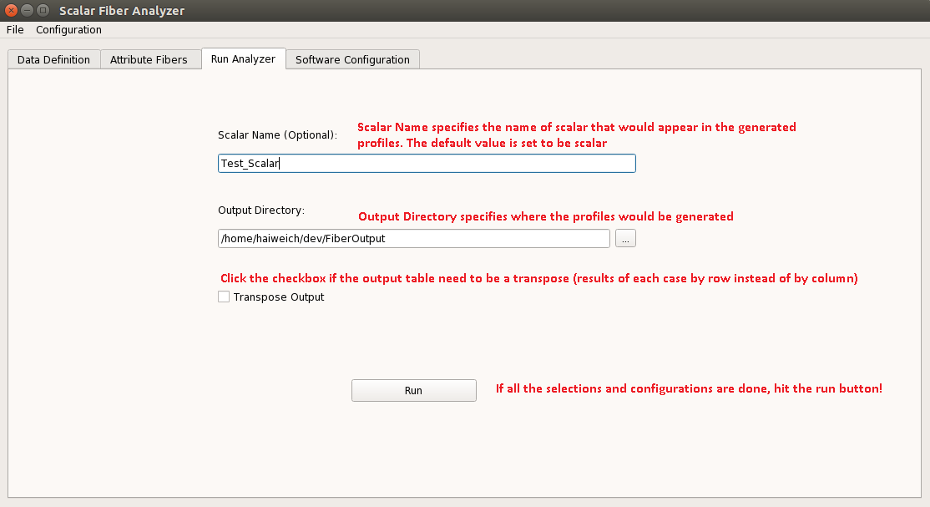
Running the analysis

Slide 12
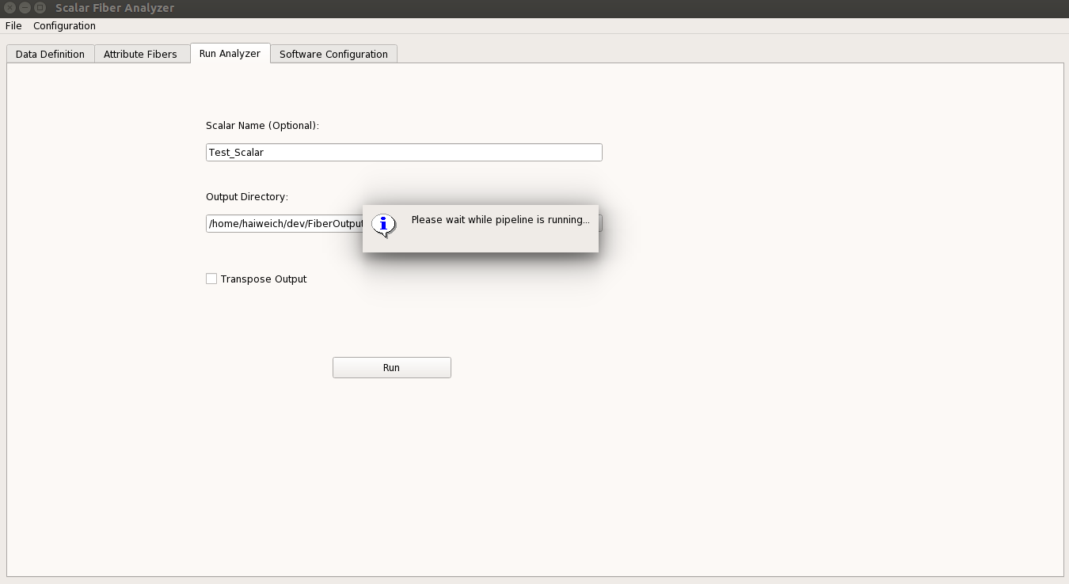
Running the analysis

Slide 13
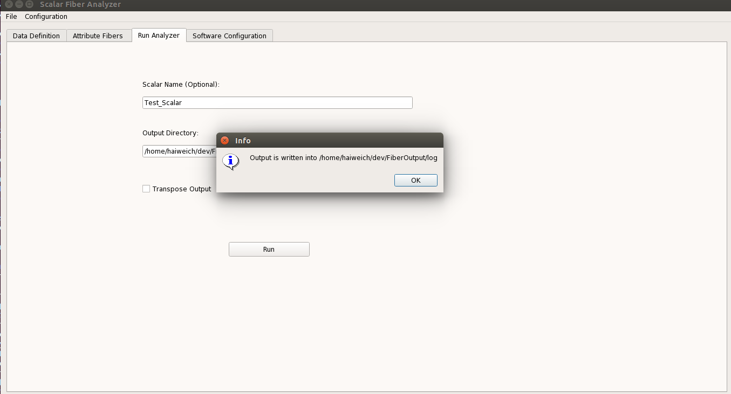
Running the analysis

Slide 14
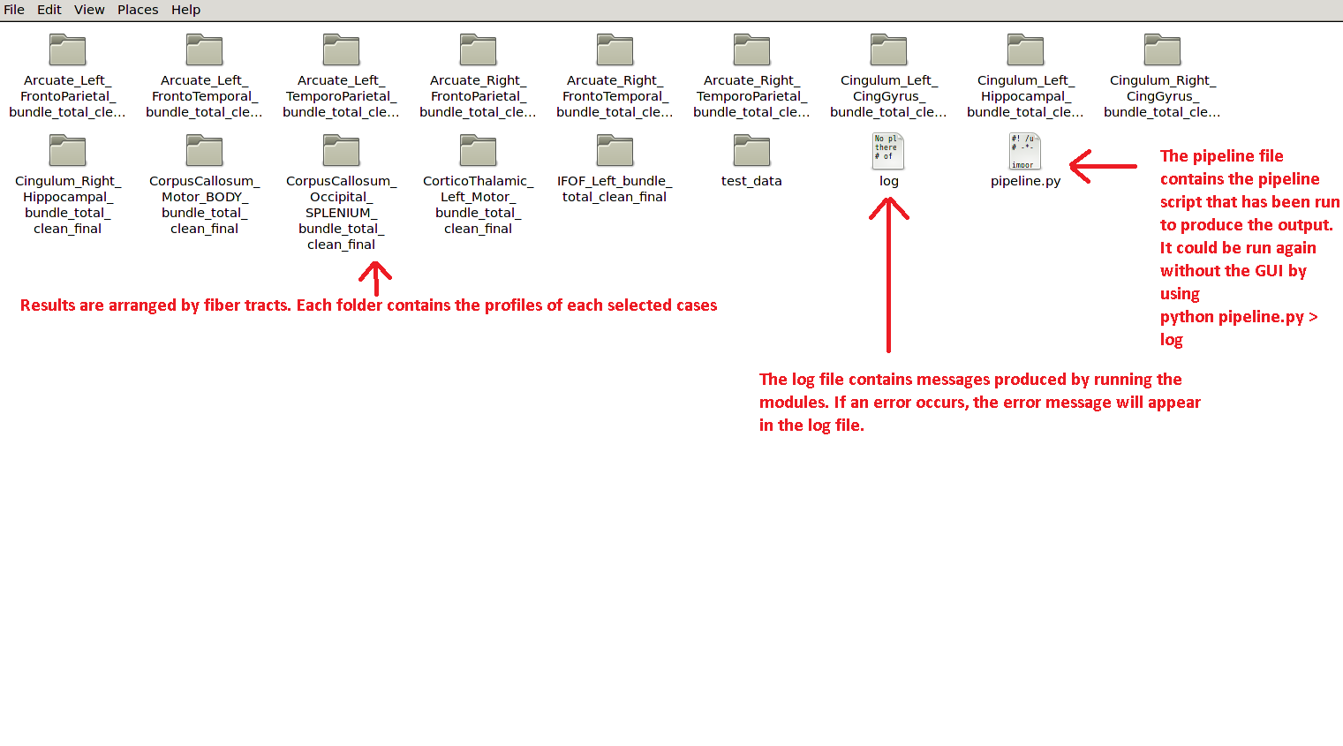
Results

Slide 15
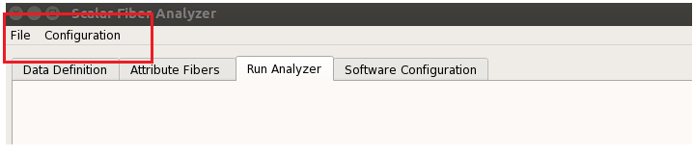
Saving the Values
The GUI allows you to save all the parameters and configurations such that the next time the GUI is launched, you won’t need to select and configure the values again.
When hitting the run button, the current parameters and configurations will be automatically saved.
Alternatively, you could save the parameters and configurations value separately by clicking the top menu as shown in the red square:

