Slide 1
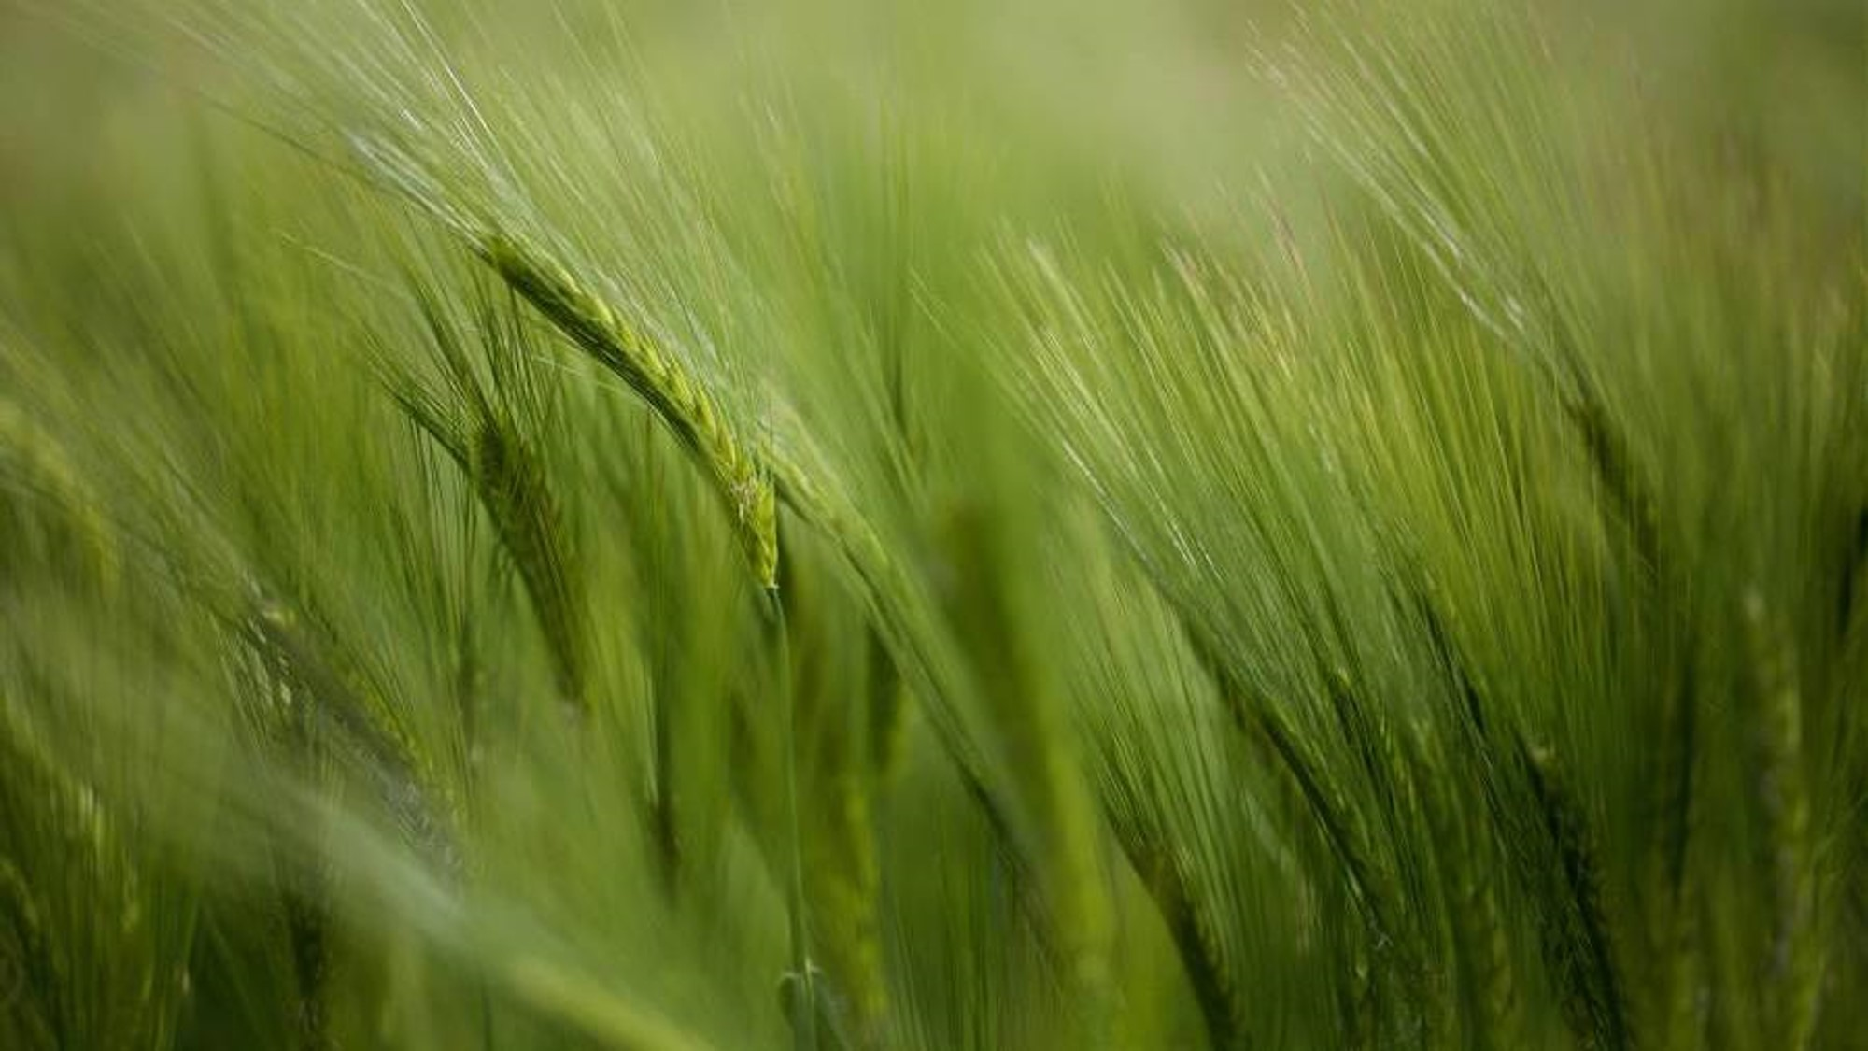
Project c turning floodwaters into productive agriculture. team id: h26agr09 project lead: Niranjan s project members: deepak p & Santhosh gk college name: vellore institute of technology - chennai

Slide 2
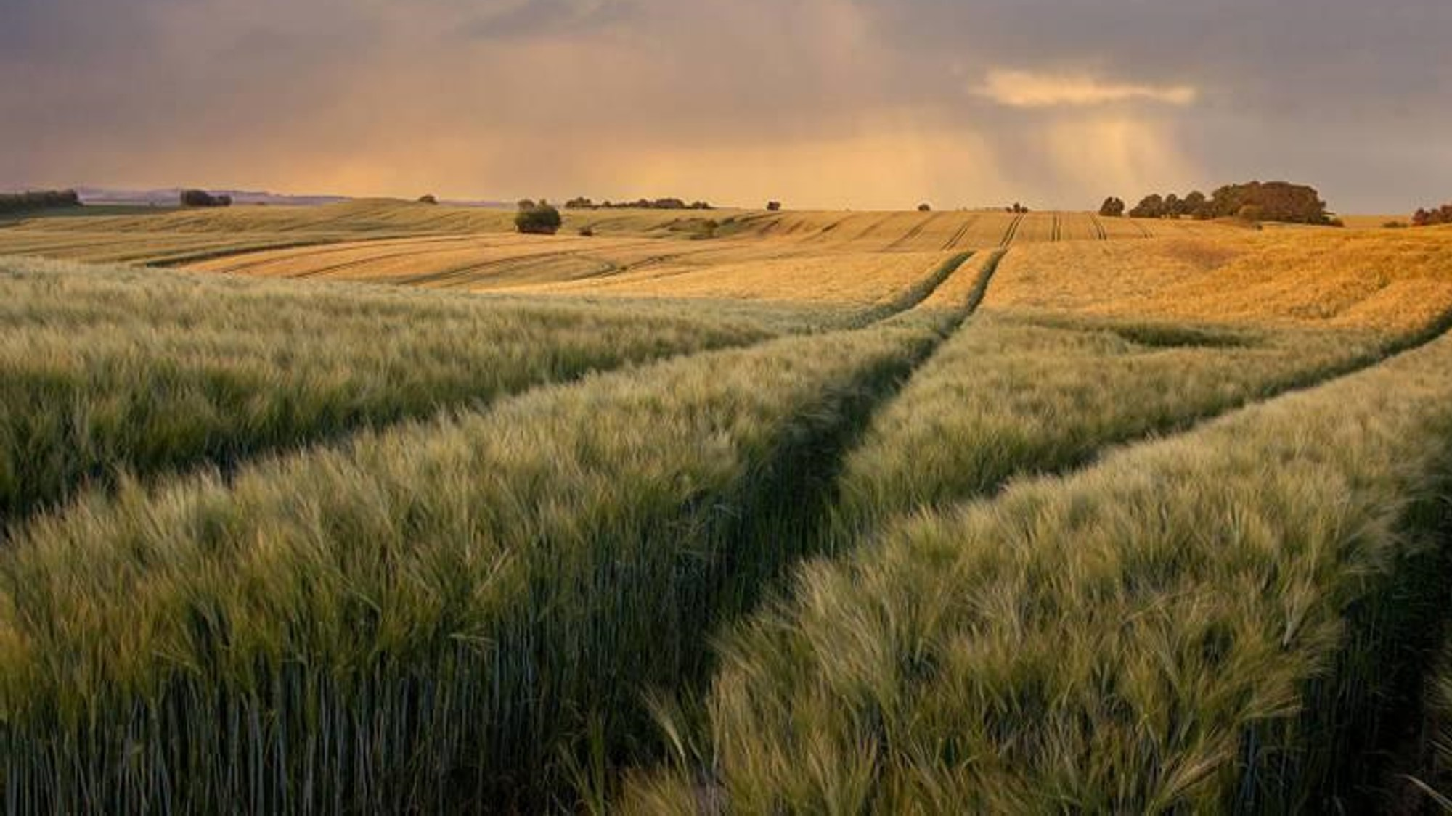
Problem Statement: During flood events, massive volumes of unutilized freshwater from the lower Kollidam River basin are lost directly to the Bay of Bengal due to a lack of water retention structures, leaving adjacent agricultural zones to suffer from severe groundwater depletion. Objectives: 1) Develop an AI-driven geospatial decision support system to optimize check-dam placement along the Kollidam River basin using multi-criteria hydrological modeling. 2)Maximize groundwater recharge and prevent freshwater sea loss by analyzing high-resolution 30m DEM terrain elevation, soil permeability, and daily rainfall data.

Slide 3
System design
Dataset used: | Purpose
NASA SRTM 30m DEM | Slope and Elevation
Copernicus Sentinel-2 L2A Satellite Imagery | Water Detection (NDWI)
ESA WorldCover 10m Land Cover (LULC) | Cropland Mapping
PWD/CGWB Hydrological Telemetry & USDA Soil Dataset | Soil Infiltration
Pre-Processing Engine
Spatial Interpolation -
Fills Raster Gaps
Grid Smoothing
DUAL AI & HYDROLOGICAL ENGINE | Parameters
Unsupervised AI (K-means) | 5 Spatial Cluster Centers
Supervised AI (Random Forest) | 50 Tree Suitability Scores
Hydro-MCDA | Slope(30%), Flow(25%), Soil(20%), Farmland(15%), Width(10%)
SCS-CN Runoff Hydro Calculator | Runoff Volume (ML) & GW Rise (+m)
 | Presentation Layer
UI Component | Framework/Library | User Actions
GIS Map View XAI Panel Slider Controls | React + Leaflet Recharts Waterfall chart TailwindCSS rasterio python library | Visually pin and mask Feature breakdown Real-time Weights
 | Explainable AI
Feature | XAI Method | Output
Score Attribution | SHAP Additive Decomposition | +/- Score Impact

Slide 4
Algorithm
Algorithm | Use | Purpose
K-Means | Unsupervised ML | Group river into 5 spatial zones
Random Forest | Supervised ML | Predict terrain suitability scores
Hydro-MCDA | Spatial Scoring | Rank sites by weighted criteria
SCS-CN Model | Hydrology | Calculates rainfall runoff volume
SHAP XAI | Explainable AI | Explains feature impact on scores
3x3 Interpolator | Raster Processing | Fills missing soil/DEM pixels

Slide 5
Technology stack
Layer | Primary Technology
Frontend UI | React 18 + Vite 5
GIS Mapping | Leaflet.js + Recharts
Backend API | Python 3.12 + FastAPI
GIS Engine | Rasterio + NumPy
AI / Machine Learning | PyTorch + Scikit-Learn
Hydrology Modeling | USDA SCS-CN Engine
Datasets | GeoTIFF + GeoJSON

Slide 6
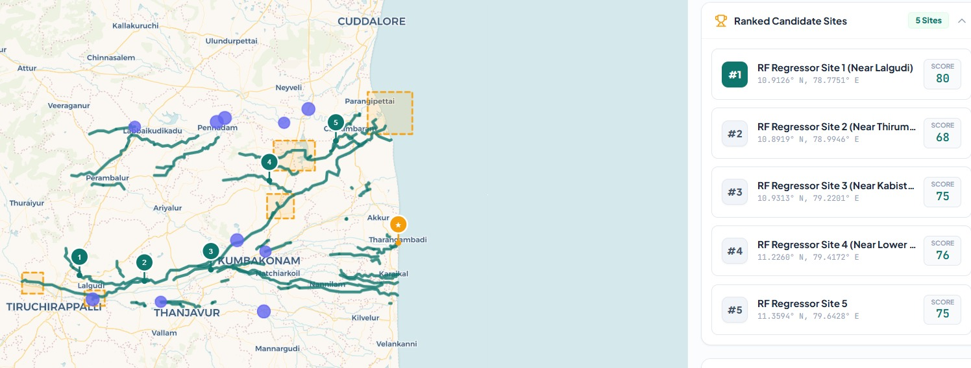
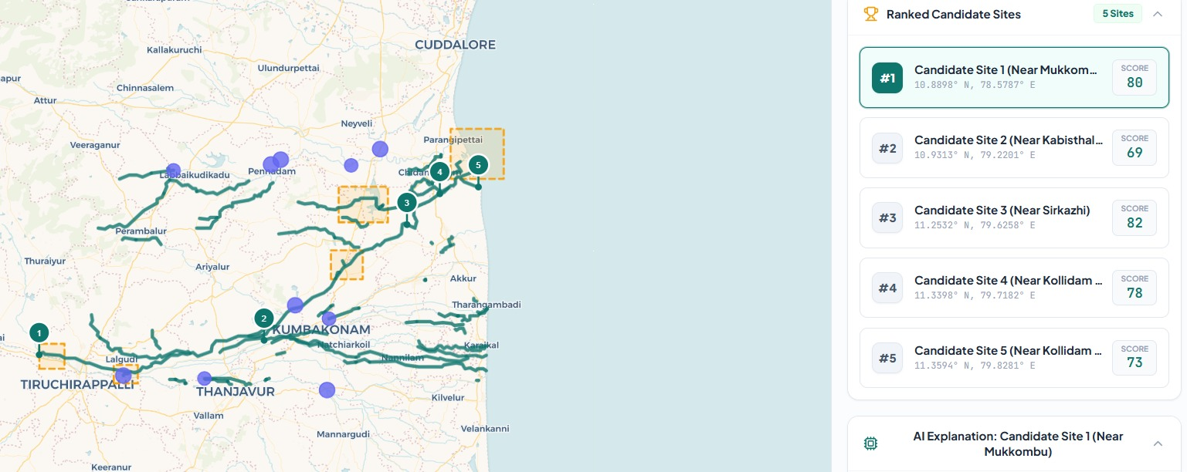
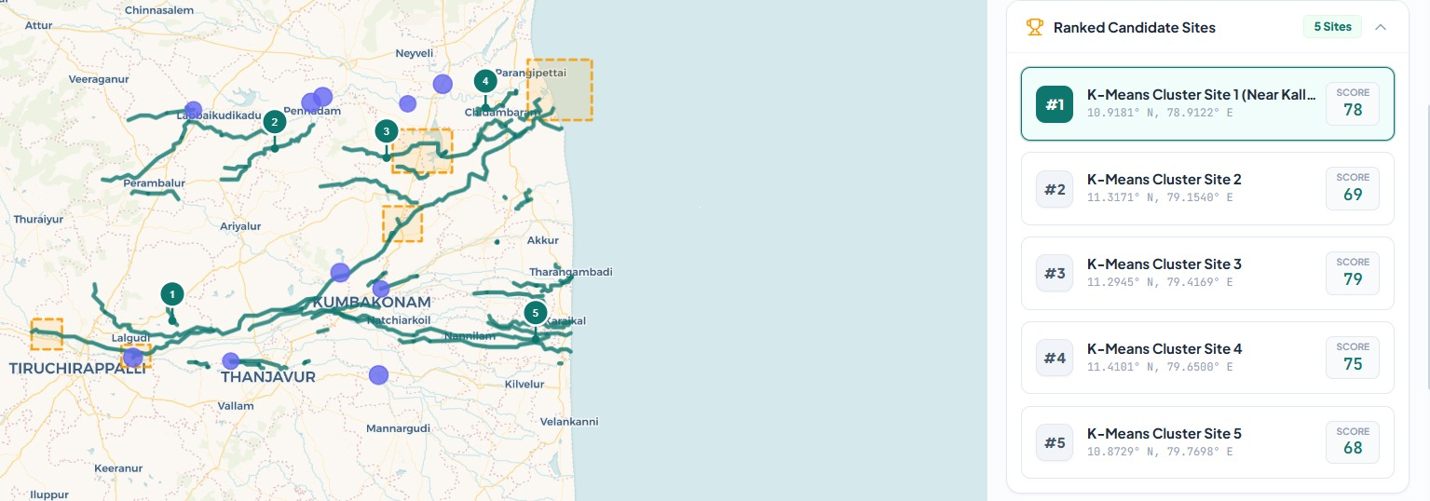
Result

Slide 7
Existing solutions and its gap
Category | IMD / CWC (Flood warning system) | Hydro Simulators (HEC-RAS/SWMM) | PWD Manual Field Surveys | PROJECT - C
Primary Focus | Flood alerts only | Post-Design Physics | Physical soil drilling | Automated Dam Siting and Water Recovery
Automated Site Discovery | No | No | Slow | Instant AI Spatial Scan
Multi-Model Satellite Ingestion | No | Manual inputs | Expensive, Manual sampling | Full automated pipeline (DEM + SOIL + RAIN)
AI Feasibility Scoring | No | No | Subjective opinions | Data Driven Score(0-100)
Historical Disaster Simulation | Alert and warning only | No simulation | No simulation | 72h Hydrograph (NOV 2021 Case Study)
Farmland irrigation and Aquifer gain | No | No | Post-Survey only | Automated Table Gain and Area calculation
Unmatched Novelty: No direct end-to-end automated solution exists in current literature or industry.

Slide 8
Summary
Satellite Data: Combined Elevation, Soil, Land Cover & Rainfall maps.
Dual AI Engine: Used K-Means & Random Forest to find 5 optimal check dam sites.
Proven Impact: Captures 118M Liters of water & recharges 7,800+ Acres of farmland.
Future Scope
Live Radar Data: Integrate Sentinel-1 satellite radar for monsoon tracking.
2D Flood Simulation: Model exact water depth spreading behind dam.
State-Wide Scaling: Expand system to cover all river basins in Tamil Nadu.

