Slide 1

Tamil Nadu 2026 Assembly Election Analysis:
The Great Realignment
"2026 was not about who won, but who emerged."
The Dawn of a New Political Era: The most significant transformation in the state's political landscape in decades.
The Bipolar Tradition: Disruption of the long-standing DMK-AIADMK duopoly by the new entrant, TVK.
A State in Transition: Record-breaking voter turnout of 85.1% signaling a clear desire for political evolution.
MAY 2026 ELECTION REPORT
By – Nirmit Gupta

Slide 2
Methodology & Data Coverage
COMPREHENSIVE SCOPE
COMPARATIVE FRAMEWORK
234
Analysis of all 234 constituencies across Tamil Nadu to ensure a complete state-wide perspective and eliminate regional bias.
Direct comparison between the 2021 and 2026 election cycles to identify structural shifts versus cyclical changes.
CONSTITUENCIES
4,257
CANDIDATES (2026)
DATA INTEGRITY
REGIONAL GRANULARITY
Based on official Election Commission of India (ECI) data, covering over 4,200 candidates per election cycle.
Data aggregated into six key geographic regions: Chennai Metro, North, Central, Kongu, Delta, and South.
85.1%
VOTER TURNOUT
Research Questions :
6
MAJOR REGIONS
The vote share story : Where did TVK's votes come from? Compare party vote share state-wide and by region in 2021 vs 2026. Did TVK pull from DMK, AIADMK, both, or from previously non-voting populations?
The geographic story : How did the seat distribution shift across Tamil Nadu's six regions (Chennai Metro, North, Central, Kongu, Delta, South) between 2021 and 2026? Where did each major formation gain or lose ground?
The margin of victory story : How did the average margin of victory change between 2021 and 2026? In how many constituencies did the winning candidate secure more than 50% of the valid votes polled? In how many did the winning candidate receive less than 35% of the valid votes polled?

Slide 3
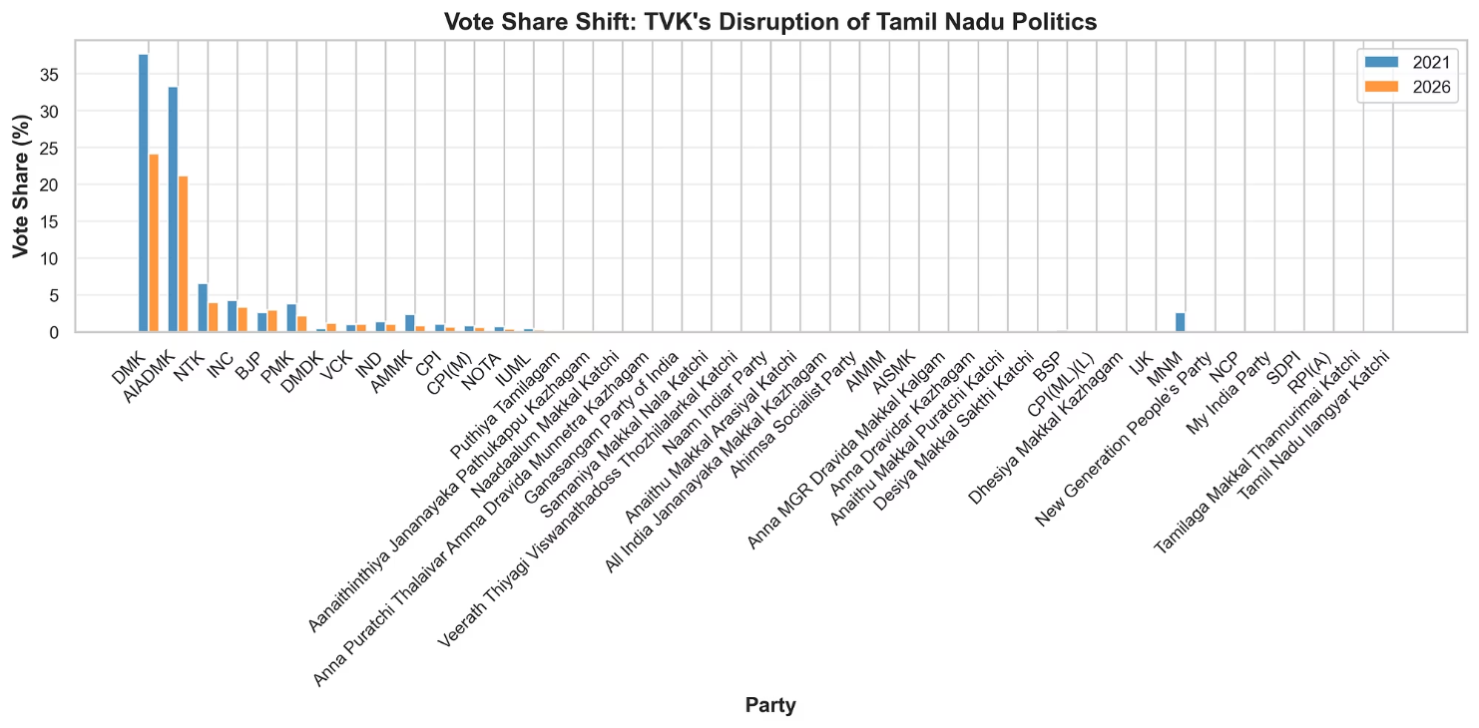
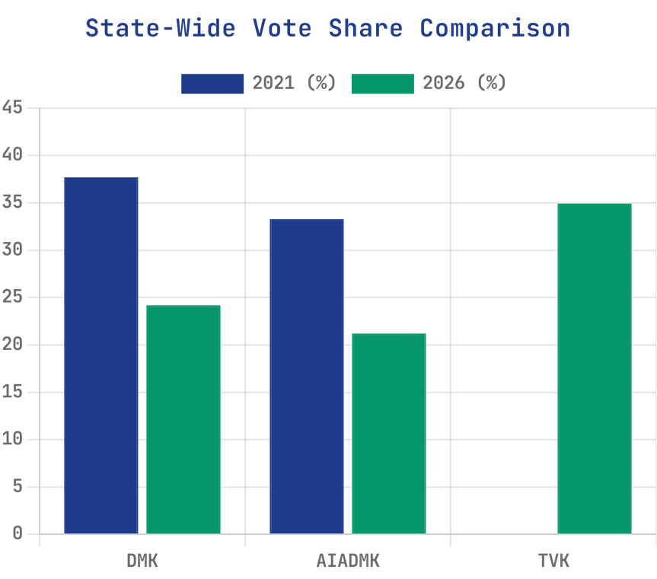
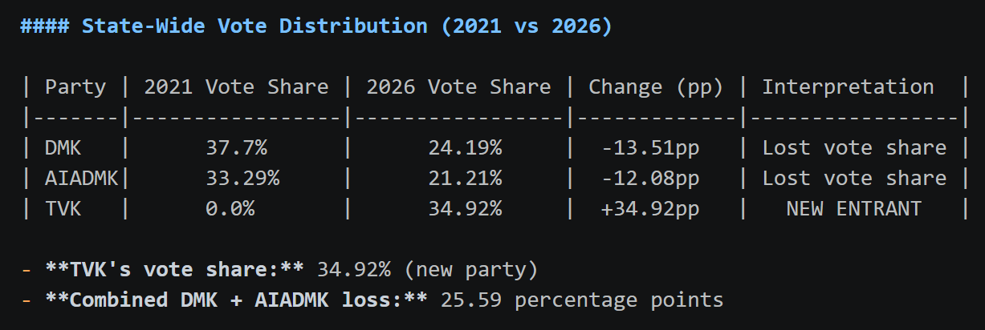
TVK's Disruptive Entry: The new entrant captured a massive 34.92% of the state-wide vote share in its debut performance, fundamentally altering the electoral landscape.
The Vote Share Story: A Genuine Political Realignment
Erosion of Bases: DMK's vote share dropped from 37.7% to 24.19% (-13.51pp), while AIADMK fell from 33.29% to 21.21% (-12.08pp). Combined loss of 25.59pp from the traditional "Big Two" accounts for the majority of TVK's gains, suggesting a true state-wide realignment.
An 85.1% turnout — a state record — suggests TVK also mobilized voters the two-party era never reached.

Slide 4
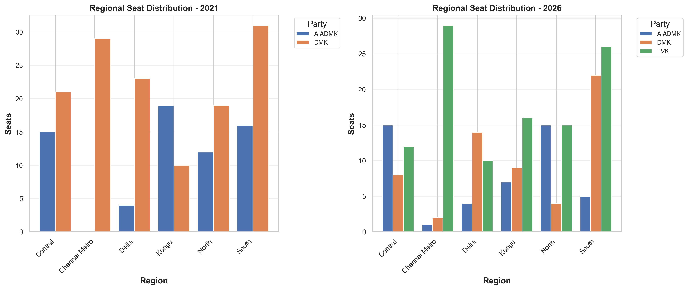
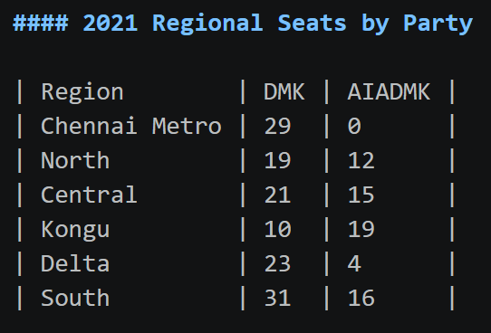
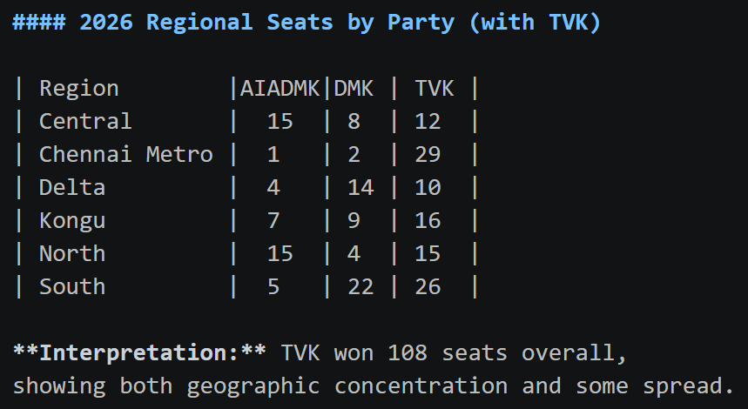
The Seat Distribution Shift (2021 vs 2026)
A New Three-Way Split: The legislative assembly transitioned from a bipolar structure to a complex triangular contest, with TVK securing 108 seats overall.
Regional Strongholds: While DMK maintained strength in the South (22 seats), TVK swept the Chennai Metro region with a dominant 29 seats.
AIADMK's Resilience: Despite vote share losses, AIADMK retained its presence in the North and Central regions, holding 15 seats in each.

Slide 5
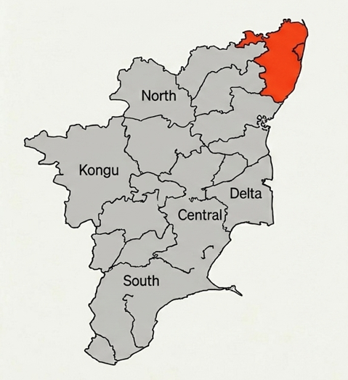
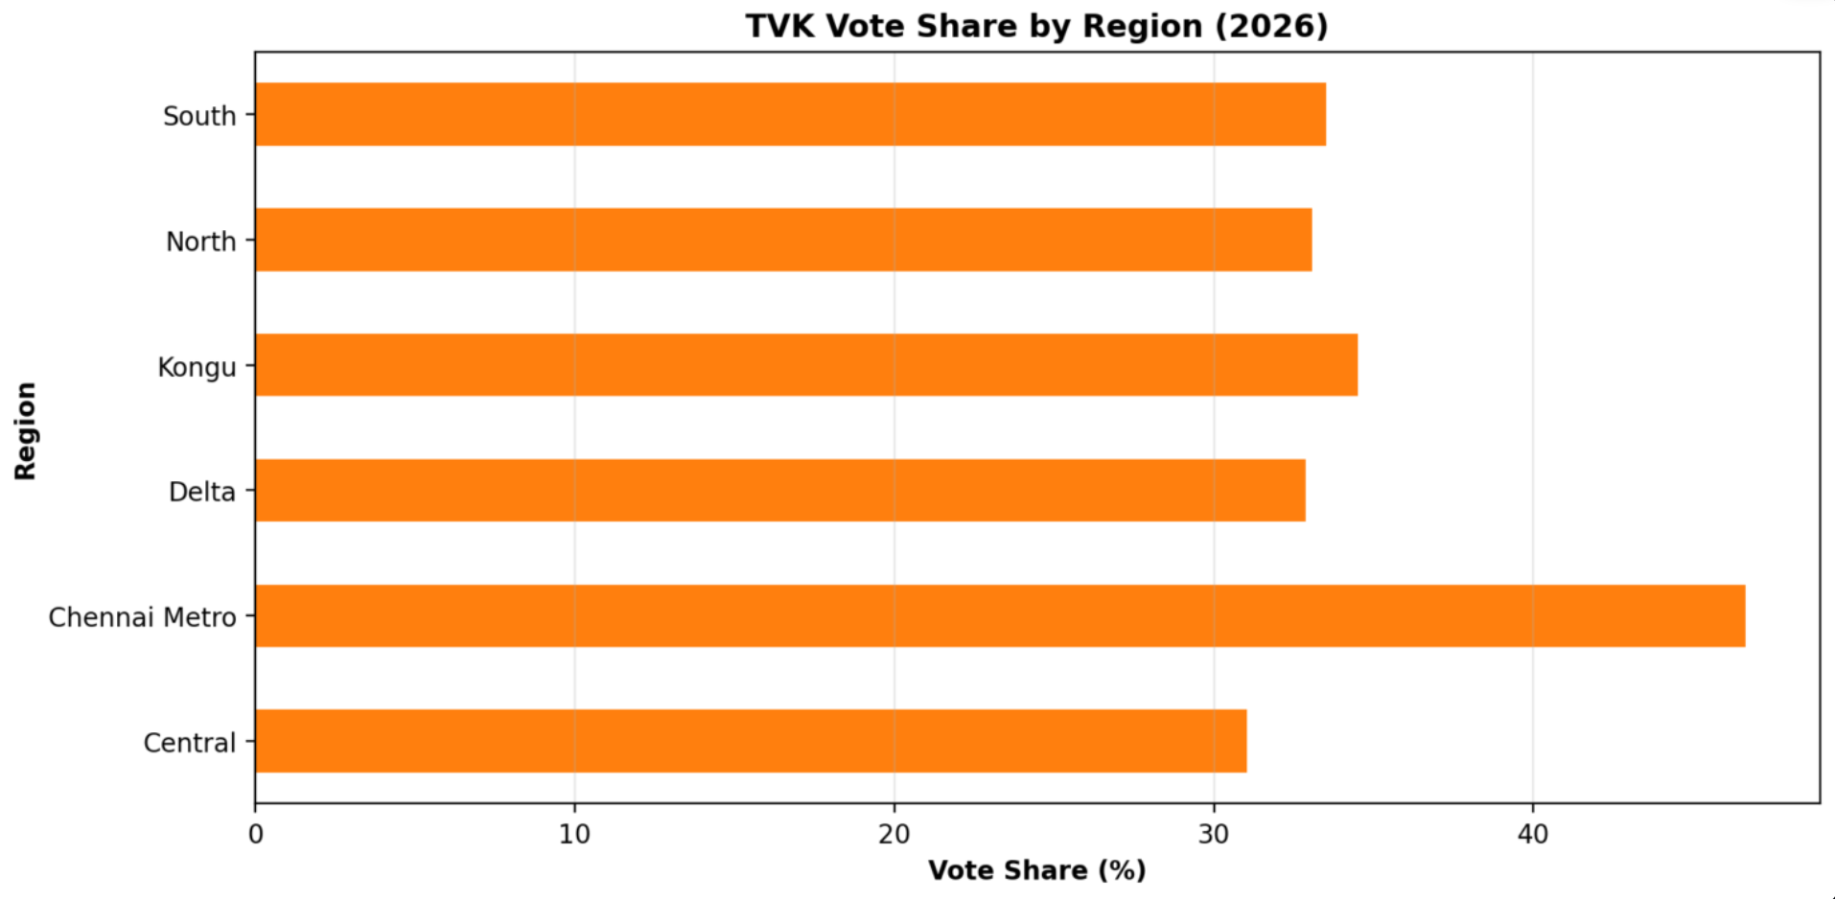
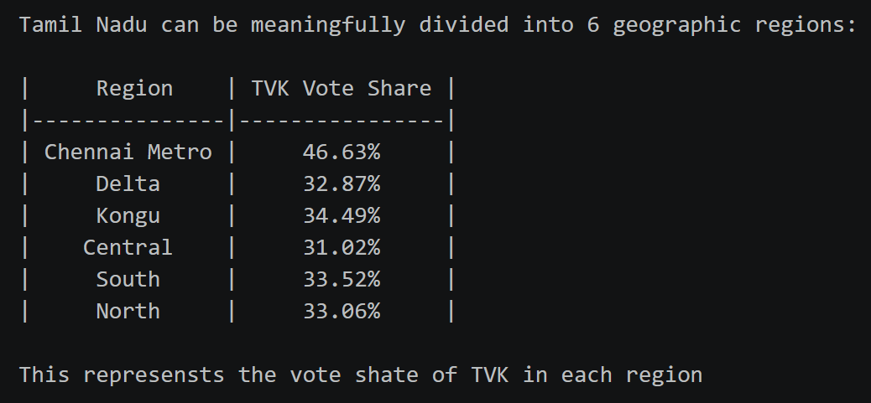
The Geographic Story: Uniformity Across Regions
TVK demonstrated a consistent appeal across all of Tamil Nadu, suggesting a movement that resonated across different economic and social strata. While the Chennai Metro region emerged as a dominant stronghold, support remained robust in all other geographic belts. Creating roughly a 15-point difference across regions.

Slide 6
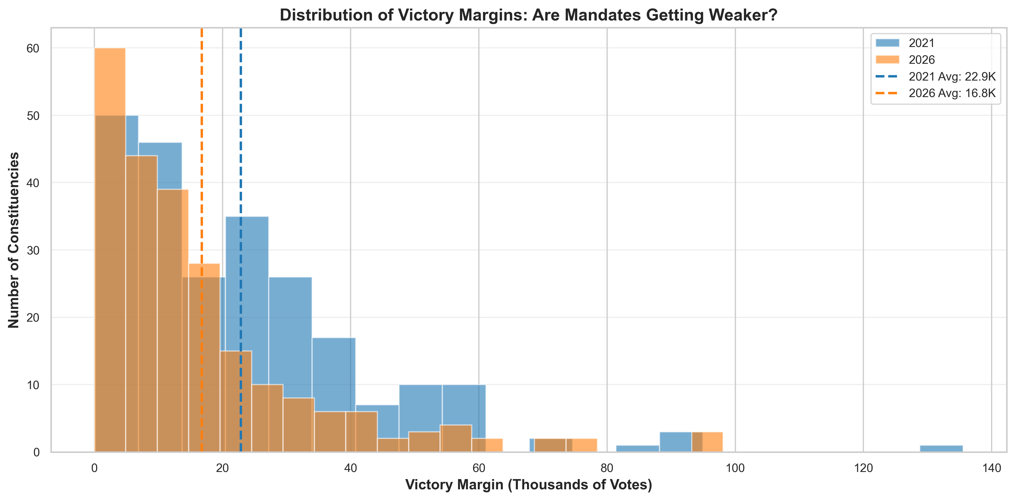
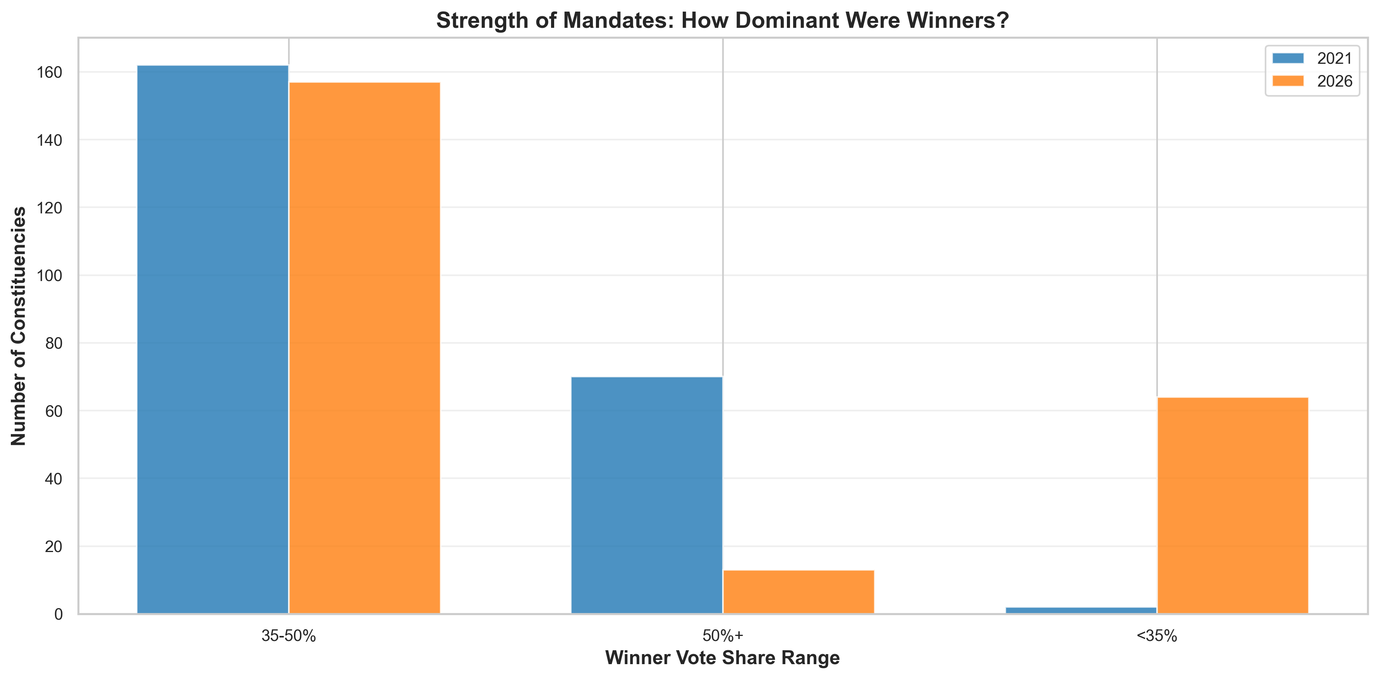
The Margin of Victory Story:
Declining Average Margins: The average victory margin dropped significantly from 22,871 votes in 2021 to 16,784 votes in 2026, a decrease of over 6,000 votes.
Increased Competition: Multi-cornered contests led to split votes, making every constituency a high-stakes battle with increased statistical volatility.
GOVERNANCE IMPLICATIONS
Narrower margins often lead to more accountable representatives but can also result in less stable mandates and legislative fragility.
Mandate Strength:
Collapse of the 50%+ Mandate: In 2021, 70 winners secured over 50% of the vote; in 2026, this number plummeted to just 13, indicating a loss of absolute majority mandates.
The New Normal: 27.4% of constituencies (64 seats) were won with less than 35% of the total valid votes polled, creating "plurality winners."
A fragmented electorate requires broader coalition-building and shifts the nature of political legitimacy.

Slide 7

Conclusion: The Future of Tamil Nadu Politics
PERMANENT TRANSFORMATION
THE TVK FACTOR
The 2026 election has effectively ended the era of bipolar politics in Tamil Nadu, ushering in a multi-polar reality that demands new political strategies.
With a 34.92 percent vote share and 108 seats, TVK is no longer an "alternative" but a central pillar of the state's political and legislative future.
VOTER ENGAGEMENT
THE ROAD AHEAD
The record 85.1 percent turnout reflects a highly demanding electorate willing to experiment with new leadership and break traditional party loyalties.
As margins thin and mandates fragment, the ability to build broad-based coalitions will become the defining skill for future political success in the state.
"Tamil Nadu has set a precedent for how established political systems can be disrupted through organized, state-wide mobilization."
2026 ELECTION ANALYSIS · FINAL REPORT SUMMARY

Slide 8
Editorial Recommendations: Navigating the New Landscape
NARRATIVE FRAMING
COMPETITIVE ANALYSIS
Frame the 2026 results as a fundamental structural shift rather than a temporary protest vote. Emphasize the emergence of a permanent multi-polar reality in Tamil Nadu politics.
Highlight that TVK's growth was fueled almost equally by losses from both DMK and AIADMK. This suggests a broad-based appeal that transcends traditional ideological divides.
STRATEGY: LEAD WITH REALIGNMENT
STRATEGY: ANALYZE "BIG TWO" EROSION
GEOGRAPHIC FOCUS
MANDATE STABILITY
Utilize the Chennai Metro sweep as a primary case study. Explain how new political movements can capture core urban centers through organized, state-wide mobilization.
Address the implications of narrow victory margins for future policy stability. Analyze how fragmented mandates will necessitate more complex legislative alliances and coalition-building.
STRATEGY: HIGHLIGHT URBAN DOMINANCE
STRATEGY: ADDRESS MANDATE FRAGILITY

Slide 9
Data Limitations & Analytical Boundaries
ANALYTICAL STRENGTHS
ANALYTICAL BOUNDARIES
Descriptive Accuracy: Precise tracking of vote share migration and margin shifts.
Geographic Patterns: Clear identification of regional variations in TVK support.
Comparative Depth: Robust 2021 vs 2026 constituency-level breakdown.
Official Sourcing: Based entirely on verified Election Commission of India data.
Causation: Cannot definitively prove *why* voters switched without survey data.
Demographics: Aggregated data hides individual factors like caste or occupation.
Qualitative Context: Impact of campaigns and media influence remains unmeasured.
Temporal Limits: Two-cycle comparison may miss long-term structural trends.
This analysis is based on results data. To answer behavioral "why" questions would require supplemental exit polls and post-election surveys.

