Slide 1
Lending club Case study
Pilakkil, Nisar​

Slide 2
Introduction
A consumer finance company named 'Lending Club' specializes in lending various types of loans to urban customers. When the company receives a loan application, it has to make a decision for loan approval based on the applicant’s profile. There are two types of risks are associated with the bank’s decision:
(i) If the applicant is likely to repay the loan, then not approving the loan results in a loss of business to the company. (ii) If the applicant is not likely to repay the loan, i.e., he/she is likely to default, then approving the loan may lead to a financial loss for the company Based on the dataset supplied company wants to understand the driving factors (or driver variables) behind loan default, i.e. the variables which are strong indicators of default.

Slide 3
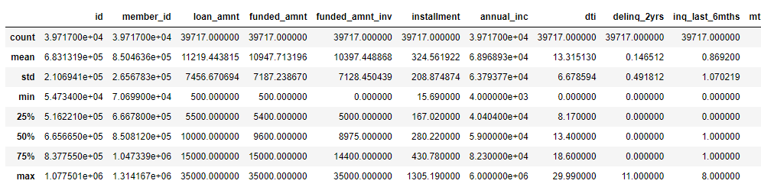
Loading the load document
Load Loan document to a data frame
Confirming the encoding of the document.
Listdown all statistical result by python command describe()

Slide 4
Data cleaning
eliminate columns having more than 50% missing values
Remove single value unique columns from the dataframe, by checking dataFrame. .nunique() ==1
Removing duplicate rows (if any), using DataFrame. drop_duplicates() function.
Dropping some columns as they are not of much use for analysis.
Checking % of NaNs in columns (>0)
Creating new columns like, month and year based on 'issue_d' column
Converting some columns to lowercase strings and stripping off blank spaces around the content

Slide 5
Data analysis
Check count of columns fully paid, charged off, Current
Calculate the percentage of counted columns
Considering only the candidates with 'fully paid' and 'charged off' loan_status. Removing records for 'current state', loan status.
Check for assigned '0' to 'fully paid' and set 'charged off' to '1' (as our target is to determine 'defaulter' factors)
List down of continuous variables
List of categorical variables

Slide 6
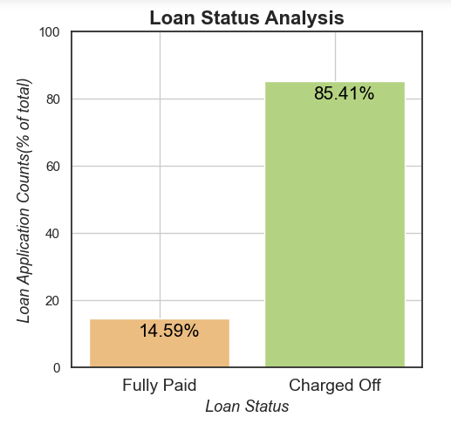
Univariate Analysis and Segmented Univariate Analysis
Lets check how 'loan_status'(%) is distributed

Slide 7
QUARTERLY PERFORMANCE

Slide 8
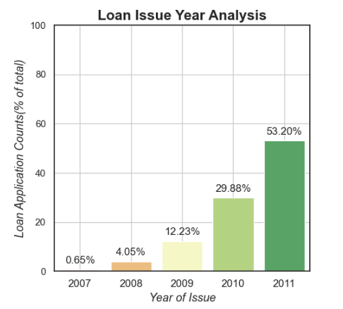
Loan Issue Year Analysis
Lets check the total number of approved applications by year

Slide 9
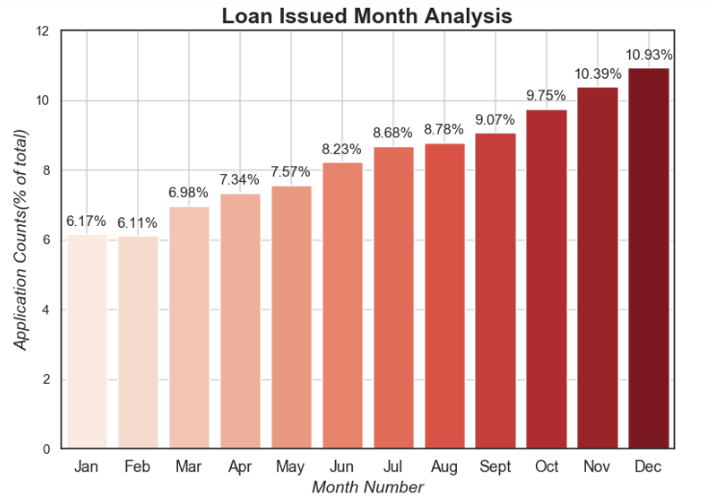
Total% of approved loan applications by Month Analysis:

Slide 10
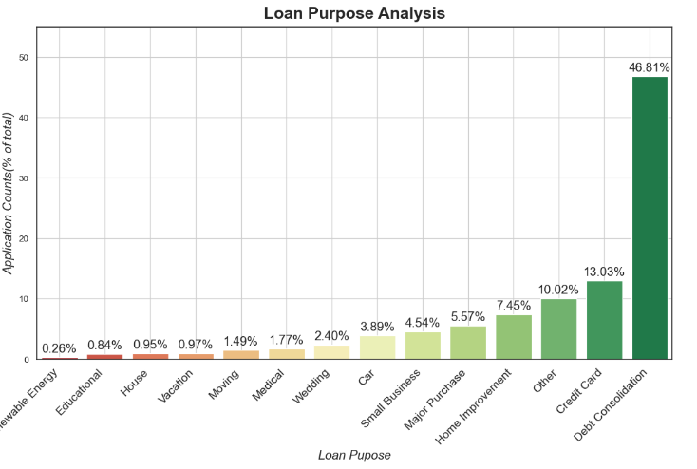
Loan Purpose Analysis

Slide 11
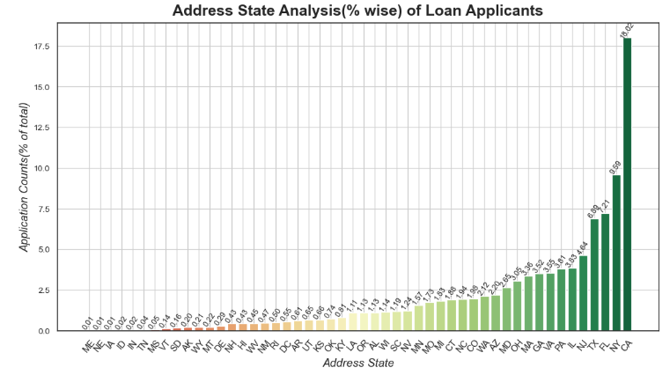
Address State Analysis(% wise) of Loan Applicants

Slide 12
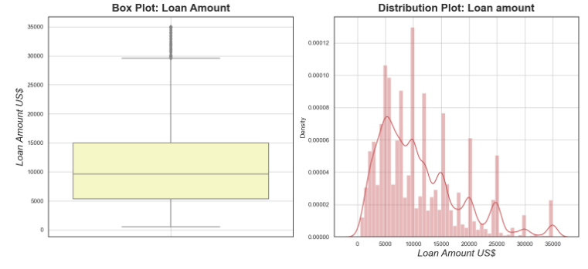
Applicant's Loan amount' analysis

Slide 13
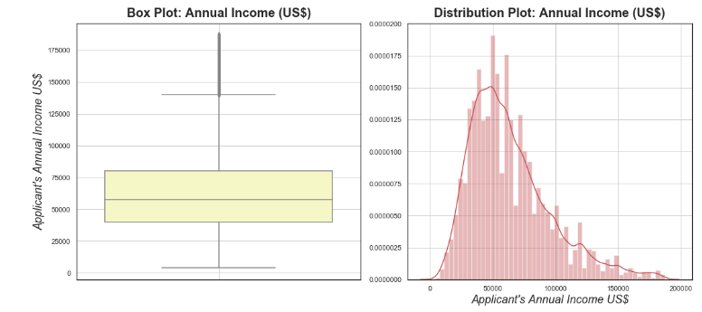
Applicant's Annual Income Analysis

Slide 14
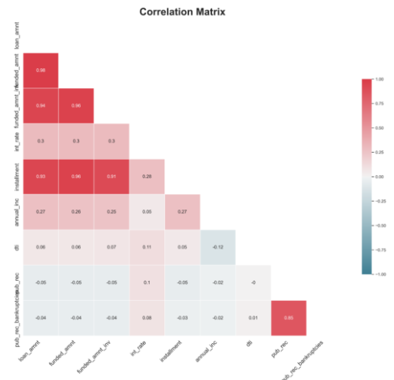
Bivariate Analysis

Slide 15
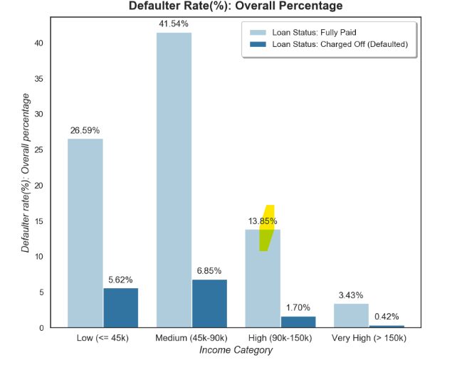
Defaulters Rate(%) analysis based on Annual Income of approved Loan Applicants

Slide 16
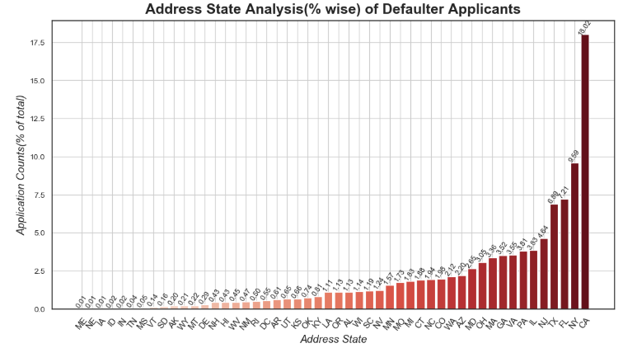
Address State Analysis(% wise) of Defaulters

Slide 17
SUMMARY
At Contoso, we believe in giving 110%. By using our next-generation data architecture, we help organizations virtually manage agile workflows. We thrive because of our market knowledge and great team behind our product. As our CEO says, "Efficiencies will come from proactively transforming how we do business."

Slide 18
THANK YOU
Pilakkil, Nisar​
nisarop@gmail.com

