Slide 1
Project Presentation Integrated Project
On
Yapster
Nischay Bareja, Prikshit Khuruana, Nitin Goyal Thakur
2210991987, 2210992087, 2210992000
Supervised By
Mr. Rahul
Department of Computer Science and Engineering,
Chitkara University, Punjab

Slide 2
Content
Introduction
Problem Statement
Proposed Design
Tech Stack
Features
Limitations
Conclusion
Future Scope

Slide 3
Introduction
In today’s fast-paced digital world, real-time communication is essential for seamless interaction. Our MERN Stack Chat Application is designed to provide an efficient, scalable, and interactive messaging experience.
This project leverages MongoDB, Express.js, React.js, and Node.js (MERN) along with Socket.io to enable real-time, bi-directional communication between users. The application ensures instant message delivery, user authentication, and a smooth UI/UX experience.
Key highlights of this project include: Real-time Messaging using WebSockets User Authentication with JWT Scalability & Performance Optimization
Through this presentation, we will walk through the system architecture, key features, implementation details, and technologies used to build this chat application.

Slide 4
Problem Statement
In the digital era, seamless and instant communication is crucial for personal and professional interactions. However, many existing chat applications face challenges such as delayed message delivery, lack of real-time updates, security vulnerabilities, and limited scalability.
This project aims to develop a real-time chat application using the MERN stack and Socket.io, addressing the following key problems:
Lack of Real-time Messaging: Traditional HTTP-based messaging introduces latency, making conversations less interactive.
Security Concerns: Many chat applications do not ensure end-to-end authentication and data protection.
Scalability Issues: Handling multiple concurrent users efficiently can be challenging.
💬 Limited Features: Many platforms lack support for group chats, media sharing, and user presence tracking.
Solution Approach: Our chat application leverages WebSockets for real-time communication, JWT authentication for secure access, and a scalable MERN architecture to provide an efficient and feature-rich messaging platform.

Slide 5
Tech Stack
The Yapster platform is built using the MERN Stack along with additional technologies to enhance user experience.
Backend:
Node.js – For server-side logic and API development
Express.js – For handling backend routing and middleware
Mongoose – For interacting with the MongoDB database
Json Web Token (JWT) – For secure authentication using access and refresh tokens
Dot env – For environment variable management
Frontend:
React.js – For building the user interface
Vite – For fast development and optimized builds

Slide 6
Tailwind CSS – For responsive and modern styling
DaisyUi
Zustand
Database:
MongoDB – For storing user, product, and transaction data
Authentication & Security:
OTP-based email verification – Implemented using Resend
Password recovery system – Securely manages password reset requests
Access & refresh tokens – Ensures secure user authentication

Slide 7
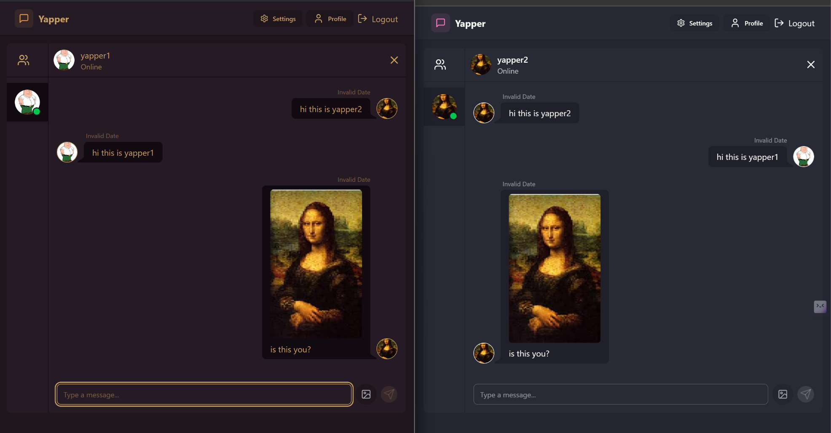

Slide 8
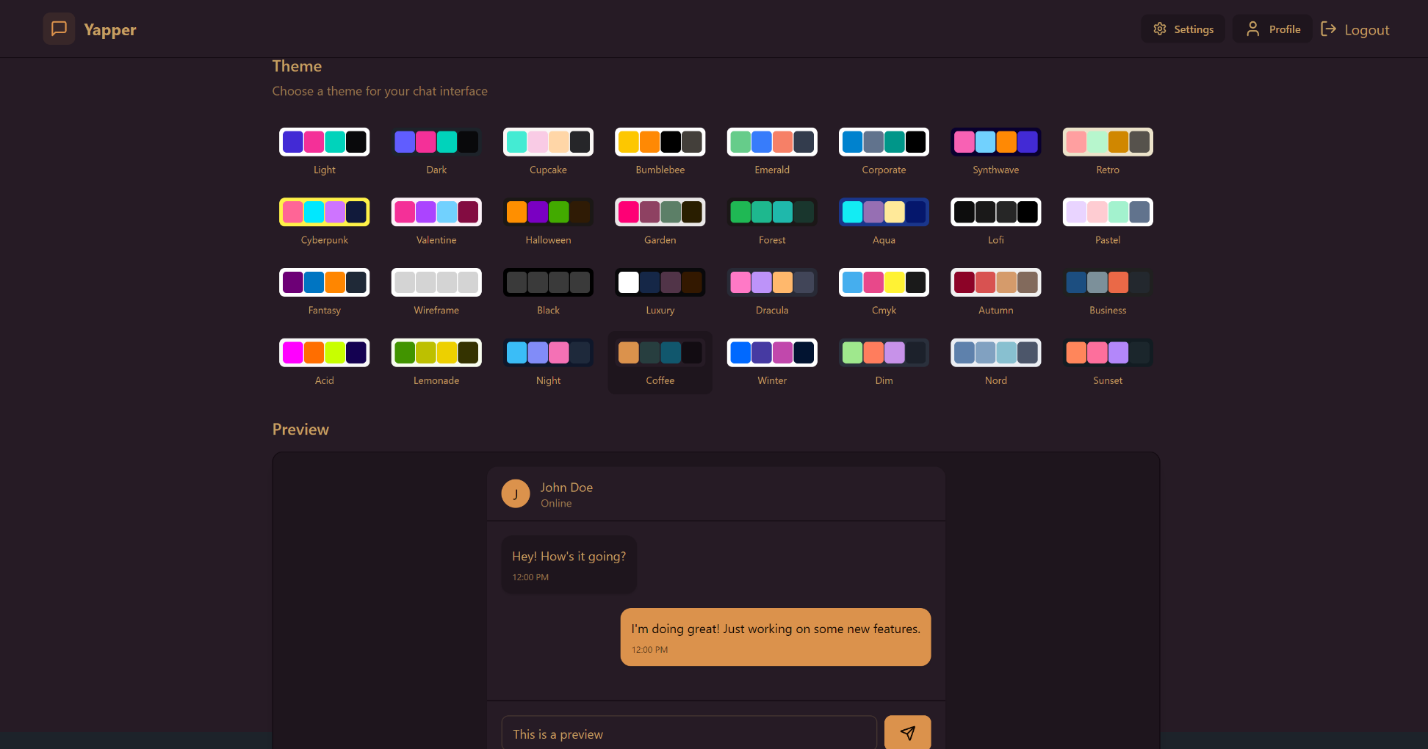

Slide 9
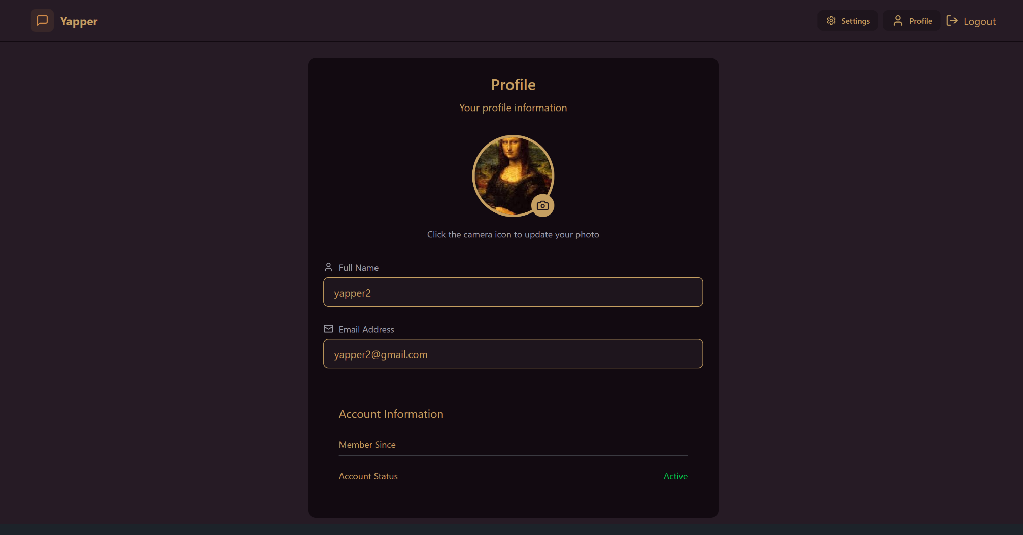

Slide 10
Features
Our MERN Stack Chat Application is designed with a user-first approach, ensuring seamless and efficient communication. Key features include:
Real-Time Messaging
Instant one-on-one and group chats using Socket.io.
Messages delivered without delays, ensuring a smooth conversation flow.
User Authentication & Security
Secure JWT-based authentication to protect user data.
Bcrypt password hashing for added security.
Interactive & Intuitive UI
Clean and responsive UI using React.js & Tailwind CSS.
Dark mode/light mode toggle for user convenience.
Customizable User Profiles
Users can update their profile picture, status, and display name.
Personalized experience with profile settings.

Slide 11
Limitations
Scalability Constraints
WebSockets maintain a persistent connection, which can be resource-intensive when handling thousands of concurrent users.
Scaling Socket.io requires load balancing and Redis-based session storage.
No End-to-End Encryption (E2EE) Yet
Messages are secured in transit, but true end-to-end encryption (like WhatsApp) is not implemented yet.
Currently, the server can access message content, making it vulnerable to potential security threats.
Limited Offline Support
The app does not provide a robust offline messaging system.
Users cannot send messages while offline and have them automatically delivered when they reconnect.
No Video or Voice Calls Yet
Currently, the app supports text-based communication only.
Integrating WebRTC for audio/video calls would enhance the user experience.

Slide 12
Conclusion
Our MERN Stack Chat Application using Socket.io successfully demonstrates the power of real-time communication by enabling seamless messaging between users. With features like instant messaging, authentication, group chats, and media sharing, the application provides a fast, secure, and interactive chatting experience.
This project highlights the potential of WebSockets in modern applications and showcases how MongoDB, Express.js, React.js, and Node.js work together to build a scalable and efficient communication platform.
Key Takeaways:
✅ Real-time and responsive chat system using WebSockets. ✅ Secure authentication & optimized backend for smooth user experience. ✅ Scalable architecture with room for future enhancements.

Slide 13

13

