Slide 1
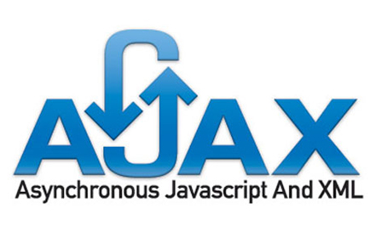

Slide 2
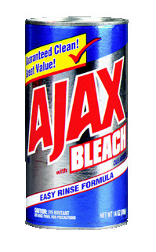
What is Ajax?

Slide 3
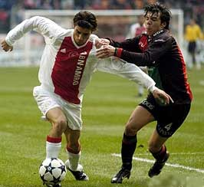
What is Ajax?

Slide 4

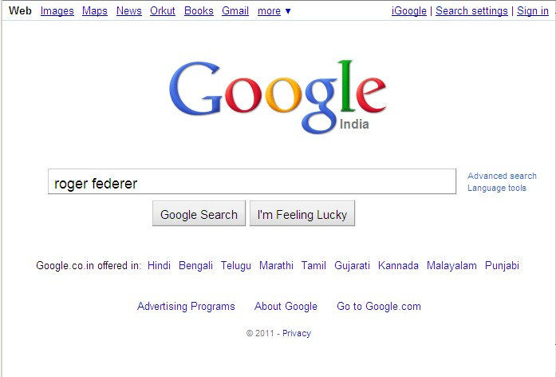
BACK THEN…
Click Search

Slide 5
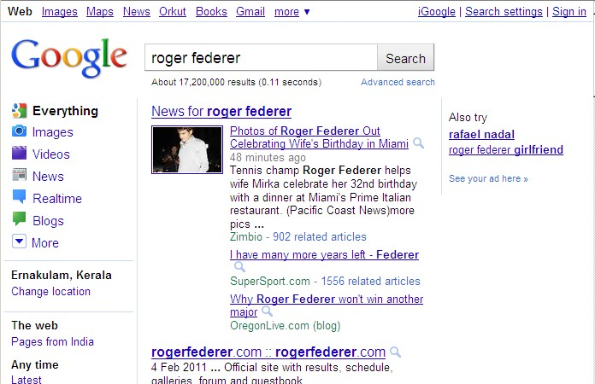
AND YOU GET THIS …

Slide 6
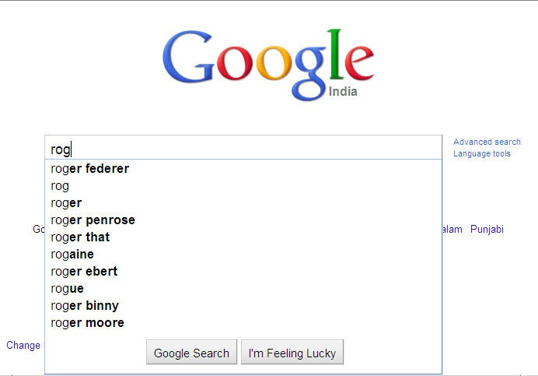
THESE DAYS..

Slide 7
THE MAGIC SPELL BEHIND THIS IS
AJAX
(Asynchronous JavaScript and XML)

Slide 8
What is Ajax?
Asynchronous
JavaScript
And
XmlHttpRequest (XHR)
Some use XML

Slide 9
Ajax
AJAX is not a new programming language, but a new way to use existing standards.
AJAX is the art of exchanging data with a server, and updating parts of a web page - without reloading the whole page.
AJAX is a new technique for creating better, faster, and more interactive web applications with the help of XML, HTML, CSS, and Java Script.

Slide 10
Ajax
Ajax uses XHTML for content, CSS for presentation, along with Document Object Model and JavaScript for dynamic content display.
Conventional web applications transmit information to and from the sever using synchronous requests.
It means you fill out a form, hit submit, and get directed to a new page with new information from the server.
With AJAX, when you hit submit, JavaScript will make a request to the server, interpret the results, and update the current screen.
In the purest sense, the user would never know that anything was even transmitted to the server.

Slide 11
XML is commonly used as the format for receiving server data, although any format, including plain text, can be used.
AJAX is a web browser technology independent of web server software.
A user can continue to use the application while the client program requests information from the server in the background.
Intuitive and natural user interaction. Clicking is not required, mouse movement is a sufficient event trigger.
Data-driven as opposed to page-driven.

Slide 12
AJAX is Based on Open Standards
Browser-based presentation using HTML and Cascading Style Sheets (CSS).
Data is stored in XML format and fetched from the server.
Behind-the-scenes data fetches using XMLHttpRequest objects in the browser.
JavaScript to make everything happen.

Slide 13
Why Ajax?
XHR Support across all browsers
Based on DOM, CSS, XHTML
Emergence of broadband
AJAX-based JavaScript can take considerable bandwidth to download
The “Killer App” - Google Maps
A Catchy Acronym
Coined by Jesse James Garrett of Adaptive Path (February 2005)

Slide 14
HISTORY OF AJAX
Starts with web pages
Static web pages
Static html page is loaded
No interaction with user
Dynamic web pages
Html page is generated dynamically
Interaction with user
Becomes slower as functionality increases
Speed becomes intolerable, so AJAX has been born

Slide 15
The term AJAX is coined on February 18, 2005, by Jesse James Garret in a short essay published a few days after Google released its Maps application.
In the year 2006, the W3C (World Wide Web Consortium) announces the release of the first draft which made AJAX an official web standard.
Ajax makes it possible to update a page without a refresh.
Using Ajax, we can refresh a particular DOM object without refreshing the full page.
Page 10

Slide 16
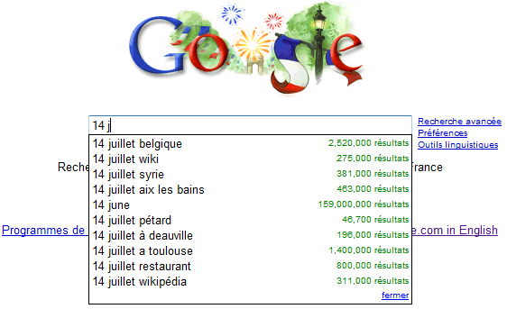
GOOGLE SUGGEST
Google Suggest is using AJAX to create a very dynamic web interface: When you start typing in Google's search
box, a JavaScript sends the letters off to a server and the server returns a list of suggestions.

Slide 17
SİMPLE PROCESSİNG
AJAX is based on Javascript, and the main functionality is to access the web server inside the Javascript code.
When user initiates an
event, a javascript function is called which accesses server using the objects.
The received information is shown to the user by means of the Javascript’s functions.
We access to the server using special objects; we send data and retrieve data.

Slide 18
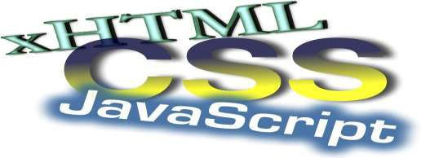
COMPONENTS OF AJAX
Ajax incorporates several technologies, each flourishing in
its own right, coming together in powerful new ways.
standards-based presentation using XHTML, CSS
dynamic display and interaction using DOM
data interchange and manipulation using XML
asynchronous data retrieval using XMLHttpRequest
and JavaScript binding everything together.

Slide 19
AJAX - Technologies
AJAX cannot work independently. It is used in combination with other technologies to create interactive webpages.
JavaScript
Loosely typed scripting language.
JavaScript function is called when an event occurs in a page.
Glue for the whole AJAX operation.

Slide 20
DOM
API for accessing and manipulating structured documents.
Represents the structure of XML and HTML documents.
CSS
Allows for a clear separation of the presentation style from the content and may be changed programmatically by JavaScript.
XMLHttpRequest
JavaScript object that performs asynchronous interaction with the server.

Slide 21
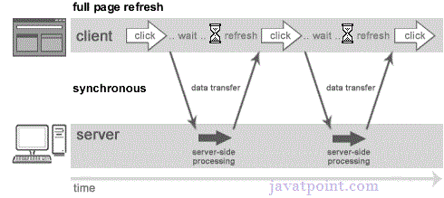
Synchronous vs Asynchronous
A synchronous request blocks the client until operation completes i.e. browser is not unresponsive. In such case, javascript engine of the browser is blocked.
Full page is refreshed at request time and user is blocked until request completes.

Slide 22
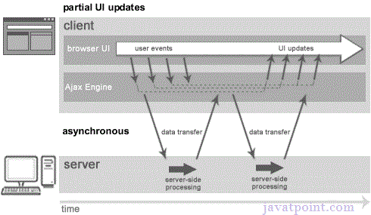
Asynchronous (AJAX Web-Application Model)
An asynchronous request doesn’t block the client i.e. browser is responsive. At that time, user can perform another operations also. In such case, javascript engine of the browser is not blocked.

Slide 23
AJAX Alternatives
Macromedia Flash
Requires a plug-in
So what? It comes already with almost every browser
Java Web Start/Applets
.NET – No Touch Deployment
Both need a runtime preinstalled
Handheld device browsers generally do not support the full range of Ajax technologies.

Slide 24
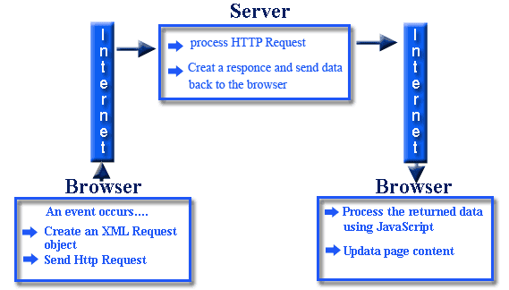
How AJAX Works

Slide 25
Implementing AJAX
To implement AJAX we need to answer three questions:
What triggers the AJAX request?
Usually a JavaScript event (onblur, onclick, etc.)
What is the server process that handles the AJAX request and issues the response?
Some kind of URL (use a Service Locator)
What processes the response from the server(what is the callback method)?
A JavaScript function that gets the response and manipulates the DOM, based on the text returned.

Slide 26
XmlHttpRequest Object (XHR)
The Heart of AJAX
First implemented in IE in 1997 as part of the new DHTML standard
Response comes in one of two properties:
responseXML – Returns a DOM document (can use functions such as, getElementById())
responseText – A text string (can be HTML, or even JavaScript code)

Slide 27
Create an XMLHttpRequest Object
The keystone of AJAX is the XMLHttpRequest object.
The XMLHttpRequest object is used to exchange data with a server behind the scenes.
This means that it is possible to update parts of a web page, without reloading the whole page.
All modern browsers (IE7+, Firefox, Chrome, Safari, and Opera) have a built-in XMLHttpRequest object.

Slide 28
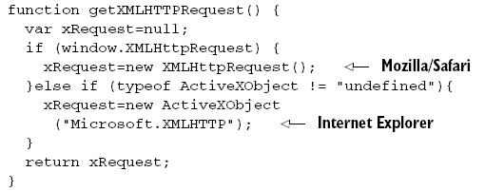
XHR : Creating
variable=new XMLHttpRequest();
variable=new ActiveXObject("Microsoft.XMLHTTP");
Notes:
Non-standard extensions to the web-browser DOM.

Slide 29
Send a Request To a Server
The XMLHttpRequest object is used to exchange data with a server.
To send a request to a server, we use the open() and send() methods of the XMLHttpRequest object
xmlhttp.open("GET","ajax_info.txt",true); xmlhttp.send();

Slide 30
XMLHttpRequest Methods
Method | Description
open(method,url,async) | Specifies the type of request, the URL, and if the request should be handled asynchronously or not. method: the type of request: GET or POST url: the location of the file on the server async: true (asynchronous) or false (synchronous)
send(string) | Sends the request off to the server. string: Only used for POST requests

Slide 31
GET or POST?
GET is simpler and faster than POST, and can be used in most cases.
However, always use POST requests when:
A cached file is not an option (update a file or database on the server)
Sending a large amount of data to the server (POST has no size limitations)
Sending user input (which can contain unknown characters), POST is more robust and secure than GET

Slide 32
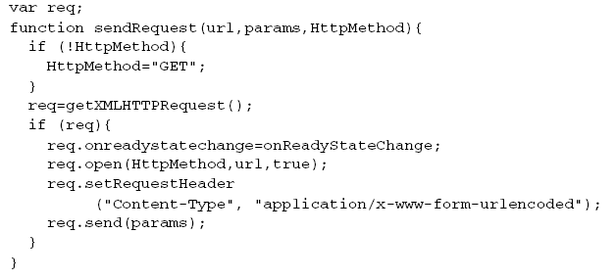
XHR : Sending the Request
true = asynchronous
Notes:
Non-standard extensions to the web-browser DOM.

Slide 33
Server Response
To get the response from a server, use the responseText or responseXML property of the XMLHttpRequest object.
Property | Description
responseText | get the response data as a string
responseXML | get the response data as XML data

Slide 34
The responseText Property
If the response from the server is not XML, use the responseText property.
The responseText property returns the response as a string, and you can use it accordingly:
document.getElementById("myDiv").innerHTML=xmlhttp.responseText;

Slide 35
The responseXML Property
If the response from the server is XML, and you want to parse it as an XML object, use the responseXML property
xmlDoc=xmlhttp.responseXML;

Slide 36
XMLHttpRequest Properties
Onreadystatechange :An event handler for an event that fires at every state change.
readyState - property defines the current state of the XMLHttpRequest object.

Slide 37
The onreadystatechange event
When a request to a server is sent, we want to perform some actions based on the response.
The onreadystatechange event is triggered every time the readyState changes.
The readyState property holds the status of the XMLHttpRequest.
In the onreadystatechange event, we specify what will happen when the server response is ready to be processed.
When readyState is 4 and status is 200, the response is ready

Slide 38
Properties of the XMLHttpRequest object
Property | Description
onreadystatechange | Stores a function (or the name of a function) to be called automatically each time the readyState property changes
readyState | Holds the status of the XMLHttpRequest. Changes from 0 to 4: 0: request not initialized 1: server connection established 2: request received 3: processing request 4: request finished and response is ready
status | 200: "OK" 404: Page not found

Slide 39
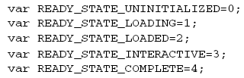
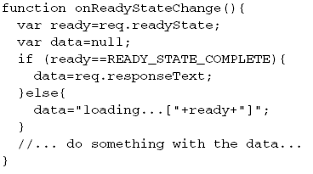
XHR : Using a callback handler
Notes:
Non-standard extensions to the web-browser DOM.

Slide 40
Handling the Response
Response can be one of the following:
Formatted data (XML, other custom format)
XMLHttpRequest.responseXML
Decouples the server from presentation issues
Could perform XSLT transformation on returned XML
HTML
XMLHttpRequest.responseText
Server generates HTML, script “injects” HTML via innerHTML
Server is now concerned with presentation
JavaScript
XMLHttpRequest.responseText
Use the eval() JavaScript command
Again, our server code is concerned with presentation

Slide 41
Using a Callback Function
A callback function is a function passed as a parameter to another function.
If you have more than one AJAX task on your website, you should create ONE standard function for creating the XMLHttpRequest object, and call this for each AJAX task.
The function call should contain the URL and what to do on onreadystatechange (which is probably different for each call)

Slide 42
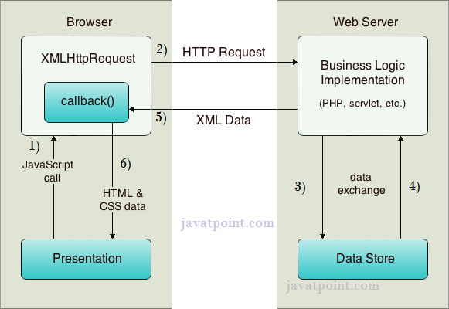
AJAX Process
AJAX communicates with the server using XMLHttpRequest object.

Slide 43
AJAX Process
User sends a request from the UI and a javascript call goes to XMLHttpRequest object.
HTTP Request is sent to the server by XMLHttpRequest object.
Server interacts with the database using JSP, PHP, Servlet, ASP.net etc.
Data is retrieved.
Server sends XML data or JSON data to the XMLHttpRequest callback function.
HTML and CSS data is displayed on the browser.

Slide 44
Ajax-Server Code
The server code takes the input from ajax/http request, and processes the request.
It also prepare the response data if required.
It sends the data back to the original webpage that made the request.
Server logic should be coded in server-side language e.g. servlet, jsp, php, asp.net etc

Slide 45
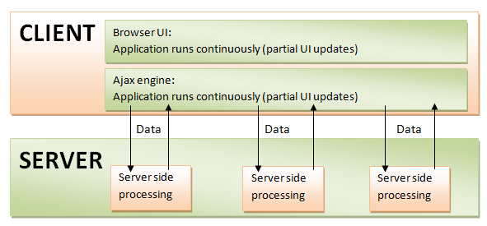
Ajax – Server side Code

Slide 46
AJAX –JSP
Java Server Pages (JSP) are used for server-side programming for web based applications.
It is used for building static as well as dynamic web content.
JSP is based on the servlet technology and uses data in different formats such as HTML, XML and WML.
If your web page uses a lot of server side programming, then it becomes very processing intensive.
As the dynamic content in the page increases, the response time for server side processing increases.

Slide 47
AJAX –JSP
JSP is a server side technology that focuses on implementing the business logic.
AJAX is a collection of scripting tools such as JavaScript, CSS, HTML and XML used for ensuring that dynamic updates happen fast on the client side.
This is done by refreshing the page’s partially based on the response received from the web server.
The integration of AJAX with JSP gives you an important tool to maximize the performance of your web applications without compromising on correctness or security of the data.

Slide 48
AJAX –JSP Example
If you are updating a control selected from a drop down in a form that has twenty fields, then the typical JSP processing would send all the twenty values to the server even if only one value has been changed.
This is not required and makes the processing on the server side really slow.
Integrating AJAX with JSP helps developers save on such dynamic updates, because the AJAX framework allows you to refresh only the effected portion of the webpage keeping the other content unaffected.

Slide 49
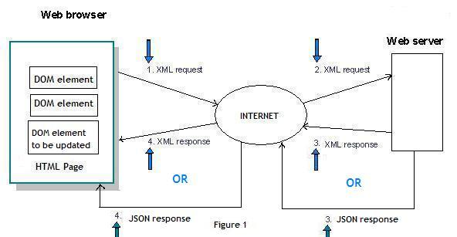
Ajax with XML Response and with JSON

Slide 50
Ajax with XML Response and with JSON
Web browser requests the content of just the part of the page that it needs to refresh.
Web server analyzes the received request and builds up an XML message or JSON depend upon the user selection, which is then sent back to the web browser.
After the web browser receives the XML/JSON message, it parses the message in order to update the content of that part of the page.

Slide 51
JSON vs XML
Both JSON and XML can be used to receive data from a web server.
Both JSON and XML are "self describing" (human readable)
Both JSON and XML are hierarchical (values within values)
Both JSON and XML can be parsed and used by lots of programming languages
Both JSON and XML can be fetched with an XMLHttpRequest

Slide 52
JSON - Example
{"employees":[
{ "firstName":"John", "lastName":"Doe" },
{ "firstName":"Anna", "lastName":"Smith" },
{ "firstName":"Peter", "lastName":"Jones" }
]}

Slide 53
XML Example
<employees>
<employee>
<firstName>John</firstName> <lastName>Doe</lastName>
</employee>
<employee>
<firstName>Anna</firstName> <lastName>Smith</lastName>
</employee>
<employee>
<firstName>Peter</firstName> <lastName>Jones</lastName>
</employee>
</employees>

Slide 54
JSON vs XML
JSON doesn't use end tag
JSON is shorter
JSON is quicker to read and write
JSON can use arrays
XML has to be parsed with an XML parser.
JSON can be parsed by a standard JavaScript function.

Slide 55
JSON & XML in AJAX
Using XML
Fetch an XML document
Use the XML DOM to loop through the document
Extract values and store in variables
Using JSON
Fetch a JSON string
JSON.Parse the JSON string

Slide 56
AJAX Security: Server Side
AJAX-based Web applications use the same server-side security schemes of regular Web applications.
You specify authentication, authorization, and data protection requirements in your web.xml file (declarative) or in your program (programmatic).
AJAX-based Web applications are subject to the same security threats as regular Web applications.

Slide 57
AJAX Security: Client Side
JavaScript code is visible to a user/hacker. Hacker can use JavaScript code for inferring server-side weaknesses.
JavaScript code is downloaded from the server and executed ("eval") at the client and can compromise the client by mal-intended code.
Downloaded JavaScript code is constrained by the sand-box security model and can be relaxed for signed JavaScript.

Slide 58
Demo – Creator 2 AJAX Components
Auto Complete
Map Viewer
Drag-and-drop components
Code server-based functionality

Slide 59
Links
Original AJAX Blog by Jesse James Garrett
http://adaptivepath.com/publications/essays/archives/000385.php
“Fixing AJAX: XMLHttpRequest Considered Harmful”
http://www.xml.com/pub/a/2005/11/09/fixing-ajax-xmlhttprequest-considered-harmful.html
DWR (Direct Web Remoting) Home Page
http://getahead.ltd.uk/dwr/
Java AJAX BluePrints Solutions Catalog
https://bpcatalog.dev.java.net/nonav/ajax/index.html
“AJAX Without the J” Blog
http://www.jsfcentral.com/listings/A10500?link
Really Simple History (RSH) Framework
http://codinginparadise.org/projects/dhtml_history/README.html
ECHO 2 Web Framework
http://www.nextapp.com/platform/echo2/echo/

