Slide 1



Slide 2
Hibernate 5.0.1 Introduction
Hibernate framework simplifies the development of java application to interact with the database.
Hibernate is an open source, lightweight, ORM (Object Relational Mapping) tool.
An ORM tool simplifies the data creation, data manipulation and data access.
It is a programming technique that maps the object to the data stored in the database.
The ORM tool internally uses the JDBC API to interact with the database.

Slide 3
Hibernate Introduction…
Hibernate is a high-performance Object/Relational persistence and query service.
It is licensed under the open source GNU Lesser General Public License (LGPL) and is free to download.
Hibernate takes care of the mapping from Java classes to database tables (and from Java data types to SQL data types),
It also provides data query and retrieval facilities.

Slide 4
What is JDBC?
JDBC stands for Java Database Connectivity and provides a set of Java API for accessing the relational databases from Java program.
These Java APIs enables Java programs to execute SQL statements and interact with any SQL compliant database.
Pros of JDBC | Cons of JDBC
Clean and simple SQL processing Good performance with large data Very good for small applications Simple syntax so easy to learn | Complex if it is used in large projects Large programming overhead No encapsulation Hard to implement MVC concept Query is DBMS specific

Slide 5
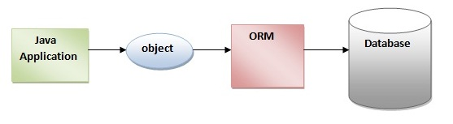
Why Object Relational Mapping (ORM) ?
In an object-oriented systems, there's a mismatch between the object model and the relational database.
RDBMSs represent data in a tabular format .
Object-oriented languages, such as Java or C# represent it as an interconnected graph of objects.

Slide 6
Why ORM ? Consider a Java Class with proper constructors and associated public function
public class Employee {
private int id;
private String first_name;
private String last_name;
private int salary;
public Employee() {}
public Employee(String fname, String lname, int salary)
{
this.first_name = fname;
this.last_name = lname;
this.salary = salary;
}
public int getId() {
return id;
}
public String getFirstName() {
return first_name;
}
public String getLastName() {
return last_name;
}
public int getSalary() {
return salary;
}
}

Slide 7
Why ORM ?
Consider above objects need to be stored and retrieved into the following RDBMS table:
create table EMPLOYEE (
id INT NOT NULL auto_increment,
first_name VARCHAR(20) default NULL,
last_name VARCHAR(20) default NULL,
salary INT default NULL,
PRIMARY KEY (id)
);
Problem - What if we need to modify the design of our database after having developed few pages or our application?

Slide 8
ORM - is the solution to handle below impedance mismatches.
Loading and storing objects in a relational database exposes us to the following five mismatch problems.
Mismatch | Description
Granularity | Sometimes you will have an object model which has more classes than the number of corresponding tables in the database.
Inheritance | RDBMSs do not define anything similar to Inheritance which is a natural paradigm in object-oriented programming languages.
Identity | A RDBMS defines exactly one notion of 'sameness': the primary key. Java, however, defines both object identity (a==b) and object equality (a.equals(b)).
Associations | Object-oriented languages represent associations using object references where as am RDBMS represents an association as a foreign key column.
Navigation | The ways you access objects in Java and in a RDBMS are fundamentally different.

Slide 9
What is ORM?
ORM stands for Object-Relational Mapping .
(ORM) is a programming technique for converting data between relational databases and object oriented programming languages such as Java, C# etc.
An ORM system has following advantages over plain JDBC
Lets business code access objects rather than DB tables.
Hides details of SQL queries from OO logic.
Based on JDBC 'under the hood'
No need to deal with the database implementation.
Entities based on business concepts rather than database structure.
Transaction management and automatic key generation.
Fast development of application.

Slide 10
ORM Solution -4 Entities
An API to perform basic CRUD operations on objects of persistent classes.
A language or API to specify queries that refer to classes and properties of classes.
A configurable facility for specifying mapping metadata.
A technique to interact with transactional objects to perform dirty checking, lazy association fetching, and other optimization functions.

Slide 11
Java ORM Frameworks
There are several persistent frameworks and ORM options in Java.
A persistent framework is an ORM service that stores and retrieves objects into a relational database.
Enterprise JavaBeans Entity Beans
Java Data Objects
Castor
TopLink
Spring DAO
Hibernate
And many more

Slide 12
Hibernate - Overview
Hibernate is an Object-Relational Mapping(ORM) solution for JAVA.
It raised as an open source persistent framework created by Gavin King in 2001.
It is a powerful, high performance Object-Relational Persistence and Query service for any Java Application.
Hibernate maps Java classes to database tables and from Java data types to SQL data types.
Hence relieve the developer from 95% of common data persistence related programming tasks.

Slide 13
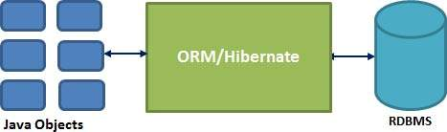
Hibernate – Overview…
Hibernate sits between traditional Java objects and database server.
It handles all the work in persisting those objects based on the appropriate O/R mechanisms and patterns.

Slide 14
Hibernate Advantages
Hibernate takes care of mapping Java classes to database tables using XML files and without writing any line of code.
Provides simple APIs for storing and retrieving Java objects directly to and from the database.
If there is change in Database or in any table then the only need to change XML file properties.
Abstract away the unfamiliar SQL types and provide us to work around familiar Java Objects.

Slide 15
Hibernate Advantages
Hibernate does not require an application server to operate.
Manipulates Complex associations of objects of your database.
Minimize database access with smart fetching strategies.
Provides Simple querying of data.

Slide 16
Hibernate Advantages
Opensource and Lightweight: Hibernate framework is opensource under the LGPL license and lightweight.
Fast performance: The performance of hibernate framework is fast because cache is internally used in hibernate framework.
There are two types of cache in hibernate framework first level cache and second level cache. First level cache is enabled by default.
Database Independent query: HQL (Hibernate Query Language) is the object-oriented version of SQL.
It generates the database independent queries.
So you don't need to write database specific queries.
Before Hibernate, If database is changed for the project, we need to change the SQL query as well that leads to the maintenance problem.

Slide 17
Hibernate Advantages
Automatic table creation: Hibernate framework provides the facility to create the tables of the database automatically. So there is no need to create tables in the database manually.
Simplifies complex join: To fetch data form multiple tables is easy in hibernate framework.
Provides query statistics and database status: Hibernate supports Query cache and provide statistics about query and database status.

Slide 18
Supported Databases
Hibernate supports almost all the major RDBMS.
HSQL Database Engine
DB2/NT
MySQL
PostgreSQL
FrontBase
Oracle
Microsoft SQL Server Database
Sybase SQL Server
Informix Dynamic Server

Slide 19
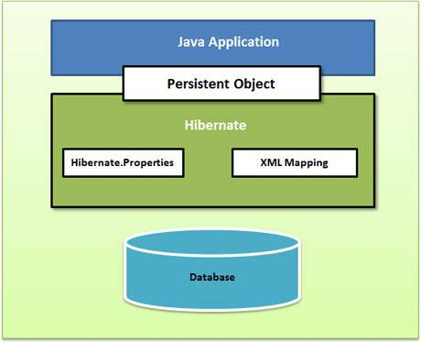
Hibernate - Architecture
The Hibernate architecture is layered to keep you isolated from having to know the underlying APIs.
Hibernate makes use of the database and configuration data to provide persistence services (and persistent objects) to the application.

Slide 20
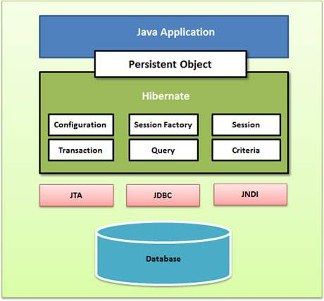
Detailed view of the Hibernate Application Architecture
Core Classes

Slide 21
Hibernate Architecture – API’s
Hibernate uses various existing Java APIs, like JDBC, Java Transaction API(JTA), and Java Naming and Directory Interface (JNDI).
JDBC provides a rudimentary level of abstraction of functionality common to relational databases, allowing almost any database with a JDBC driver to be supported by Hibernate.
JNDI and JTA allow Hibernate to be integrated with J2EE application servers.

Slide 22
Configuration Object
The Configuration object is the first Hibernate object you create in any Hibernate application.
It is usually created only once during application initialization.
It represents a configuration or properties file required by the Hibernate.
The Configuration object provides two keys components:
Database Connection: This is handled through one or more configuration files supported by Hibernate.
These files are hibernate.properties and hibernate.cfg.xml.
Class Mapping Setup
This component creates the connection between the Java classes and database tables.

Slide 23
SessionFactory Object
Configuration object is used to create a SessionFactory object.
It in turn configures Hibernate for the application using the supplied configuration file and allows for a Session object to be instantiated.
The SessionFactory is a thread safe object and used by all the threads of an application.
The SessionFactory is heavyweight object so usually it is created during application start up and kept for later use.
You would need one SessionFactory object per database using a separate configuration file.
So if you are using multiple databases then you would have to create multiple SessionFactory objects.

Slide 24
Session Object
A Session is used to get a physical connection with a database.
The Session object is lightweight and designed to be instantiated each time an interaction is needed with the database.
Persistent objects are saved and retrieved through a Session object.
The session objects should not be kept open for a long time because they are not usually thread safe and they should be created and destroyed them as needed.

Slide 25
Transaction Object
A Transaction represents a unit of work with the database and most of the RDBMS supports transaction functionality.
Transactions in Hibernate are handled by an underlying transaction manager and transaction (from JDBC or JTA).
This is an optional object.
Hibernate applications may choose not to use this interface, instead managing transactions in their own application code.

Slide 26
Query Object
Query objects use SQL or Hibernate Query Language (HQL) string to retrieve data from the database and create objects.
A Query instance is used to bind query parameters, limit the number of results returned by the query, and finally to execute the query.

Slide 27
Criteria Object
Criteria object are used to create and execute object oriented criteria queries to retrieve objects.

Slide 28
Hibernate - Environment
JDK latest Version
Eclipse IDE
Download the latest version of Hibernate from http://www.hibernate.org/downloads
Download Hibernate Prerequisites
dom4j - XML parsing www.dom4j.org/
Xalan - XSLT Processor http://xml.apache.org/xalan-j/
Xerces - The Xerces Java Parser http://xml.apache.org/xerces-j/
cglib - Appropriate changes to Java classes at runtime http://cglib.sourceforge.net/
log4j - Logging Faremwork http://logging.apache.org/log4j
Commons - Logging, Email etc. http://jakarta.apache.org/commons
SLF4J - Logging Facade for Java http://www.slf4j.org

Slide 29
Hibernate - Configuration
Hibernate requires to know in advance where to find the mapping information that defines how your Java classes relate to the database tables.
Hibernate also requires a set of configuration settings related to database and other related parameters.
All such information is usually supplied as a standard Java properties file called hibernate.properties, or as an XML file named hibernate.cfg.xml.

Slide 30
hibernate.cfg.xml
We will consider XML formatted file hibernate.cfg.xml to specify required Hibernate properties.
Most of the properties take their default values and it is not required to specify them in the property file unless it is really required.
This file is kept in the root directory of your application's classpath.

Slide 31
Hibernate Properties
Properties | Description
hibernate.dialect | This property makes Hibernate generate the appropriate SQL for the chosen database.
hibernate.connection.driver_class | The JDBC driver class.
hibernate.connection.url | The JDBC URL to the database instance.
hibernate.connection.username | The database username.
hibernate.connection.password | The database password.
hibernate.connection.pool_size | Limits the number of connections waiting in the Hibernate database connection pool.
hibernate.connection.autocommit | Allows autocommit mode to be used for the JDBC connection.

Slide 32
Hibernate with Oracle Database
<hibernate-configuration>
<session-factory>
<property name="dialect">org.hibernate.dialect.MySQLDialect </property>
<property name="connection.url"> jdbc:mysql://localhost:3306/mysqljdbc </property>
<property name="connection.username">root</property>
<property name="connection.password">redhat</property>
<property name="connection.driver_class"> com.mysql.jdbc.Driver</property>
<mapping resource="user.hbm.xml"/>
</session-factory>
</hibernate-configuration>

Slide 33
Databases dialect property
Database | Dialect Property
DB2 | org.hibernate.dialect.DB2Dialect
HSQLDB | org.hibernate.dialect.HSQLDialect
HypersonicSQL | org.hibernate.dialect.HSQLDialect
Informix | org.hibernate.dialect.InformixDialect
Ingres | org.hibernate.dialect.IngresDialect
Interbase | org.hibernate.dialect.InterbaseDialect
Microsoft SQL Server 2000 | org.hibernate.dialect.SQLServerDialect
Microsoft SQL Server 2005 | org.hibernate.dialect.SQLServer2005Dialect
Microsoft SQL Server 2008 | org.hibernate.dialect.SQLServer2008Dialect
MySQL | org.hibernate.dialect.MySQLDialect
Oracle (any version) | org.hibernate.dialect.OracleDialect
Oracle 11g | org.hibernate.dialect.Oracle10gDialect
Oracle 10g | org.hibernate.dialect.Oracle10gDialect
Oracle 9i | org.hibernate.dialect.Oracle9iDialect
PostgreSQL | org.hibernate.dialect.PostgreSQLDialect
Progress | org.hibernate.dialect.ProgressDialect
SAP DB | org.hibernate.dialect.SAPDBDialect
Sybase | org.hibernate.dialect.SybaseDialect
Sybase Anywhere | org.hibernate.dialect.SybaseAnywhereDialect

Slide 34
Hibernate - Sessions
A Session is used to get a physical connection with a database.
The Session object is lightweight and designed to be instantiated each time an interaction is needed with the database.
Persistent objects are saved and retrieved through a Session object.
The session objects should not be kept open for a long time because they are not usually thread safe and they should be created and destroyed them as needed.
The main function of the Session is to offer create, read and delete operations for instances of mapped entity classes.

Slide 35
Session object - Instance
transient: A new instance of a a persistent class which is not associated with a Session and has no representation in the database and no identifier value is considered transient by Hibernate.
persistent: You can make a transient instance persistent by associating it with a Session. A persistent instance has a representation in the database, an identifier value and is associated with a Session.
detached: Once we close the Hibernate Session, the persistent instance will become a detached instance.

Slide 36
Session instance
A Session instance is serializable if its persistent classes are serializable.
A typical transaction should use the following idiom
Session session = factory.openSession();
Transaction tx = null;
try {
tx = session.beginTransaction();
// do some work
...
tx.commit();
}
catch (Exception e) {
if (tx!=null) tx.rollback();
e.printStackTrace();
}finally {
session.close();
}

Slide 37
Hibernate - Persistent Class
The entire concept of Hibernate is to take the values from Java class attributes and persist them to a database table.
A mapping document helps Hibernate in determining how to pull the values from the classes and map them with table and associated fields.
Java classes whose objects or instances will be stored in database tables are called persistent classes in Hibernate.
Hibernate works best if these classes follow some simple rules, also known as the Plain Old Java Object (POJO) programming model.

Slide 38
Rules of persistent classes
All Java classes that will be persisted need a default constructor.
All classes should contain an ID in order to allow easy identification of your objects within Hibernate and the database.
This property maps to the primary key column of a database table.
All attributes that will be persisted should be declared private and have getXXXand setXXX methods defined in the JavaBean style.
A central feature of Hibernate, proxies, depends upon the persistent class being either non-final, or the implementation of an interface that declares all public methods.
All classes that do not extend or implement some specialized classes and interfaces required by the EJB framework.

Slide 39
A simple POJO example
public class Employee {
private int id;
private String firstName;
private String lastName;
private int salary;
public Employee() {}
public Employee(String fname, String lname, int salary) {
this.firstName = fname;
this.lastName = lname;
this.salary = salary; }
public int getId() {
return id; }
public void setId( int id ) {
this.id = id; }
public String getFirstName() {
return firstName; }
public void setFirstName( String first_name ) {
this.firstName = first_name;
}
public String getLastName() {
return lastName;
}
public void setLastName( String last_name ) {
this.lastName = last_name;
}
public int getSalary() {
return salary;
}
public void setSalary( int salary ) {
this.salary = salary;
}
}

Slide 40
Hibernate - Mapping Files
An Object/relational mappings are usually defined in an XML document.
This mapping file instructs Hibernate how to map the defined class or classes to the database tables.
Though many Hibernate users choose to write the XML by hand, a number of tools exist to generate the mapping document.
You should save the mapping document in a file with the format <classname>.hbm.xml.

Slide 41
Employee.hbm.xml – Sample Mapping File
<hibernate-mapping>
<class name="Employee" table="EMPLOYEE">
<meta attribute="class-description">
This class contains the employee detail.
</meta>
<id name="id" type="int" column="id">
<generator class="native"/>
</id>
<property name="firstName" column="first_name" type="string"/>
<property name="lastName" column="last_name" type="string"/>
<property name="salary" column="salary" type="int"/>
</class>
</hibernate-mapping>

Slide 42
Employee.hbm.xml - Properties
The mapping document is an XML document having <hibernate-mapping> as the root element which contains all the <class> elements.
The <class> elements are used to define specific mappings from a Java classes to the database tables.
The Java class name is specified using the name attribute of the class element and the database table name is specified using the table attribute.
The <meta> element is optional element and can be used to create the class description.
The <id> element maps the unique ID attribute in class to the primary key of the database table.
The name attribute of the id element refers to the property in the class and the column attribute refers to the column in the database table.
The type attribute holds the hibernate mapping type, this mapping types will convert from Java to SQL data type.

Slide 43
Employee.hbm.xml - Properties
The <generator> element within the id element is used to automatically generate the primary key values.
Set the class attribute of the generator element is set to native to let hibernate pick up either identity, sequence or hilo algorithm to create primary key depending upon the capabilities of the underlying database.
The <property> element is used to map a Java class property to a column in the database table.
The name attribute of the element refers to the property in the class and the column attribute refers to the column in the database table.
The type attribute holds the hibernate mapping type, this mapping types will convert from Java to SQL data type.

Slide 44
Hibernate - Mapping Types
When you prepare a Hibernate mapping document, we have seen that you map Java data types into RDBMS data types.
The types declared and used in the mapping files are not Java data types; they are not SQL database types either.
These types are called Hibernate mapping types, which can translate from Java to SQL data types and vice versa.
Mapping type | Java type | ANSI SQL Type
integer | int or java.lang.Integer | INTEGER
long | long or java.lang.Long | BIGINT
string | java.lang.String | VARCHAR
class | java.lang.Class | VARCHAR
date | java.util.Date or java.sql.Date | DATE

Slide 45
Generator classes in Hibernate
The <generator> class is a sub-element of id.
It is used to generate the unique identifier for the objects of persistent class.
Assigned -It is the default generator strategy if there is no <generator> element , application assigns the id.
Increment -It generates the unique id only if no other process is inserting data into this table. It generates short, int or long type identifier.
Native - It uses identity, sequence or hilo depending on the database vendor.
Identity - It is responsibility of database to generate unique identifier.

Slide 46
Hibernate hbm2ddl.auto possible values and their uses
Automatically validates or exports schema DDL to the database when the SessionFactory is created.
With create-drop, the database schema will be dropped when the SessionFactory is closed explicitly.
validate: validate the schema, makes no changes to the database.
update: update the schema.
create: creates the schema, destroying previous data.
create-drop: drop the schema when the SessionFactory is closed explicitly, typically when the application is stopped.

Slide 47
Create Hibernate Application in Eclipse IDE
Create the java project
Add jar files for hibernate
Create the Persistent class
Create the mapping file for Persistent class
Create the Configuration file
Create the class that retrieves or stores the persistent object
import org.hibernate.*;
Run the application

Slide 48
Hibernate - O/R Mappings
Most important mapping :
Collections Mappings
Association Mappings
Component Mappings
Inheritance Mappings

Slide 49
Collections Mappings
If an entity or class has collection of values for a particular variable, then we can map those values using any one of the collection interfaces available in java.
Hibernate can persist instances of java.util.Map, java.util.Set, java.util.SortedMap, java.util.SortedSet, java.util.List, and any array of persistent entities or values.
Notes:
Mapping A Set
In this example we will map a property of type set. To start with, we will create a class Employee with properties employeeId , employeeName and phoneNumbers .Here we want to store Phones for a Student. There are more than one Phone for a Student so phoneNumbers should be declared as collection type.We need to create two tables corresponding to Student and Phone. However we do not want to expose Phone The code for this class is shown bellow:

Slide 50
Component Mappings
It is very much possible that an Entity class can have a reference to another class as a member variable.
If the referred class does not have it's own life cycle and completely depends on the life cycle of the owning entity class, then the referred class hence therefore is called as the Component class.
The mapping of Collection of Components is also possible in a similar way just as the mapping of regular Collections with minor configuration differences.
Component Mappings - Mapping for a class having a reference to another class as a member variable.

Slide 51
Component Mapping - Example
Java supports composition in the form of has-a relationship.
Composition is stronger association where the contained object has no existence of its own.
For example Person has an address, Person has a job . In these examples job and address have no existence without Person.
We may want to store contained objects like Job, Address etc in the same entity table (person) as a value type and Hibernate does support this feature using <component> tag.
Most important thing is – contained object is not stored in a separate table instead it will be stored as a value type in table corresponding to contained object and we can have nested component mapping.

Slide 52
Inheritance Mapping In Hibernate
Java is object oriented language and inheritance is one of main functionalities of java.
Relation model can implement "is a" and "has a" relationship but hibernate provides us way to implement class hierarchy in a different ways.
In this mapping if we have base and derived classes, now if we save derived(sub) class object, base class object will also be stored into the database.

Slide 53
Association Mappings
The mapping of associations between entity classes and the relationships between tables is the soul of ORM.
Following are the four ways in which the cardinality of the relationship between the objects can be expressed.
An association mapping can be unidirectional as well as bidirectional.
Mapping type | Description
Many-to-One | Mapping many-to-one relationship using Hibernate
One-to-One | Mapping one-to-one relationship using Hibernate
One-to-Many | Mapping one-to-many relationship using Hibernate
Many-to-Many | Mapping many-to-many relationship using Hibernate

Slide 54
Hibernate - Query Language
Hibernate Query Language (HQL) is an object-oriented query language, similar to SQL.
Instead of operating on tables and columns, HQL works with persistent objects and their properties.
HQL queries are translated by Hibernate into conventional SQL queries which in turns perform action on database.
We can use SQL statements directly with Hibernate using Native SQL.
Use HQL whenever possible to avoid database portability hassles, and to take advantage of Hibernate's SQL generation and caching strategies.

Slide 55
Advantage of HQL
Database independent
Supports polymorphic queries
Easy to learn for Java Programmer

Slide 56
Query Object
Query objects use SQL or Hibernate Query Language (HQL) string to retrieve data from the database and create objects.
A Query instance is used to bind query parameters, limit the number of results returned by the query, and finally to execute the query.

Slide 57
Query Interface - Methods
The object of Query can be obtained by calling the createQuery() method Session interface.
public int executeUpdate() is used to execute the update or delete query.
public List list() returns the result of the ralation as a list.
public Query setFirstResult(int rowno) specifies the row number from where record will be retrieved.
public Query setMaxResult(int rowno) specifies the no. of records to be retrieved from the relation (table).
public Query setParameter(int position, Object value) it sets the value to the JDBC style query parameter.
public Query setParameter(String name, Object value) it sets the value to a named query parameter.

Slide 58
HQL- FROM Clause
Use FROM clause if you want to load a complete persistent objects into memory.
String hql = "FROM Employee";
Query query = session.createQuery(hql); List results = query.list();

Slide 59
HQL- AS Clause
The AS clause can be used to assign aliases to the classes in your HQL queries, specially when you have long queries.
String hql = "FROM Employee AS E"; Query query = session.createQuery(hql); List results = query.list();

Slide 60
HQL- SELECT Clause
The SELECT clause provides more control over the result set than the from clause.
If you want to obtain few properties of objects instead of the complete object, use the SELECT clause.
String hql = "SELECT E.firstName FROM Employee E";
Query query = session.createQuery(hql);
List results = query.list();
Note : Employee.firstName is a property of Employee object rather than a field of the EMPLOYEE table.

Slide 61
HQL-WHERE Clause
If you want to narrow the specific objects that are returned from storage, you use the WHERE clause.
String hql = "FROM Employee E WHERE E.id = 10";
Query query = session.createQuery(hql); List results = query.list();

Slide 62
HQL-ORDER BY Clause
To sort your HQL query's results, you will need to use the ORDER BY clause.
You can order the results by any property on the objects in the result set either ascending (ASC) or descending (DESC).
String hql = "FROM Employee E WHERE E.id > 10 ORDER BY E.salary DESC";
Query query = session.createQuery(hql);
List results = query.list();

Slide 63
HQL-GROUP BY Clause
This clause lets Hibernate pull information from the database and group it based on a value of an attribute .
typically, use the result to include an aggregate value.
String hql = "SELECT SUM(E.salary), E.firtName FROM Employee E " + "GROUP BY E.firstName";
Query query = session.createQuery(hql);
List results = query.list();

Slide 64
HQL- Using Named Paramters
Hibernate supports named parameters in its HQL queries.
This makes writing HQL queries that accept input from the user easy and you do not have to defend against SQL injection attacks.
String hql = "FROM Employee E WHERE E.id = :employee_id"; Query query = session.createQuery(hql); query.setParameter("employee_id",10); List results = query.list();

Slide 65
HQL - UPDATE Clause
The UPDATE clause can be used to update one or more properties of an one or more objects.
Bulk updates are new to HQL with Hibernate 3, and deletes work differently in Hibernate 3 than they did in Hibernate 2.
The Query interface now contains a method called executeUpdate() for executing HQL UPDATE or DELETE statements.
String hql = "UPDATE Employee set salary = :salary " + "WHERE id = :employee_id"; Query query = session.createQuery(hql);
query.setParameter("salary", 1000);
query.setParameter("employee_id", 10);
int result = query.executeUpdate();
System.out.println("Rows affected: " + result);

Slide 66
HQL-DELETE Clause
The DELETE clause can be used to delete one or more objects.
String hql = "DELETE FROM Employee " + "WHERE id = :employee_id";
Query query = session.createQuery(hql);
query.setParameter("employee_id", 10);
int result = query.executeUpdate();
System.out.println("Rows affected: " + result);

Slide 67
HQL-INSERT Clause
HQL supports INSERT INTO clause only where records can be inserted from one object to another object.
String hql = "INSERT INTO Employee(firstName, lastName, salary)" + "SELECT firstName, lastName, salary FROM old_employee"; Query query = session.createQuery(hql);
int result = query.executeUpdate();
System.out.println("Rows affected: " + result);

Slide 68
HQL-Aggregate Methods
HQL supports a range of aggregate methods, similar to SQL.
The distinct keyword only counts the unique values in the row set.
String hql = "SELECT count(distinct E.firstName) FROM Employee E";
Query query = session.createQuery(hql);
List results = query.list();
avg(property name)
count(property name or *)
max(property name)
min(property name)
sum(property name)

Slide 69
Hibernate - Criteria Queries
Hibernate provides alternate ways of manipulating objects and in turn data available in RDBMS tables.
One of the methods is Criteria API.
It allows you to build up a criteria query object programmatically.
You can apply filtration rules and logical conditions .

Slide 70
Criteria Queries
The Hibernate Session interface provides createCriteria() method which can be used to create a Criteria object.
It returns instances of the persistence object's class when your application executes a criteria query.
Criteria query is one which will simply return every object that corresponds to the Employee class.
Criteria cr = session.createCriteria(Employee.class);
List results = cr.list();

Slide 71
Restrictions with Criteria
You can use add() method available for Criteria object to add restriction for a criteria query.
Example to add a restriction to return the records with salary is equal to 2000
Criteria cr = session.createCriteria(Employee.class); cr.add(Restrictions.eq("salary", 2000));
List results = cr.list();
cr.add(Restrictions.gt("salary", 2000));
cr.add(Restrictions.between("salary", 1000, 2000));
cr.add(Restrictions.like("firstName", “r%"));

Slide 72
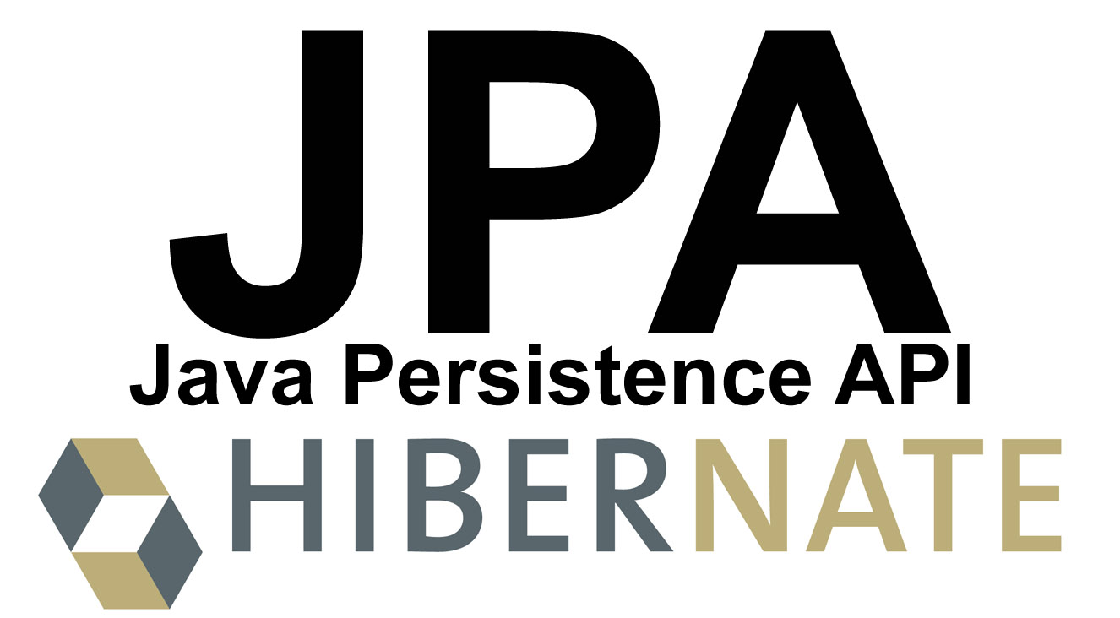
Hibernate

Slide 73
JPA
Java Persistence API is a collection of classes and methods to persistently store the vast amounts of data into a database which is provided by the Oracle Corporation.

Slide 74
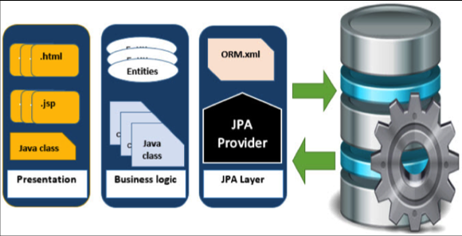
Where to use JPA
To reduce the burden of writing codes for relational object management, a programmer follows the ‘JPA Provider’ framework, which allows easy interaction with database instance.
Here the required framework is taken over by JPA.

Slide 75
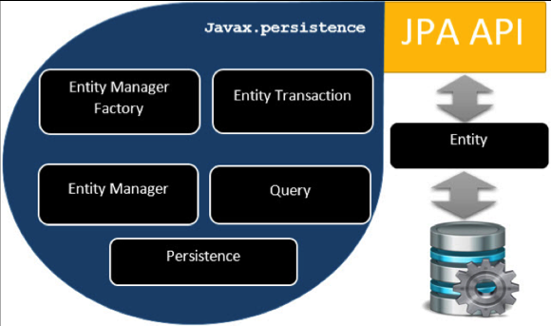
JPA - Architecture
Java Persistence API is a source to store business entities as relational entities.
It shows how to define a PLAIN OLD JAVA OBJECT (POJO) as an entity and how to manage entities with relations.

Slide 76
Object Relational Mapping
Object Relational Mapping (ORM) briefly tells you about what is ORM and how it works.
ORM is a programming ability to covert data from object type to relational type and vice versa.
The main feature of ORM is mapping or binding an object to its data in the database.
While mapping we have to consider the data, type of data and its relations with its self-entity or entity in any other table.

Slide 77
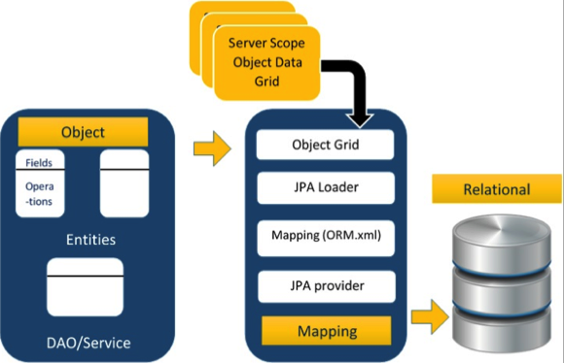
ORM Architecture
The first phase, named as the Object data phase contains POJO classes, service interfaces and classes.
It is the main business component layer, which has business logic operations and attributes.
The second phase named as mapping or persistence phase which contains JPA provider, mapping file (ORM.xml), JPA Loader, and Object Grid.

Slide 78
Mapping.xml
The mapping.xml file is to instruct the JPA vendor for mapping the Entity classes with database tables.
<entity-mappings> : tag defines the schema definition to allow entity tags into xml file.
<entity> : tag defines the entity class which you want to convert into table in a database. Attribute class defines the POJO entity class name.
<id> : tag defines the primary key of the table.
The <generated-value> tag defines how to assign the primary key value such as Automatic, Manual, or taken from Sequence.

Slide 79
Hibernate Annotations
We have seen how Hibernate uses XML mapping file for the transformation of data from POJO to database tables and vice versa.
Hibernate annotations are the newest way to define mappings without the use of XML file.
You can use annotations in addition to or as a replacement of XML mapping metadata.
Hibernate Annotations is the powerful way to provide the metadata for the Object and Relational Table mapping.
All the metadata is clubbed into the POJO java file along with the code.
If you want greater flexibility, then you should go with XML-based mappings.

Slide 80
Environment Setup for Hibernate Annotation
JDK 1.5 & above
hibernate-annotations.jar,
hibernate-comons-annotations.jar
ejb3-persistence.jar

Slide 81
Hibernate using Annotation
The hibernate application can be created with annotation.
There are many annotations that can be used to create hibernate application such as @Entity, @Id, @Table etc.
Hibernate Annotations are based on the JPA 2 specification and supports all the features.
All the JPA annotations are defined in the javax.persistence package.
Hibernate EntityManager implements the interfaces and life cycle defined by the JPA specification.
The core advantage of using hibernate annotation is that you don't need to create mapping (hbm) file.
Here, hibernate annotations are used to provide the meta data.

Slide 82
Annotations in Hibernate
@Entity Annotation- Marks a class as an entity bean, so it must have a no-argument constructor that is visible with at least protected scope.
@Table Annotation – It allows you to specify the details of the table that will be used to persist the entity in the database.
@Id - Each entity bean will have a primary key, which you annotate on the class with the @Id annotation. The primary key can be a single field or a combination of multiple fields depending on your table structure.
@GeneratedValue - which takes two parameters strategy and generator type.
@Column Annotation - is used to specify the details of the column to which a field or property will be mapped.

Slide 83
Persistence class
import javax.persistence.Entity;
import javax.persistence.Id;
import javax.persistence.Table;
@Entity
@Table(name= "emp500")
public class Employee {
@Id
private int id;
private String firstName,lastName;

Slide 84
hibernate.cfg.xml
The hibernate.cfg.xml file should have <mapping class>.
<hibernate-configuration>
<session-factory>
<property name="hbm2ddl.auto">update</property>
<property name="dialect">org.hibernate.dialect.Oracle9Dialect</property>
<property name="connection.url">jdbc:oracle:thin:@localhost:1521:xe</property>
<property name="connection.username">system</property>
<property name="connection.password">tiger</property>
<property name="connection.driver_class">oracle.jdbc.driver.OracleDriver</property>
<mapping class="com.lti.HiberAnnotations.Employee"/>
</session-factory>
</hibernate-configuration>

Slide 85
Hibernate 5
Hibernate 5 is the major release of Hibernate framework, which provides the support for JDK 8 and Special database.
Hibernate provides the JPA(Java Persistence) support for NoSQL databases. It supports - MongoDB(Fongo)
Bootstrap comes with release of Hibernate ORM.
New bootstrap mechanism of the Hibernate SessionFactory has been introduced with many features.
Although method of creating SessionFactory used in Hibernate 4 is still compatible.
Java 8 Support
Significant performance improvements

Slide 86
Hibernate 5 Session Factory
SessionFactory plays a major role in Hibernate framework and takes the responsibility to provide session object to the client program in thread safe way.
SessionFactory is heavy weight object and it is usually initialized at the start-up of the application.
SessionFactory uses the information defined in the hibernate.cfg.xml file bootstrap Hibernate ORM environment.
SessionFactory provides the Session object to Java program in thread safe way.

Slide 87
Package org.hibernate.boot
This package contains the contracts that make up the Hibernate native bootstrapping API (building a SessionFactory).

Slide 88
StandardServiceRegistry Class
In Hibernate 5 StandardServiceRegistry class is used to create SessioFactory Object.
Configuration configuration = new Configuration();
configuration.configure("hibernate.cfg.xml");
SessionFactory factory = configuration.buildSessionFactory(new StandardServiceRegistryBuilder().configure().build());
Session sess= factory.openSession();
Transaction tx = sess.getTransaction();
tx.begin();

Slide 89
Hibernate in Web Application
Use JSP for presentation logic.
Bean class for representing data and DAO class for database codes.
Insert the record of the user in the database.
index.jsp
This page gets input from the user and sends it to the register.jsp file using post method.
<form action="register.jsp" method="post">
Name:<input type="text" name="name"/><br><br/>
Password:<input type="password" name="password"/><br><br/>
Email ID:<input type="text" name="email"/><br><br/>
<input type="submit" value="register"/>"
</form>

Slide 90
Hibernate in Web Application- register.jsp
This file gets all request parameters and stores this information into an object of User class. Further, it calls the register method of UserDao class passing the User class object.
<%@page import="com.csc.hibernate"%>
<jsp:useBean id="obj" class="com.csc.hibernate.User">
</jsp:useBean>
<jsp:setProperty property="*" name="obj"/>
<%
int i=UserDao.register(obj);
if(i>0)
out.print("You are successfully registered");
%>

Slide 91
Hibernate in Web Application- User.java
It is the simple bean class representing the Persistent class in hibernate.
package com.csc.hibernate;
public class User {
private int id;
private String name,password,email;
//getters and setters
}

Slide 92
Hibernate in Web Application- user.hbm.xml
It maps the User class with the table of the database.
<?xml version='1.0' encoding='UTF-8'?>
<!DOCTYPE hibernate-mapping PUBLIC
"-//Hibernate/Hibernate Mapping DTD 3.0//EN"
"http://hibernate.sourceforge.net/hibernate-mapping-3.0.dtd">
<hibernate-mapping>
<class name="com.csc.hibernate.User" table=“emp100">
<id name="id">
<generator class="increment"></generator>
</id>
<property name="name"></property>
<property name="password"></property>
<property name="email"></property>
</class>
</hibernate-mapping>

Slide 93
Hibernate in Web Application- UserDao.java
A Dao class, containing method to store the instance of User class.
package com.com.hibernate;
import org.hibernate.Session;
import org.hibernate.Transaction;
import org.hibernate.cfg.Configuration;
public class UserDao {
public static int register(User u){
int i=0;
Session session=new Configuration().
configure().buildSessionFactory().openSession();
Transaction t=session.beginTransaction();
t.begin();
i=(Integer)session.save(u);
t.commit();
session.close();
return i; } }

Slide 94
Hibernate in Web Application- hibernate.cfg.xml
It is a configuration file, containing informations about the database and mapping file.
<?xml version='1.0' encoding='UTF-8'?>
<!DOCTYPE hibernate-configuration PUBLIC
"-//Hibernate/Hibernate Configuration DTD 3.0//EN"
"http://hibernate.sourceforge.net/hibernate-configuration-3.0.dtd">
<hibernate-configuration>
<session-factory>
<property name="dialect">org.hibernate.dialect.OracleDialect</property>
<property name="connection.url">jdbc:oracle:thin:@localhost:1521:orcl</property>
<property name="connection.username">system</property>
<property name="connection.password">oracle</property>
<property name="connection.driver_class">oracle.jdbc.driver.OracleDriver</property <mapping resource="user.hbm.xml"/>
</session-factory>
</hibernate-configuration>

Slide 95
THE END

