Slide 1


Introduction to Java EE (J2EE)

Slide 2
Session Objectives
Understanding the value propositions of J2EE
Getting a big picture of J2EE architecture and platform
Getting high-level exposure of APIs and Technologies that constitute J2EE
●
●
●
−
You don't have to understand the details
●
Understanding why J2EE is a great platform for development and deployment of web services

Slide 3
Agenda
●
What is J2EE?
Evolution of Enterprise Application Development Frameworks
Why J2EE?
J2EE Platform Architecture J2EE APIs and Technologies
Standard Impl (J2EE 1.4), Compatibility Test Suite (CTS)
BluePrints
J2EE and Web Services How to get started
●
●
●
●
●
●
●
●

Slide 4
What is J2EE?

Slide 5

Enterprise Computing
Challenges
Portability
Diverse Environments
Time-to-market Core Competence Assembly Integration
Key Technologies
J2SE™ J2EE™
JMS
Servlet JSP
Connector XML
Data Binding
XSLT
Products App Servers Web Servers Components Databases
Object to DB tools
Legacy Systems
Databases TP Monitors EIS Systems
Notes:
Transaction Processing Monitor
executive information system (EIS), also known as an executive support system(ESS), is a type of management information system that facilitates and supports senior executive information and decision-making needs.

Slide 6
What Is the J2EE?
Open and standard based platform for
developing, deploying and managing
n-tier, Web-enabled, server-centric, and component-based enterprise applications

Slide 7

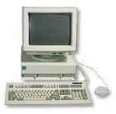
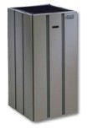


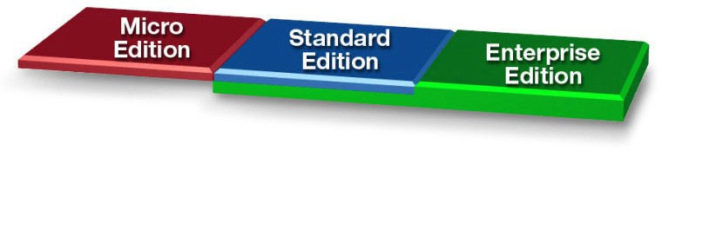
The Java™ Platform
Java Technology Enabled Devices
Java Technology Enabled Desktop
Workgroup Server
High-End Server
7

Slide 8
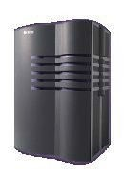
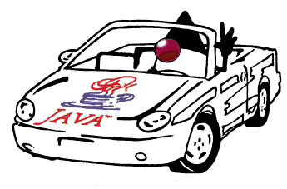

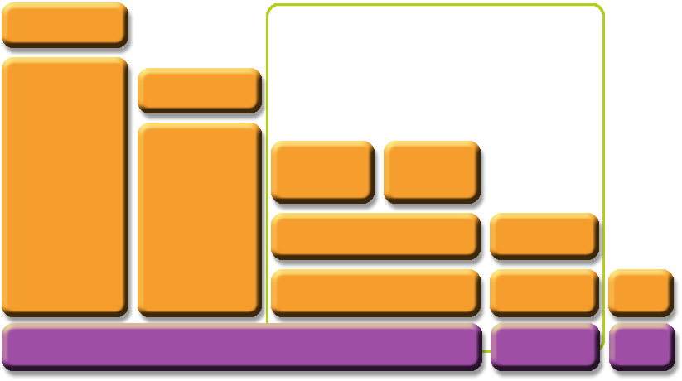





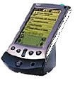
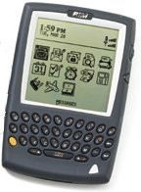
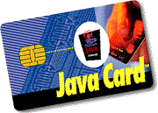
The JavaTM Platform
Java 2 Platform Micro Edition (J2METM)
Optional Packages
Optional Packages
Personal Basis Profile
Personal Profile
Java 2 Enterprise Edition (J2EE)
Java 2 Standard Edition (J2SE)
Foundation Profile
MIDP
CDC
CLDC
Java Card APIs
JVM
KVM
CardVM
Notes:
Connected Device Configuration and Connected Limited Device Configuration.
Connected Limited Device Configuration
K Virtual Machine

Slide 9
What Makes Up J2EE?
●
API and Technology specifications Development and Deployment Platform
Standard and production-quality implementation
Compatibility Test Suite (CTS) J2EE brand
J2EE Blueprints Sample codes
●
●
●
●
●
●

Slide 10
Evolution of Enterprise Application Frameworks

Slide 11
Evolution of Enterprise Application Framework
●
Single tier Two tier Three tier
●
●
−
−
RPC based
Remote object based
●
Three tier (HTML browser and Web server) Proprietary application server
Standard application server
●
●

Slide 12
About Enterprise Applications
●
Things that make up an enterprise application
−
−
−
−
Presentation logic Business logic
Data access logic (and data model) System services
●
The evolution of enterprise application framework reflects
−
−
How flexibly you want to make changes Where the system services are coming from

Slide 13
Application Architecture
Software Application Components
Types of Architecture
-Presentation Logic
-Application Logic
-Data Access Logic
-One-Tier
-Two-Tier
-Three-Tier
Presentation
Business
Presentation
Data Access
Business
Data Access

Slide 14

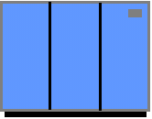
Single Tier (Mainframe-based)
●
Dumb terminals are directly connected to mainframe
Centralized model (as opposed distributed model)
Presentation, business logic, and data access are intertwined in one monolithic mainframe application
●
●

Slide 15
Single-Tier: Pros & Cons
●
Pros:
−
−
No client side management is required Data consistency is easy to achieve
●
Cons:
−
Functionality (presentation, data model, business logic) intertwined, difficult for updates and maintenance and code reuse

Slide 16

Two-Tier
SQL
request
Database
SQL
response
●
Fat clients talking to back end database
−
SQL queries sent, raw data returned
●
Presentation,Business logic and Data Model processing logic in client application

Slide 17
Two-Tier
●
Pro:
−
DB product independence (compared to single-tier model)
●
Cons:
−
Presentation, data model, business logic are intertwined (at client side), difficult for updates and maintenance
Data Model is “tightly coupled” to every client: If DB Schema changes, all clients break
Updates have to be deployed to all clients making System maintenance nightmare
DB connection for every client, thus difficult to scale
Raw data transferred to client for processing causes high network traffic
−
−
−
−

Slide 18

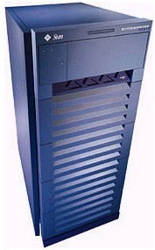

Three-Tier (RPC based)
SQL
request
RPC request
RPC response
SQL
response
Database
●
Thinner client: business & data model separated from presentation
Business logic and data access logic reside in middle tier server while client handles presentation
Middle tier server is now required to handle system services
−
●
−
Concurrency control, threading, transaction, security,
persistence, multiplexing, performance, etc.
17

Slide 19
Three-tier (RPC based): Pros & Cons
●
Pro:
−
Business logic can change more flexibly than 2- tier model
●
Most business logic reside in the middle-tier server
●
Cons:
−
−
Complexity is introduced in the middle-tier server
Client and middle-tier server is more tightly- coupled (than the three-tier object based model)
Code is not really reusable (compared to object model based)
18
−

Slide 20
Three-Tier (Remote Object based)
Object request
SQL
request
SQL
response
Object response
Database
●
Business logic and data model captured in objects
– Business logic and data model are now described in “abstraction” (interface language)
Object models used: CORBA, RMI, DCOM
●
−
−
Interface language in CORBA is IDL Interface language in RMI is Java interface
19

Slide 21
Three-tier (Remote Object based): Pros & Cons
●
Pro:
−
−
More loosely coupled than RPC model Code could be more reusable
●
Cons:
−
Complexity in the middle-tier still need to be addressed

Slide 22
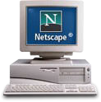
Three-Tier (Web Server)
WEB
Server
SQL
request
HTML request
HTML response
SQL
response
Database
●
Browser handles presentation logic Browser talks Web server via HTTP protocol
Business logic and data model are handled by “dynamic contents generation” technologies (CGI, Servlet/JSP, ASP)
●
●

Slide 23
Web Application Architecture
Web Applications use Three-tier architecture
Data Tier
Database
Business Tier
Web Server
Presentation Tier
Clients

Slide 24
Three-tier (Web Server based): Pros & Cons
●
Pro:
−
−
−
Ubiquitous client types Zero client management
Support various client devices
●
J2ME-enabled cell-phones
●
Cons:
−
Complexity in the middle-tier still need to be addressed

Slide 25
Trends
●
Moving from single-tier or two-tier to multi- tier architecture
Moving from monolithic model to object- based application model
Moving from application-based client to HTML-based client
●
●

Slide 26

Single-tier vs. Multi-tier
Single tier
Multi-tier
●
No separation among presentation, business logic, database
Hard to maintain
●
Separation among presentation, business logic, database
More flexible to change, i.e. presentation can change without affecting other tiers
●
●

Slide 27
Monolithic vs. Object-based
Monolithic
Object-based
●
1 Binary file Recompiled, relinked, redeployed every time there is a change
●
Pluggable parts Reusable Enables better design
Easier update Implementation can be separated from interface Only interface is published
●
●
●
●
●
●

Slide 28
Outstanding Issues & Solution
Complexity at the middle tier server still remains
Duplicate system services still need to be provided for the majority of enterprise applications
●
●
−
−
−
Concurrency control, Transactions Load-balancing, Security
Resource management, Connection pooling
●
How to solve this problem?
−
Commonly shared container that handles the above system services
Proprietary versus Open-standard based
−

Slide 29
Proprietary Solution
●
Use "component and container" model
−
−
Components captures business logic Container provides system services
●
The contract between components and container is defined in a well-defined but with proprietary manner
Problem of proprietary solution: Vendor lock-in
Example: Tuxedo, .NET
●
●

Slide 30
Open and Standard Solution
Use "component and container" model in which container provides system services in a well-defined and as industry standard
J2EE is that standard that also provides portability of code because it is based on Java technology and standard-based Java programming APIs
●
●

Slide 31
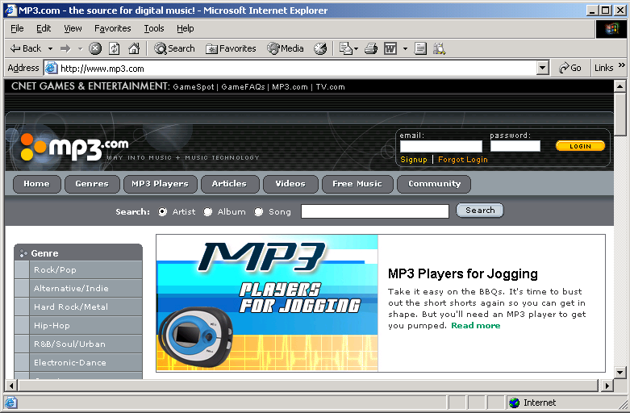
Web Applications 2-1
www.mp3.com
Web Site hosted on a Web Server

Slide 32
Web Applications 2-2
User requests a song
Web Application
www.mp3.com
Song is played in response
Web Application running on a Web Server
Advantages of Web Applications:
Accessing Web Applications is easier
Maintenance and deployment costs are low

Slide 33
HTTP Protocol 3-1
HyperText Transfer Protocol
Stateless protocol
Used to send request and response messages over the Internet.
Uses port 80 to send and receive messages
HTTP
GET
image/bar01.jpg
HTTP/1.1
HTTP/1.1 200 OK
Get File
File Received

Slide 34
HTTP Protocol 3-2
Request Message
HTTP messages consist of:
Request
Response
Headers
Request Line
Method
Resource Name
Version
GET/POST
bar01.jpg
HTTP/1.1
Header Information
Browser Type
Content Type
User-Agent: Mozilla/4.0 (Compatible; MSIE 4.0 : Windows 7
Accept: image/gif, image/jpeg, text/*, */*
Response Message
Status Line
Version
Status Code
Description
HTTP/1.1
200
OK
Header Information
Server
Software
Modified
Date
Size
(bytes)
Content
Type
Server: JavaWebServer
Last modified: Tuesday, 07-Sep-14 1:14:34 GMT
Content-length: 100
Content-type: text/plain

Slide 35
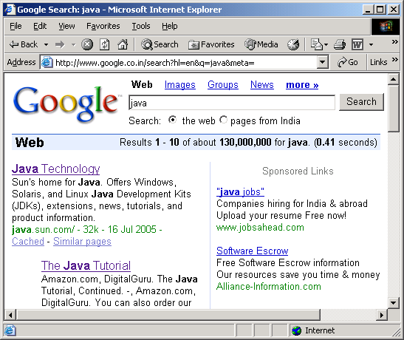
HTTP Protocol 3-3
HTTP protocol uses the following methods to send
request messages:
GET Method
POST Method
query string
(240-255 characters)
GET Method
Used for retrieving information such as document, charts, or database query results.
Requested pages can be bookmarked and emailed.
Request information is sent as query string
POST Method
Used to send sensitive information such as credit card numbers or information to be saved in the database.
Requested pages cannot be bookmarked or emailed.
No size limit on information being sent

Slide 36
Why J2EE?

Slide 37
Platform Value to Developers
Can use any J2EE implementation for development and deployment
Use production-quality standard implementation which is free for development/deployment
Use high-end commercial J2EE products for scalability and fault-tolerance
●
−
−
●
Vast amount of J2EE community resources
Many J2EE related books, articles, tutorials, quality code you can use, best practice guidelines, design patterns etc.
Can use off-the-shelf 3rd-party business components
−
●

Slide 38
Platform Value to Vendors
●
Vendors work together on specifications and then compete in implementations
In the areas of Scalability, Performance, Reliability, Availability, Management and development tools, and so on
Freedom to innovate while maintaining the portability of applications
Do not have create/maintain their own proprietary APIs
−
●
●

Slide 39
Platform Value to Business Customers
Application portability
Many implementation choices are possible based on various requirements
●
●
−
Price (free to high-end), scalability (single CPU to clustered model), reliability, performance, tools, and more
Best of breed of applications and platforms
−
●
Large developer pool

Slide 40
J2EE APIs &
Technologies

Slide 41
J2EE 1.4 APIs and Technologies
J2SE 1.4 (improved) JAX-RPC (new)
Web Service for J2EE
J2EE Management J2EE Deployment JMX 1.1
JMS 1.1
JTA 1.0
●
Servlet 2.4
JSP 2.0
EJB 2.1 JAXR
Connector 1.5 JACC
JAXP 1.2
JavaMail 1.3
JAF 1.0
●
●
●
●
●
●
●
●
●
●
●
●
●
●
●
●

Slide 42
Java EE 5
●
JAX-WS 2.0 & JSR 181
Java Persistence
●
EJB 3.0
JAXB 2.0
JavaSever Faces 1.2 – new to Platform JSP 2.1 – Unification w/ JSF 1.2
StAX – Pull Parser – new to Platform
●
●
●
●

Slide 43
JAVA EE 6
Java API for RESTful Web Services (JAX-RS)
Managed Beans
Contexts and Dependency Injection for the Java EE Platform (JSR 299), informally known as CDI
Dependency Injection for Java (JSR 330)
Bean Validation (JSR 303)
Java Authentication Service Provider Interface for Containers (JASPIC)

Slide 44
Servlet &
JSP (JavaServer Pages)

Slide 45
What is a Servlet?
Java™ objects which extend the functionality of a HTTP server
Dynamic contents generation
Better alternative to CGI, NSAPI, ISAPI, etc.
●
●
●
−
−
−
−
Efficient
Platform and server independent Session management
Java-based

Slide 46
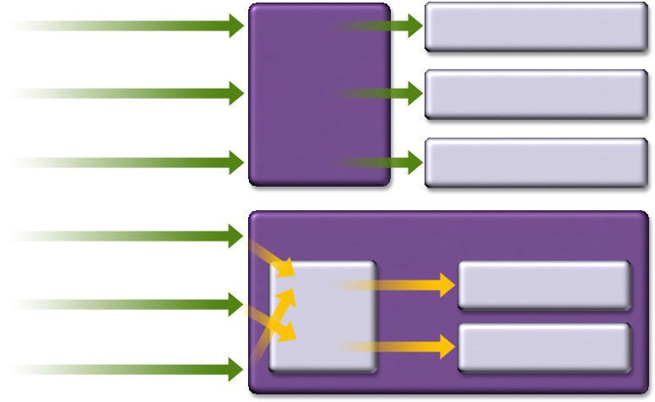
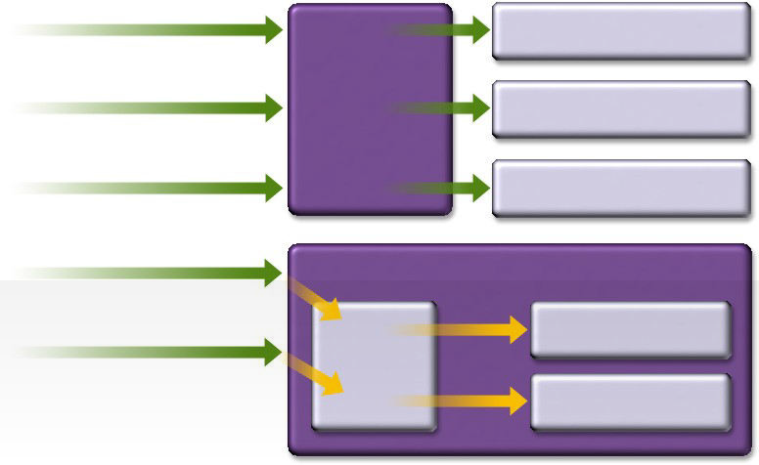
Servlet vs. CGI
Request CGI1
Request CGI1
Child for CGI1
Request CGI2 ^{CGI}
Based Child for CGI2
Webserver
Request CGI1
Child for CGI1
^{Request Servlet1} Servlet Based Webserver
Request Servlet2 Servlet1
JVM
Servlet2
Request CGI1
Child for CGI1
CGI
Based Webserver
Request CGI1
Child for CGI1
CGI
Based Webserver
Servlet Based Webserver
JVM
Request CGI1
Child for CGI1
Request CGI2 ^{CGI}
Based Child for CGI2
Webserver
^{Request Servlet1} Servlet Based Webserver
Request Servlet2 Servlet1
JVM
Servlet2
Request CGI1
Child for CGI1
CGI
Based Webserver
^{Request Servlet1} Servlet Based Webserver
Servlet1
JVM
Request CGI1
Child for CGI1
Request CGI2 ^{CGI}
Based Child for CGI2
Webserver
^{Request Servlet1} Servlet Based Webserver
Servlet1
JVM
CGI
Based Webserver
Child for CGI1
Request CGI2
CGI
Based Webserver
Child for CGI2
Request CGI1
Child for CGI1
Request Servlet1
Servlet Based Webserver
Request Servlet2
Servlet1
JVM
Request Servlet1
Servlet2

Slide 47
What is JSP Technology?
●
Enables separation of business logic from presentation
−
Presentation is in the form of HTML or XML/XSLT
Business logic is implemented as Java Beans or custom tags
Better maintainability, reusability
−
−
●
Extensible via custom tags Builds on Servlet technology
●

Slide 48
EJB
(Enterprise Java Beans)

Slide 49
What is EJB Technology?
●
A server-side component technology
Easy development and deployment of Java technology-based application that are:
●
−
Transactional, distributed, multi-tier, portable, scalable, secure, …

Slide 50
Why EJB Technology?
●
Leverages the benefits of component-model on the server side
Separates business logic from system code
●
−
Container provides system services
●
Provides framework for portable components
−
−
Over different J2EE-compliant servers Over different operational environments
●
Enables deployment-time configuration
−
Deployment descriptor

Slide 51
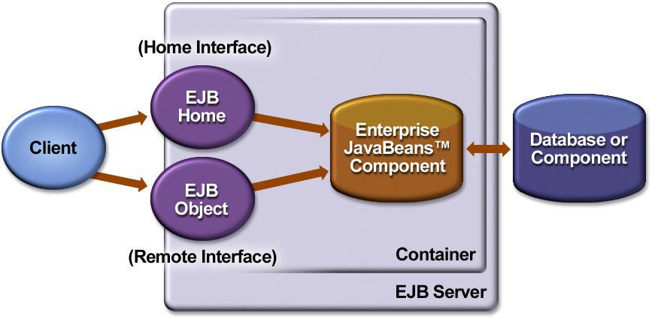
EJB Architecture

Slide 52
Enterprise JavaBeans
Enterprise JavaBeans
Synchronous communication
Session Bean Entity Bean
Asynchronous communication
Message-Driven Bean
Stateless
Stateful
Bean managed Persistence (BMP)
Container managed Persistence
(CMP)

Slide 53
JMS
(Java Message Service)

Slide 54
Java Message Service (JMS)
●
Messaging systems (MOM) provide
−
−
−
De-coupled communication Asynchronous communication Plays a role of centralized post office
●
Benefits of Messaging systems
Flexible, Reliable, Scalable communication systems
Point-to-Point, Publish and Subscribe
JMS defines standard Java APIs to messaging systems
−
●
●

Slide 55
Connector Architecture

Slide 56
Connector Architecture
●
Defines standard API for integrating J2EE technology with EIS systems
−
CICS, SAP, PeopleSoft, etc.
●
Before Connector architecture, each App server has to provide an proprietary adaptor for each EIS system
−
m (# of App servers) x n (# of EIS's) Adaptors
●
With Connector architecture, same adaptor works with all J2EE compliant containers
−
1 (common to all App servers) x n (# of EIS's) Adaptors

Slide 57
m x n Problem Before Connector Architecture
m n
App
SAP
Server1
App
Server2
EIS 2
App
EIS3
Server3
App
EIS4
Server

Slide 58
JAAS (Part of J2SE 1.4)
(Java Authentication & Authorization Service)

Slide 59
JAAS: Authentication
●
Pluggable authentication framework
−
−
−
−
Userid/password Smartcard Kerberos Biometric
●
Application portability regardless of authentication schemes underneath
−
JAAS provides authentication scheme independent API
Authentication schemes are specified Login configuration file, which will be read by JAAS
−
51

Slide 60
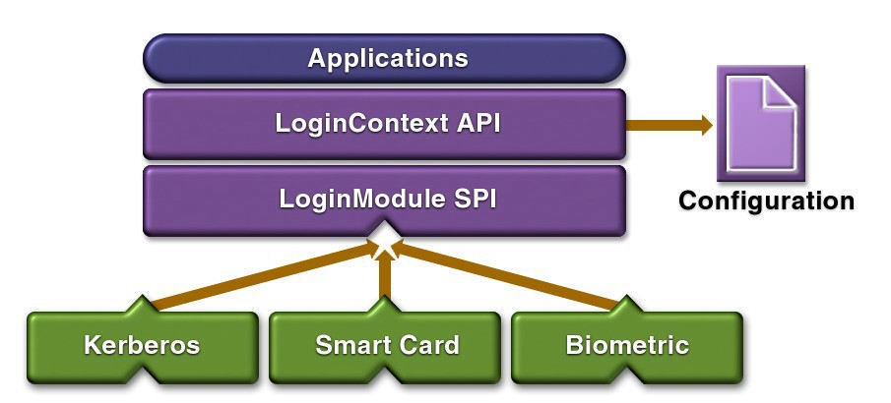
JAAS Pluggable Authentication

Slide 61
JAAS: Authorization
●
Without JAAS, Java platform security are based on
−
−
Where the code originated Who signed the code
●
The JAAS API augments this with
−
Who’s running the code
●
User-based authorization is now possible

Slide 62
Other J2EE APIs & Technologies

Slide 63
JNDI
●
Java Naming and Directory Interface
Utilized by J2EE applications to locate resources and objects in portable fashion
●
−
Applications use symbolic names to find object references to resources via JNDI
The symbolic names and object references have to be configured by system administrator when the application is deployed.
−

Slide 64
JDBC
●
Provides standard Java programming API to relational database
−
Uses SQL
●
Vendors provide JDBC compliant driver which can be invoked via standard Java programming API

Slide 65
J2EE Management (JSR-77)
●
Management applications should be able to discover and interpret the managed data of any J2EE platform
Single management platform can manage multiple J2EE servers from different vendors
Management protocol specifications ensure a uniform view by SNMP and WBEM management stations
Leverages JMX
●
●
●

Slide 66



J2EE Deployment (JSR-88) - J2EE 1.4
Tools
J2EE Platforms
Standard Deployment API (Universal Remote)
IDEs
Vendor Deploy Tools
Management Tools

Slide 67
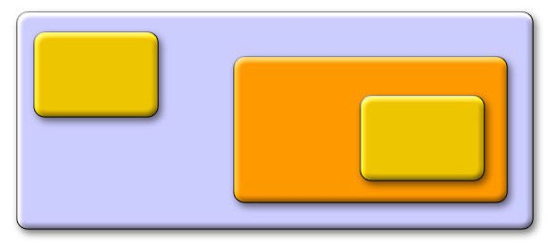
JMX
JMX API into
the J2EE 1.4 platform
Dynamic Deployment
JMX
JMX
App
J2EE App Server
JMX defacto
A single technology for the J2EE platform
Notes:
Java Management Extensions (JMX) was introduced in J2SE 5.0 release. It provides an architecture to manage resources dynamically at runtime. JMX is used mostly in enterprise applications to make the system configurable or to get the state of application at any point of time.

Slide 68
JACC (Java Authorization Contract for Containers) - J2EE 1.4
●
Defines contract between J2EE containers and authorization policy modules
−
Provider configuration subcontract Policy configuration subcontract Policy enforcement subcontract
−
−
●
Enable application servers to integrate with enterprise user registries and authorization policy infrastructure

Slide 69
J2EE is an End-to-End Architecture

Slide 70
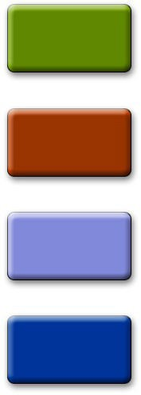
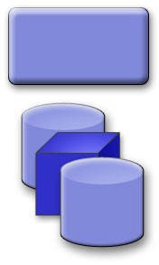
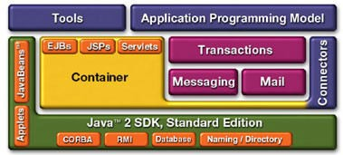
The J2EE Platform Architecture
B2B
Applications
Existing Applications
B2C
Applications
Web Services
Application Server
Wireless Applications
Enterprise Information Systems

Slide 71
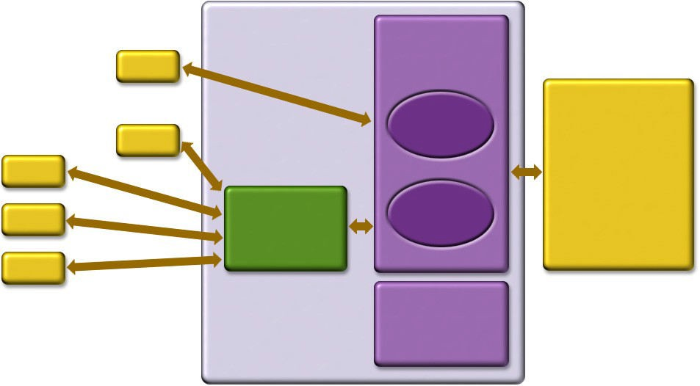
J2EE is End-to-End Solution
Firewall
J2EE
Application Server
Client
Enterprise Information Systems (EIS):
Relational Database,
Legacy Applications,
ERP Systems
Enterprise JavaBeans™
Client
Client
Web Server JSP,
Servlets
Enterprise JavaBeans
Client
Client
HTML/XML
Other Services: JNDI, JMS,
JavaMail™
Enterprise Information
Tier
Client Tier
Middle Tier

Slide 72
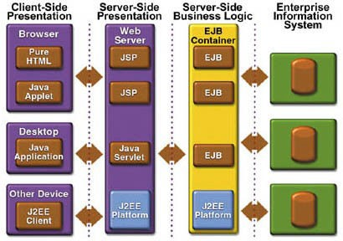
N-tier J2EE Architecture
Web Tier
EJB Tier

Slide 73
J2EE
Component & Container Architecture

Slide 74
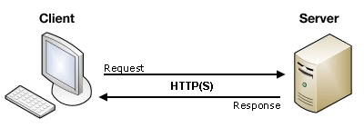
J2EE CONTAINERS
Server is a device or a computer program that accepts and responds to the request made by other program, known as client.
It is used to manage the network resources and for running the program or software that provides services.
The application server which control and provide services through an interface is known as a container.
J2EE container helps in deployment and execution of J2EE component.

Slide 75
J2EE CONTAINERS - TYPES
In J2EE specification we can classify container types as five.
Three of these are server-side containers:
The server, which provides the J2EE runtime environment.
An EJB container that manage EJB components.
A Web container that manage servlets and JavaServer Pages.
The other two container are client-side:
An application container for standalone GUIs, console, and batch-type programs — the familiar Java applications started with the java command.
An applet container, meaning a browser, usually with the Java Plug-in.

Slide 76
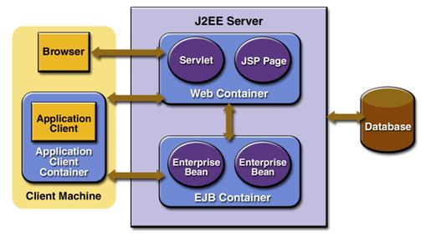
J2EE CONTAINERS
J2EE server: The runtime portion of a J2EE product. It provides EJB and Web containers.
Applet container: It is a mixture of web browser and java plug in on client machine .
Client container : To host application components, application clients, the application client container is used.
Web Container: A Web application runs within a Web container of a Web server which is also known as servlet container.
EJB Container: It provides a run-time environment for enterprise beans within the application server.

Slide 77
Containers and Components
67
Containers Handle
Concurrency Security Availability Scalability Persistence Transaction
Life-cycle management Management
Components Handle
Presentation Business Logic
●
●
●
●
●
●
●
●
●
●

Slide 78
Containers & Components
●
Containers do their work invisibly
No complicated APIs
They control by interposition
Containers implement J2EE
Look the same to components
Vendors making the containers have great freedom to innovate
●

Slide 79
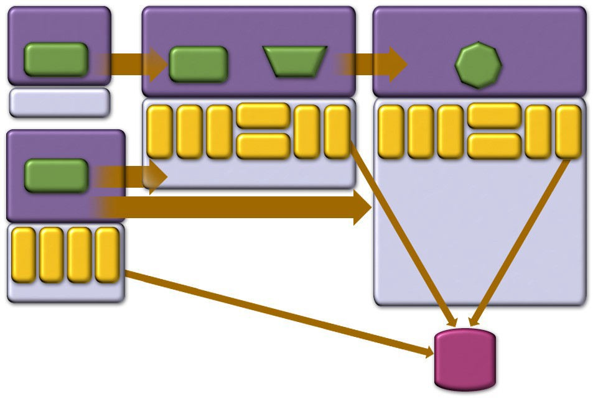
J2EE Containers & Components
Applet Container
Web Container
EJB Container
Applet
HTTP/ HTTPS
JSP
Servlet
RMI
EJB
J2SE
RMI/IIOP
JavaMail
RMI/IIOP
JNDI JMS
JTA
JavaMail
JDBC
JNDI
JMS
JDBC
JTA
App Client Container
App Client
JAF
JAF
HTTP/ HTTPS
J2SE
RMI
RMI/IIOP
JDBC
JNDI JMS
J2SE
J2SE
66
Database

Slide 80

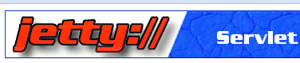


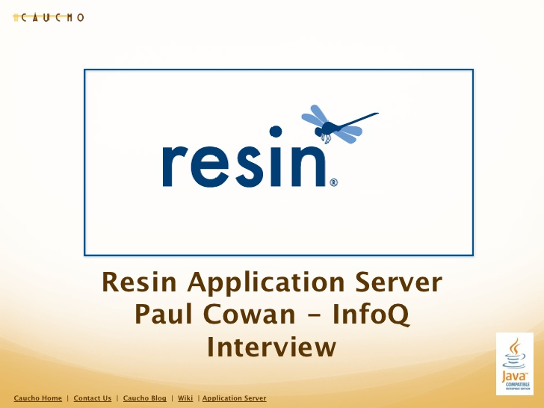
Web Server
Web server contains only web or servlet container.
It can be used for servlet, jsp, struts, jsf etc.
It can't be used for EJB.
It is a computer where the web content can be stored.
In general web server can be used to host the web sites.
It is also used some other web servers also such as FTP, email, storage, gaming etc.
PHP
CGI

Slide 81
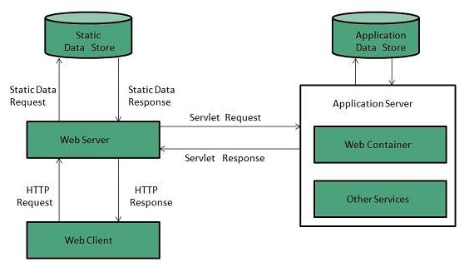
Web Server Working
It can respond to the client request in either of the following two possible ways:
Generating response by using the script and communicating with database.
Sending file to the client associated with the requested URL.

Slide 82
Web Server Working
If the requested web page at the client side is not found, then web server will sends the HTTP response: Error 404 Not found.
When the web server searching the requested page if requested page is found then it will send to the client with an HTTP response.
If the client requests some other resources then web server will contact to application server and data is store for constructing the HTTP response.

Slide 83
Application Server
It contains Web and EJB containers.
It can be used for servlet, jsp, struts, jsf, ejb etc.
It is a component based product that lies in the middle-tier of a server centric architecture.
It provides the middleware services for state maintenance and security, along with persistence and data access.
It is a type of server designed to install, operate and host associated services and applications for the IT services, end users and organizations.

Slide 84
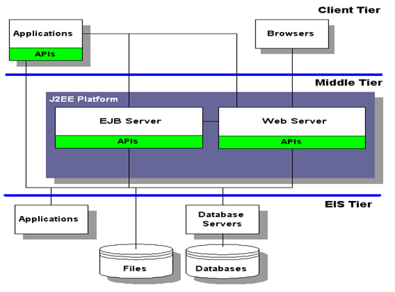
Block diagram of Application Server

Slide 85
Application Servers
Open-source server from JBoss community.
Provided by Sun Microsystem. Now acquired by Oracle.
Provided by IBM.
Provided by Oracle. Its more secured.

Slide 86
J2EE Application Development & Deployment
Life Cycle

Slide 87
J2EE Application Development Lifecycle
Write and compile component code
●
−
Servlet, JSP, EJB
●
Write deployment descriptors for components
−
From Java EE 5, you can use annotations
●
Assemble components into ready-to- deployable package
Deploy the package on a server
Execute web application
●
●

Slide 88
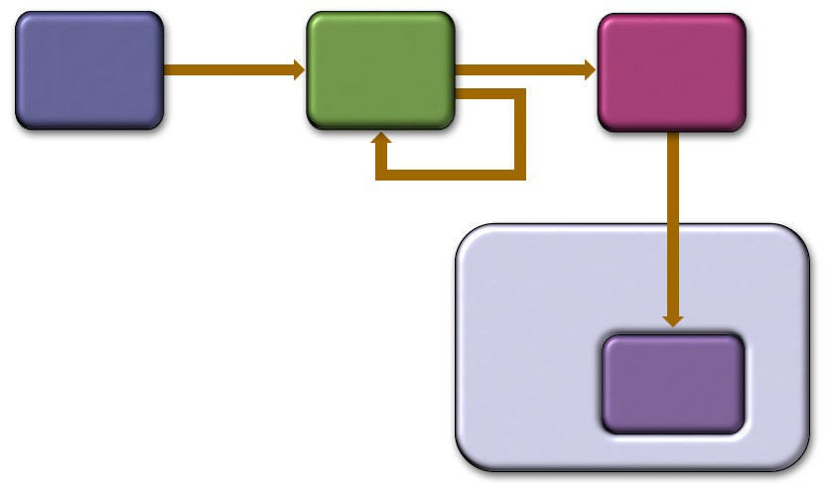
Life-cycle Illustration
Creation Assembly
Deployment
Created by Component Developer
J2EE Modules
Assembled and Augmented by Application Assembler
J2EE APP
Processed by Deployer
Deploy
J2EE Container
Enterprise Components

Slide 89
Web Application Directory Structure
Web Application
HTML files
Images
Servlets
JSP pages
JavaBeans
Jar files
Applets
Tag files
Tag Library Descriptor files
Deployment descriptors
Web Application Directory Structure
Document Root
.war file
Static Files(html, images, JSP)
WEB-INF
index.html, login.jsp, contactus.jsp
ViewBooks.jsp, logo.jpg
book1.jpg
classes
lib
tags
.tld, web.xml
AddBook.class,
DeleteBook.class
mbase.jar,
msqlserver.jar,
msutil.jar
DisplayBook.tag
web.xml, books.tld

Slide 90
J2EE Development Roles
●
Component provider
−
Bean provider
●
Application assembler Deployer
Platform provider
●
●
−
Container provider
●
Tools provider System administrator
●

Slide 91
The Deployment Descriptor
●
Gives the container instructions on how to manage and control behaviors of the J2EE components
Transaction
Security
Persistence
Allows declarative customization (as opposed to programming customization)
●
−
XML file
●
Enables portability of code
73

Slide 92
J2EE Application Anatomies

Slide 93
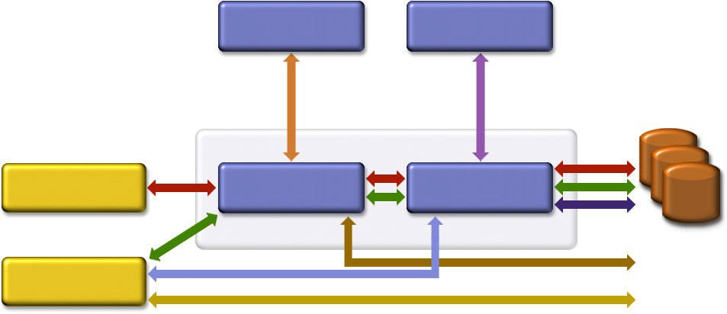
Possible J2EE Application Anatomies
Web Server EJB Server
DB & EIS
Resources
Browser
Web Server
EJB Server
Stand-alone

Slide 94
J2EE Application Anatomies
4-tier J2EE applications
– HTML client, JSP/Servlets, EJB, JDBC/Connector
3-tier J2EE applications
– HTML client, JSP/Servlets, JDBC
3-tier J2EE applications
EJB standalone applications, EJB, JDBC/Connector
B2B Enterprise applications
J2EE platform to J2EE platform through the
●
●
●
●
exchange of JMS or XML-based messages
76

Slide 95
Which One to Use?
●
Depends on several factors
−
Requirements of applications Availability of EJB tier Availability of developer resource
−
−

Slide 96
J2EE 1.4
Standard Implementation, Compatibility Suite, Brand

Slide 97
Standard Implementation
●
Under J2EE 1.4 SDK, it is Sun Java Application Server Platform Edition 8
Production-quality J2EE 1.4 compliant app server
Free to develop and free to deploy
Seamless upgrade path to Sun Java Application Server Enterprise Edition
●
●
●

Slide 98
Compatibility Test Suite (CTS)
●
Ultimate Java™ technology mission:
−
−
Write Once, Run Anywhere™
My Java-based application runs on any compatible Java virtual machines
My J2EE based technology-based application will run on any J2EE based Compatible platforms
−

Slide 99
J2EE Application Verification Kit (J2EE AVK)
●
How can I test my J2EE application portability?
Obtain the J2EE RI 1.3.1 and the J2EE Application Verification Kit (J2EE AVK)
Self verification of application
•
●
−
−
Static verification Dynamic verification
●
Obtain the tests results, verify that all criteria are met

Slide 100

Compatible Products
for the J2EE Platform (Brand)
ATG
Bea Systems Borland Computer
Associates
Fujitsu Hitachi HP IBM
iPlanet Macromedia NEC
Oracle
Pramati SilverStream Sybase Talarian Trifork
IONA

Slide 101
The J2EE Platform “Ecosystem,” Application Servers and…
IDE’s: Borland JBuilder Enterprise, WebGain Visual Cafe’, IBM Visual Age for Java™, Forte™ for Java™, Oracle JDeveloper, Macromedia Kawa
Modeling, Performance, Testing, etc.
●
Tools
−
−
●
Enterprise Integration: Connectors, Java Message Service (JMS) API, XML Components
Frameworks
●
●
●
Applications

Slide 102
Major Investment in Compatibility by the Industry
Sun has spent scores of engineer years developing tests
Licensees have spent scores of engineer years passing the tests
Testing investment on top of specification investment, implementation investment, business investments
In total, tens of millions of dollars invested in J2EE platform compatibility by the industry
●
●
●
●

Slide 103
J2EE Blueprint & Pet Store Application

Slide 104
J2EE Blueprint
●
Best practice guidelines, design patterns and design principles
−
MVC pattern
●
Covers all tiers
−
−
−
−
Client tier Web tier
Business logic (EJB) tier Database access tier
●
Sample codes come with J2EE 1.4 SDK
−
Java Pet Store, Adventure builder

Slide 105
Why J2EE
for Web Services?

Slide 106
Why J2EE for Web Services?
●
Web services is just one of many service delivery channels of J2EE
−
No architectural change is required
Existing J2EE components can be easily exposed as Web services
−
●
Many benefits of J2EE are preserved for Web services
−
Portability, Scalability, Reliability No single-vendor lock-in
−

Slide 107
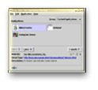
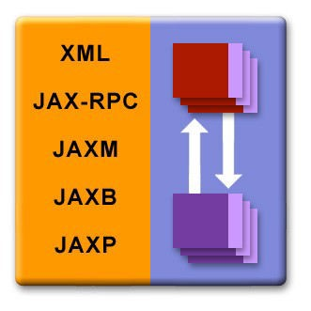





Web Services Model Over J2EE
Rich Clients
J2EE S erver JS P™ / JavaS ervlet API / EJB ™
XMLP /S OAP
JJSSPP
JDB C
DBMS
MIDP
Devices
XMLP /S OAP
XHTML/WM L
JMS
Connectors
EEJJBB
EExxiissttiinngg
AAppppss
HTML/XML
Browsers
XMLP /S OAP
S ervices

Slide 108
Where Are We Now?
●
Java APIs for Web Services are being developed very rapidly
•
Web services support on WUST (WSDL, UDDI, SOAP) ready now
Next layer Web services work in progress
•
●
Tools are available now for exposing existing J2EE components as Web services
J2EE community has defined overall framework for Web Services (J2EE 1.4, Web services for J2EE)
●

Slide 109
Design Goals J2EE 1.4 Web Services Framework
●
Portability of Web services component
−
−
Over different vendor platform
Over different operational environment
●
Leveraging existing J2EE programming models for service implementation
Easy to program and deploy
●
−
−
High-level Java APIs
Use existing deployment model

Slide 110
J2EE 1.4 Web Services Framework
●
J2EE 1.4 (JSR 151)
Web services for J2EE (JSR 109) JAX-RPC (JSR 101)
JAXR (Java API for XML Registries)
SAAJ (SOAP with Attachments API for Java)
EJB 2.1
●
●
●
●
●

Slide 111
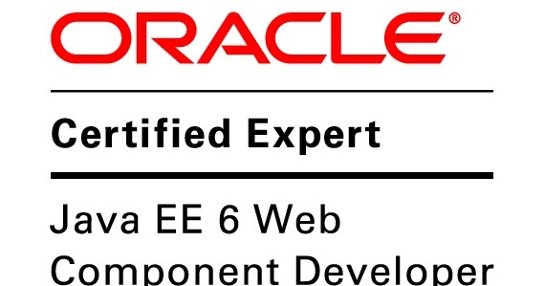
Certifications

Slide 112
How to Get Started

Slide 113
Step1: For Beginners and Intermediate J2EE Programmers
●
Follow along with this course
Start using J2EE IDE of your choice Try open source IDE's
●
●
−
NetBeans IDE 5.0 (netbeans.org)
●
Excellent out of the box J2EE support
We will use NetBeans IDE 5.0 or NetBeans IDE 5.5 as our default IDE in this course
Lots of tutorials
●
●
−
Eclipse

Slide 114
J2EE - IDE
The Best freeware Java IDE Sponsored By Oracle
The Best paid IDE For Java Developers.
The Illustrious open source IDE For Java Developers
A Java IDE Tailored For Android Developers
GreenFoot – The Online Java Instructor And IDE

Slide 115
Step2: Next Step (For Advanced J2EE Programmers)
Spring framework (for light-weight framework) Hibernate (for O/R mapping)
JDO (for transparent persistence)
Struts, WebWork, Tapestry (for Web-tier frameworks)
JUnit (for unit testing) Log4j (for logging)
Many more
●
Learn practical open-source solutions
−
−
−
−
−
−
−

Slide 116
Step3: Next Step (For Advanced J2EE Programmers)
java.sun.com/j2ee www.theserverside.com
www.javapassion.com/j2ee/J2EEresources.html#J2 EEResourceSites
●
There is no shortage of quality J2EE online resources
−
−
−

Slide 117
Summary & Resources

Slide 118
Summary
●
J2EE is the platform of choice for development and deployment of n-tier, web-based, transactional, component- based enterprise applications
J2EE is standard-based architecture J2EE is all about community
J2EE evolves according to the needs of the industry
●
●
●

