Slide 1
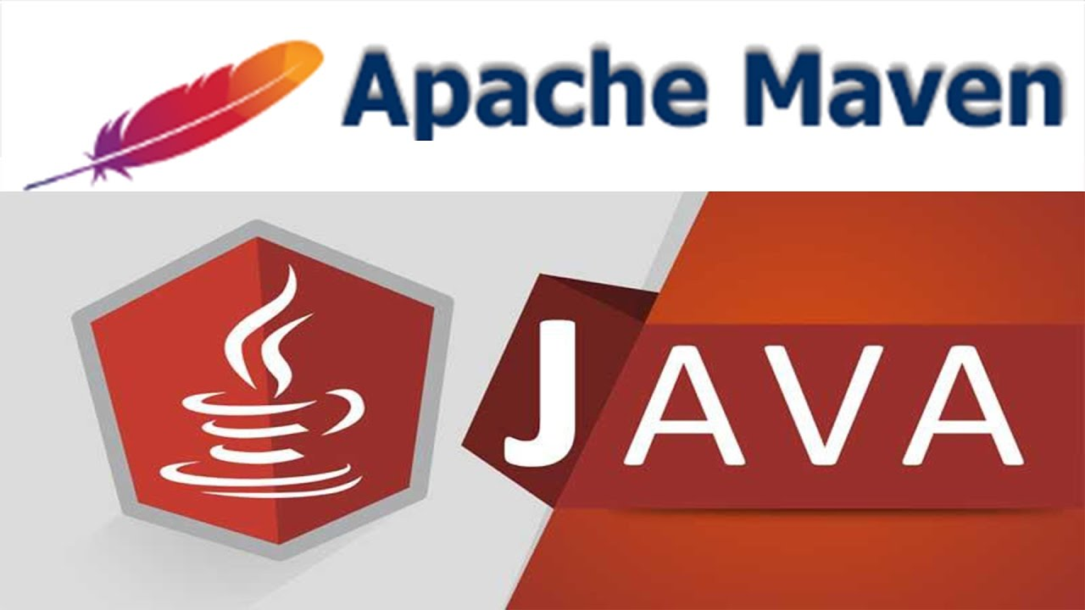

Slide 2
Building a Project
Compiling is the act of turning source code into object code.
Linking is the act of combining object code with libraries into a raw executable.
Building is the sequence composed of compiling and linking, with possibly other tasks such as installer creation.

Slide 3
Build Life Cycle

Slide 4
Building a Project - Process
The "Build" is a process that covers all the steps required to create a "deliverable" of your software. In the Java world, this typically includes:
Generating sources
Compiling sources.
Compiling test sources.
Executing tests (unit tests, integration tests, etc).
Packaging (into jar, war, ejb-jar, ear).
Running health checks (static analyzers like Checkstyle, Findbugs, test coverage, etc).
Generating reports.

Slide 5
Introduction to Building a Software
Building a software project typically consists of such tasks as:
Downloading dependencies,
Putting additional jars on a classpath,
Compiling source code into binary code,
Running tests,
Packaging compiled code into deployable artifacts such as JAR, WAR, and ZIP files
Deploying these artifacts to an application server or repository.

Slide 6
What is Build Tool ?
A build tool is a tool that automates everything related to building the software project.
It does following:
Generates source code (if auto-generated code is used)
Generates documentation from source code
Compiles source code
Packages compiled code into JAR of ZIP file
Installs the packaged code in local repository, server repository, or central repository

Slide 7
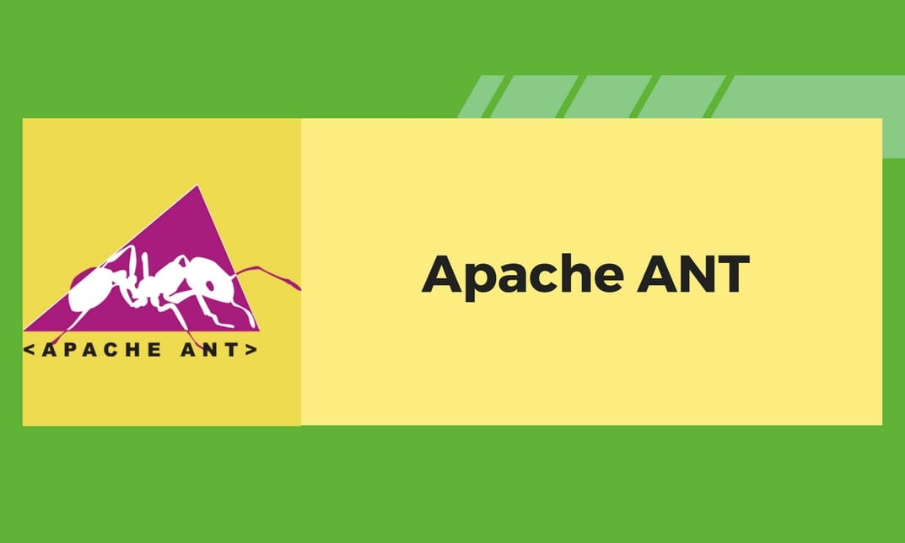



Build Tools

Slide 8
Difference between Ant and Maven
Ant and Maven both are build tools provided by Apache. The main purpose of these technologies is to ease the build process of a project.
Ant | Maven
Ant doesn't has formal conventions, so we need to provide information of the project structure in build.xml file. | Maven has a convention to place source code, compiled code etc. So we don't need to provide information about the project structure in pom.xml file.
Ant is procedural, you need to provide information about what to do and when to do through code. You need to provide order. | Maven is declarative, everything you define in the pom.xml file.
There is no life cycle in Ant. | There is life cycle in Maven.
It is a tool box. | It is a framework.
It is mainly a build tool. | It is mainly a project management tool.
The ant scripts are not reusable. | The maven plugins are reusable.
It is less preferred than Maven. | It is more preferred than Ant.

Slide 9
Maven History
Maven, created by Takari's Jason van Zyl, began as a subproject of Apache Turbine in 2002.
In 2003, it was voted on and accepted as a top level Apache Software Foundationproject.
In July 2004, Maven's release was the critical first milestone, v1.0.
Maven 2 was declared v2.0 in October 2005 after about six months in beta cycles.
Maven 3.0 was released in October 2010 being mostly backwards compatible with Maven 2.
Apache Maven 3.5.3 is the latest release and recommended version for all users.

Slide 10
Introduction to Maven
Maven is a simple build automation tool which is basically used with java projects.
Maven is also defined as a comprehensive project management tool.
It aims to provide the developers a complete and detailed build life cycle framework of an application.
Maven also ease up the task of developers in checking a build status, generating reports (basically javadocs) and setting up the automated build process and monitor the same.
The ease of source code compilation, distribution, documentation, collaboration with different teams and other vital tasks are seamless done by using maven.

Slide 11
Understanding the problem without Maven
Adding set of Jars in each project:
In case of struts, spring, hibernate frameworks, we need to add set of jar files in each project. It must include all the dependencies of jars also.
Creating the right project structure:
We must create the right project structure in servlet, struts etc, otherwise it will not be executed.
Building and Deploying the project:
We must have to build and deploy the project so that it may work.

Slide 12
What Maven does?
Maven simplifies the above mentioned problems. It does mainly following tasks.
It makes a project easy to build
It provides uniform build process (maven project can be shared by all the maven projects)
It provides project information (log document, cross referenced sources, mailing list, dependency list, unit test reports etc.)
It is easy to migrate for new features of Maven

Slide 13
Why Use Maven?
Simple project setup that follows best practices:
Maven tries to avoid as much configuration as possible, by supplying project templates (named archetypes)
Dependency management:
It includes automatic updating, downloading and validating the compatibility, as well as reporting the dependency closures (known also as transitive dependencies)
Isolation between project dependencies and plugins:
Project dependencies are retrieved from the dependency repositories while any plugin’s dependencies are retrieved from the plugin repositories, resulting in fewer conflicts when plugins start to download additional dependencies
Central repository system:
Project dependencies can be loaded from the local file system or public repositories, such as Maven Central

Slide 14
Maven Repository
A maven repository is a directory of packaged JAR file with pom.xml file.
Maven searches for dependencies in the repositories.
There are 3 types of maven repository:
Local Repository
Central Repository
Remote Repository

Slide 15
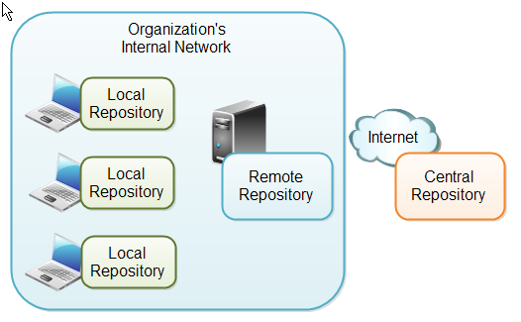
Maven Repository
Maven searches for the dependencies in the following order:
Local repository then Central repository then Remote repository.
If dependency is not found in these repositories, maven stops processing and throws an error.

Slide 16
Maven Local Repository
Maven local repository is located in your local system.
This repository will contain all the dependencies Maven downloads.
The same Maven repository is typically used for several different projects.
Thus Maven only needs to download the dependencies once, even if multiple projects depends on them (e.g. Junit).

Slide 17
Maven Central repository
Maven central repository is located on the web.
It has been created by the apache maven community itself.
By default Maven looks in this central repository for any dependencies needed but not found in your local repository.
Maven then downloads these dependencies into your local repository.
You need no special configuration to access the central repository.
The path of central repository is: http://repo1.maven.org/maven2/.
The central repository contains a lot of common libraries that can be viewed by this url http://search.maven.org/#browse.

Slide 18
Maven Remote Repository
A remote repository is a repository on a web server from which Maven can download dependencies, just like the central repository.
A remote repository can be located anywhere on the internet, or inside a local network.
A remote repository is often used for hosting projects internal to your organization, which are shared by multiple projects.
You can configure a remote repository in the POM file.
You can search any repository from Maven official website mvnrepository.com.

Slide 19
Maven Overview - Core Concepts
Maven is centered around the concept of POM files (Project Object Model).
A POM file is an XML representation of project resources like source code, test code, dependencies (external JARs used) etc.
The POM contains references to all of these resources.
The POM file should be located in the root directory of the project it belongs to.

Slide 20
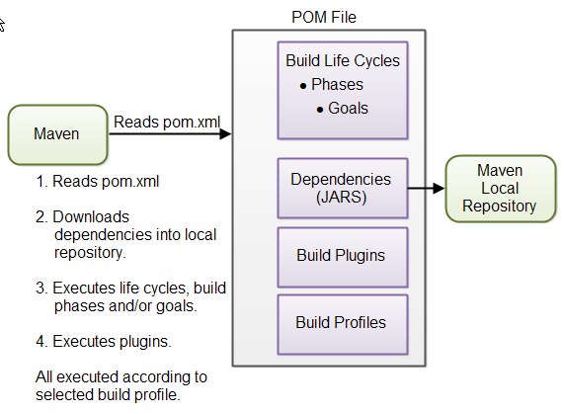
How Maven uses the POM file ?

Slide 21
POM.xml file
POM is an acronym for Project Object Model.
The pom.xml file contains
information of project and configuration information for the maven to build the project such as dependencies, build directory, source directory, test source directory, plugin, goals etc.
Maven reads the pom.xml file, then executes the goal.

Slide 22
Project Identifiers
Maven uses a set of identifiers, also called coordinates, to uniquely identify a project and specify how the project artifact should be packaged:
groupId – a unique base name of the company or group that created the project
artifactId – a unique name of the project
version – a version of the project
packaging – a packaging method (e.g. WAR/JAR/ZIP)
The first three of these (groupId:artifactId:version) combine to form the unique identifier and are the mechanism by which you specify which versions of external libraries (e.g. JARs) your project will use.

Slide 23
Naming Conventions of Maven Project
groupId This is an Id of project's group. This is generally unique amongst an organization or a project. For example, a banking group com.company.bank has all bank related projects.
artifactId This is an Id of the project. This is generally name of the project. For example, consumer-banking. Along with the groupId, the artifactId defines the artifact's location within the repository.
version This is the version of the project. Along with the groupId, It is used within an artifact's repository to separate versions from each other. For example − com.company.bank:consumer-banking:1.0 com.company.bank:consumer-banking:1.1.

Slide 24
Elements of maven pom.xml file
For creating the simple pom.xml file, you need to have following elements:
Element | Description
project | It is the root element of pom.xml file.
modelVersion | It is the sub element of project. It specifies the modelVersion. It should be set to 4.0.0.
groupId | It is the sub element of project. It specifies the id for the project group.
artifactId | It is the sub element of project. It specifies the id for the artifact (project). An artifact is something that is either produced or used by a project. Examples of artifacts produced by Maven for a project include: JARs, source and binary distributions, and WARs.
version | It is the sub element of project. It specifies the version of the artifact under given group.

Slide 25
Pom.xml file
<project xmlns="http://maven.apache.org/POM/4.0.0"
xmlns:xsi="http://www.w3.org/2001/XMLSchema-instance"
xsi:schemaLocation="http://maven.apache.org/POM/4.0.0
http://maven.apache.org/xsd/maven-4.0.0.xsd">
<modelVersion>4.0.0</modelVersion>
<groupId>com.rps.application1</groupId>
<artifactId>my-app</artifactId>
<version>1</version>
</project>

Slide 26
Maven pom.xml file with additional elements
Element | Description
packaging | defines packaging type such as jar, war etc.
name | defines name of the maven project.
url | defines url of the project.
dependencies | defines dependencies for this project.
dependency | defines a dependency. It is used inside dependencies.
scope | defines scope for this maven project. It can be compile, provided, runtime, test and system.

Slide 27
Maven pom.xml file with additional elements Example
<packaging>jar</packaging>
<name>Maven Quick Start Archetype</name>
<url>http://maven.apache.org</url>
<dependencies>
<dependency>
<groupId>junit</groupId>
<artifactId>junit</artifactId>
<version>4.8.2</version>
<scope>test</scope>
</dependency>
</dependencies>

Slide 28
Project Dependencies
Pproject may need external Java APIs or frameworks which are packaged in their own JAR files.
These JAR files are needed on the classpath when you compile your project code.
Downloading all these external dependencies (JAR files) recursively and making sure that the right versions are downloaded is cumbersome.
Especially when your project grows big, and you get more and more external dependencies.
Luckily, Maven has built-in dependency management.
You specify in the POM file what external libraries your project depends on, and which version, and then Maven downloads them for you and puts them in your local Maven repository.

Slide 29
Project dependencies in the POM file
<dependencies>
<dependency>
<groupId>org.jsoup</groupId>
<artifactId>jsoup</artifactId>
<version>1.7.1</version>
</dependency>
<dependency>
<groupId>junit</groupId>
<artifactId>junit</artifactId>
<version>4.8.1</version>
<scope>test</scope>
</dependency>
</dependencies>

Slide 30
Maven Directory Structure
Maven has a standard directory structure.
If you follow that directory structure for your project, you do not need to specify the directories of your source code, test code etc. in your POM file.
src
- main
- java
- resources
- webapp
- test
- java
- resources
- target
The target directory is created by Maven.
It contains all the compiled classes, JAR files etc. produced by Maven.
When executing the clean build phase, it is the target directory which is cleaned.

Slide 31
Maven Build Life Cycles
Default
Handles everything related to compiling and packaging your project.
Clean
Handles everything related to removing temporary files from the output directory, including generated source files, compiled classes, previous JAR files etc.
Site
Generates a complete website with documentation for your project.

Slide 32
Maven Plugins
Maven is actually a plugin execution framework where every task is actually done by plugins.
Maven Plugins are generally used to −
create jar file
create war file
compile code files
unit testing of code
create project documentation
create project reports

Slide 33
Plugin Types
According to Apache Maven, there are 2 types of maven plugins.
Build Plugins
These plugins are executed at the time of build. These plugins should be declared inside the <build> element.
Reporting Plugins
These plugins are executed at the time of site generation. These plugins should be declared inside the <reporting> element.

Slide 34
Some Common Plugins
Plugin name | Description
clean | Used to delete the target directory in order to clean up the earlier build artifacts
compiler | To compile java source files
surefile | Executes the Junit tests and generate the reports.
jar | Build the jar file of the project
war | Build the war file of the project
javadoc | Generates the javadocs of the project
antrun | Runs a set of ant tasks specified in any stage/phase of the build

Slide 35
Maven Archetypes
Maven archetypes are project templates which can be generated for your by Maven.
In other words, when you are starting a new project you can generate a template for that project with Maven.
In Maven a template is called an archetype.
Each Maven archetype thus corresponds to a project template that Maven can generate.
There is a Maven archetype which can generate a new Java project including files for the Eclipse IDE.

Slide 36
Maven - Eclipse IDE
Eclipse provides an excellent plugin m2eclipse which seamlessly integrates Maven and Eclipse together.
Features of m2eclipse are listed below :
You can run Maven goals from Eclipse.
You can view the output of Maven commands inside the Eclipse, using its own console.
You can update maven dependencies with IDE.
You can Launch Maven builds from within Eclipse.
It does the dependency management for Eclipse build path based on Maven's pom.xml.
It automatically downloads the required dependencies and sources from the remote Maven repositories.
It provides wizards for creating new Maven projects, pom.xml and to enable Maven support on existing projects
It provides quick search for dependencies in remote Maven repositories.

