Slide 1


Introduction to Servlets

Slide 2
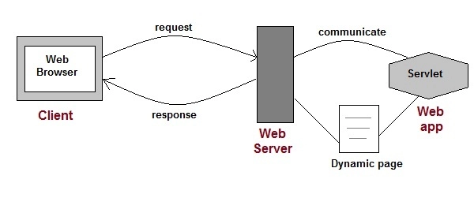
Introduction to Servlet
Servlet Technology is used to create web applications.
Servlet technology uses Java language to create web applications.
Web applications are helper applications that resides at web server and build dynamic web pages.
A dynamic page could be anything like a page that randomly chooses picture to display or even a page that displays the current time.

Slide 3



Introduction
A Servlet is a program written in Java, which runs on the server to process client requests.
Servlet runs on the server
Client
Request
Response
Client – Java Application, Browser, Device
Only one instance of Servlet created for all clent requests, hence save in memory.
Servlet once initialised stays in a memory , and no need to be loaded every time a request is made.
As Servlet Technology uses Java, web applications made using Servlet are Secured, Scalable and Robust.

Slide 4
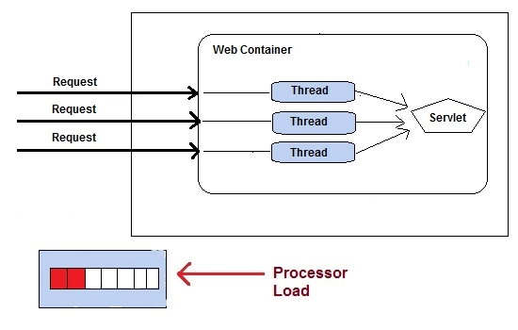
Advantages of using Servlets
Less response time because each request runs in a separate thread.
Servlets are scalable.
Servlets are robust and object oriented.
Servlets are platform independent.

Slide 5
Servlet API
Servlet API consists of two important packages that encapsulates all the important classes and interface, namely :
javax.servlet
javax.servlet.http

Slide 6
Important Classes and Interfaces of javax.servlet
INTERFACES | CLASSES
Servlet | ServletInputStream
ServletContext | ServletOutputStream
ServletConfig | ServletRequestWrapper
ServletRequest | ServletResponseWrapper
ServletResponse | ServletRequestEvent
ServletContextListener | ServletContextEvent
RequestDispatcher | ServletRequestAttributeEvent
SingleThreadModel | ServletContextAttributeEvent
Filter | ServletException
FilterConfig | UnavailableException
FilterChain | GenericServlet
ServletRequestListener

Slide 7
Important Classes and Interface of javax.servlet.http
CLASSES and INTERFACES
HttpServlet | HttpServletRequest
HttpServletResponse | HttpSessionAttributeListener
HttpSession | HttpSessionListener
Cookie | HttpSessionEvent

Slide 8
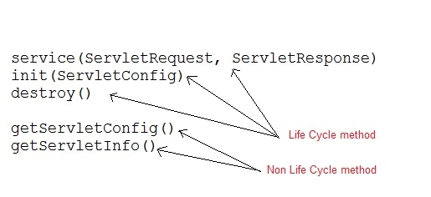
Servlet Interface
Servlet Interface provides five methods.
Out of these five methods, three methods are Servlet life cycle methods and rest two are non life cycle methods.

Slide 9
GenericServlet Class
GenericServlet is an abstract class that provides implementation of most of the basic servlet methods. This is a very important class.
public void init(ServletConfig)
public abstract void service(ServletRequest request,ServletResposne response)
public void destroy()
public ServletConfig getServletConfig()
public String getServletInfo()
public ServletContext getServletContext()
public String getInitParameter(String name)
public Enumeration getInitParameterNames()
public String getServletName()
public void log(String msg)
public void log(String msg, Throwable t)

Slide 10
HttpServlet class
HttpServlet is also an abstract class.
This class gives implementation of various service() methods of Servlet interface.
To create a servlet, we should create a class that extends HttpServlet abstract class.
The Servlet class that we will create, must not override service() method.
Our servlet class will override only the doGet() and/or doPost() methods.
The service() method of HttpServlet class listens to the Http methods (GET, POST etc) from request stream and invokes doGet() or doPost() methods based on Http Method type.

Slide 11
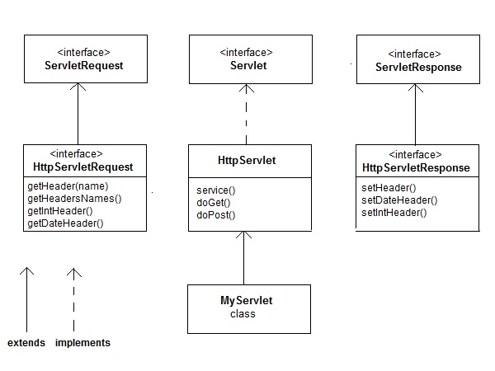
HttpServlet class

Slide 12
Basics of HTTP Servlet 2-1
HttpServlet class provides an abstract class to create an HTTP servlet.
protected void doGet(HttpServletRequest req,
HttpServletResponse res);
doGet() method handles the GET request made by the client
protected void doPost(HttpServletRequest req,
HttpServletResponse res);
doPost() method handles the POST request made by the client

Slide 13
Basics of HTTP Servlet 2-2
The other methods of HttpServlet class are:
protected void doDelete(HttpServletRequest req,
HttpServletResponse res);
doDelete() method is used to delete a resource from the server
protected void doPut(HttpServletRequest req,
HttpServletResponse res);
doPut() method is used to place a resource on the server
protected void doHead(HttpServletRequest req,
HttpServletResponse res);
doHead() method handles the HEAD request made by the client

Slide 14
Life Cycle of a Servlet 2-1
An instance of a Servlet is created by the Servlet container.
The life cycle of Servlet explains when this instance was created, for how long it lived and when it expired.
Servlets don't have a main() method.
Web Container manages the life cycle of a Servlet instance.
The 3 methods of Servlet life cycle are:
init()
service()
destroy()

Slide 15
Life Cycle of a Servlet 2-2
The different stages of life cycle are:
Instantiation
The Servlet container creates an instance of Servlet.
Initialization
The init() method is called by the container.
Service
The service() method is called by the container if it has a request for a Servlet.
Destroy
The destroy() method is called before destroying the instance.
Unavailable
The instance is destroyed and marked for garbage collection.

Slide 16
Servlet Hierarchy 3-1
javax.servlet package
The interfaces of javax.servlet package are:
Used by Servlet container
during initialization
Interface ServletConfig
Defines methods used by the
servlets to get information
from its container
Interface ServletContext
Interface ServletRequest
Requests information from
the server
Interface ServletResponse
Responds to client request

Slide 17
Servlet Hierarchy 3-2
javax.servlet package
The classes of javax.servlet package are:
Used to read binary
data from client
Class ServletInputStream
Used to send binary
data to client
Class ServletOutputStream

Slide 18
Servlet Hierarchy 3-3
javax.servlet.http package
The interfaces of javax.servlet.http package are:
Provides HTTP request
information
Interface HttpServletRequest
Provides HTTP
response
Interface HttpServletResponse

Slide 19
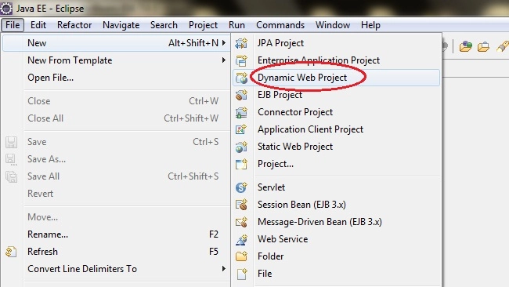
Creating First Servlet Application using Eclipse IDE
Eclipse IDE is the most popular Java IDE used in the Industry.
It is developed by an open source community and can be downloaded for free from Eclipse.org
Goto File -> New -> Dynamic Web Project

Slide 20
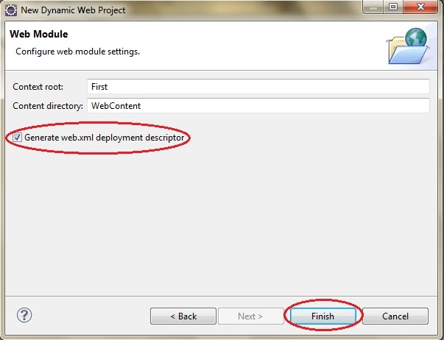
Using Eclipse IDE
Give a Name to your Project and click Next ---- > Next
Check Generate web.xml Deployment Descriptor and click Finish

Slide 21
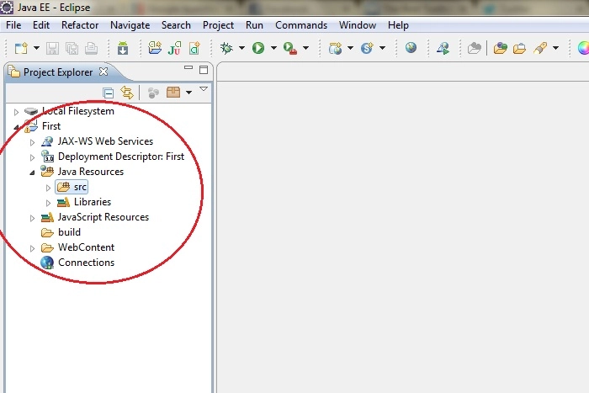
Using Eclipse IDE
Now, the complete directory structure of your Project will be automatically created by Eclipse IDE.

Slide 22
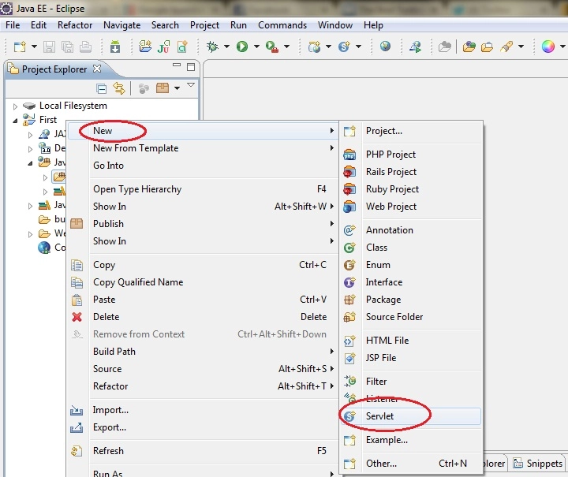
Using Eclipse IDE – Creating Servlet
Click on First project, go to Java Resources -> src. Right click on src select New -> Servlet

Slide 23
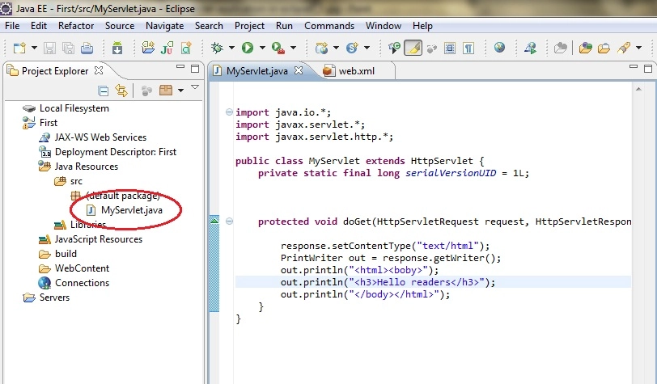
Using Eclipse IDE – Creating Servlet
Give Servlet class name and click Next
Give your Servlet class a Nmae of your choice.
Leave everything else to default and click Finish

Slide 24
Structure of a simple Servlet
package example1; import java.io.*; import java.net.*; import javax.servlet.*; import javax.servlet.http.*; public class HelloWorld extends HttpServlet { protected void processRequest(HttpServletRequest request, HttpServletResponse response) throws ServletException, IOException { response.setContentType("text/html;charset=UTF-8"); PrintWriter out = response.getWriter(); out.println("<html>"); out.println("<head>"); out.println("<title>Servlet HelloWorld</title>"); out.println("</head>"); out.println("<body>"); out.println("<h1>Servlet HelloWorld at" +request.getContextPath()+ "</h1>"); out.println("</body>"); out.println("</html>"); out.close(); } protected void doGet(HttpServletRequest request, HttpServletResponse response) throws ServletException, IOException { processRequest(request, response); } protected void doPost(HttpServletRequest request, HttpServletResponse response) throws ServletException, IOException { processRequest(request, response); } }
Packages need to be Imported
Method used to
process the
request
Code to set
text format and
PrintWriter object is created to send data to
the client
Methods used to
process the
GET and POST
request
Demonstration: Example 1

Slide 25
Summary 2-1
Servlets allow the users to run Java code on the server and generate dynamic content.
An HTTP Servlet sends HTTP Request and gets response in the form of HTTP Response.
The various HTTP methods are GET, POST, OPTIONS and DELETE.
The Servlet life cycle consists of three methods: init(), service() and destroy().
The Servlet API is contained in two packages: javax.servlet and javax.servlet.http.

Slide 26
Summary 2-2
The Servlets implement interfaces by extending either from GenericServlet class or HttpServlet class.
The Eclipse / NetBeans software is used for developing Java based applications, such as applets, servlets and JSPs.

