Slide 1


Servlet Request
and Response

Slide 2
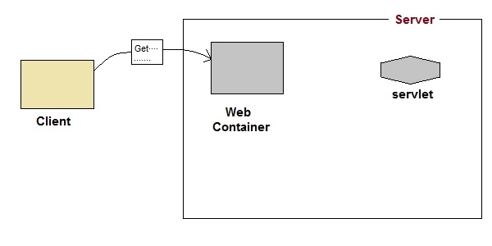
Servlet Request & Response – Scope Objects
User sends request for a servlet by clicking a link that has URL to a servlet.

Slide 3
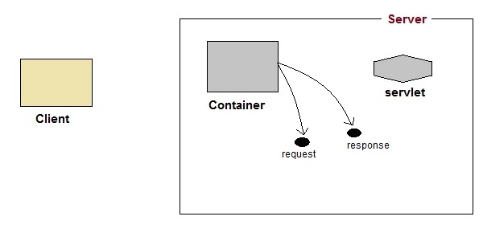
Servlet Request & Response
The container finds the servlet using deployment descriptor and creates two objects :
HttpServletRequest
HttpServletResponse

Slide 4
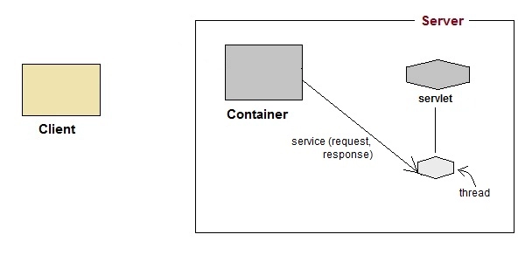
Servlet Request & Response
Then the container creates or allocates a thread for that request and calls the Servlet's service() method and passes the request, response objects as arguments.

Slide 5
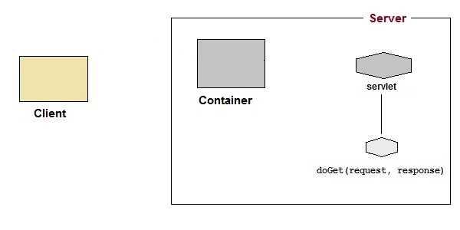
Servlet Request & Response
The service() method, then decides which servlet method, doGet() or doPost() to call, based on HTTP Request Method(Get, Post etc) sent by the client.
Suppose the client sent an HTTP GET request, so the service() will call Servlet's doGet() method

Slide 6
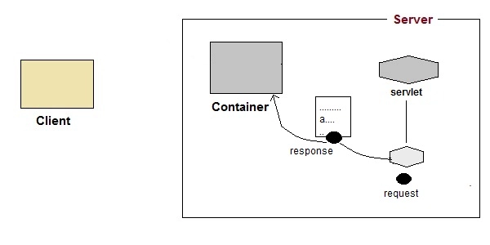
Servlet Request & Response
Then the Servlet uses response object to write the response back to the client.

Slide 7
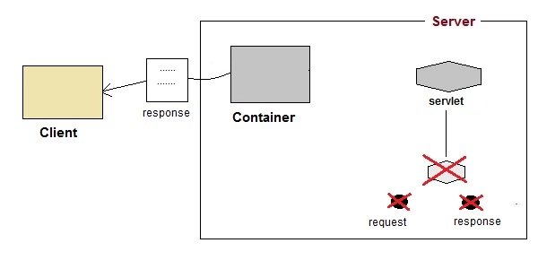
Servlet Request & Response
After the service() method is completed the thread dies. And the request and response objects are ready for garbage collection.

Slide 8
Introduction to Servlet Request
Servlet is used to handle client request.
Servlet API provides two important interfaces javax.servlet.ServletRequest and javax.servlet.http.HttpServletRequest to encapsulate client request.
Implementation of these interfaces provide important information about client request to a servlet.
The various methods are :
getParameterValues(String name) , getServletContext(), getServerName(),
setAttribute(String name, Object o), getAttribute(String name)

Slide 9
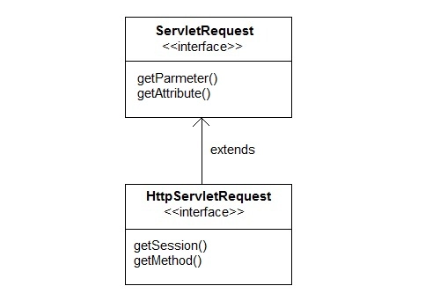
HttpServletRequest interface
HttpServletRequest interface adds the methods that relates to the HTTP protocol.

Slide 10
Important methods of HttpServletRequest
Methods | Description
String getContextPath() | returns the portion of the request URI that indicates the context of the request
Cookies getCookies() | returns an array containing all of the Cookie objects the client sent with this request
String getQueryString() | returns the query string that is contained in the request URL after the path
HttpSession getSession() | returns the current HttpSession associated with this request or, if there is no current session and create is true, returns a new session
String getMethod() | Returns the name of the HTTP method with which this request was made, for example, GET, POST, or PUT.
Part getPart(String name) | gets the Part with the given name
String getPathInfo() | returns any extra path information associated with the URL the client sent when it made this request.
String getServletPath() | returns the part of this request's URL that calls the servlet

Slide 11
Introduction to Servlet Response
Servlet API provides two important interfaces ServletResponse and HttpServletResponse to assist in sending response to client.
Methods | Description
PrintWriter getWriter() | returns a PrintWriter object that can send character text to the client.
void setBufferSize(int size) | Sets the preferred buffer size for the body of the response
void setContentLength(int len) | Sets the length of the content body in the response In HTTP servlets, this method sets the HTTP Content-Length header
void setContentType(String type) | sets the content type of the response being sent to the client before sending the respond.
void setBufferSize(int size) | sets the preferred buffer size for the body of the response.
boolean isCommitted() | returns a boolean indicating if the response has been committed
void setLocale(Locale loc) | sets the locale of the response, if the response has not been committed yet.

Slide 12
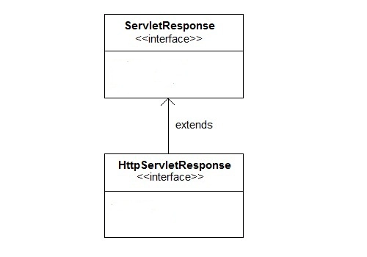
HttpServletResponse Interface
HttpServletResponse interface adds the methods that relates to the HTTP response.

Slide 13
Methods of HttpServletResponse
Methods | Description
void addCookie(Cookie cookie) | adds the specified cookie to the response.
void sendRedirect(String location) | Sends a temporary redirect response to the client using the specified redirect location URL and clears the buffer
int getStatus() | gets the current status code of this response
String getHeader(String name) | gets the value of the response header with the given name.
void setHeader(String name, String value) | sets a response header with the given name and value
void setStatus(int sc) | sets the status code for this response
void sendError(int sc, String msg) | sends an error response to the client using the specified status and clears the buffer

Slide 14
Servlet Communication Methods
The RequestDispatcher interface provides the facility of dispatching the request to another resource it may be html, servlet or jsp.
This interface can also be used to include the content of another resource also.
It is one of the way of servlet collaboration.

Slide 15
Servlet Communication Methods
Servlets access network resources to satisfy client requests
The forward() and include() methods of RequestDispatcher
interface are used by Servlets to access network resources.
RequestDispatcher interface is part of javax.servlet package
public void forward (ServletRequest req, ServletResponse res);
Forwards the requests from one Servlet to another on the same server
public void include (ServletRequest req, ServletResponse res);
Includes the contents of one Servlet in another Servlet in the Response

Slide 16
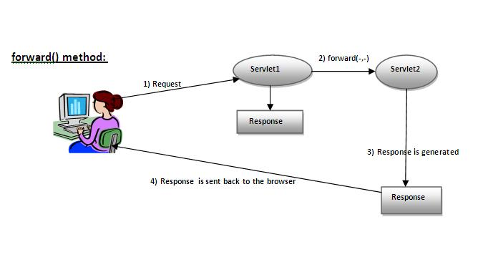
Forward() Method
As you see in the above figure, response of second servlet is sent to the client.
Response of the first servlet is not displayed to the user

Slide 17
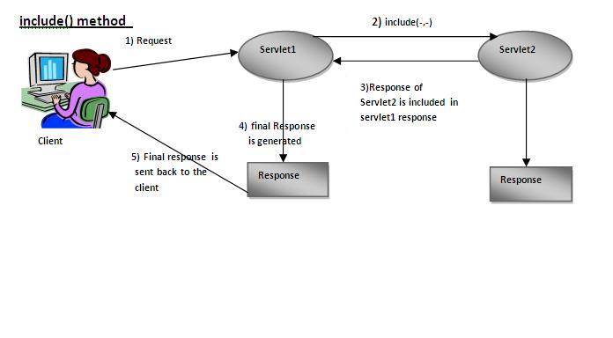
Include() Method
As you can see in the above figure, response of second servlet is included in the response of the first servlet that is being sent to the client.

Slide 18
Get the object of RequestDispatcher
The getRequestDispatcher() method of ServletRequest interface returns the object of RequestDispatcher.
Syntax of getRequestDispatcher method
public RequestDispatcher getRequestDispatcher(String resource);
Example of using getRequestDispatcher method
RequestDispatcher rd=request.getRequestDispatcher("servlet2");
//servlet2 is the url-pattern of the second servlet
rd.forward(request, response);//method may be include or forward

Slide 19
SendRedirect ()-Servlet Communication
The sendRedirect() method of HttpServletResponse interface can be used to redirect response to another resource, it may be servlet, jsp or html file.
It accepts relative as well as absolute URL.
It works at client side because it uses the url bar of the browser to make another request.
So, it can work inside and outside the server.

Slide 20
Difference between forward() and sendRedirect() method
forward() method | sendRedirect() method
The forward() method works at server side. | The sendRedirect() method works at client side.
It sends the same request and response objects to another servlet. | It always sends a new request.
It can work within the server only. | It can be used within and outside the server.
Example: request.getRequestDispacher("servlet2").forward(request,response); | Example: response.sendRedirect("servlet2");

Slide 21
InterServlet Communication 3-1
InterServlet communication can be used by Servlets to gain access to other currently loaded Servlets and perform some task on each Servlet. This is called Servlet Chaining . The output of one Servlet act as Input to another Servlet. The InterServlet communication methods are:
InterServlet Communication
Servlet Manipulation
Servlet Reuse
Servlet Collaboration
Servlet manipulation allows one Servlet to invoke the methods of another
Servlet.
Servlet reuse allows one Servlet to reuse the methods and properties of
another Servlet for its own purpose.
Servlet collaboration allows the Servlets to share information.

Slide 22
InterServlet Communication
Servlets running together in the same server have several ways to communicate with each other.
There are three major reasons to useinterservlet communication:
Direct servlet manipulation:
A servlet can gain access to the other currently loaded servlets and perform some task on each.
The servlet could, for example, periodically ask every servlet to write its state to disk to protect against server crashes.

Slide 23
InterServlet Communication
Servlet reuse:
Servlet collaboration
The most common, situation involves two or more servlets sharing state information.
For example, a set of servlets managing an online store could share the store's product inventory count. Session tracking is a special case of servlet collaboration.
One servlet can use another's abilities to perform a task.
For Eg Chat Servlet written as a server for chat applets, can be reused (unchanged) by another servlet that needed to support an HTML-based chat interface.

Slide 24
ServletContext Interface
An object of ServletContext is created by the web container at time of deploying the project.
This object can be used to get configuration information from web.xml file.
There is only one ServletContext object per web application.
If any information is shared to many servlet, it is better to provide it from the web.xml file using the <context-param> element.

Slide 25
Advantage of ServletContext
Easy to maintain if any information is shared to all the servlet, it is better to make it available for all the servlet.
We provide this information from the web.xml file, so if the information is changed, we don't need to modify the servlet.
Thus it removes maintenance problem.

Slide 26
Uses of ServletContext Interface
The object of ServletContext provides an interface between the container and servlet.
The ServletContext object can be used to get configuration information from the web.xml file.
The ServletContext object can be used to set, get or remove attribute from the web.xml file.
The ServletContext object can be used to provide inter-application communication.

Slide 27
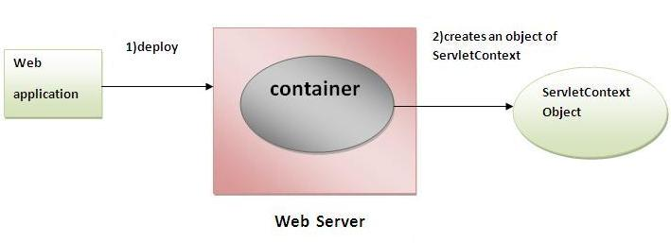
ServletContext object

Slide 28
Methods of ServletContext interface
public String getInitParameter(String name):Returns the parameter value for the specified parameter name.
public Enumeration getInitParameterNames():Returns the names of the context's initialization parameters.
public void setAttribute(String name,Object object):sets the given object in the application scope.
public Object getAttribute(String name):Returns the attribute for the specified name.
public Enumeration getInitParameterNames():Returns the names of the context's initialization parameters as an Enumeration of String objects.
public void removeAttribute(String name):Removes the attribute with the given name from the servlet context.

Slide 29
Get the object of ServletContext Interface
getServletContext() method of ServletConfig interface returns the object of ServletContext.
Syntax of getServletContext() method
public ServletContext getServletContext()
Example:
//We can get the ServletContext object from ServletConfig object
ServletContext application=getServletConfig().getServletContext();
ServletContext application=getServletContext();

Slide 30
Syntax to provide the initialization parameter in Context scope
The context-param element, subelement of web-app, is used to define the initialization parameter in the application scope.
The param-name and param-value are the sub-elements of the context-param.
The param-name element defines parameter name and and param-value defines its value.
<web-app>
......
<context-param>
<param-name>parametername</param-name>
<param-value>parametervalue</param-value>
</context-param>
......
</web-app>

Slide 31
InterServlet Communication 3-2
UserDetails.html
<HTML>
<HEAD><TITLE>User Details</TITLE></HEAD>
<BODY>
<FORM method=post action="/Example3/UserServlet1">
<H1 align=center>Welcome to Shop Stop</H1>
Please enter your user id to display your details:
<Input type=text name=txtuserid>
<br/>
<input type=submit>
</FORM>
</BODY>
</HTML>
//UserServlet1
String uid=request.getParameter("txtuserid");
response.setContentType(CONTENT_TYPE);
PrintWriter out = response.getWriter();
ServletContext context=getServletContext();
context.setAttribute("userid",uid);
RequestDispatcher
dispatcher=getServletContext().getRequestDispatcher(
"/UserServlet2");
if(dispatcher==null)
{
response.sendError(response.SC_NO_CONTENT);
}
dispatcher.forward(request,response);
out.close();
RequestDispatcher object is created to
access the context of another Servlet using
getServletContext() method.
Demonstration: Example 4
Demonstration: Example 5

Slide 32
InterServlet Communication 3-3
//UserServlet2
ServletContext context=getServletContext();
Object obj=context.getAttribute("userid");
Class.forName("sun.jdbc.odbc.JdbcOdbcDriver");
Connection con=DriverManager.getConnection("jdbc:odbc:pubs",
"sa","playware");
Statement s=con.createStatement();
ResultSet rs=s.executeQuery("Select * from CustomerRegistration
where UserId='"+obj.toString()+"'");
boolean flag=rs.next();
if(flag==true) {
password=rs.getString(2);
FullName=rs.getString(3);
gender=rs.getString(4);
age=rs.getString(5);
} else {
out.println("<font color=red size=7>Login Failed</font>");
}
Demonstration: Example 6

Slide 33
Servlet Context 2-1
Stores the attributes and resources common to all Servlets in a ServletContext interface object. The methods dealing with context attributes are:
public Object getAttribute(String name);
Returns the Servlet container attribute name
Returns null if there is no attribute by that name
public void setAttribute(String name, Object object);
Binds an object to a given attribute name in the Servlet context
public void removeAttribute(String name);
Removes the attribute with the given name

Slide 34
Servlet Context 2-2
The ServletContext interface defines methods which allow the
users to access the context’s state.
public ServletContext getContext(String path);
Returns an object of ServletContext interface that corresponds to the
specified URL on the server
public String getInitParameter(String name);
Returns a string containing the context initialization parameters
public String getServletContextName();
Returns the name of the Web application corresponding to the
context object as specified in the deployment descriptor file

Slide 35
Chat Application 5-1
//UserServlet
response.setContentType("text/html;charset=UTF-8");
PrintWriter out = response.getWriter();
out.println("<html>");
out.println("<head><title>UserServlet</title></head>");
out.println("<body bgcolor=\"#ffffff\"onload=
'javascript:frm.userName.focus();'>");
out.println("<FORM METHOD=POST Action='MainServlet'" +
"name='frm'><center>Please enter your nick name<br>
<INPUT " + "TYPE='text' NAME='userName'>" +
"<INPUT TYPE='submit'" + "value='chat'></center></FORM>");
out.println("</body>");
out.println("</html>");
out.close();
Demonstration: Example 7

Slide 36
Chat Application 5-2
//MainServlet
response.setContentType("text/html;charset=UTF-8");
PrintWriter out = response.getWriter();
String usrName = request.getParameter("userName");
if(usrName == null || usrName.equals("")) {
out.println("<h1 style='color:red' align='center'>" +
"Please go back and put a valid User Name</h1>");
} else {
Vector vec =
(Vector)getServletContext(). getAttribute("userArray");
if (vec == null) {
vec = new Vector();
}
if(!vec.contains(usrName)) {
vec.add(usrName);
//Servlet Context Initialization
HttpSession ses = request.getSession();
ses.setAttribute("userName",usrName);
getServletContext().setAttribute("userArray",vec);
//Servlet Context Initialization End
out.println("<html>");
out.println("<frameset rows='80%,*'>");
out.println("<frame src='TopServlet?name=" +
usrName + "'>");
out.println("<frame src='MessageServlet?name=" +
usrName + "' >");
out.println("<frameset>");
out.println("</body>");
out.println("</html>");
} else {
out.println("<h1 style='color:red'
align='center'>" + "UserID in use</h1>");
}
}
out.close();
Demonstration: Example 8

Slide 37
Chat Application 5-3
//TopServlet
response.setContentType("text/html;charset=UTF-8");
PrintWriter out = response.getWriter();
out.println("<html>");
out.println("<head><title>TopServlet</title></head>");
out.println("<frameset cols='80%,*'>");
out.println("<frame src='DisplayServlet'>");
String usrName = request.getParameter("name");
out.println("<frame src='UserList?name'= + usrName + >");
out.println("<frameset>");
out.println("</html>");
out.close();
Demonstration: Example 9

Slide 38
Chat Application 5-4
//UserList
response.setContentType("text/html;charset=UTF-8");
PrintWriter out = response.getWriter();
out.println("<html>");
out.println("<META HTTP-EQUIV='REFRESH' CONTENT='3;Userlist'>");
out.println("<head><title>UserList</title></head>");
out.println("<body bgcolor=\"#ffffff\">");
Vector usr = (Vector) getServletContext(). getAttribute("userArray");
String UserName = request.getParameter("name");
if(usr == null) {
throw new ServletException("Error in Servlet.");
}
for(int i = 0;i<usr.size();i++) {
if(String.valueOf(usr.get(i)).equals(UserName)) {
out.println("<b>" + String.valueOf(usr.get(i)) +
"</b><br>");
} else {
out.println(String.valueOf(usr.get(i)) + "<br>");
}
}
out.println("</body>");
out.println("</html>");
out.close();
Demonstration: Example 10

Slide 39
Chat Application 1-5
//DisplayServlet
response.setContentType("text/html;charset=UTF-8");
PrintWriter out = response.getWriter();
ServletContext app = getServletContext();
StringBuffer strMsg =
(StringBuffer)app.getAttribute("objMessage");
if(strMsg == null) {
strMsg = new StringBuffer("");
}
displayHtml(out,strMsg);
out.close();
public void displayHtml(PrintWriter out,StringBuffer msgBuffer) {
out.println("<html>");
out.println("<META HTTP-EQUIV='REFRESH'
CONTENT='3;DisplayServlet'>");
out.println("<head><title>MessageServlet
</title></head>");
out.println("<body bgcolor=\"#ffffff\">");
out.println(msgBuffer.toString());
out.println("</body>");
out.println("</html>");
}
Demonstration: Example 11

Slide 40
Chat Application 5-5
//MessageServlet
response.setContentType("text/html;charset=UTF-8");
PrintWriter out = response.getWriter();
String strMsg = null;
strMsg = request.getParameter("message");
if (strMsg == null || strMsg.equals("")) {
displayHtml(out);
} else {
ServletContext app = getServletContext();
StringBuffer objMsg =
(StringBuffer)app.getAttribute("objMessage");
if(objMsg == null) {
objMsg = new StringBuffer("");
}
String userName = request.getParameter("name");
objMsg.append("<b>" + userName +
" Says : </b>" + strMsg + "<br>");
app.setAttribute("objMessage",objMsg);
displayHtml(out);
}
out.close();
public void displayHtml(PrintWriter out) {
out.println("<html>");
out.println("<head><title>MessageServlet</title></head>");
out.println("<body bgcolor=\"#ffffff\"onload =
'javascript:frm.message.focus();'>");
out.println("<form method='post' name='frm'>");
out.println("<input type='textbox'
name='message'size='40'>");
out.println("<input type='submit' value='Send'>");
out.println("</form>");
out.println("</body>");
out.println("</html>");
}
Demonstration: Example 12

Slide 41
Attribute
An attribute is an object that is used to share information in a web app.
Attribute allows Servlets to share information among themselves.
Attributes can be SET and GET from one of the following scopes :
request
session
application

Slide 42
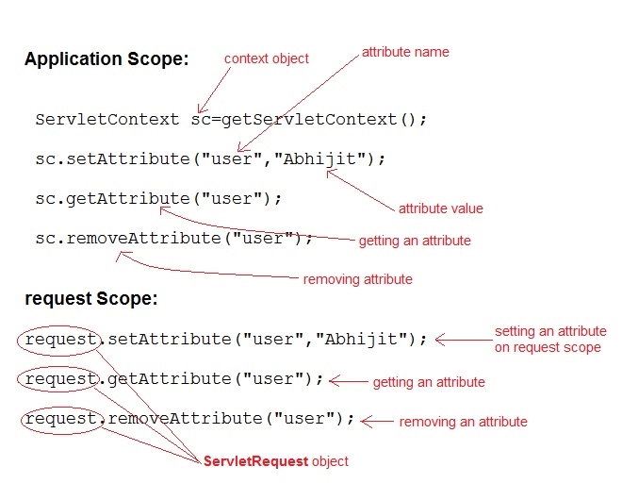
Attribute

Slide 43
Session
A session is defined as a series of related browser requests that come from the same client during a certain time period.
Session tracking ties together a series of browser requests—think of these requests as pages—that may have some meaning as a whole, such as a shopping cart application.

Slide 44
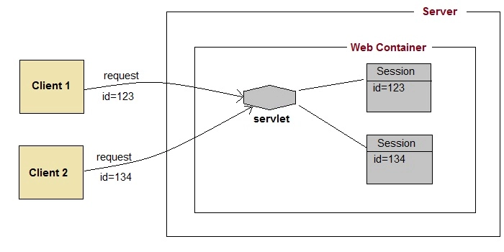
Session Tracking

Slide 45
Session Tracking
Session simply means a particular interval of time.
Session Tracking is a way to maintain state (data) of an user. It is also known as session management in servlet.
Http protocol is a stateless so we need to maintain state using session tracking techniques.
Each time user requests to the server, server treats the request as the new request.
So we need to maintain the state of an user to recognize to particular user.

Slide 46

Session Tracking
Request 1
Request 2
…….
Request n
Server assigns unique session ID to client to track the user

Slide 47
The HttpSession Object
Servlet provides HttpSession Interface which provides a way to identify a user across more than one page request or visit to a Web site and to store information about that user.
The servlet container uses this interface to create a session between an HTTP client and an HTTP server.
The session persists for a specified time period, across more than one connection or page request from the user.

Slide 48
Creating a Session
public HttpSession getSession();
public HttpSession getSession(boolean value);
The getSession() method is used to create a session if there is no current
session associated with the request.
The getSession(boolean value) is used to create a session if the boolean value is true and no session is currently associated with the request.
If the boolean value is false then no session is associated with the current request.

Slide 49
Methods & Description –HTTP Session Object
public Object getAttribute(String name) This method returns the object bound with the specified name in this session, or null if no object is bound under the name.
public Enumeration getAttributeNames() This method returns an Enumeration of String objects containing the names of all the objects bound to this session.
public long getCreationTime() This method returns the time when this session was created, measured in milliseconds since midnight January 1, 1970 GMT.
public String getId() This method returns a string containing the unique identifier assigned to this session.
public long getLastAccessedTime() This method returns the last time the client sent a request associated with this session, as the number of milliseconds since midnight January 1, 1970 GMT.

Slide 50
public int getMaxInactiveInterval() This method returns the maximum time interval, in seconds, that the servlet container will keep this session open between client accesses.
public void invalidate() This method invalidates this session and unbinds any objects bound to it.
public boolean isNew() This method returns true if the client does not yet know about the session or if the client chooses not to join the session.
public void removeAttribute(String name) This method removes the object bound with the specified name from this session.
public void setAttribute(String name, Object value) This method binds an object to this session, using the name specified.
public void setMaxInactiveInterval(int interval) This method specifies the time, in seconds, between client requests before the servlet container will invalidate this session.

Slide 51
Session Tracking Techniques 9-1
Session Tracking Techniques
User Authorization
Hidden Form Fields
URL Rewriting
Cookies

Slide 52
Session Tracking Techniques 9-2
User Authorization
Tracks the user when the user logs in
Does not allow unauthorized users to access some resources on the
Web page.
Request
Authorized user
Request
Unauthorized user

Slide 53
Hidden Form Field
Hidden Form Field is a hidden (invisible) textfield is used for maintaining the state of an user.
We store the information in the hidden field and get it from another servlet.
This approach is better if we have to submit form in all the pages and we don't want to depend on the browser.

Slide 54
Application of Hidden field
It is widely used in comment form of a website.
We store page id or page name in the hidden field so that each page can be uniquely identified.
It will always work whether cookie is disabled or not.
It is maintained at server side.
Extra form submission is required on each pages.
Only textual information can be used.

Slide 55
Session Tracking Techniques 9-3
Hidden Form Fields
Hidden form fields are added to the HTML page. However, these fields are not rendered on the page.
…
<form action = "\\firsthtml.htm" method="POST">
<input type = "hidden" name="productid" value="123">
</form>
…

Slide 56
URL Rewriting
In URL rewriting, we append a token or identifier to the URL of the next Servlet or the next resource.
We can send parameter name/value pairs using the following format:
url?name1=value1&name2=value2&??
A name and a value is separated using an equal = sign, a parameter name/value pair is separated from another parameter using the ampersand(&).

Slide 57
URL Rewriting
When the user clicks the hyperlink, the parameter name/value pairs will be passed to the server.
From a Servlet, we can use getParameter() method to obtain a parameter value.
It will always work whether cookie is disabled or not (browser independent).
Extra form submission is not required on each pages.
It will work only with links.

Slide 58
Session Tracking Techniques 9-4
URL Rewriting
Adds a unique session ID at the end of the URL to identify a session.
For example, following URLs are rewritten to pass session ID 10.
Original URL: http://server:post/servlet/Rewritten
URL rewritten with extra information:
http://server:post/servlet/Rewritten/10
URL rewritten with added parameters:
http://server:post/servlet/Rewritten?sessionid=10
URL rewritten with custom change:
http://server:post/servlet/Rewritten;$sessionid$10

Slide 59
Cookies in Servlet
A cookie is a small piece of information that is persisted between the multiple client requests.
A cookie has a name, a single value, and optional attributes such as a comment, path and domain qualifiers, a maximum age, and a version number.

Slide 60
How Cookie works
By default, each request is considered as a new request.
In cookies technique, we add cookie with response from the servlet.
So cookie is stored in the cache of the browser.
After that if request is sent by the user, cookie is added with request by default.
Thus, we recognize the user as the old user.

Slide 61
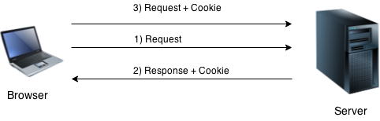
How Cookie works

Slide 62
Types of Cookie
Non-persistent cookie
It is valid for single session only.
It is removed each time when user closes the browser.
Persistent cookie
It is valid for multiple session .
It is not removed each time when user closes the browser.
It is removed only if user logout or signout.

Slide 63
Pros & Cons of Cookies
Pros
Simplest technique of maintaining the state.
Cookies are maintained at client side.
Cons
It will not work if cookie is disabled from the browser.
Only textual information can be set in Cookie object.

Slide 64
Cookie class
javax.servlet.http.Cookie class provides the functionality of using cookies.
It provides a lot of useful methods for cookies.
Constructor | Description
Cookie() | constructs a cookie.
Cookie(String name, String value) | constructs a cookie with a specified name and value.

Slide 65
Methods of Cookie class
Method | Description
public void setMaxAge(int expiry) | Sets the maximum age of the cookie in seconds.
public String getName() | Returns the name of the cookie. The name cannot be changed after creation.
public String getValue() | Returns the value of the cookie.
public void setName(String name) | changes the name of the cookie.
public void setValue(String value) | changes the value of the cookie.

Slide 66
Session Tracking Techniques 9-5
Cookies
Are used to store information sent by the Web server to the client.
The server sends the cookie by setting Set-Cookie method in the response
header. The syntax is as follows:
Set-Cookie: Name=VALUE; Comment=COMMENT; Domain=
DOMAINNAME; Max-age=SECONDS; Path=PATH; secure;
Name– Specifies the name of the cookie
VALUE– Specifies the value of the Cookie name
Domain – Specifies the URL for which the cookie is valid
Max-age – Specifies the life of the cookie in seconds
secure – Specifies whether cookies can be exchanged over HTTP

Slide 67
Session Tracking Techniques 9-6
Cookies
Contain one or more name-value pairs, which are exchanged in request
and response headers.
public void setDomain(String domain);
public String getDomain();
public void setMaxAge(int age);
public int getMaxAge();
public void setPath(String path);
public String getPath();

Slide 68
Session Tracking Techniques 9-7
//UrlRedirectServlet
response.setContentType("text/html;charset=UTF-8");
PrintWriter out = response.getWriter();
out.println("<html>");
out.println("<head>");
out.println("<title>Servlet UrlRedirectServlet</title>");
out.println("</head>");
out.println("<body>");
out.println("<h1>Servlet UrlRedirectServlet at " +
request.getContextPath() + "</h1>");
out.println("<body bgcolor=\"#ffffff\">");
String contextPath = request.getContextPath();
String encodedUrl = response.encodeURL(contextPath +
"/CookieReader");
out.println("<h3>This page will use URL rewriting if " +
"necessary</h3>");
out.println("Go to the default page <a href=\"" +
encodedUrl + "\">here</a>.");
out.println("</body>");
out.println("</html>");
//create a cookie
Cookie c = new Cookie("servletName", getServletName());
response.addCookie(c);
out.close();
getContextPath() returns context path
and encodeURL() converts the string
to URL path.
Demonstration: Example 1

Slide 69
Session Tracking Techniques 9-8
//CookieReader
Cookie cookie = null;
Cookie[] cookies = request.getCookies();
boolean hasCookies = false;
if (cookies != null)
hasCookies = true;
if (hasCookies)
{
out.println("<h2> The name and value of each found
cookie</h2>");
for (int i = 0; i < cookies.length; i++)
{
cookie = cookies[i];
out.println("Name of cookie #" + (i + 1) +
": " + cookie.getName() + "<br>");
out.println("Value of cookie #" + (i + 1) +
": " + cookie.getValue() + "<br><br>");
}
} else {
out.println("<h2> This request did not
include any cookies</h2>");
}
If the requested URL contains cookies, the
corresponding names and values are displayed.
Demonstration: Example 2

Slide 70
Session Tracking Techniques 9-9
//SessionServlet
HttpSession session=request.getSession();
out.println("Session status:<br/>");
if(session.isNew()) {
out.println("New session created...<br/>");
} else {
out.println("Old session...<br/>");
}
out.println("<br/> Session id : "+session.getId());
out.println("<br/> Creation time : ");
out.println(new Date(session.getCreationTime()));
out.println("<br/> Last Accessed : ");
out.println(new Date(session.getLastAccessedTime()));
This example displays various session attributes as output.
Demonstration: Example 3

Slide 71
Tracking Service Requests
To track service requests, include in your servlet class a field that counts the
number of service methods that are running.
The field should have synchronized access methods to increment, decrement, and return its value.

Slide 72
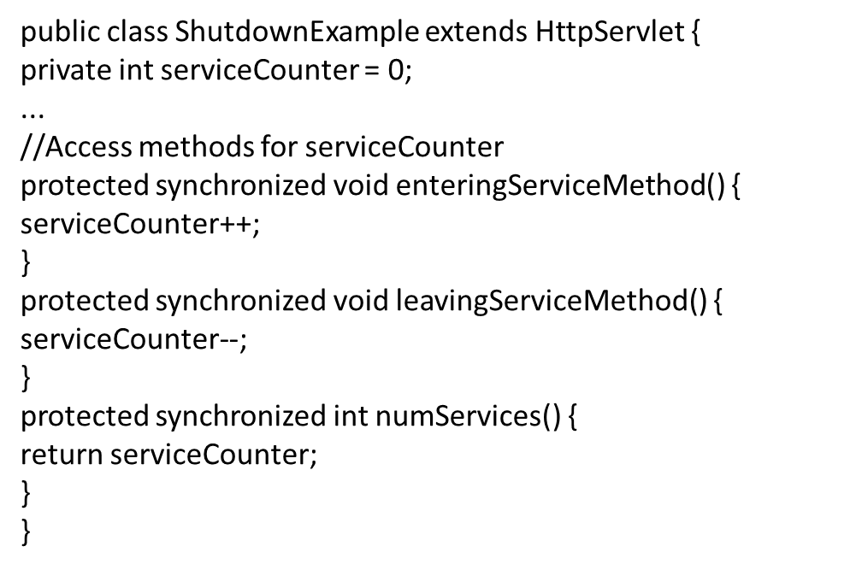
Tracking Service Requests
The service method should increment the service counter each time the method is entered and should decrement the counter each time the method returns.

Slide 73
Tracking Service Requests
protected void service(HttpServletRequest req,
HttpServletResponse resp)
throws ServletException,IOException {
enteringServiceMethod();
try {
super.service(req, resp);
} finally {
leavingServiceMethod();
}
}
This is one of the few times that your HttpServlet subclass should override the service method.
The new method should call super.service to preserve all of the original service method’s functionality:

Slide 74
Notifying Methods to Shut Down
To ensure a clean shutdown, your destroy method should not release any shared resources until all of the service requests have completed.
One part of doing this is to check the service counter.
Another part is to notify the long-running methods that it is time to shut down.
For this notification, another field is required.
The field should have the usual access methods:
protected synchronized void setShuttingDown(boolean flag) {
shuttingDown = flag;
}
protected synchronized boolean isShuttingDown() {
return shuttingDown;
}
}
public class ShutdownExample extends HttpServlet {
private boolean shuttingDown;
...
//Access methods for shuttingDown

Slide 75
Notifying Methods to Shut Down
An example of the destroy method using these fields to provide a clean shutdown follows:
public void destroy() {
/* Check to see whether there are still service methods /*
/* running, and if there are, tell them to stop. */
if (numServices() > 0) {
setShuttingDown(true);
}
/* Wait for the service methods to stop. */
while(numServices() > 0) {
try {
Thread.sleep(interval);
} catch (InterruptedException e) {
}
}
}

Slide 76
Creating Polite Long-Running Methods
The final step in providing a clean shutdown is to make any long-running methods behave politely.
Methods that might run for a long time should check the value of the field that notifies them of shutdowns and should interrupt their work,
if necessary.
public void doPost(...) {
...
for(i = 0; ((i < lotsOfStuffToDo) &&
!isShuttingDown()); i++) {
try {
partOfLongRunningOperation(i);
} catch (InterruptedException e) {
...
}
}
}

Slide 77
Java XML Parser
Java XML parser is used to work with xml data.
XML is widely used technology to transport or store data.
That’s why there are many java xml parsers available.
Some of the commonly used java xml parsers are;
DOM Parser
SAX Parser
StAX Parser
JAXB

Slide 78
Java XML Parser – DOM
DOM Parser is the easiest java xml parser to learn.
DOM parser loads the XML file into memory and we can traverse it node by node to parse the XML.
DOM Parser is good for small files but when file size increases it performs slow and consumes more memory.
Read XML File
- DOM Parser to parse XML file to Object.
Write XML File
- DOM Parser to write Object data to XML file.
Edit XML File
DOM Parser can be used to edit XML data also. How to add elements, remove elements, edit element values, edit attributes in an XML document using DOM Parser.

Slide 79
Summary
The successive requests made by the client can be identified using Session Tracking.
The different session tracking techniques are: User Authorization, Hidden Form Fields, URL Rewriting and Cookies.
The forward() and include() methods of RequestDispatcher objects are used by the Servlets belonging to the same application to communicate.
The InterServlet communication techniques are: Servlet Manipulation, Servlet Reuse and Servlet Collaboration.
A ServletContext is used to store the information of different Servlets.
The getServletContext() method of ServletConfig interface is used to configure the Servlet context.

