Slide 1
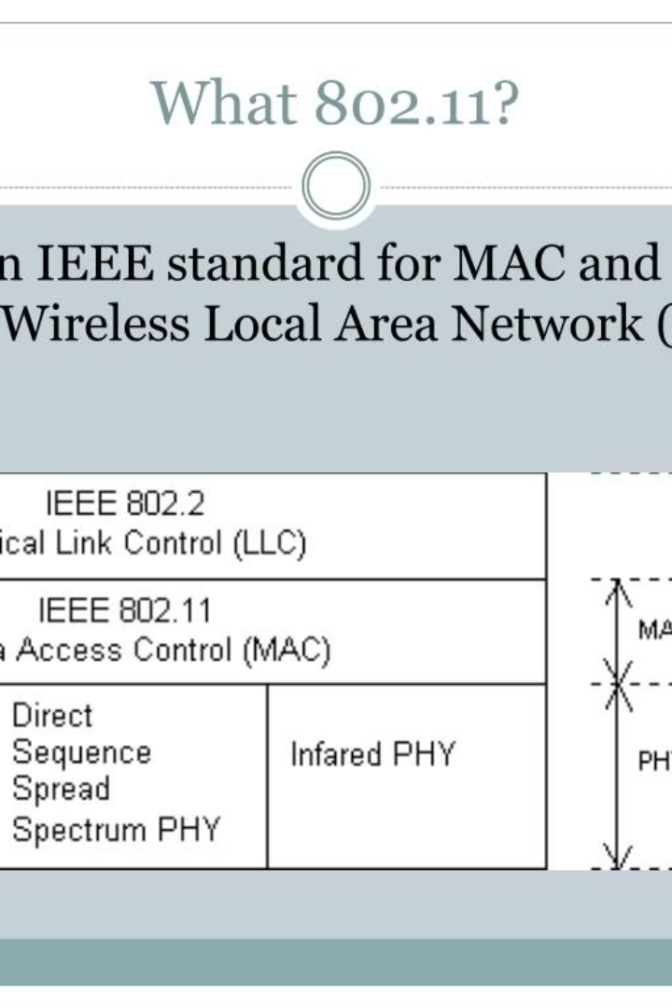

Introduction to Mac Management in IEEE 802.11
Mac Management in IEEE 802.11 is a critical aspect of wireless network management. It encompasses various functionalities that are essential for the efficient operation and coordination of wireless devices within the network. These functionalities include synchronization, power management, roaming, and maintenance of the management information base. Each of these components plays a vital role in ensuring the smooth and seamless functioning of wireless communication systems within the IEEE 802.11 standard.

Slide 2
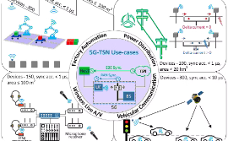
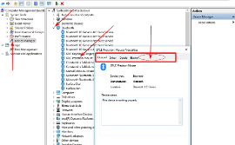
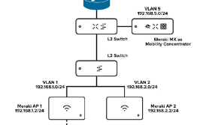
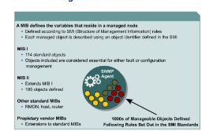
Mac Management Functional Group in IEEE 802.11
Synchronization
Power Management
Roaming
Management Information Base
Synchronization is a fundamental aspect of Mac management in IEEE 802.11. It involves the coordination of timing and frequency among wireless devices to ensure effective communication and data transmission.
Roaming facilitates the seamless transition of wireless devices between different access points within the network, ensuring uninterrupted connectivity and communication during device mobility.
This critical functionality focuses on optimizing the power consumption of wireless devices, thereby extending their battery life and ensuring sustainable operation while minimizing energy usage.
The management information base serves as a repository of network-related data, providing crucial information for network management and facilitating effective decision-making for network

