Slide 1
Machine Learning for Video Games
P.Sivakishore
2017HD12517

Slide 2
Abstract
The issue of Video Game industry is to put lot of manpower to test AAA Games to small Indie Games. Therefore, we intended to aid in testing the game using Machine Learning that involves concepts like Neural Networks and Deep Learning. This can be achieved by training Artificial Intelligence using data set generated while playing the game. Then the data set is processed through deep learning and neural networks to generate datasets. Once the Neural Network dataset is generated, this dataset can be feed to Game player so that it can played by itself for maximum profit. By this we can play the game number of times and look for crash and bugs in the gameplay that can be fixed in development stage and thereby reducing the development cost and manpower required for making the game a GOLD BUILD. From this project, we hope to build an alternative way to test Video Game for Game Industry using Machine Learning.

Slide 3
POC
For proof of concept we are developing a Tetris game in python and implement Deep Learning and Neural Network that generates the data set that helps the Game to play itself automatically and helps to reproduce the bugs in the game. The project also involves in concept like serialization and deserialization of data.

Slide 4
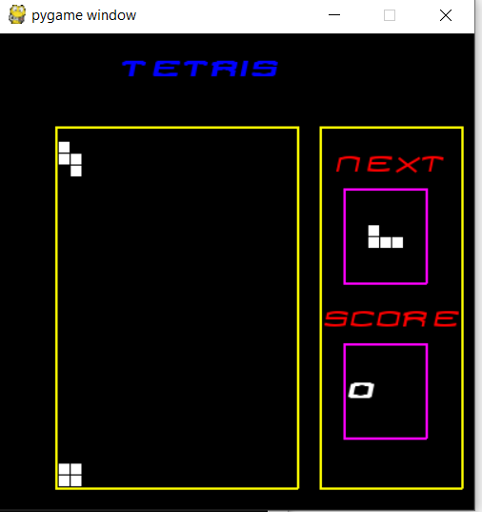
Things done
Get a route map to use matrix representation for building the game
Developing Tetris game from scratch using python
Add Next and Score to the game
Finished the implementation of the game
Getting open source neural network library (Pytorch)

Slide 5
Things to Do
Implement serialization class for game
Generate game data and save in serialized format
Develop neural network class to accept serialized game data
Train the data using neural network class created
Extend game to play from dataset generated from neural network
See if the game plays itself
Conclusion and finds
Report updating parallelly

