Slide 1
Windows Endpoint SIEM and SOC Console
Presented by Y Nishanth Reddy
“I developed this Windows Endpoint SIEM and SOC Console as an internship project to monitor Windows security events and endpoint information through a standalone web interface.”

Slide 2
ConTENTS
Topics Covered
Introduction & Objectives
Technology Stack
System Architecture
Event Collection
Detection & Correlation
Endpoint Monitoring
Web Console & Alerts
Database Results
Testing & Limitations
Future Scope
Conclusion

Slide 3
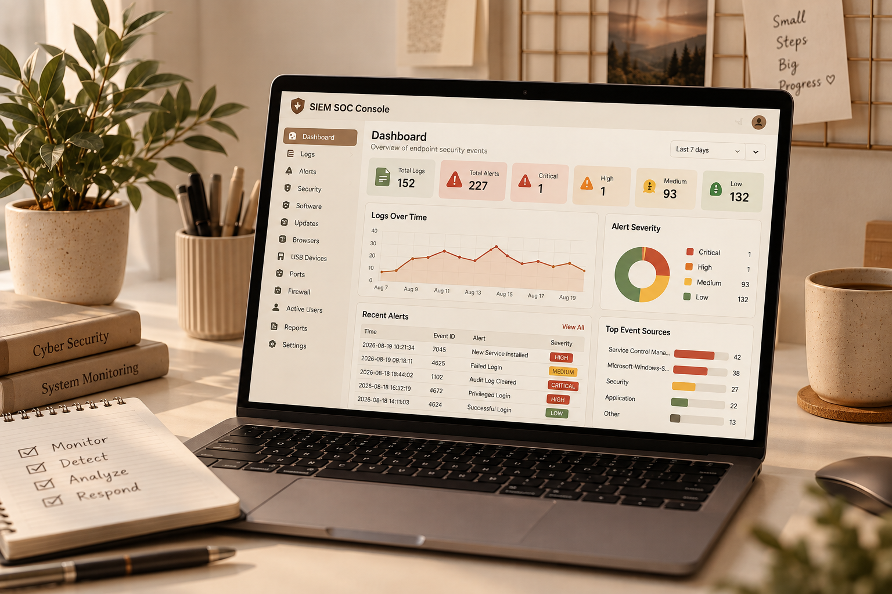
Introduction
Windows generates a large number of system and security events every day.
Checking these logs manually can be time-consuming.
I developed a Windows-focused SIEM and SOC console that:
Collects Windows event logs
Detects suspicious activity using rules
Monitors the endpoint
Shows alerts through a web dashboard
It also monitors software, updates, browsers, USB devices and security settings.
Important: If Windows cannot provide a value, the system shows UNKNOWN instead of making up data.

Slide 4
OBJECTIVES
Main Objectives
Collect Windows Security, System and Application logs
Store logs and alerts in SQLite
Detect suspicious events using clear rules
Correlate related alerts
Monitor endpoint security information
Provide a simple SOC dashboard
Generate CSV and PDF reports
The main idea is to bring important security information into one place.

Slide 5
Technology stack
Component | Technology used
Programming Language | Python
Web framework | Flask
Database | SQLite
Windows Event Collection | Pywin32
Endpoint Commands | PowerShell/Windows APIs
Front end | HTML, CSS, JavaScript
Reports | PDF/CSV

Slide 6
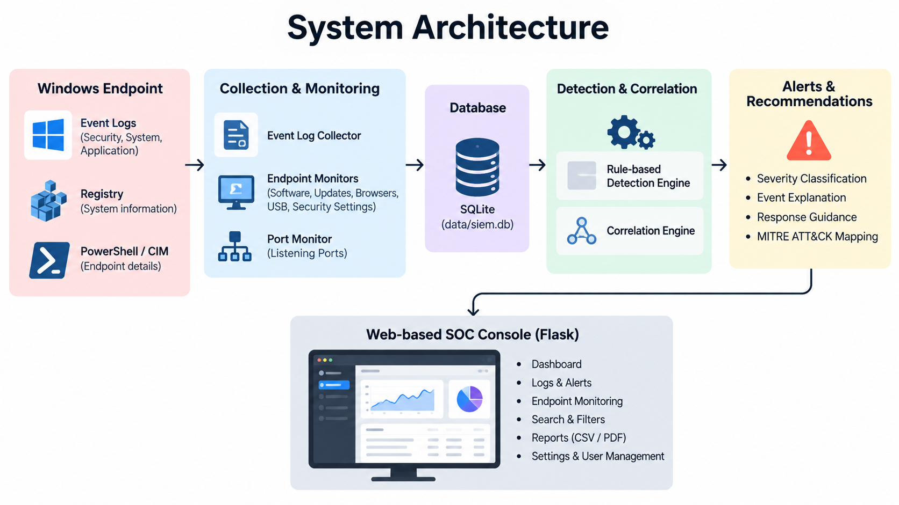
System architecture
How the system works
Windows Endpoint
↓
Log Collector + Endpoint Monitors
↓
SQLite Database
↓
Detection Engine
↓
Correlation Engine
↓
Alerts & Recommendations
↓
Flask SOC Console
The system follows a simple flow:
Collect → Store → Detect → Correlate → Alert → Display

Slide 7
Main modules
File | Purpose
app.py | Flask routes, APIs, dashboard data
collector.py | Reads Windows Event Logs
database.py | SQLite schema, inserts, queries
detector.py | Rule-based detection
correlation_engine.py | Combines related alerts
severity_policy.py | Severity and event explanations
recommendations.py | Response guidance, MITRE mapping
endpoint_monitor.py | Runs software, update, browser, settings and USB checks
port_monitor.py | Lists listening TCP/UDP port
report_generator.py | CSV and PDF reports

Slide 8
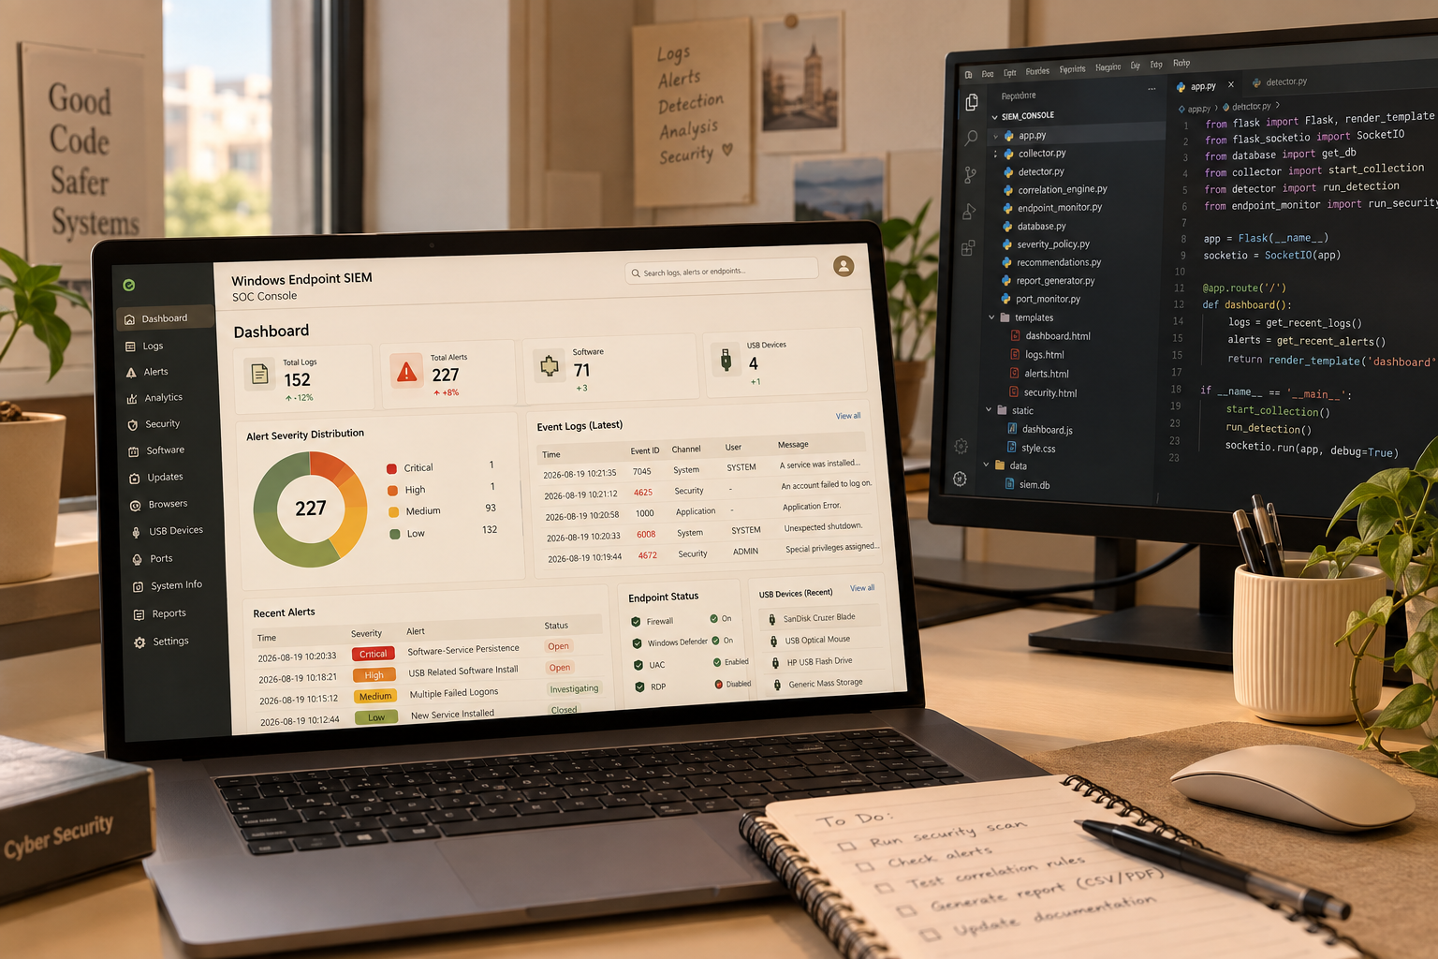
EVENT COLLECTION
Collecting Windows Events
The system reads:
Security
System
Application
Collection process
Runs every 10 seconds
Reads only new events
Stores important event details
Uses a fingerprint to avoid duplicates
Supports up to 75 records per channel per cycle
Security log access works best with Administrator privileges.

Slide 9
Detection Rules
Event / condition | Alert | Severity
462c5 | Failed Login | MEDIUM
3+ failures | Multiple Failed Logins | HIGH (CRITICAL at 8+)
8+ failures | Brute Force | CRITICAL
Failures for 5+ users from one source | Password Spray | CRITICAL
4672 / 4719 / 4720 | Privilege escalation / audit policy / new user | HIGH
4724 / 4732 / 4740 | Account changes | HIGH
1102 | Audit Log Cleared | CRITICAL
6008 | Unexpected Shutdown | HIGH
7031 / 7034, 1000 / 1026 | Service or application crash | MEDIUM
4616 | System time changed | Based on size of change

Slide 10
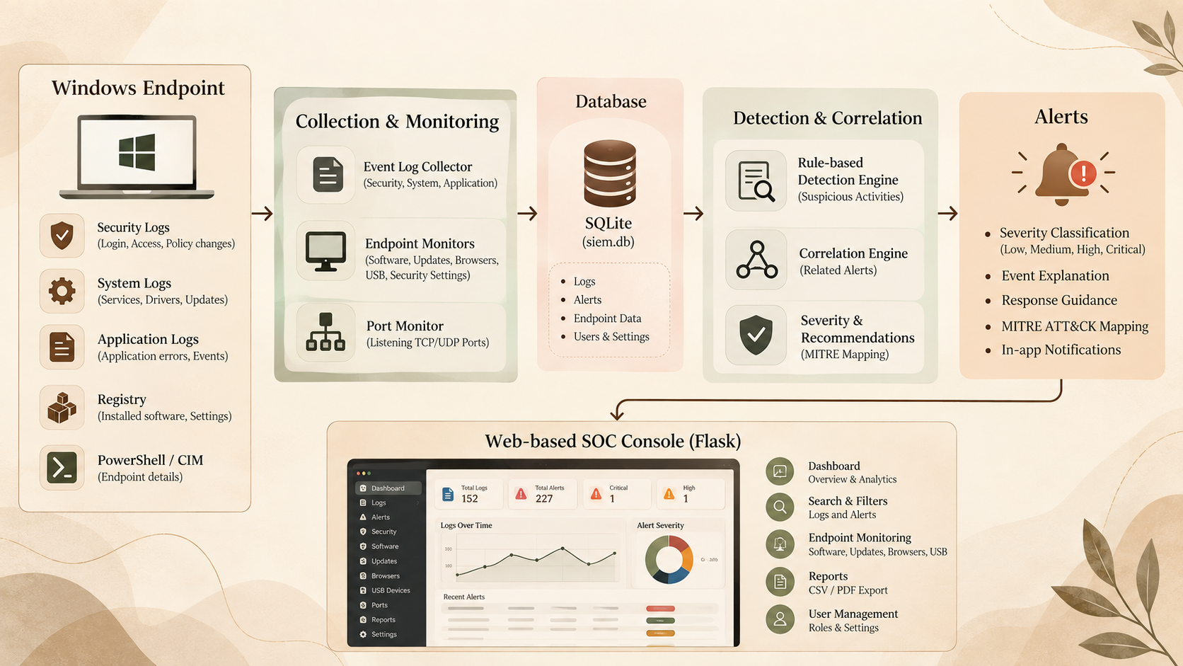
New service detection
Event 7045 — New Service
A new Windows service is not always malicious, so the system checks its file path.
LOW
Known vendor paths such as Microsoft, Google or Mozilla
MEDIUM
Unknown path that needs review
HIGH
Suspicious locations or commands such as:
AppData / Temp / PowerShell / rundll32 / regsvr32
Each alert also includes:
Explanation
Recommendation
MITRE ATT&CK reference

Slide 11
Correlation rules
Alerts seen together | Correlated alert | Severity
Clock backdated + Audit Log Cleared | CLOCK_CHANGE_AND_LOG_TAMPERING | CRITICAL
Unregistered software + New Service Installed | SOFTWARE_SERVICE_PERSISTENCE | CRITICAL
USB first seen + Unregistered software | USB_RELATED_SOFTWARE_INSTALL | HIGH
Firewall disabled + Defender disabled | DEFENSES_IMPAIRED | CRITICAL
The engine checks the latest 200 alerts and creates a correlated alert when the required conditions are present.

Slide 12
Endpoint Monitoring
Check | What it does | Interval
Software | Detect installed/unregistered programs | 5 min
OS updates | Checks recent windows updates | 1 hour
Browsers | Check Supported browser versions | 5 min
Security settings | Firewall, RDP ,UAC | 5 min
USB devices | D first-seen devices | 30 sec
"Run Security Scan" on the /security page runs all of these checks on demand.

Slide 13
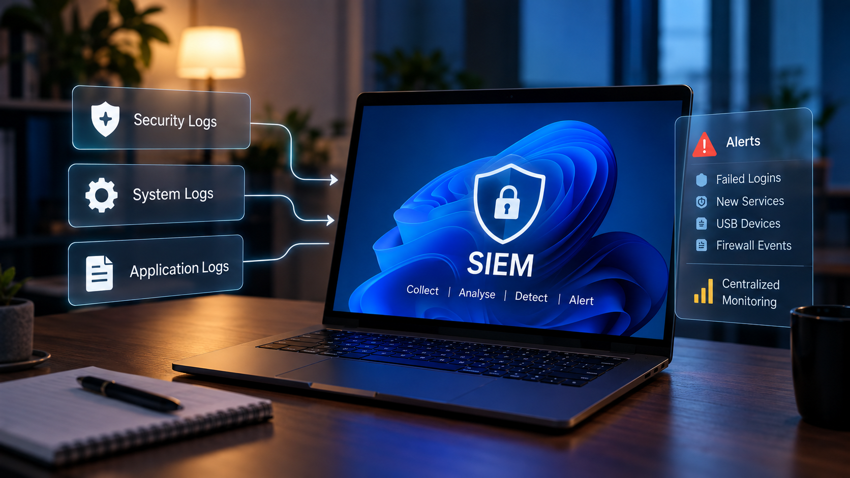
TIME INTEGRITY & UNKNOWN HANDLING
The system monitors Event 4616 for system clock changes.
60+ seconds backwards → Warning
300+ seconds backwards → Critical
Thresholds can be configured
Changing the system clock can affect the order of events, so it can be important during investigation.
UNKNOWN Handling
If Windows cannot provide a value because of missing permissions or information, the system shows:
UNKNOWN
It does not guess the result.

Slide 14
Web Console Pages
Page | Shows
Dashboard | Log and alert counts, charts, live notifications
Logs / Alerts | Searchable, filterable records with explanations
Analytics | Event and alert distributions
Security | Endpoint posture and Run Security Scan
Software, Updates, Browsers, USB | Inventories and change history
Ports | Listening ports with PID and process
Firewall, Active Users, System Info | Firewall events (5156/5157/5158), sessions, host details
Reports, Settings | CSV/PDF export, themes, thresholds, roles

Slide 15
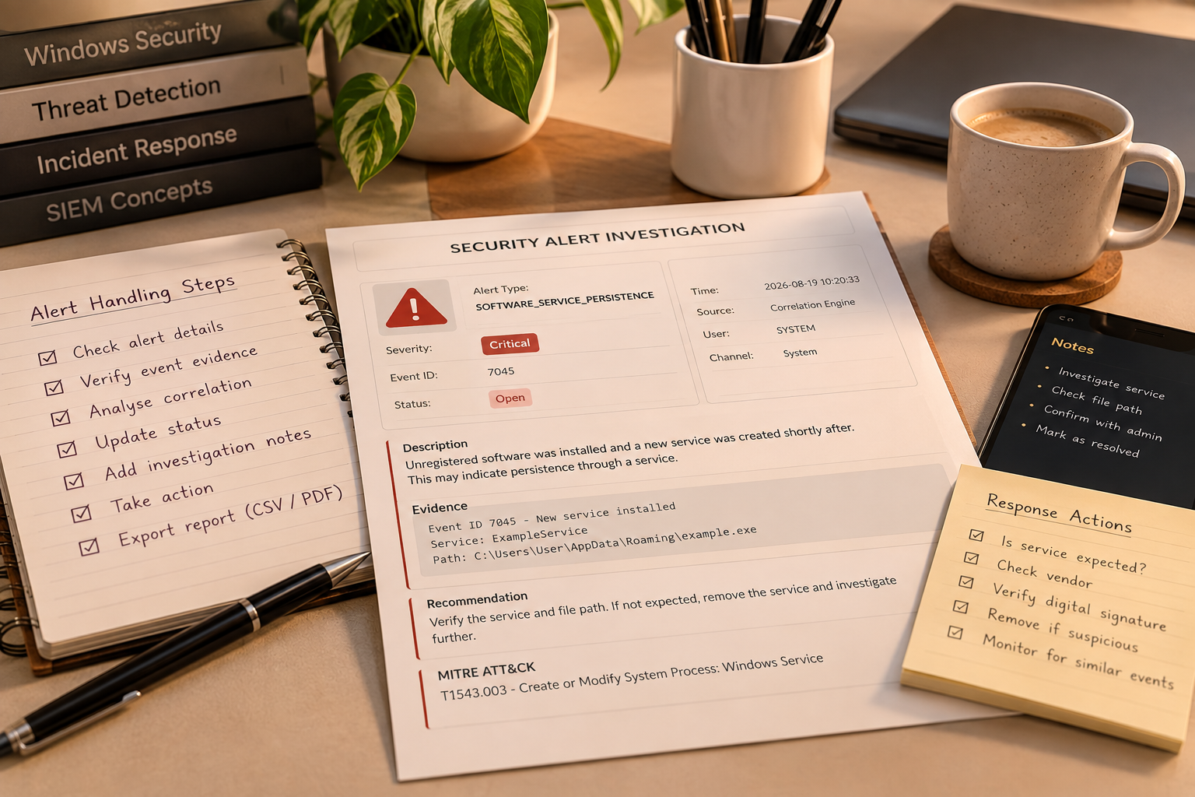
ALERT HANDLING & REPORTS
Alert Management
Each alert shows:
Severity
Evidence
Threat description
Recommendation
MITRE reference
I can also:
Change alert status
Assign alerts
Add investigation notes
Filter and search alerts
Export data as CSV/PDF
Duplicate alerts are also reduced using an alert key.

Slide 16
Results: Database Contents
Table | Records
Logs | 152 (System 76, Application 76, Security 0)
Alerts | 227
Notifications | 95
Software inventory | 71
System updates | 4
Browser inventory | 2
USB devices / USB events | 4 / 4
System settings | 3
Endpoint snapshots | 1

Slide 17
Results: Alerts
Severity | Alerts
CRITICAL | 1
HIGH | 1
MEDIUM | 93
LOW | 132
The CRITICAL alert is SOFTWARE_SERVICE_PERSISTENCE and the HIGH alert is USB_RELATED_SOFTWARE_INSTALL; both come from correlation. "Other" = NO_RECENT_OS_UPDATE and the two correlated alerts.

Slide 18
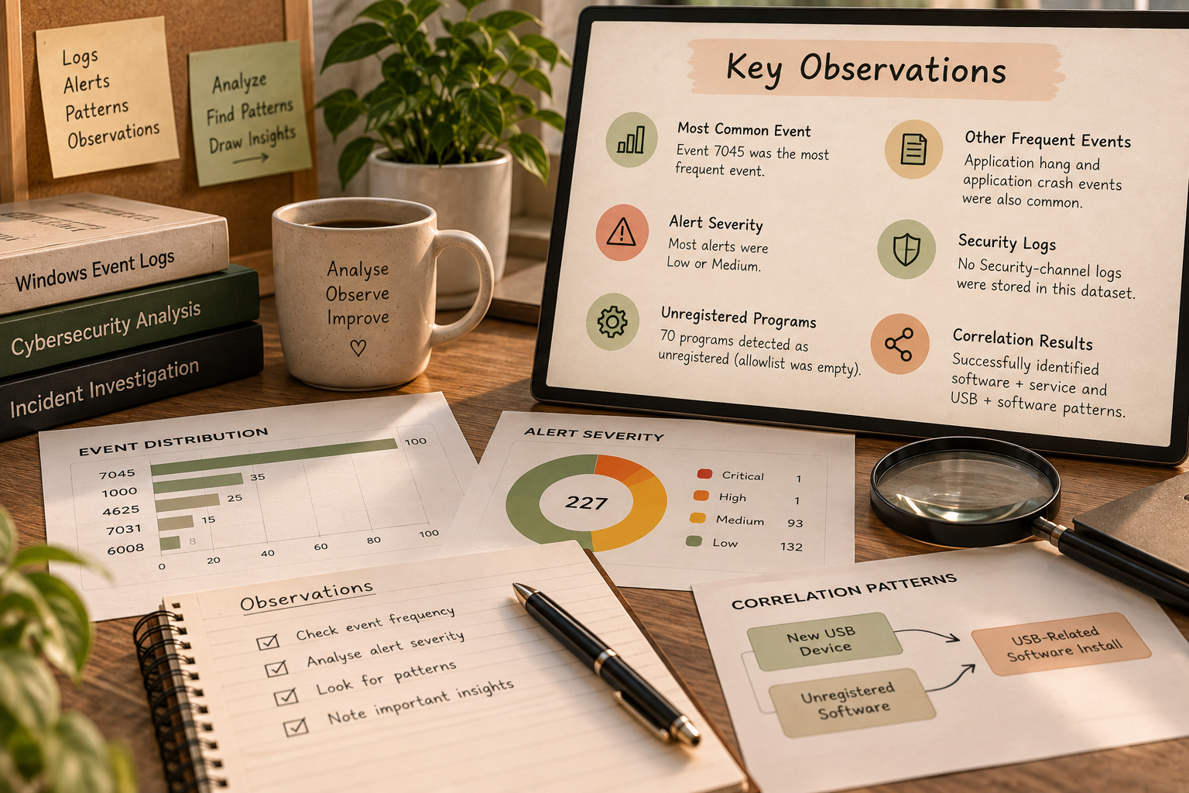

observations
What I observed from the results
Event 7045 was the most common event
Application Hang and Application Crash events were also frequent
Most alerts were LOW or MEDIUM
No Security-channel logs were stored in this dataset
70 programs were flagged as unregistered because the allowlist was empty
Correlation successfully identified software + service and USB + software patterns
The results show that the system can detect and organize real endpoint activity.

Slide 19
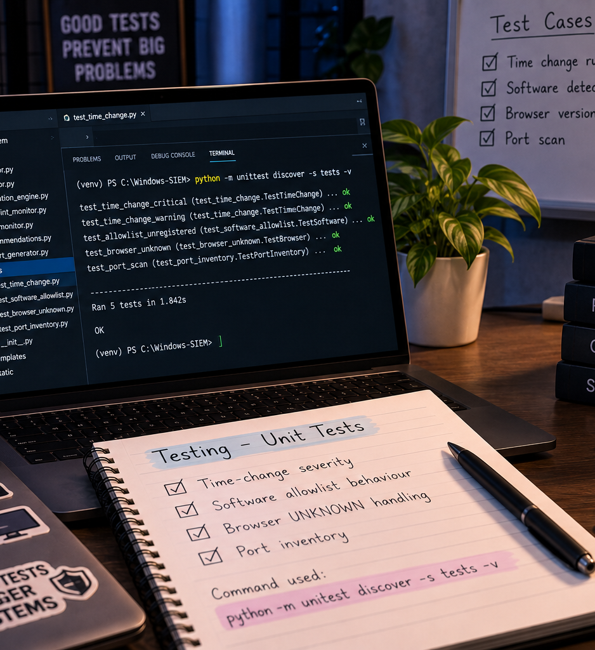

TESTING
I created 4 unit tests for important endpoint rules.
The tests cover:
Time-change severity
Software allowlist behaviour
Browser UNKNOWN handling
Port inventory
Command used:
python -m unittest discover -s tests -v
The current tests mainly cover individual rules. Integration and security testing can be added later.

Slide 20
LIMITATIONS & SECURITy
Current Limitations
Tested on one Windows machine
Rule-based detection only
No machine learning
Security-channel rules need more validation
Firewall events require Windows auditing
SSO/MFA/Syslog/Webhooks are not fully connected
Standalone version has no login
Security Note
The SQLite database contains system and security information, so it must be properly protected

Slide 21
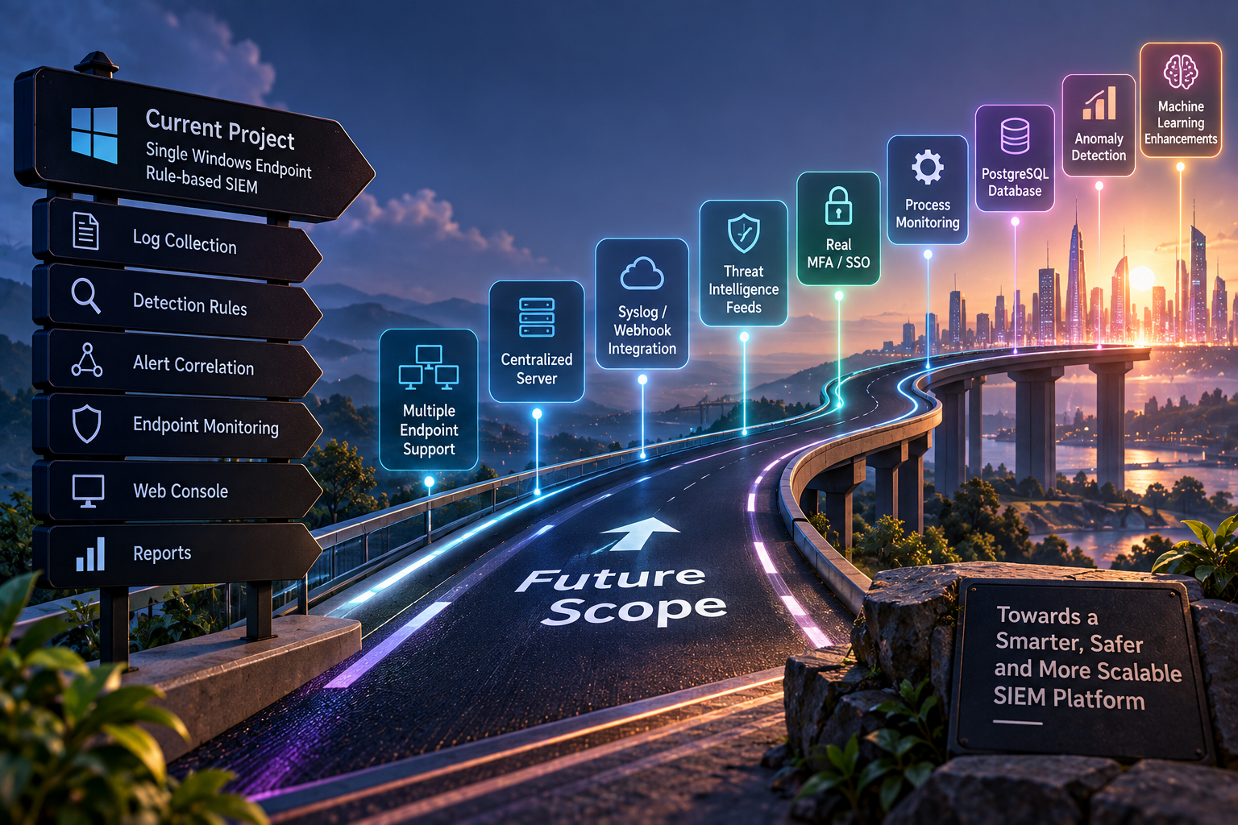
FUTURE SCOPE
I can improve the system by adding:
Security-channel test data
Monitoring for multiple endpoints
Centralized server
Working Syslog/Webhook integration
Threat-intelligence feeds
Real MFA/SSO
Process monitoring
PostgreSQL database
More integration tests
Anomaly detection
The goal is to move the project closer to a real-world SOC platform

Slide 22
CONCLUSION
I developed a Windows-based SIEM and SOC console that:
Collects → Detects → Correlates → Alerts → Reports
The system successfully collected Windows logs and endpoint information and presented them through a single web console.
It gave me practical experience with:
Windows Event Logs
SIEM concepts
Python
Flask
SQLite
Security monitoring
One important point I learned is that an alert indicates something that needs investigation; it does not automatically mean the system is compromised.

Slide 23
THANK YOU
Y Nishanth Reddy
B.Tech – Cyber Security
Sreenidhi Institute of Science & Technology

