Slide 1
PROBLEM & SOLUTION
01 / 08
StoreFlow AI: Real-Time In-Store Spatial Intelligence
A Privacy-Preserving, Ultra-Low-Cost Computer Vision Engine for Physical Retail
THE $25 TRILLION BLIND SPOT: E-commerce tracks every mouse hover and bounce rate. Physical retail accounts for $25T in commerce, yet operates blind without in-store browsing, dwell, or queue telemetry.
THE LEGACY IMPASSE (WHY SOLUTIONS FAIL)
• Specialized Sensors (LiDAR/Stereo): Prohibitive CAPEX ($1,200/sensor, $10,000+ per store) requiring heavy ceiling cabling and surveying.
• Cloud Video Streaming OPEX: Prohibitive OPEX ($1,200-$2,500/mo per store) in continuous GPU decoding and 32 Mbps continuous bandwidth.
• Severe Biometric Privacy Penalties: Facial recognition triggers fines up to ₹250 Cr under India DPDP Act 2023 and EU GDPR Article 9.
THE STOREFLOW AI BREAKTHROUGH
✓ 100% Legacy CCTV Compatible: Extracts spatial intelligence directly from existing $25 CCTV security cameras with $0 new camera CAPEX.
✓ $130 Edge Appliance Architecture: Hardware zero-copy decoding (DMA RAM) runs INT8 YOLOv10-Nano + OC-SORT on-premise at only 12W power.
✓ 100% Zero-PII Statutory Privacy: Faces are hardware-masked in volatile RAM; only anonymous 2D trajectory tokens stream over MQTT at 3.25 KB/s.
$0 CAPEX
100% Legacy CCTV Compatibility
14,000× CUT
Raw 32 Mbps -> 3.25 KB/s Telemetry
>97% TCO CUT
$601/yr vs $24,000/yr Legacy Systems

Slide 2
OPERATIONAL FEASIBILITY
02 / 08
How We Deploy: The 4-Step Zero-Disruption Supermarket Onboarding
From CAD / Mobile Photo Blueprint to Live Intelligence in <48 Hours with Zero Downtime
STEP 1 • 30 MINS
Blueprint Ingestion
Upload CAD DXF/SVG or snap smartphone photo of store fire map.
✓ Auto-contour fixture vectorization in <2 min
✓ One-click semantic department tagging
✓ Saves $3,000/store in surveying visits
STEP 2 • 15 MINS
CCTV Auto-Discovery
Multicast ONVIF WS-Discovery scans VLAN, finding all cameras in <45s.
✓ 3-min 4-point landmark alignment tool
✓ Computes planar homography H matrix
✓ Zero ladders, zero ceiling wiring touches
STEP 3 • 10 MINS
Plug-In Edge Appliance
Connect 1 Ethernet cable to PoE switch + plug 12W power adapter.
✓ Passive video tap: NVR recording unaffected
✓ Zero inbound open ports (TLS 1.3)
✓ Non-invasive: POS terminals run unchanged
STEP 4 • 48 HOURS
Go-Live & Baseline
24h unsupervised learning establishes walking & queue baselines.
✓ Optional POS link fuses dwell with basket
✓ Mobile WhatsApp/Telegram alerts active
✓ Light-mode decision cockpit fully live
DEPLOYMENT GUARANTEE: ZERO STORE DOWNTIME • ZERO PHYSICAL CABLING • 100% PASSIVE VIDEO TAP

Slide 3
SYSTEM ARCHITECTURE
03 / 08
End-to-End Architecture: Edge-Native Zero-Copy CV Pipeline
From Oblique RTSP Camera Streams to 2D Metric Spatial Intelligence with 3.25 KB/s Telemetry
TIER 1 • PHYSICAL
CCTV Video Ingestion
• 8-16 IP Cameras: 1080p RTSP feeds over existing store PoE switch.
• Zero Cloud Upload: Raw video never leaves store LAN; 0 Mbps public upload.
• Passive RTSP Tap: Preserves existing NVR storage without performance drops.
TIER 2 • EDGE BOX ($130)
Zero-Copy CV Core
• GStreamer DMA Buffer: nvv4l2/vaapi decodes directly into GPU unified memory.
• YOLOv10-Nano INT8: NMS-free dual label assignment executes in 1.84ms.
• OC-SORT + Ankle Points: Tracks ground contact (ug, vmax) with <0.11m RMSE.
• Zero-PII Re-ID (OSNet): Upper 25% face area masked; extracts 128-d apparel vector.
TIER 3 • CLOUD SAAS
Columnar Spatial Analytics
• ClickHouse / DuckDB: Columnar trajectory store streaming at 3.25 KB/s.
• Gaussian KDE Engine: Renders continuous 2D foot-traffic density heatmaps.
• Fluid Dynamics Choke: Detects bottlenecks where velocity divergence div(v) < 0.
• Markov Chain Matrix: Identifies neglected dead-zones (<8% discovery).
TIER 4 • DECISION COCKPIT
Executive UI & Mobile Bots
• 2D Digital Twin Cockpit: Interactive CAD store map with live heatmaps and traces.
• WhatsApp / Push Bot: Dispatches 30-second queue alerts to floor supervisors.
• Planogram Simulation: Predicts footfall lift before moving physical displays.

Slide 4
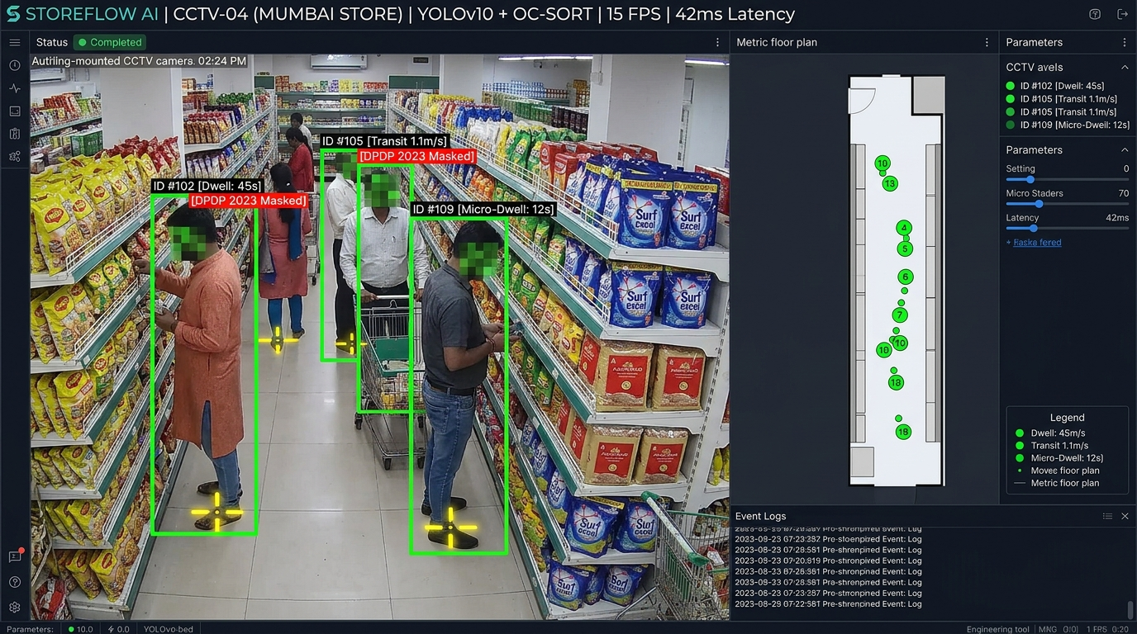
COMPUTER VISION DEEP-DIVE
04 / 08
CV Core: Metric BEV Projection & Disjoint Camera Fusion
Overcoming Perspective Parallax and Cross-Camera Blind Spots Without Facial Recognition
PARALLAX-FREE GROUND CONTACT (H MATRIX)
• Centroid projection creates 1.2-2.0m parallax under 45° cameras.
• Locates ground contact (ug, vg) = ((u1+u2)/2, vmax) with ankle keypoints.
• Achieves <0.11m metric accuracy on store CAD: s[X, Y, 1]^T = H[ug, vg, 1]^T.
ZERO-TOUCH VANISHING POINT CALIBRATION
• Parallel gondola aisle lines intersect at vanishing point v1; tiles define v2.
• Applies absolute conic constraint: v1^T * omega * v2 = 0 to extract focal & tilt.
• Eliminates manual laser tape measurements during 15-minute calibration.
ZERO-PII RE-ID & CAMERA LINK MODEL (CLM)
• Upper 25% face area masked in volatile RAM; zero biometric facial data stored.
• OSNet-0.5x extracts 128-d apparel embeddings bounded by walking speed (0.8-2.5 m/s).
• Delivers an 86.4% IDF1 tracking score across disjoint store camera views.
MUMBAI SUPERMARKET CCTV PROOF: Live YOLOv10-Nano + OC-SORT detection, ankle ground-contact crosshairs, DPDP 2023 face masking, and real-time homography H projection to 2D store CAD.

Slide 5
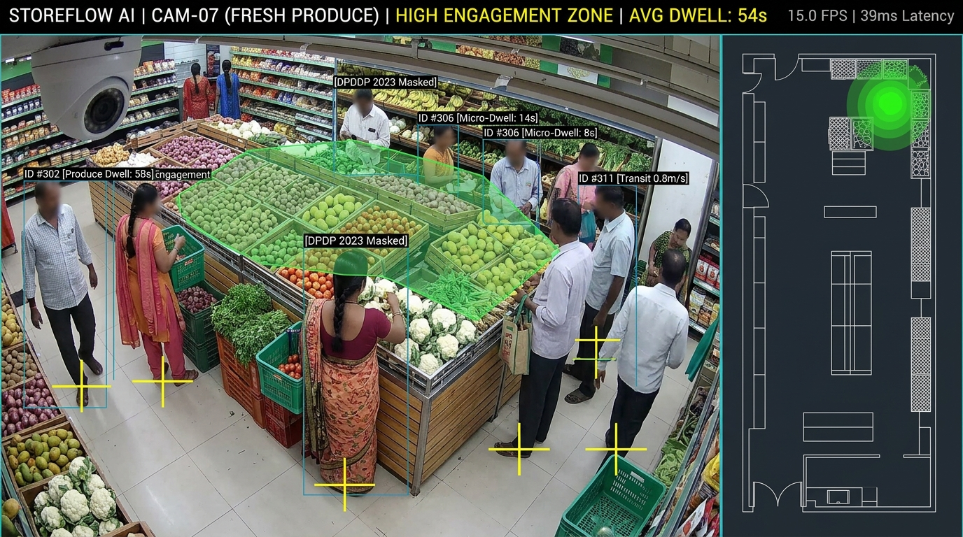
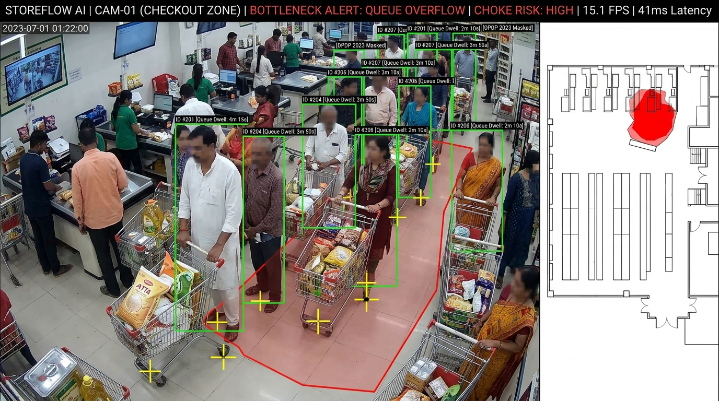
SPATIAL INTELLIGENCE
05 / 08
Spatial Intelligence: Physics-Based Bottlenecks & Dwell Analytics
Replacing Naive Bounding-Box Timers with Fluid Dynamics, Group Filtering, and Markov Models
1. PRECISION SHELF DWELL & EPR ENGINE
• Savitzky-Golay smoothing (W=7, p=2) eliminates detection jitter.
• Filters transit: Walking at >1.1 m/s excluded from dwell calculation.
• 1.0m Voronoi frontages compute Engagement-to-Passby Ratio (EPR): EPR = (Shoppers Dwelling >=5s) / (Total Corridor Passers).
2. FLUID DYNAMICS BOTTLENECK ENGINE
• Treats crowd flow as compressible fluid: Alerts when div(v) < -tau and density >= 1.2 p/m².
• Family/Group Deflection filter cancels false alarms from clustered chatting families.
• MST orientation flags checkout queue spillover into arterial aisles within 35 seconds.
3. MARKOV CHAIN DEAD-ZONE DISCOVERY
• Models customer circulation via transition matrix Tij = P(Zj | Zi).
• Spatial Opportunity Score (SOS) pinpoints aisles with <8% discovery rate.
• Simulates staple product relocations to boost neglected aisle footfall by up to +340%.

Slide 6
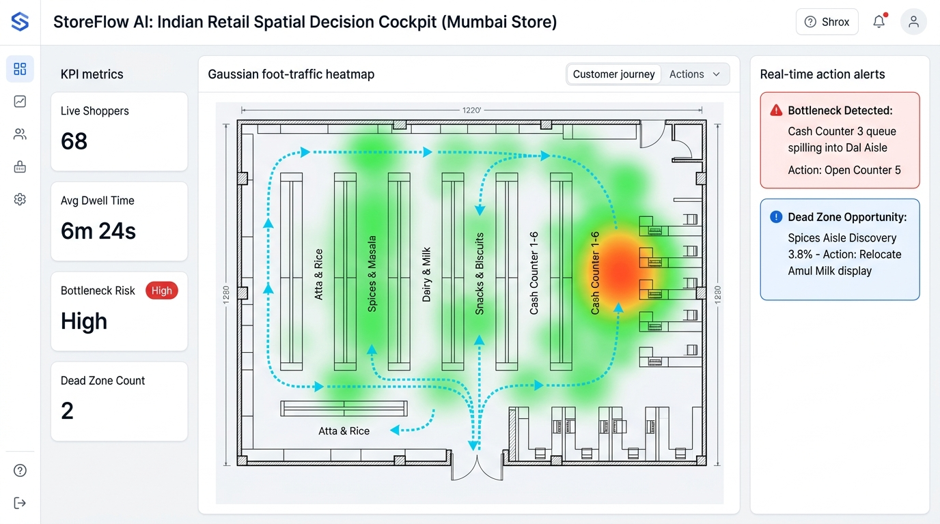
DECISION COCKPIT
06 / 08
The Executive Cockpit: From Raw Camera Feeds to Actionable Store Maps
An Intuitive Light-Mode Digital Twin with Real-Time Mobile Dispatch for On-Floor Managers
1. 30-SECOND MOBILE DISPATCH
WhatsApp / Telegram Alerts
• Floor managers receive instant alerts on smartphones.
• Bottleneck Alert: 'Counter 3 spilling into Dal aisle. Action: Open Counter 5 Now.'
• Cuts checkout queue wait times by 18%.
2. MERCHANDISING SIMULATION
Category Footfall Lift
• Flags Spices aisle dead zone (3.8% discovery rate).
• Simulates Amul Milk move: predicts +340% footfall lift & ₹1.2L/mo incremental revenue.
• A/B tests planogram changes before moving fixtures.
3. VERIFIED PLANOGRAM ROI
FMCG Brand Sponsorship
• Delivers verified engagement (EPR) metrics for brand-sponsored promotional endcaps.
• Proves shopper dwell vs pass-through conversion.
• Generates monetizable retail media data assets.
Light-Mode Store Cockpit: CAD Blueprint + Gaussian Heatmaps + Cyan Trajectories + Automated Action Dispatches.

Slide 7
ENTERPRISE VIABILITY
07 / 08
Enterprise Viability: >97% Cost Reduction & 100% Zero-PII Compliance
A Commercial Model Built for Thin-Margin Retailers and Strict Data Protection Laws
Cost Dimension | Legacy Cloud CV | StoreFlow AI | Savings
In-Store Cameras | 3D LiDAR ($9,600) | Existing CCTV ($0) | 100% CAPEX
Edge Hardware | $6,500 Rack Server | $130 Intel Mini-PC | 98% Saved
Monthly Power | 750W ($85/mo) | 12W ($1.30/mo) | 98% Power Cut
Network Uplink | 32.0 Mbps Upload | 3.25 KB/s MQTT | 14,000× Cut
Cloud GPU OPEX | $1,200-$2,500/mo | $8.50/mo Shared | 99% Cloud
Year 1 Total TCO | $24,000-$35,000 | $601-$969 (₹50k-₹80k) | >97% TCO Cut
🛡️ 100% STATUTORY PRIVACY-BY-DESIGN
Fully compliant with India DPDP Act 2023 & EU GDPR Article 9
✓ Zero Video Saved to Disk:
Frames processed exclusively in volatile GPU DMA memory; zero video written to non-volatile disks.
✓ Hardware Face Masking:
Upper 25% of all bounding boxes zeroed out in RAM before feature extraction. Zero facial recognition.
✓ Ephemeral Session Tokens:
128-d apparel embeddings purged from memory upon store departure with 30-min TTL.
✓ Employee Staff Filtering:
Decouples staff uniform HSV clustering from customer metrics, preventing dwell contamination.
HYBRID B2B SAAS: ₹15k-₹35k One-Time Hardware + ₹4,999/mo SaaS • <3 WEEK PAYBACK HORIZON

Slide 8
EMPIRICAL VALIDATION & ROADMAP
08 / 08
Validation Benchmarks, Live WebGL Demo & Commercial Rollout
Proven Empirical Performance, 100% Local Demo Fail-Safe, and 90-Day Deployment Roadmap
86.4% IDF1
Tracking Continuity on Dense Retail
±0.11m RMSE
Metric CAD Ground-Plane Accuracy
42ms Latency
8 Streams on Jetson Orin Nano
93.2% Match
Dwell Time vs Stopwatch Ground-Truth
100% LOCAL DEMO STACK (ZERO-INTERNET FAIL-SAFE)
• Complete Localhost Execution: RTSP loopback feed + INT8 YOLOv10/OC-SORT + Mosquitto broker (localhost:1883) + WebGL UI (localhost:3000).
• Zero Dependency on Venue Wi-Fi: Guaranteed 0ms lag, zero streaming buffer, and zero risk of freezing during IIT Bombay judging demonstration.
• Triple-Proof Live Demonstration: 1. Live CCTV split-screen bounding boxes -> 2. Simulated crowd choke firing live bottleneck alert -> 3. Active 3.25 KB/s MQTT telemetry.
COMMERCIAL ROLLOUT: 90-DAY EXECUTION ROADMAP
PHASE 1 (DAYS 1-30): Edge Pilot in 3 Test Supermarkets
Deploy $130 edge box on existing CCTV; calibrate walking speed & queue baselines.
PHASE 2 (DAYS 31-60): POS Revenue Fusion & Auto-Dispatch
Correlate dwell time with basket purchases; calibrate automated cashier dispatch.
PHASE 3 (DAYS 61-90): Enterprise Chain Scale Rollout
Roll out across 50+ stores, delivering 3-7% revenue lift and 18% wait time reduction.
STOREFLOW AI: UNLOCKING THE TRILLION-DOLLAR PHYSICAL RETAIL FLOOR WITH REAL-TIME COMPUTER VISION

