Slide 1

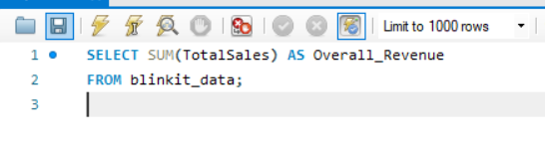
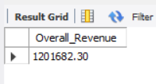


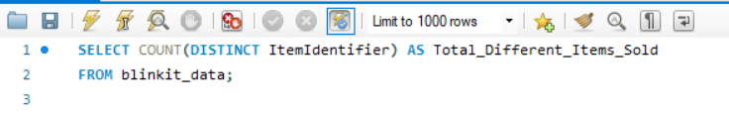
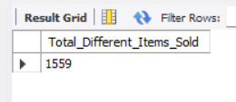
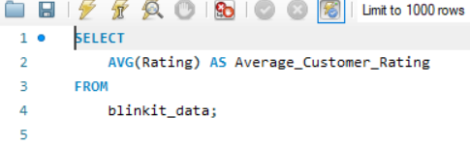


blinkit Analysis
BUSINESS REQUIREMENT
To conduct a comprehensive analysis of Blinkit's sales performance, customer satisfaction, and inventory distribution to identify key insights and opportunities for optimization using various KPIs and visualizations in Power BI.
KPI’s Requirements
1
Total Sales: The overall revenue generated from all items sold.
Average Sales: The average revenue per sale.
Number of Items: The total count of different items sold.
Average Rating: The average customer rating for items sold.
2
3
4

Slide 2
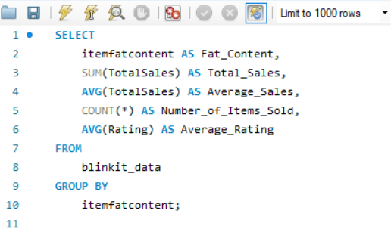
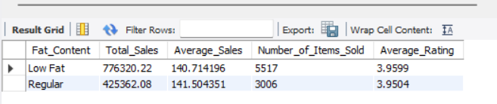
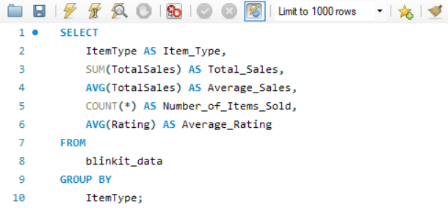
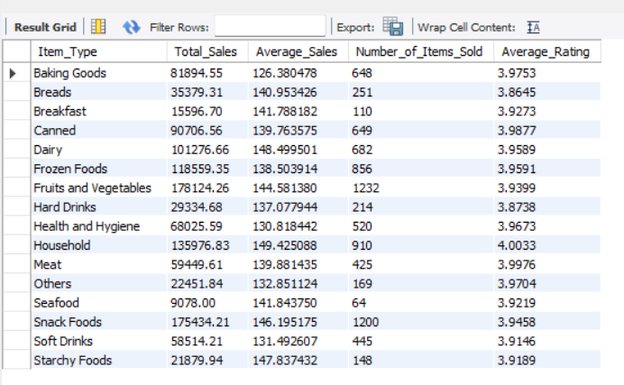
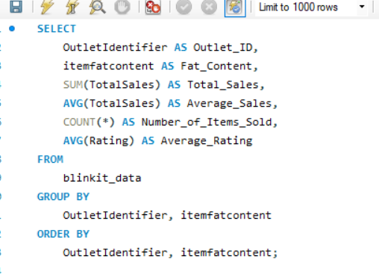
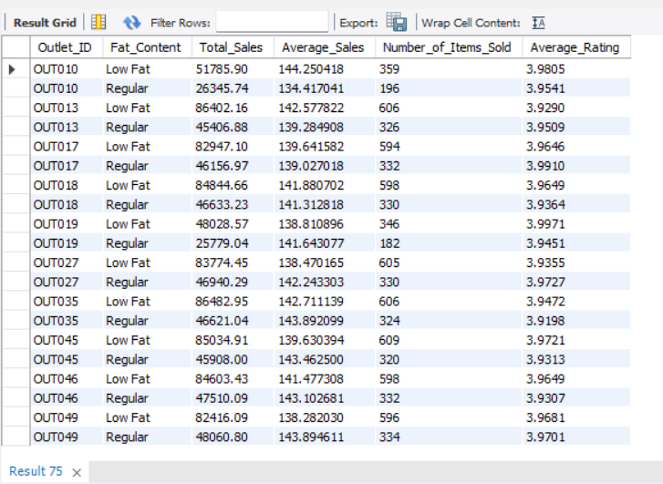
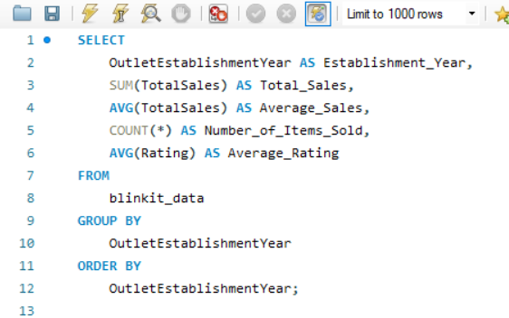
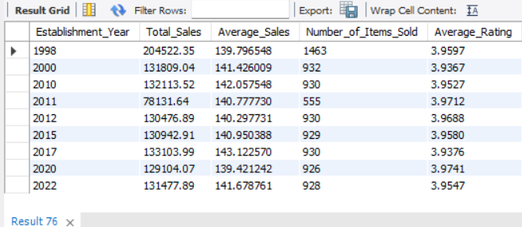
blinkit Analysis
1
BUSINESS REQUIREMENT
2
Granular Requirements
1. Total Sales by Fat Content:
Objective: Analyze the impact of fat content on total sales.
Additional KPI Metrics: Assess how other KPIs (Average Sales, Number of Items,
Average Rating) vary with fat content.
2. Total Sales by Item Type:
Objective: Identify the performance of different item types in terms of total sales.
Additional KPI Metrics: Assess how other KPIs (Average Sales, Number of Items, Average Rating) vary with fat content.
3. Fat Content by Outlet for Total Sales:
Objective: Compare total sales across different outlets segmented by fat content.
Additional KPI Metrics: Assess how other KPIs (Average Sales, Number of Items, Average Rating) vary with fat content.
4. Total Sales by Outlet Establishment:
Objective: Evaluate how the age or type of outlet establishment influences total sales.
3
4

Slide 3
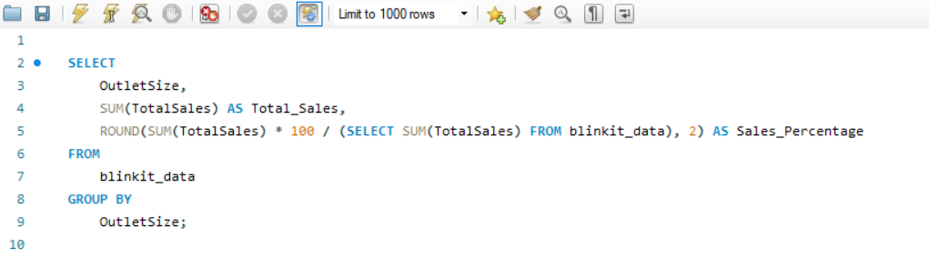
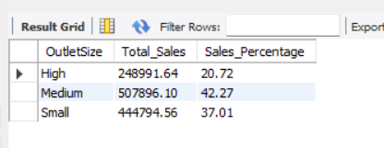
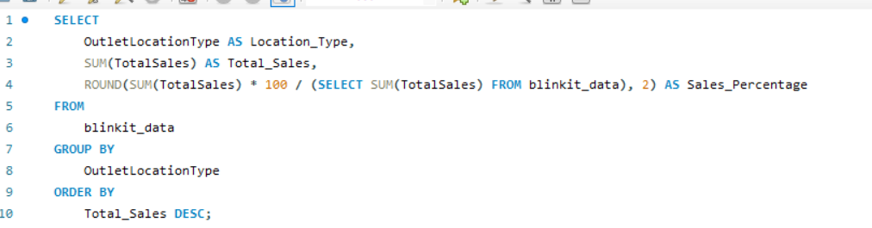
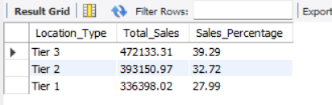
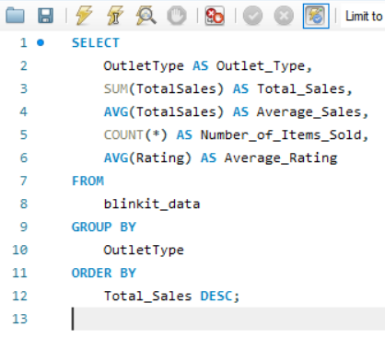
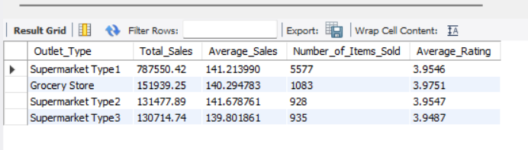
blinkit Analysis
1
BUSINESS REQUIREMENT
Chart’s Requirements
5. Percentage of Sales by Outlet Size:
Objective: Analyze the correlation between outlet size and total sales.
6. Sales by Outlet Location:
Objective: Assess the geographic distribution of sales across different locations.
7. All Metrics by Outlet Type:
Objective: Provide a comprehensive view of all key metrics (Total Sales, Average Sales, Number of Items, Average Rating) broken down by different outlet types.
2
3

