Slide 1
An efficient approach to find optimal network route using Swarm Intelligence
Minor Project - I
Presentation By :
Nishkarsh Raj
Lakshika Parihar
Harsh Joshi
Priyanka Yadav
Project Guide :
Mr. Ahatsham

Slide 2
Abstract
Traditional network routing approach is meant for finding the shortest path from one node in the system to other. They do not account for other costs like network traffic, delay, conversion time for packets to messages and intermediate nodes etc.
Their solution path for one connection is also static but different paths may be optimum depending on the network traffic; i.e., they do not account for experience gathered by previous packets sent in the system.

Slide 3
Keywords
Network Routing
Minimum Spanning Tree
Optimization
PSO algorithm
Swarm Intelligence

Slide 4
PSO Algorithm
Algorithm is based on a population-based technique which was discovered by Kennedy and Eberhart in 1995.
Inspired by the natural social behavior of particles insides swarms or the flock of birds
Movement of particles are based on natural flocking rules which make the particles flow through the best-found solution hoping to find the better one.

Slide 5
All particles move together in sync, they may diverge from each other occasionally but always regroup to share their experience.
In Particle Swarm Optimization Algorithm, a subset of Swarm Intelligence, we optimize network routing by modifying traditional graph algorithms like Minimum Spanning trees by Kruskal’s or Prim’s methods by using cognitive intelligence algorithm to get better optimization
Particle Swarm Optimization algorithm implementation on network routing gives fast convergence speed, has an easy implementation, is cognitive and supports dynamic traffic.

Slide 6
Project Objective
The main objective of the project is to optimize the network route for packets in data transmission.
To tackle the issue of dynamic network factors like traffic, network delay, noise factors etc.
To solve MDR(Multi Destination Routing) problem which cannot be solved effectively using traditional methods.

Slide 7
Network Abstraction
Networks are treated as graphs G(V,E) consisting of V vertices/nodes and E edges.
The graphs are bi-directional (undirected) because data can flow both sides.
Weighted graph is used where weight indicates distance/cost etc.
Connected graph is used as all nodes in a network are connected with each other.

Slide 8
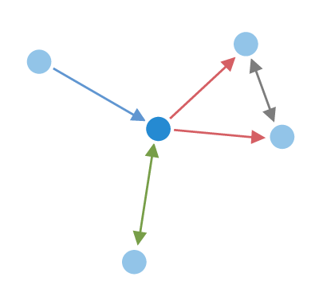
Figure 1 depicts a graph containing 5 vertices and 5 edges. It is a connected and undirected graph that can be used to represent a network.

Slide 9
Kruskal’s Algorithm
Each node is an individual and independent set initially denoted by superset S.
Sort edges in increasing order E.
Add shortest edge that connects two nodes from set E.
Repeat step 3 until all nodes of set S are connected.

Slide 10
Prim’s Algorithm
Create a set MST that keeps track of vertices already in MST (initially empty.)
Assign a key value for all vertices in the graph.
Initialize all key values as infinity except the source vertex marked as 0.

Slide 11
c) While MST set does not include all the nodes of the graph, perform following steps:
Pick a vertex U which is not in MST set and has minimum key value.
Include U in MST set.
Update key values of all adjacent nodes of U.
For every adjacent vertex Vi, if weight U to Vi is less than previous key value of Vi, update the key value of Vi else continue.

Slide 12
Basic flow of PSO Algorithm:
Fill the N-Dimensional space with randomly placed particles.
Initialize each particle property with random inputs for their location and velocity.
Iterate over all particles and perform the Objective function:
If fitness of the current particle is better than its personal best fitness (pbest), change its pbest value to current location vector.
If updated pbest is better than the global particle fitness, update gbest with current pbest value.

Slide 13
4.Update the current particle location vector and velocity and work on the next particle of the population.
5.If the global fitness gbest value meets the minimum threshold condition value, exit the current iteration cycle and stop the algorithm
6.The location vector and velocity for each particle depicts the independent solution for given network.

Slide 14
Particle Swarm Optimization algorithm:
Calculate personal best fitness (pbest) and location of the corresponding particle.
Loop over counter variable to count number of iterations for the algorithm
Loop over number of particles and update each particle’s location and velocity.
Change the weight of each node/particle along the path of each node by using a randomness parameter.

Slide 15
5.Calculate fitness of each particle and determine pbest for each particle in nth iteration.
6.Calculate the minimal personal best (pbest) and global best (gbest) for each particle to decide the shortest path in terms of weight of the associated links.

Slide 16
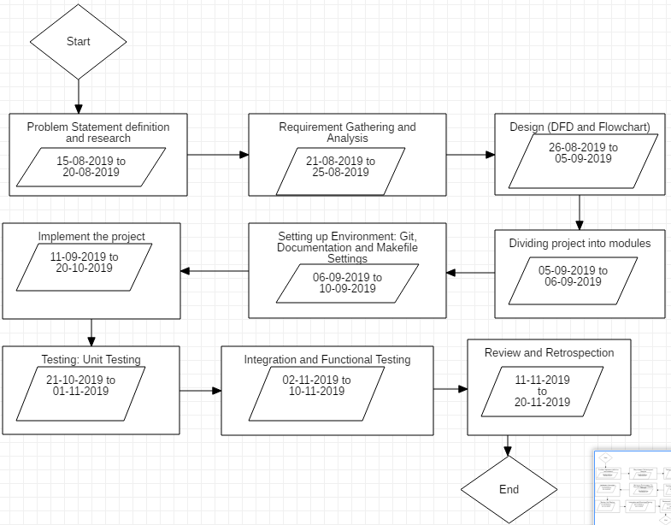
Pert Chart

Slide 17
Thank You

