Slide 1

Classification and Prediction of Skin Deformity Images into Various Diseases Types
Submitted By Submitted To
Amit Kumar Prof. . D.S. Kushwaha
Nishtha Agrawal
Pragati Nigam
Pinkesh Sethiya
Elvis Dcunha

Slide 2
INTRODUCTION
Skin deformities are a common skin condition that can be caused by various factors, such as genetics, environmental factors, and lifestyle choices.
Skin cancers, including melanoma and non-melanoma types like basal cell carcinoma (BCC) and squamous cell carcinoma (SCC), can potentially lead to death, although the outcomes vary depending on several factors.
Accurate diagnosis and treatment of skin deformities are essential to prevent complications and improve patient outcomes.

Slide 3
Number of cases
Basal Cell Carcinoma (BCC)
Melanoma
According to the American Cancer Society, it is estimated that more than 4 million cases of BCC are diagnosed in the United States each year.
According to the World Health Organization (WHO), there are approximately 287,723 new cases of melanoma worldwide each year.

Slide 4
Proposed Solution
We are designing an application which uses different deep learning and machine learning models like CNN , SVM and Bayesian to predict the skin cancer.

Slide 5




TOOLS AND TECHNOLOGY

Slide 6
DATA COLLECTION
Melanocytic nevi
Melanoma
Benign keratosis-like lesions
Basal cell carcinoma
The dataset which we have used is called HAM10000. It contains 10,015 dermatoscopic images of pigmented skin lesions, which are categorized into 7 different types of skin diseases:
Actinic keratoses
Vascular lesions
DERMATOFIBROMA

Slide 7
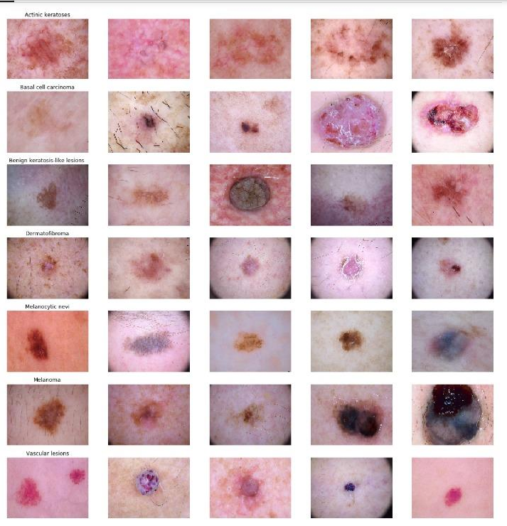
SOME SAMPLE OF IMAGES

Slide 8
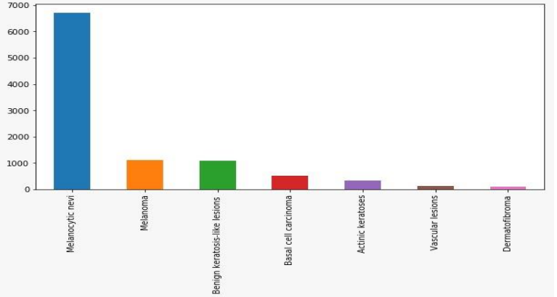
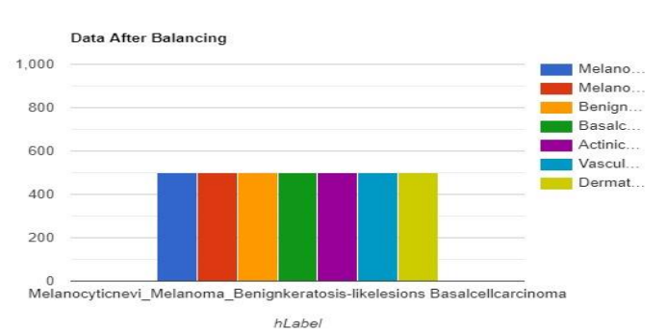
DATA pROCESSING
The data preprocessing techniques includes:
Data Balancing
Image Resizing
Image Normalization
Image Augmentation

Slide 9
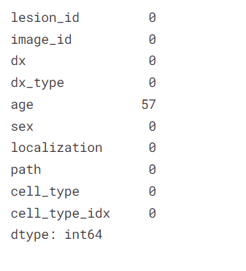
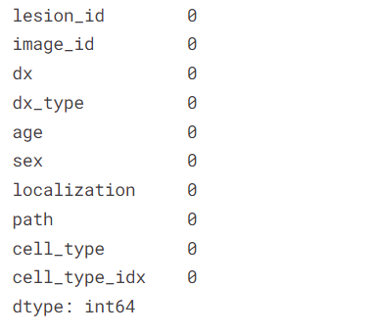
Data cleaning

Slide 10
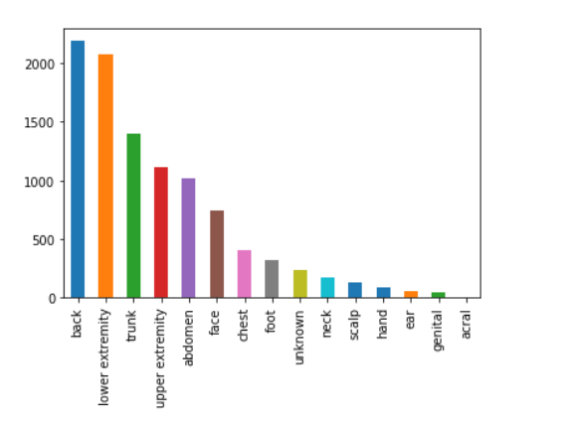
distribution of Localisation field

Slide 11
Train Test Split
In this step we will split the dataset into training and testing set of 80:20 ratio
Splitting training and validation split
Split the data into two parts:
Small part become validation set
Rest part is used to train the model

Slide 12
MODELs
CNN
SVM
NAÏVE BAYES
used the Keras library in Python to implement the CNN model
used the scikit-learn library in Python to implement the SVM model
used the scikit-learn library in Python to implement the Naive Bayes model.

Slide 13
CONVOLUTION NEURAL NETWORK
It is particulary used for image classification and pattern recognition.
There are some steps for modelling the data on this network:
Filtering
Maxpooling
Regularization(Dropout layer)
Used RELU function
Flatten Layer
As layers are added to model, we will set optimization algo , score function, loss function.
Data Augmentation is optional step.

Slide 14
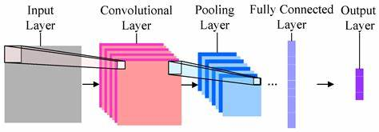

Slide 15
Naïve bayes
It is a machine learning algorithm that makes predictions based on probabilities.
Firstly initialize naïve bayes classifier object such as Gaussian Naïve bayes or Multinomial.
Fit the Naive Bayes model to the training data by calling the fit method.
Passed them in the training feature vectors.

Slide 16
SUPPort vector machine
It is used for classification and regression analysis.
It works by finding the optimal hyperplane that separates the classes in the data.
Here we take kernel svm,using polynomial function.
Initialize an SVM classifier object with the chosen model.
Fit the SVM model to the training data by calling the fit method.
passing in the training feature vectors

Slide 17
Fitting the model
Fit the model into trained dataset.
Batch size:10 to 50 epochs
We chosed 50 epochs to give model sufficient epochs to train.
As in each epoch it will show loss , accuracy , etc.

Slide 18
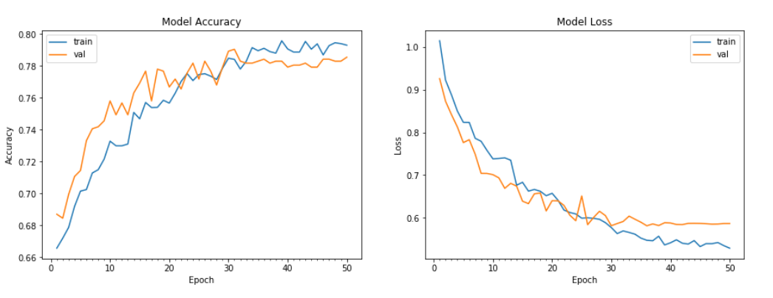
mODEl evaluation
Check testing and validation accuracy

Slide 19
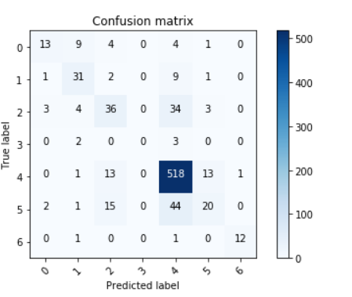
Plot Confusion Matrix

Slide 20
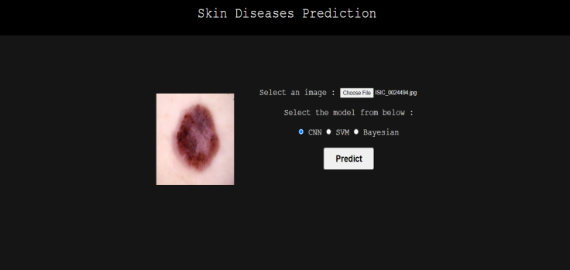
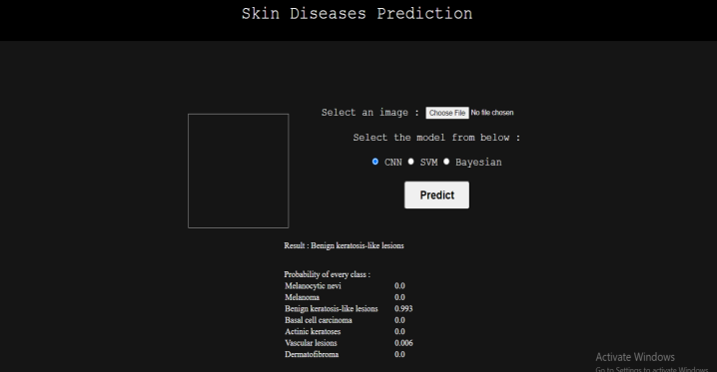
DEMO

Slide 21
Results
CNN
Accuracy : 82%
SVM
The performance of three different models, SVM, Naive Bayes, and CNN, was evaluated for the classification and prediction of skin deformities using the HAM10000 dataset.
The results suggest that the CNN model is the most effective model.
Accuracy : 78%
NAÏVE BAYES
Accuracy : 35%.

Slide 22
Future Work
In future work, more advanced machine learning techniques such as deep learning with more complex neural network architectures could be explored to improve the accuracy of skin deformity classification and prediction.
It may be worth exploring different preprocessing techniques and data augmentation methods to further improve the performance of the models.

Slide 23
THANK YOU

