Slide 1
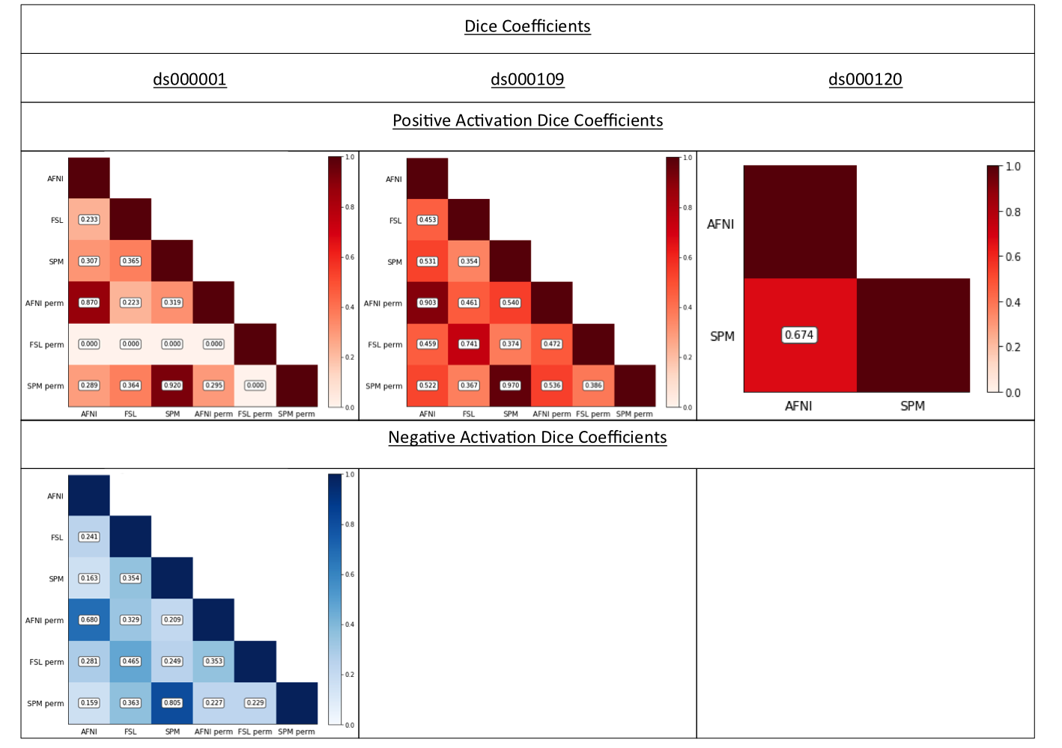
Figure 2
Dice coefficients comparing the thresholded positive and negative T-statistic maps computed using each software package and inference method for each of the three reproduced studies. Only one software – FSL parametric – obtained a result for decreases in ds000109, and hence no Dice coefficients are shown.

Slide 2
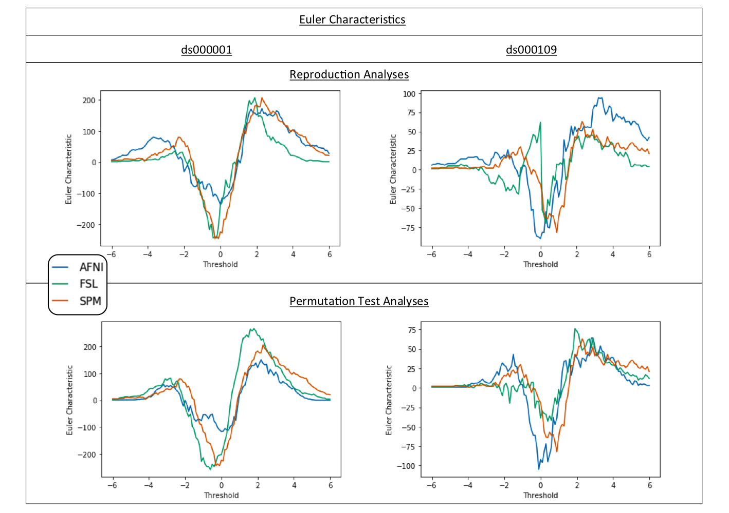
Figure 3
Euler Characteristic plots for ds000001 and ds000109. On top, comparisons of the Euler Characteristics computed after thresholding each software’s T-statistic map from our replication analyses using a range of T-values between -6 and 6. Below, comparisons of the Euler Characteristics calculated using the same thresholds on the corresponding T-statistic images for permutation inference within each package. For each T-value the Euler Characteristics summarises the topology of the thresholded image, and the curves provide a signature of the structure of the entire image.

