Slide 1
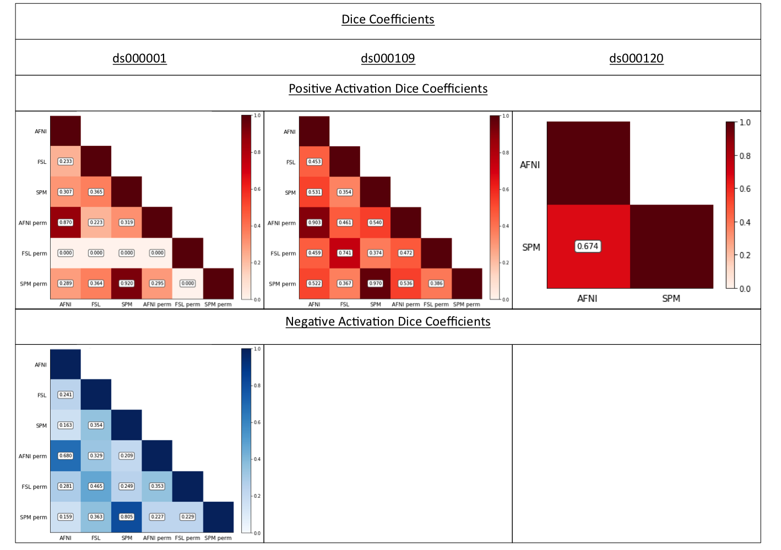
Figure 2
Dice coefficients comparing the thresholded positive and negative T-statistic maps computed using each software package and inference method for each of the three reproduced studies. Only one software – FSL parametric – obtained a result for decreases in ds000109, and hence no Dice coefficients are shown.

