Slide 1
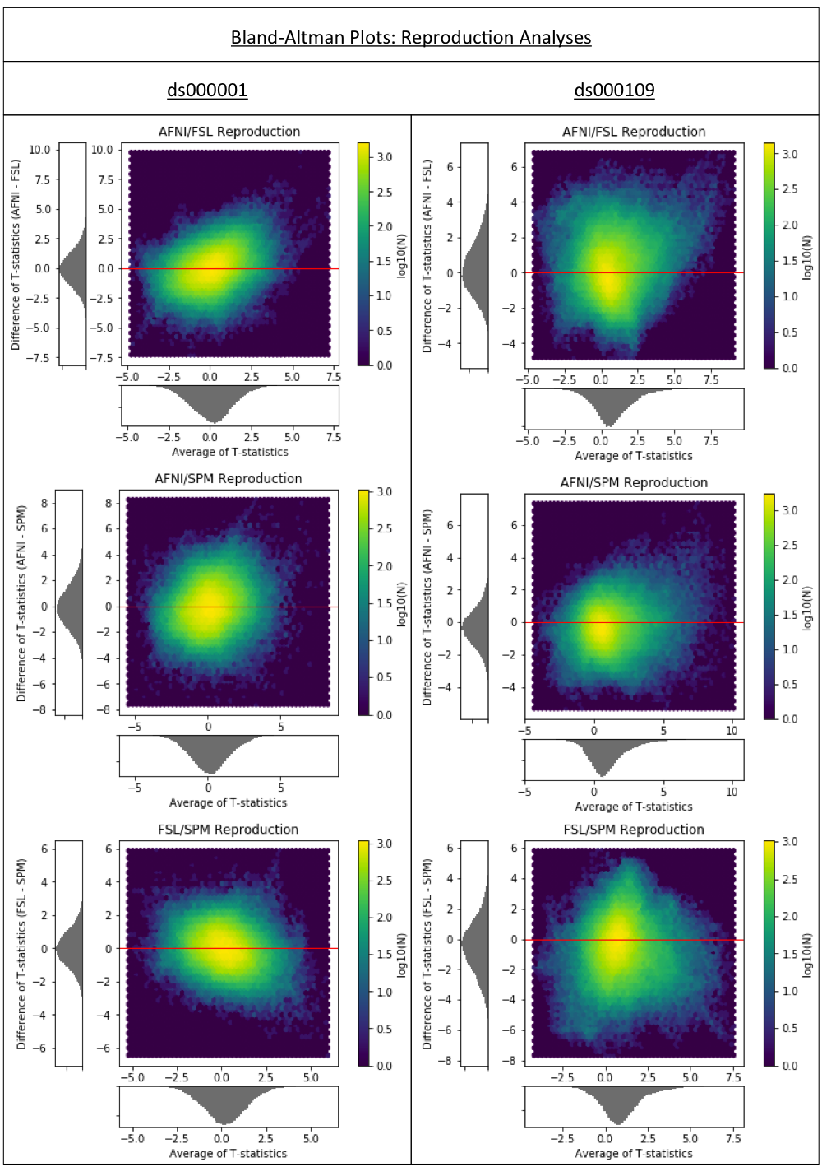
Figure 1a
Bland-Altman 2D histograms comparing the unthresholded group-level T-statistic maps computed as part of the replication analyses of the ds000001 and ds000109 studies within AFNI, FSL and SPM. Left; Comparisons for ds000001’s balloon analog risk task, T-statistic images contrasting the parametric modulation of pumps of the reward balloons versus parametric modulation of pumps of the control balloon. Right; Comparisons for ds000109’s false belief task, T-statistic images contrasting the false belief versus false photo conditions.
Density images show the relationship between the average T-statistic value and difference of T-statistic values at corresponding voxels in the unthresholded T-statistic images for each pairwise combination of software packages.

