Slide 1
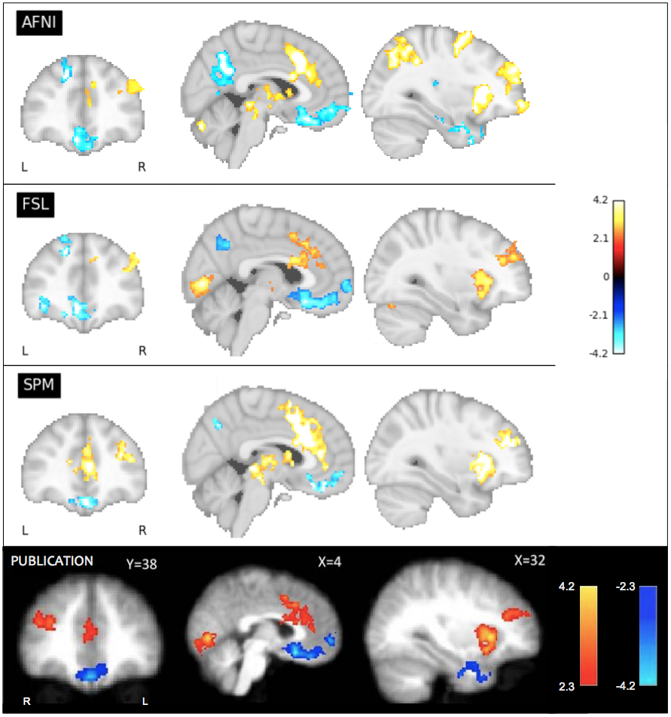
Figure 4
Our reanalysis results compared to the main figure from the ds000001 balloon analog risk task study, contrasting the parametric modulation of pumps of reward balloons versus the parametric modulation of the control balloon. Corresponding slices of the thresholded T-statistic images for each software package are displayed; beneath, Figure 03 taken from the Schonberg et al. publication connected to the ds000001 dataset. The publication analysis was conducted using FSL. While overall there is similarity between packages on the determined regions of activation, there is discordance over the size of activations as well as the precise areas of activation within a region.

