Slide 1
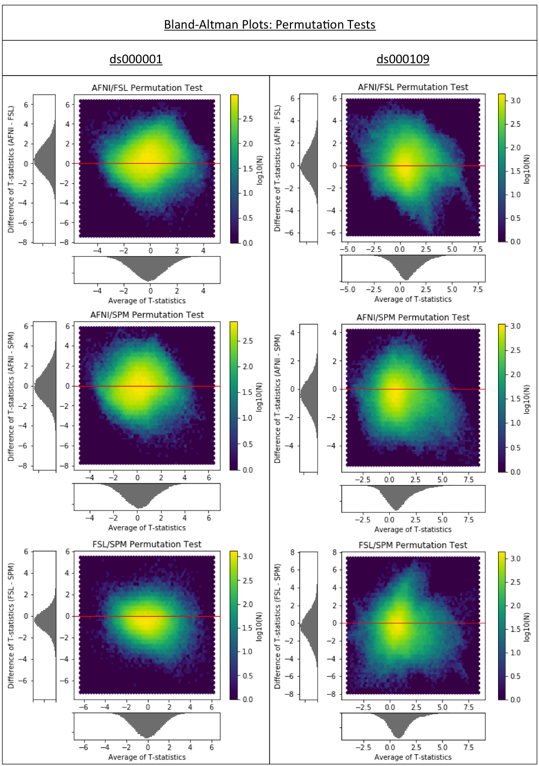
Figure 5
Bland-Altman 2D histograms for the ds000001 and ds000109 studies comparing the unthresholded group-level T-statistic maps computed using permutation inference methods within AFNI, FSL and SPM. Similar to the results obtained using parametric inferences in Figure 1a, all of the densities indicate vast differences in the size of activations determined within each package.

