Slide 1
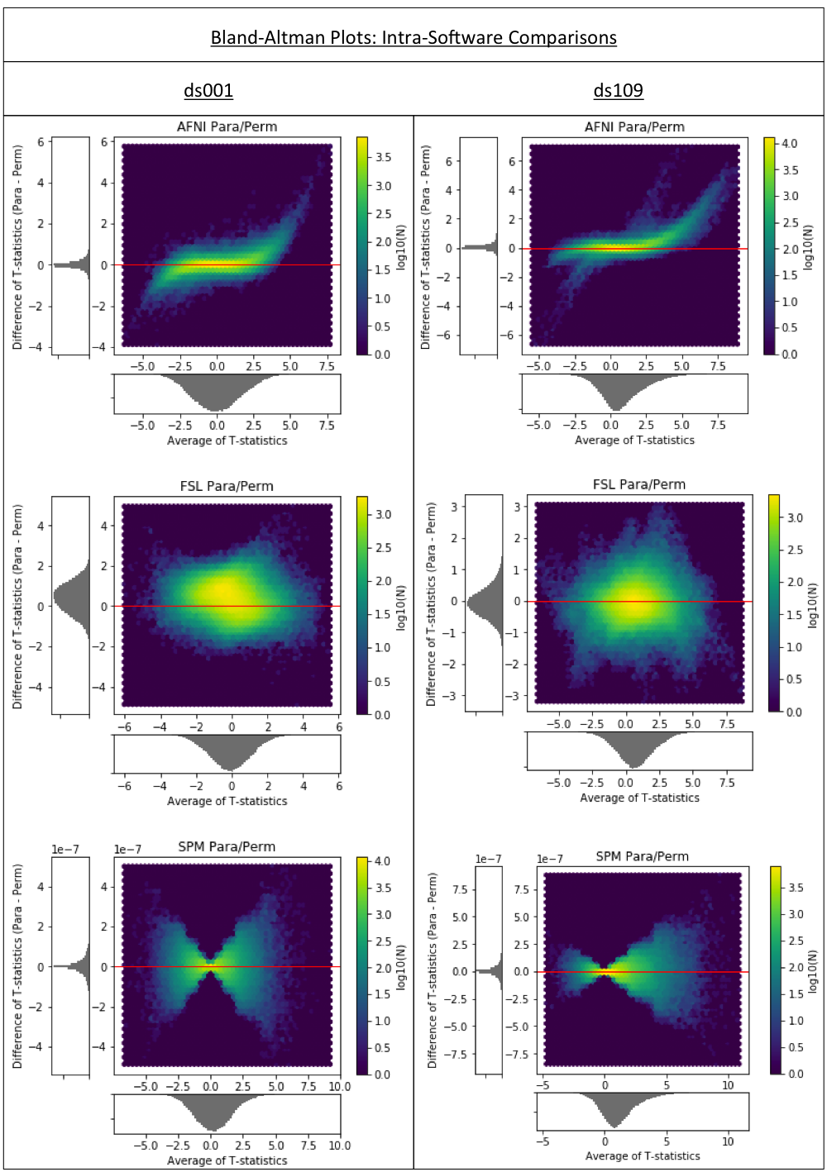
Figure 6
Bland-Altman 2D histograms for the ds000001 and ds000109 studies comparing the unthresholded group-level T-statistic maps computed within each software package using parametric or nonparametric inference methods. Overall, the concentration of densities along the x-axis in the AFNI and SPM plots signal harmonization between the two methods within these software packages. This is particularly true for SPM where - noting the scale of the y-axis – the unthresholded T-statistic images obtained for both inference methods were identical up to numerical error, which scaled in accordance with the absolute size of the activation. Densities seen in the two FSL plots suggest much greater disagreement between the inference methods within this package.

