Slide 1
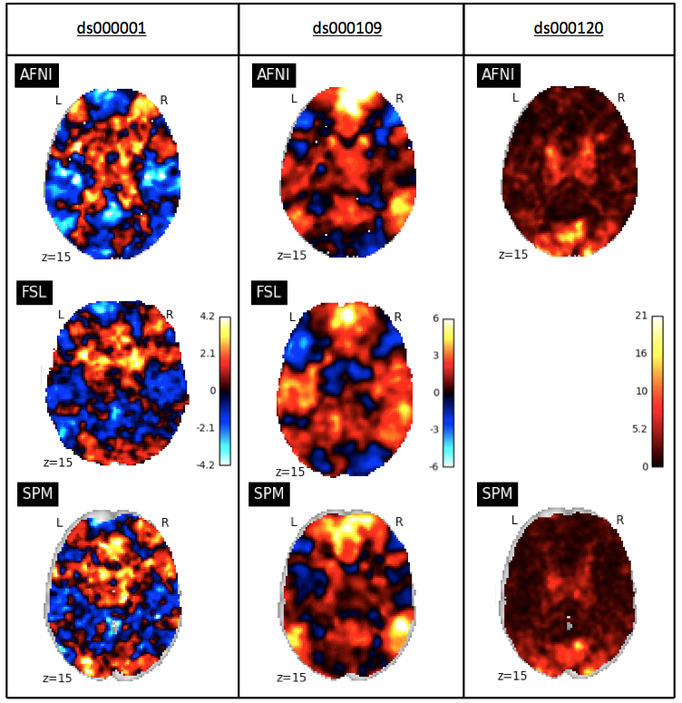
Figure 2
Slice comparison of the unthresholded statisic maps from our reanalysis of the three studies within each software package. Left: unthresholded T-statistic maps of the parametric modulation of pumps of reward balloons versus the parametric modulation of the control balloon contrast from the ds000001 study. Middle: unthresholded T-statistic maps of the false belief vs false photo contrast from the ds000109 study. Right: unthresholded F-statistic maps of the main effect of time contrast from the ds000120 study.

