Slide 1
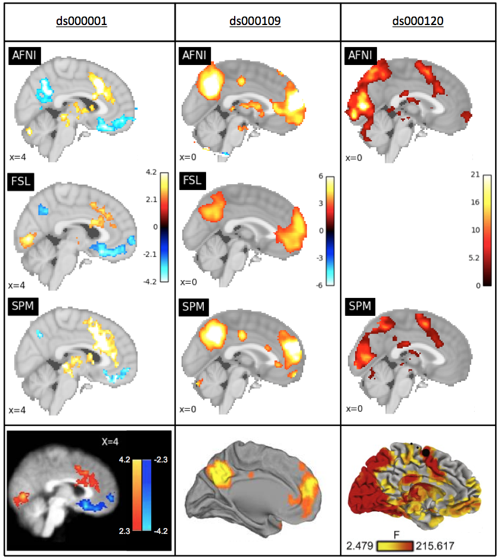
Figure 1
Slice comparison of the thresholded statisic maps from our reanalysis with the main figures from each of the three publications. Left: thresholded T-statistic images contrasting the parametric modulation of pumps of reward balloons versus the parametric modulation of the control balloon; beneath, a sagittal slice taken from Figure 3 in the Schonberg et al. publication corresponding to the ds000001 dataset. Middle: thresholded T-statistic maps of the false belief vs false photo contrast; beneath, a midsagittal render from Figure 1 in the Moran et al. publication corresponding the ds000109 dataset. Right: thresholded F-statisic images of the main effect of time contrast; beneath, a midsagittal render from Figure 3 in the Padmanabhan et al. publication corresponding to the ds000120 dataset.

Slide 2
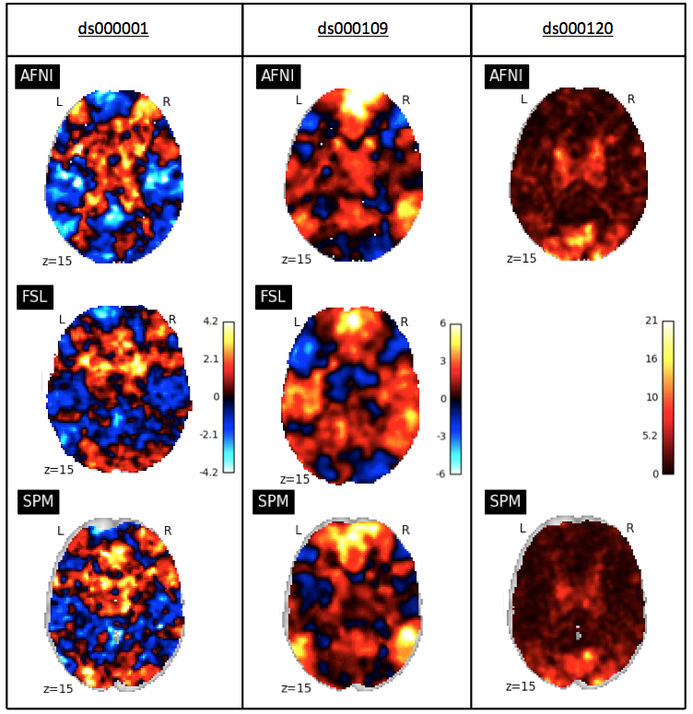
Figure 2
Slice comparison of the unthresholded statisic maps from our reanalysis of the three studies within each software package. Left: unthresholded T-statistic maps of the parametric modulation of pumps of reward balloons versus the parametric modulation of the control balloon contrast from the ds000001 study. Middle: unthresholded T-statistic maps of the false belief vs false photo contrast from the ds000109 study. Right: unthresholded F-statistic maps of the main effect of time contrast from the ds000120 study.

Slide 3
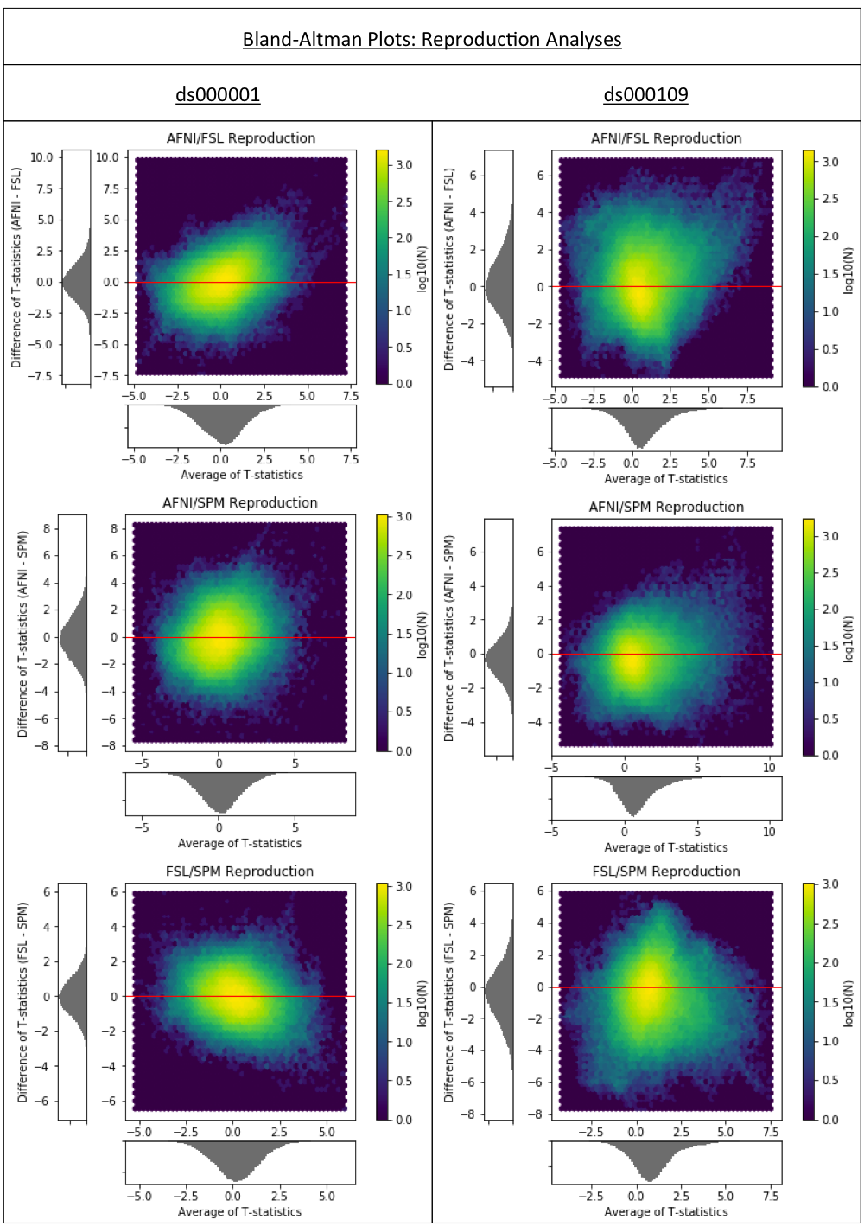
Figure 1a
Bland-Altman 2D histograms comparing the unthresholded group-level T-statistic maps computed as part of the replication analyses of the ds000001 and ds000109 studies within AFNI, FSL and SPM. Left; Comparisons for ds000001’s balloon analog risk task, T-statistic images contrasting the parametric modulation of pumps of the reward balloons versus parametric modulation of pumps of the control balloon. Right; Comparisons for ds000109’s false belief task, T-statistic images contrasting the false belief versus false photo conditions.
Density images show the relationship between the average T-statistic value and difference of T-statistic values at corresponding voxels in the unthresholded T-statistic images for each pairwise combination of software packages.

Slide 4
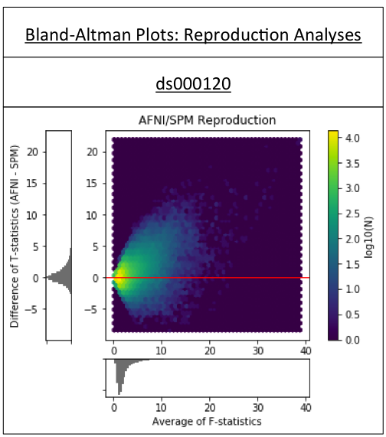
Figure 1b
Bland-Altman 2D histogram comparing the unthresholded main effect of time F-statistic maps computed in AFNI and SPM for replications of the ds000120 study.

Slide 5
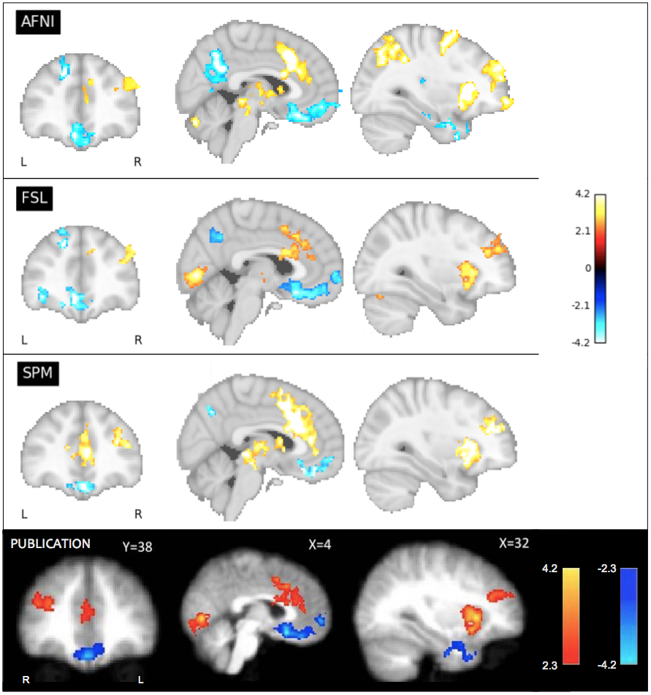
Figure 4
Our reanalysis results compared to the main figure from the ds000001 balloon analog risk task study, contrasting the parametric modulation of pumps of reward balloons versus the parametric modulation of the control balloon. Corresponding slices of the thresholded T-statistic images for each software package are displayed; beneath, Figure 3 taken from the Schonberg et al. publication connected to the ds000001 dataset. The publication analysis was conducted using FSL. While overall there is similarity between packages on the determined regions of activation, there is discordance over the size of activations as well as the precise areas of activation within a region.

Slide 6
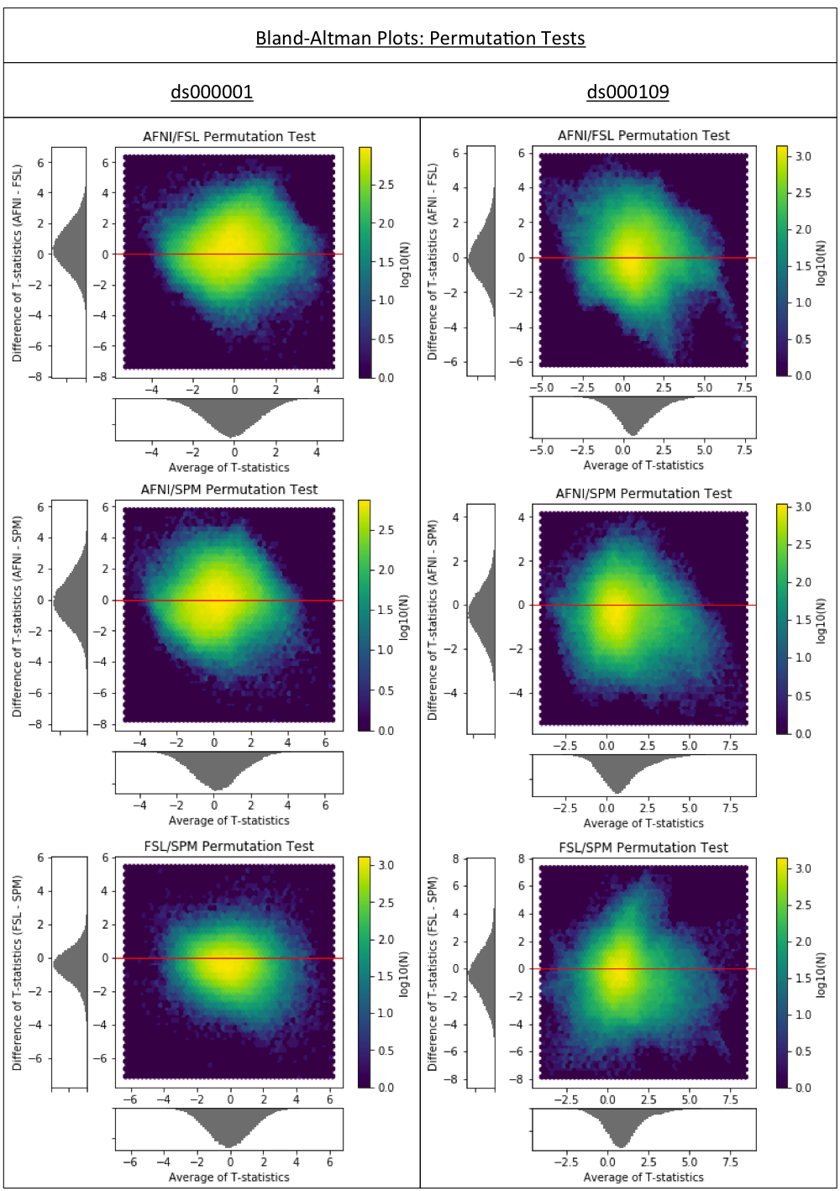
Figure 5
Bland-Altman 2D histograms for the ds000001 and ds000109 studies comparing the unthresholded group-level T-statistic maps computed using permutation inference methods within AFNI, FSL and SPM. Similar to the results obtained using parametric inferences in Figure 1a, all of the densities indicate vast differences in the size of activations determined within each package.

Slide 7
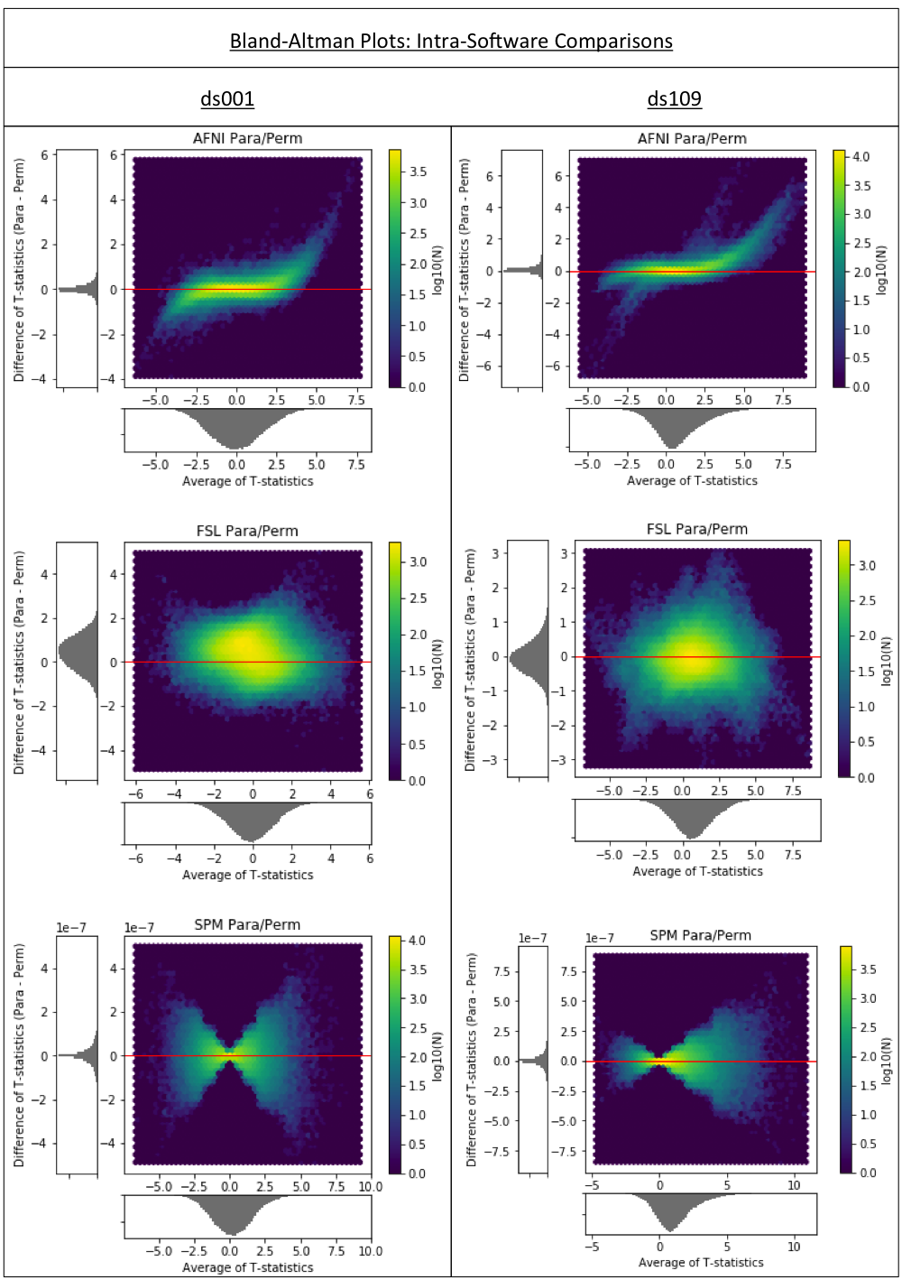
Figure 6
Bland-Altman 2D histograms for the ds000001 and ds000109 studies comparing the unthresholded group-level T-statistic maps computed within each software package using parametric or nonparametric inference methods. Overall, the concentration of densities along the x-axis in the AFNI and SPM plots signal harmonization between the two methods within these software packages. This is particularly true for SPM where - noting the scale of the y-axis – the unthresholded T-statistic images obtained for both inference methods were identical up to numerical error, which scaled in accordance with the absolute size of the activation. Densities seen in the two FSL plots suggest much greater disagreement between the inference methods within this package.

