Slide 1
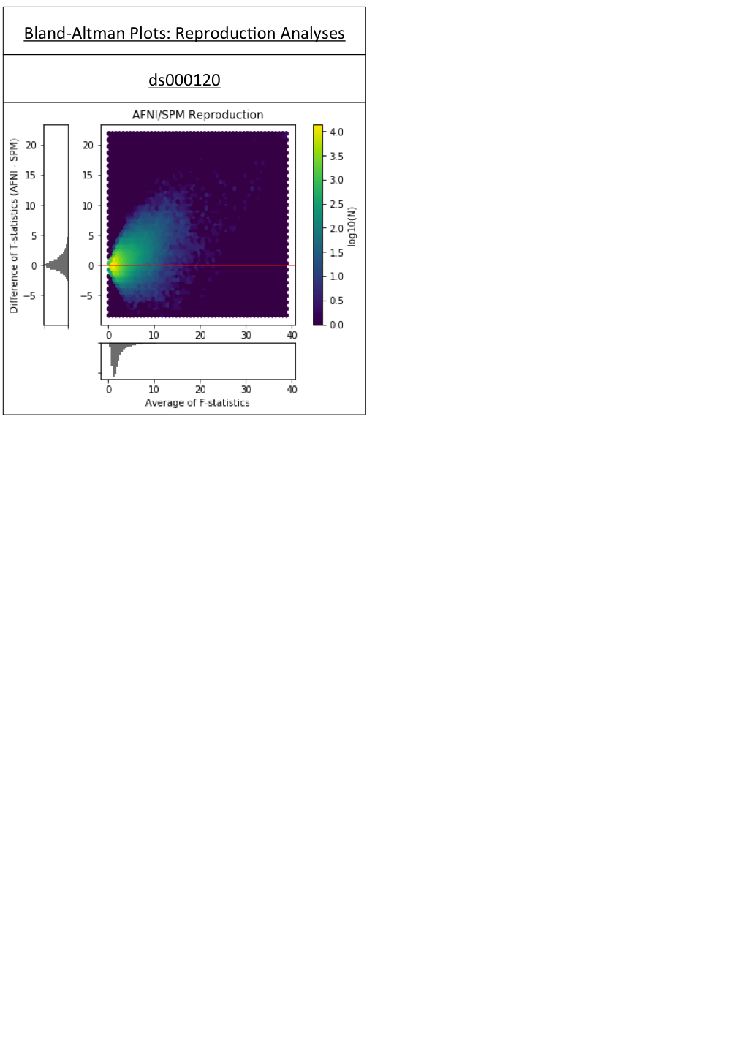
Figure 1b
Bland-Altman 2D histogram comparing the unthresholded main effect of time F-statistic maps computed in AFNI and SPM for replications of the ds000120 study.

