Slide 1
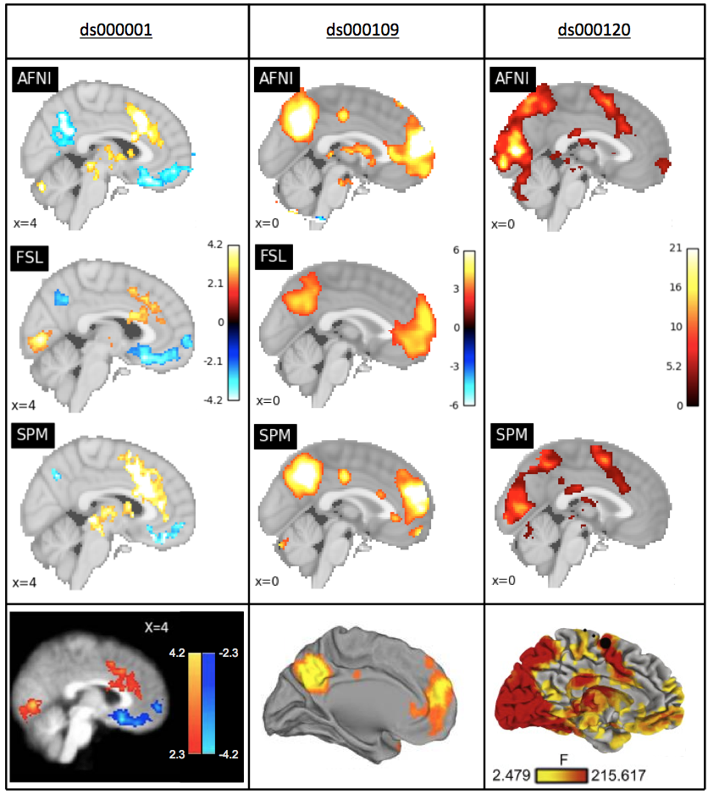
Figure 1
Slice comparison of the thresholded T-statisic maps from our reanalysis with the main figures from each of the three publications. Left: thresholded T-statistic images contrasting the parametric modulation of pumps of reward balloons versus the parametric modulation of the control balloon; beneath, a sagittal slice taken from Figure 3 in the Schonberg et al. publication corresponding to the ds000001 dataset. Middle: thresholded T-statistic maps of the false belief vs false photo contrast; beneath, a midsagittal render from Figure 1 in the Moran et al. publication corresponding the ds000109 dataset. Right: thresholded F-statisic images of the main effect of time contrast; beneath, a midsagittal render from Figure 3 in the Padmanabhan et al. publication corresponding to the ds000120 dataset.

