Slide 1
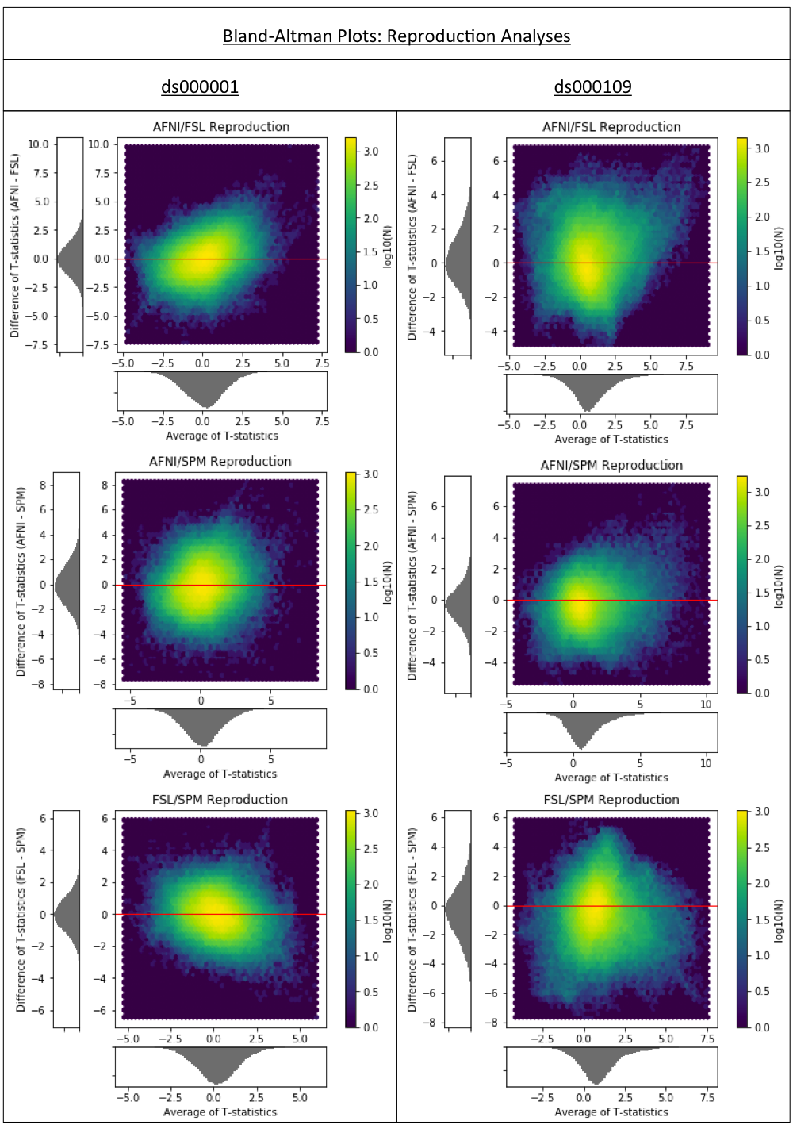
Figure 1a
Bland-Altman 2D histograms comparing the unthresholded group-level T-statistic maps computed as part of the reproduction analyses of the ds000001 and ds000109 studies within AFNI, FSL and SPM. Left; comparisons of the T-statistic images contrasting the parametric modulation of pumps of the reward balloons versus parametric modulation of pumps of the control balloon in the balloon analog risk task associated to the ds000001 study. Right; comparisons of the T-statistic images contrasting the false-belief versus false-photo activations in the false belief task associated to ds000109.
Density maps show the relationship between the average T-statistic value and difference of T-statistic values at corresponding voxels in the unthresholded T-statistic images for each pairwise combination of software packages. The x-axis is highlighted in red – densities along this line indicate agreement between software on the size of activation at corresponding voxels.

Slide 2
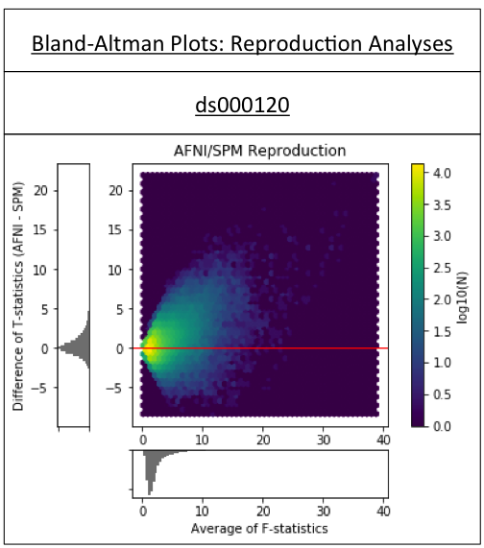
Figure 1b
Bland-Altman 2D histogram comparing the unthresholded main effect of time F-statistic maps computed in AFNI and SPM for reproductions of the ds000120 study.

Slide 3
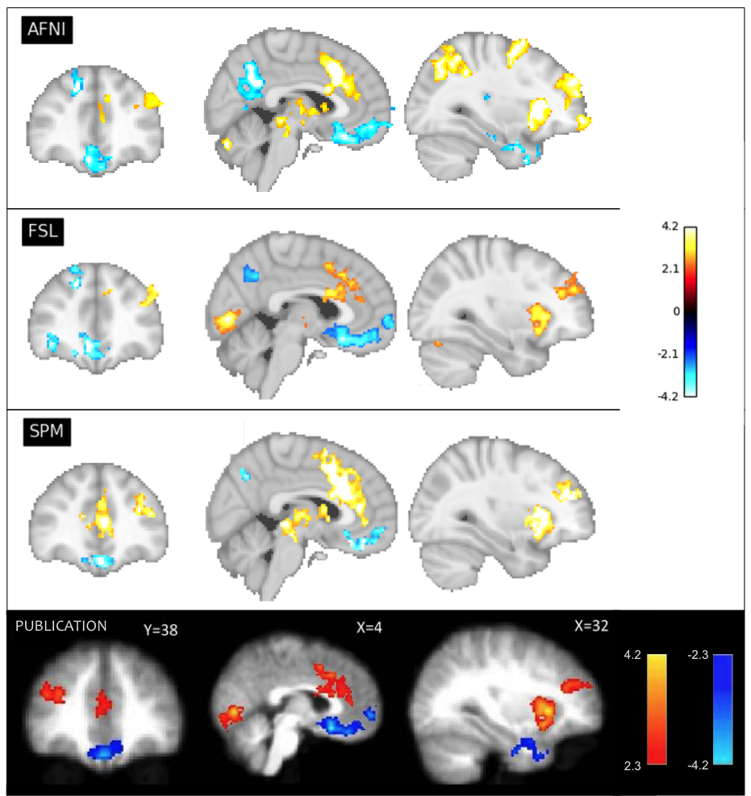
Figure 4
Reproductions of the main figure from the ds000001 balloon analog risk task study contrasting the parametric modulation of pumps of reward balloons versus the parametric modulation of control balloons. Corresponding slices of the thresholded T-statistic images for each software package are displayed; beneath, Figure 03 taken from the Schonberg et al. publication connected to the ds000001 dataset. The publication analysis was conducted using FSL. While overall there is similarity between packages on the determined regions of activation, there is discordance over the size of activations as well as the precise areas of activation within a region.

Slide 4
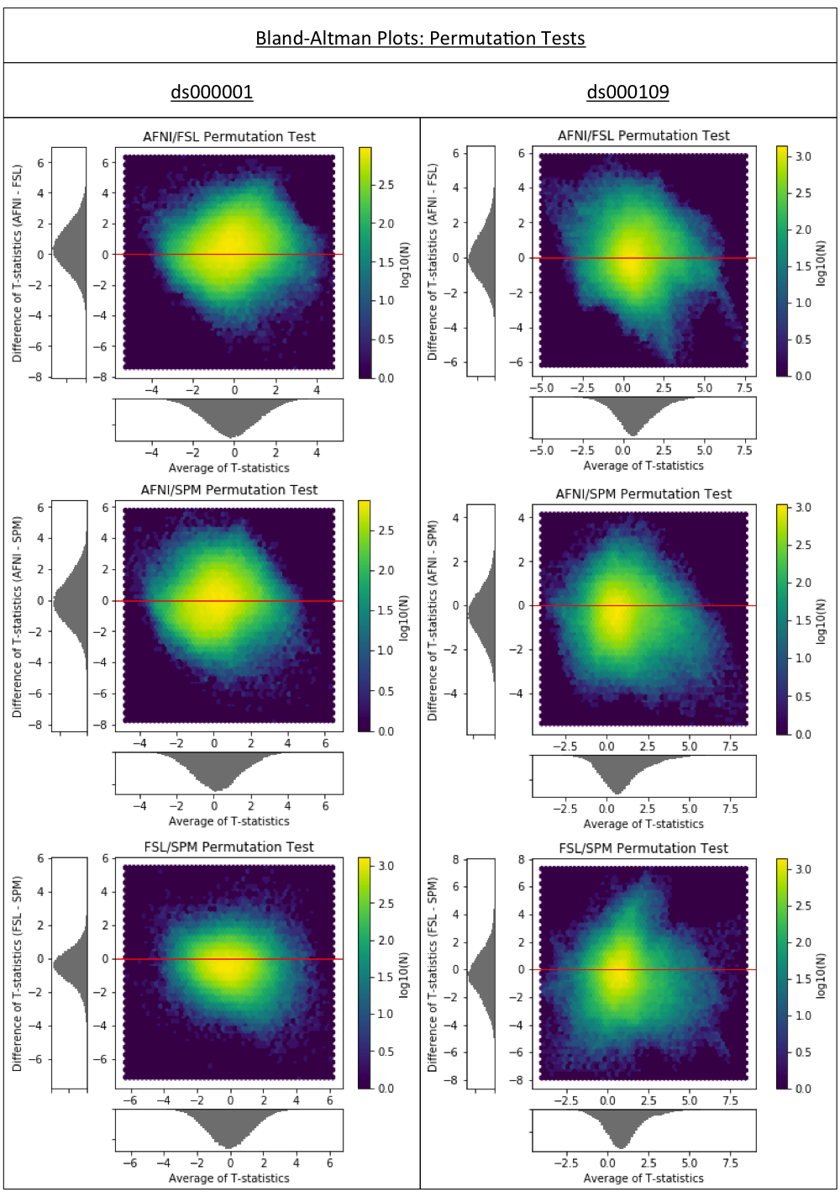
Figure 5
Bland-Altman 2D histograms for the ds000001 and ds000109 studies comparing the unthresholded group-level T-statistic maps computed using permutation inference methods within AFNI, FSL and SPM. Similar to the results obtained using parametric inferences in Figure 1a, a cloud of densities common to all Bland-Altman plots indicates vast differences in the size of activations determined within each package.

Slide 5
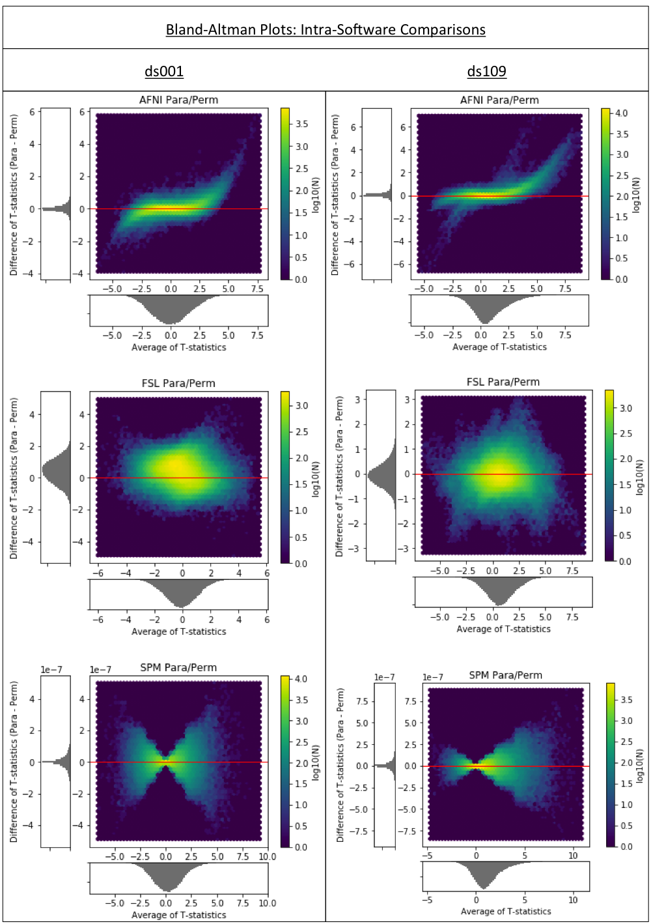
Figure 6
Bland-Altman 2D histograms for the ds000001 and ds000109 studies comparing the unthresholded group-level T-statistic maps computed within each software package using parametric or nonparametric inference methods. Overall, the concentration of densities along the x-axis of densities in the AFNI and SPM plots signal harmonization between the two methods within these software packages. This is particularly true for SPM where - noting the scale of the y-axis – the unthresholded T-statistic images obtained for both inference methods were identical up to numerical error, which scaled in accordance with the absolute size of the activation. The clouds of densities seen in the two FSL plots suggest much greater incoherence between the inference methods within this package.

