Slide 1
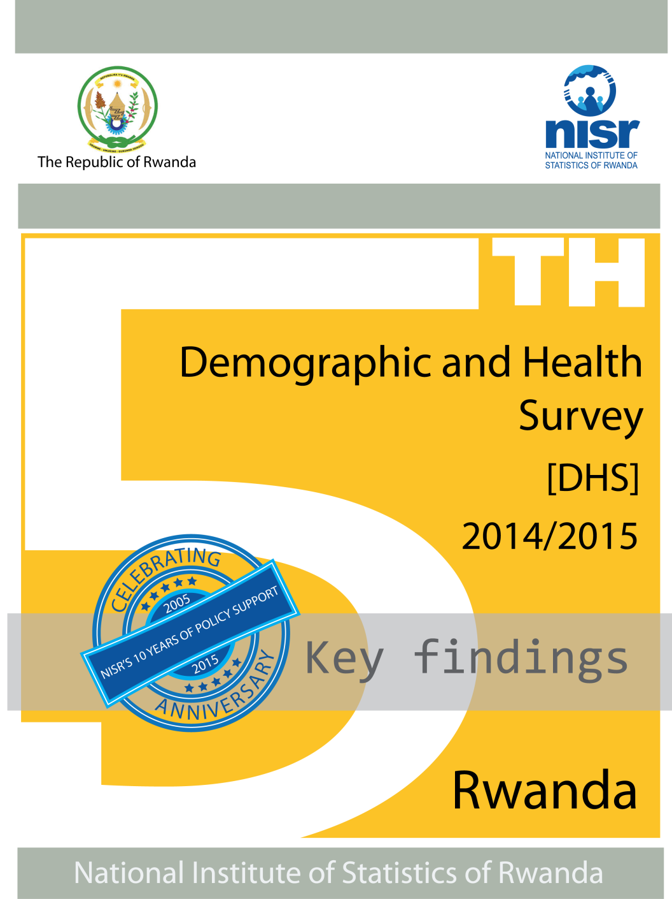





Rwanda Demographic and Health Survey 2014-15
Key findings

Slide 2


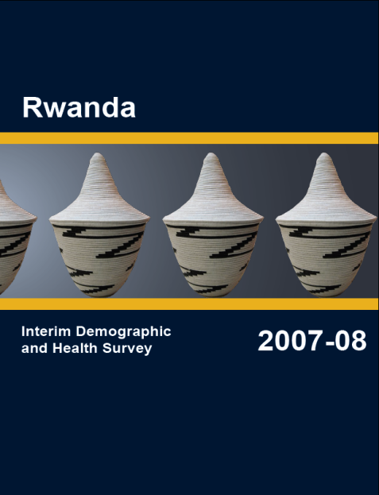
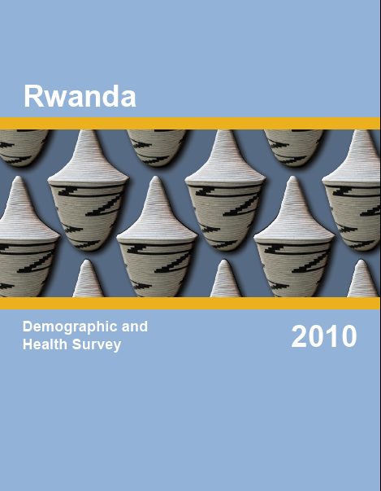
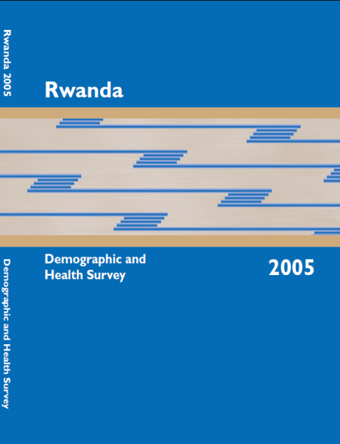

DHSs in Rwanda

Slide 3
The survey was carried out by:
NISR
Ministry of Health
Funding:
Government of Rwanda,
DPs (USAID, ONE UN, Global Fund, World Vision, Partner in Health)
Technical assistance: ICF International

Slide 4
Implementation
The fieldwork
  Nov 9, 2014 - Apr 8, 2015
The data entry and editing
  Dec 3, 2014 - Apr 26, 2015.
The processing
  Apr 27, 2015 - May 15, 2015.

Slide 5
Subject Scope
  Household questionnaire
  Women questionnaire
  Men questionnaire;

Slide 6
Women Questionnaire
Content
  birth and death history of respondents’ children,
  Contraception
  Pregnancy, delivery and postnatal care
  Immunization, health and nutrition, early childhood development
  Fertility preferences
  HIV/AIDS and other sexually transmitted infections
  Adult mortality and Maternal Mortality Ratio;
  etc

Slide 7
Men Questionnaire
Content
  Marriage and sexual activity
  Employment and gender roles
  HIV/AIDS
  etc

Slide 8
Respond Rates
Household Interviews
Households selected | 12,793
Response rate | 99.9%
Interviews with Women age 15-49
Eligible women | 13,564
Response rate | 99.5%
Interviews with Men age 15-59
Eligible men | 6,249
Response rate | 99.5%

Slide 9
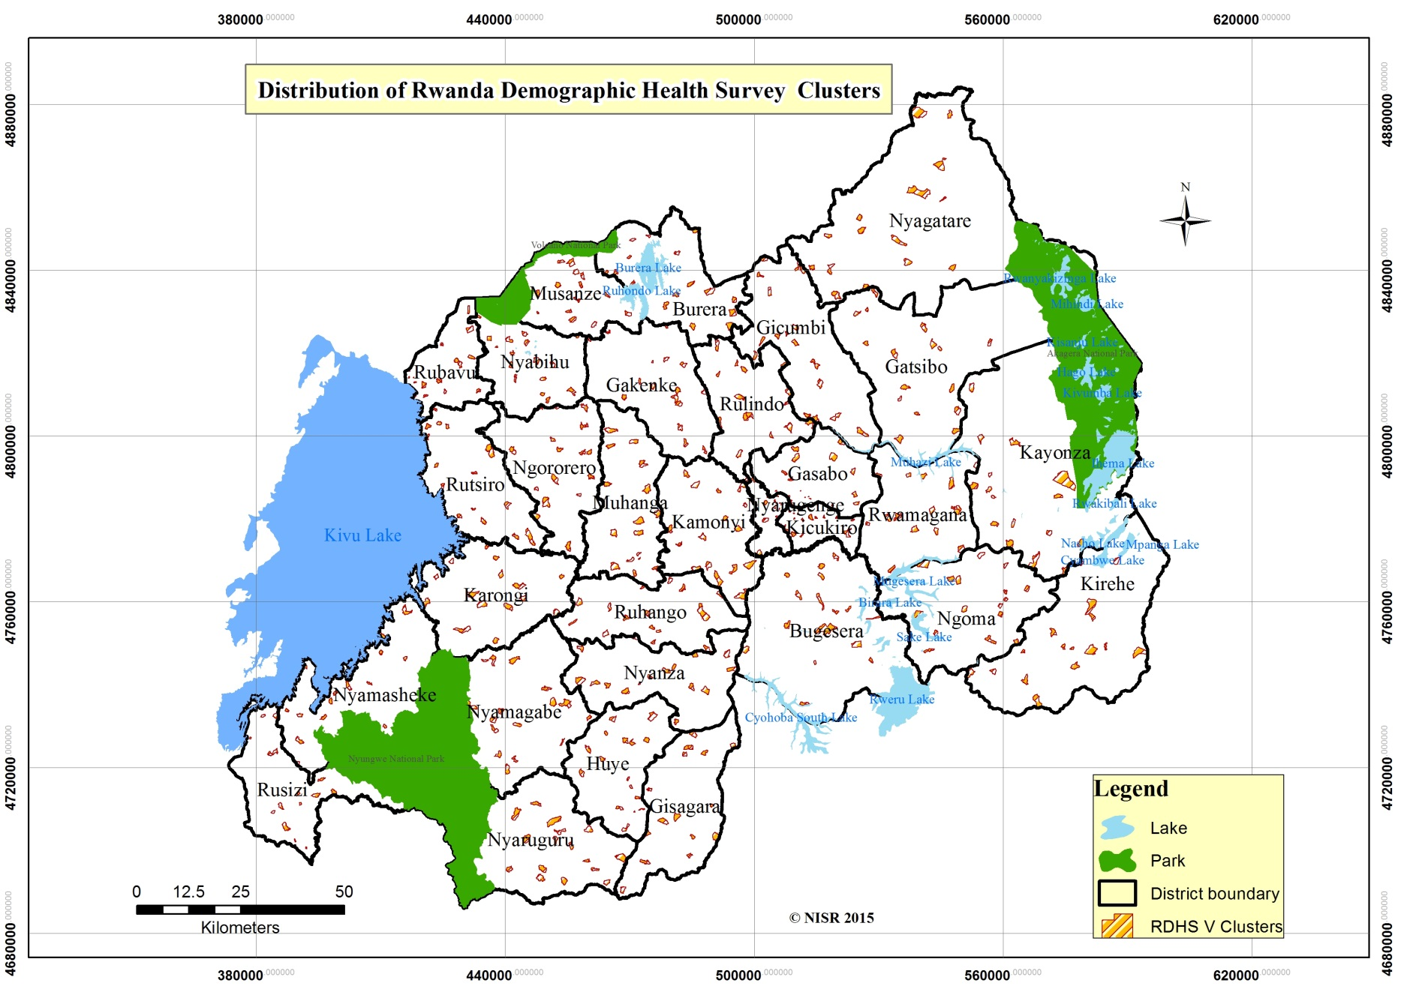
Enumeration Areas

Slide 10
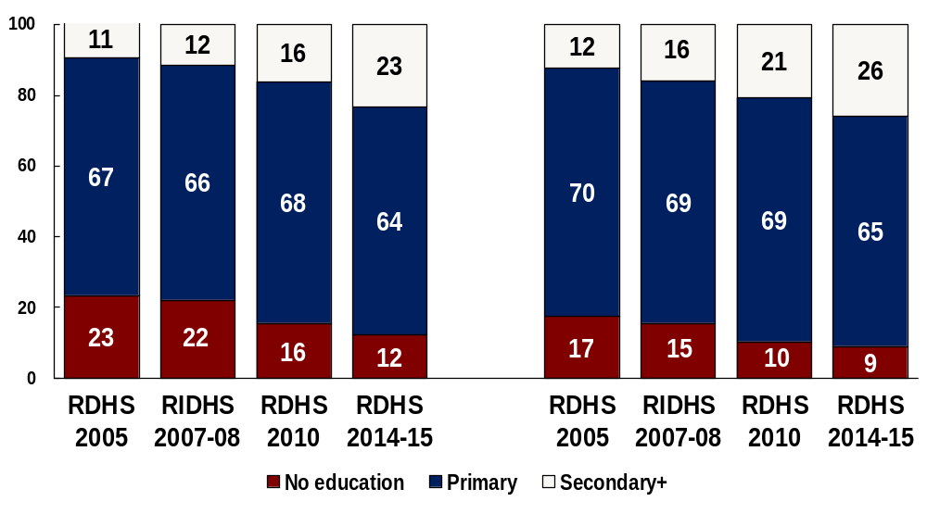
Education Level
Women
Men

Slide 11
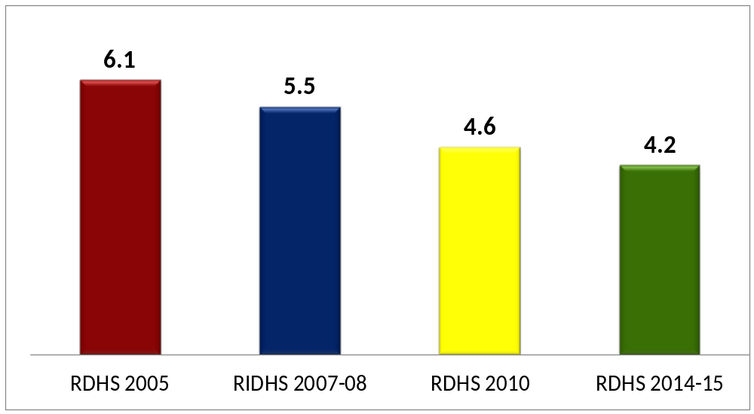
Trends in Fertility
Fertility dropping to 4.2 children per woman
Notes:
Fertility has not changed dramatically in the last 15 years. There has been a slight increase since 2001-02.

Slide 12
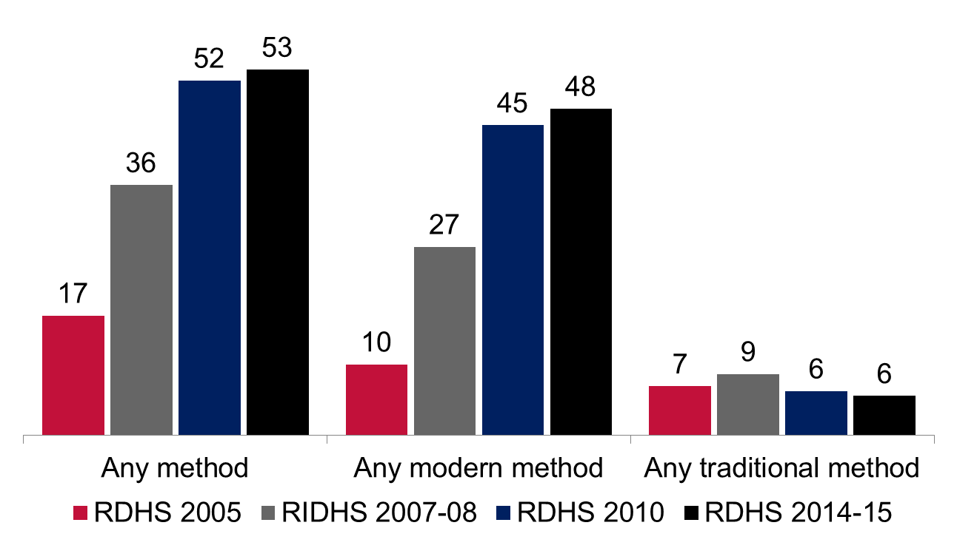
Current use of contraceptives
Percentage of currently married women using contraceptives

Slide 13
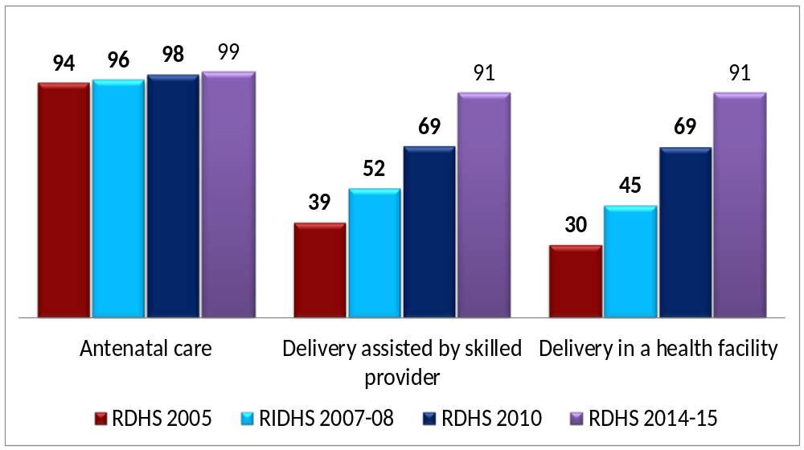
Trends in Maternal Health
91% of deliveries assisted and in health facilities. Almost all women receive antenatal care at least once during pregnancy

Slide 14
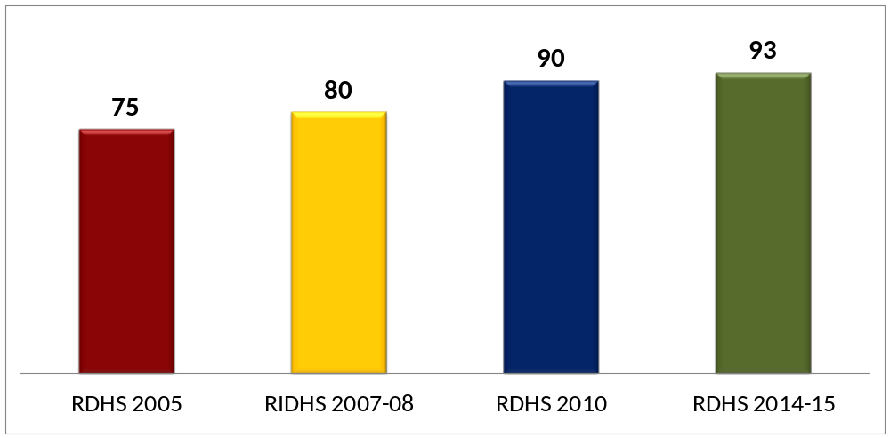
Trends in Vaccination Coverage
93% of children 12-23 months fully vaccinated

Slide 15
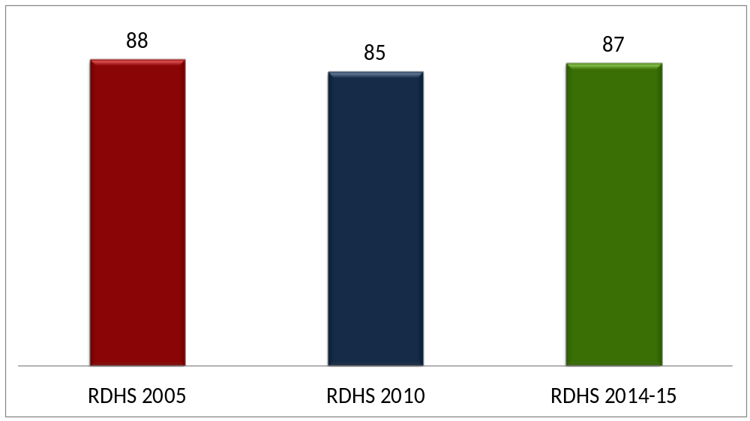
Trends in Exclusive Breastfeeding
87% of children 0-5 months exclusively breastfeeding

Slide 16
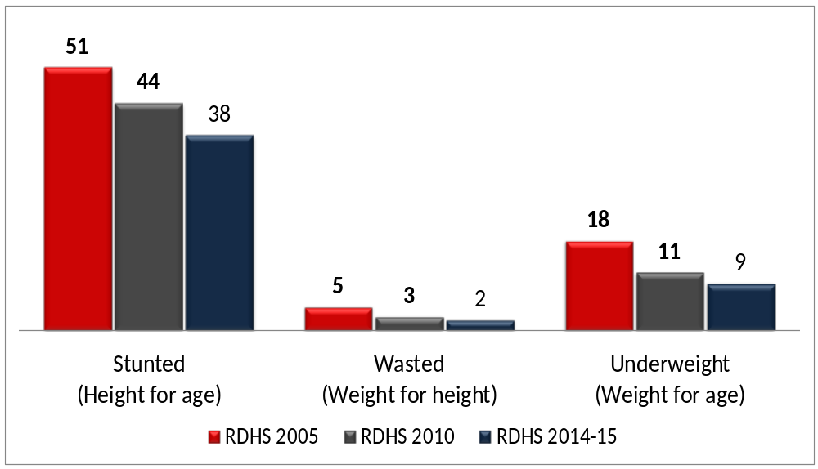
Undernourished Children
All measures of nutrition are improving among children less than 5 years

Slide 17
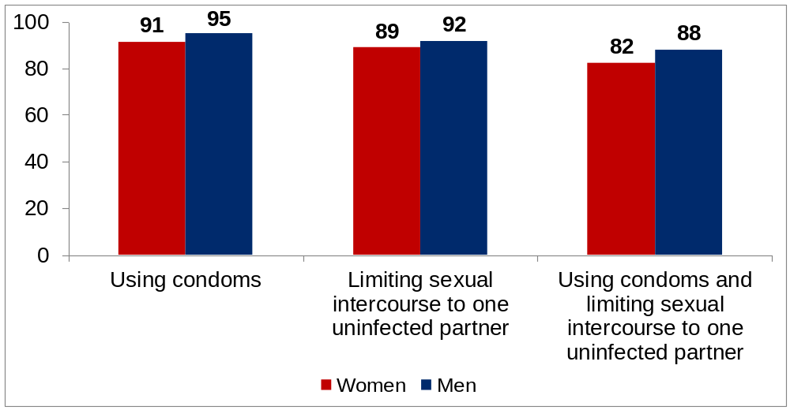
Knowledge of HIV prevention
Percentage of women and men age 15-49 who, in response to prompted questions, say that people can reduce the risk of getting the AIDS virus by :
Notes:
Fertility has not changed dramatically in the last 15 years. There has been a slight increase since 2001-02.

Slide 18
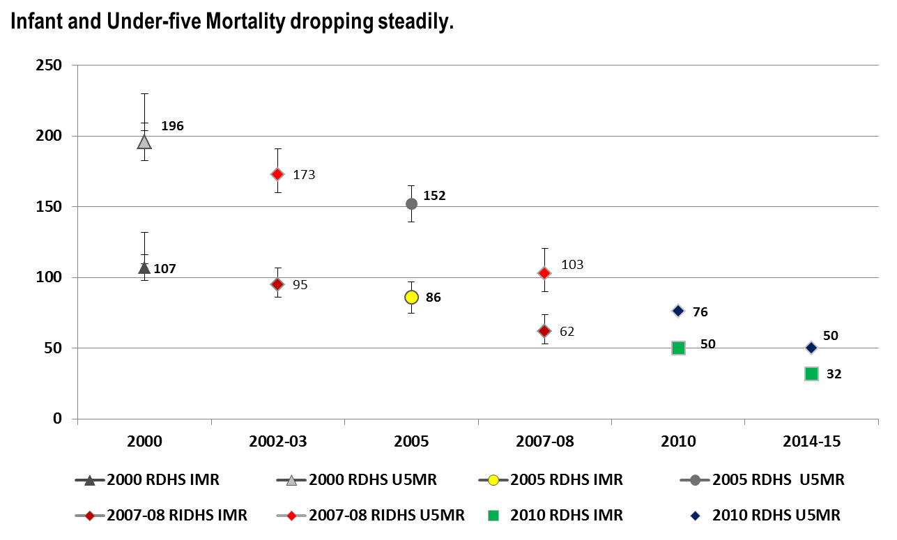
Infant and Under-five Mortality from the RDHS/RIDHS, 2005, 2007-08, 2010, and 2014-15

Slide 19
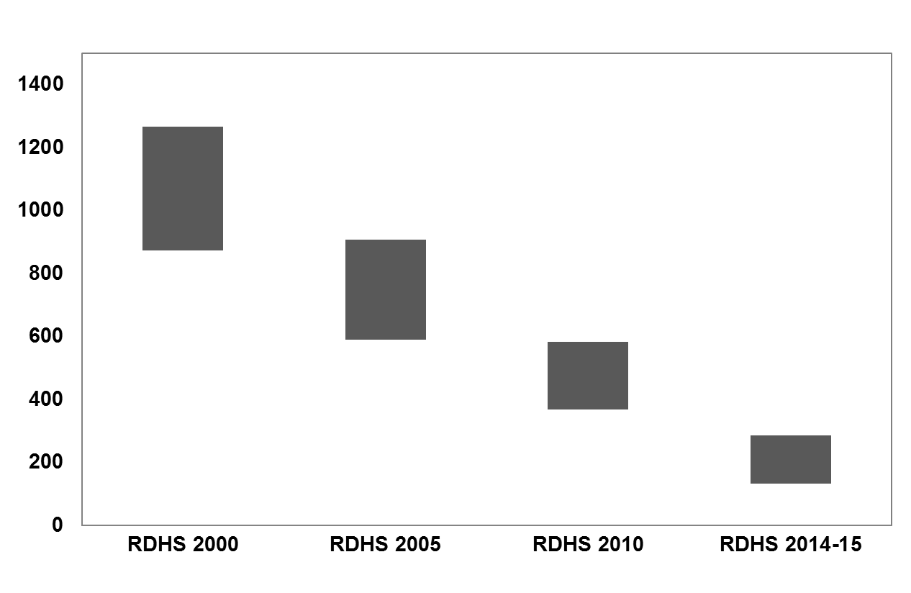
Maternal Mortality Ratio form the RDHSs 2000, 2005, 2010, and 2014-15
Maternal mortality also dropping steadily
1071
750
476
210

Slide 20
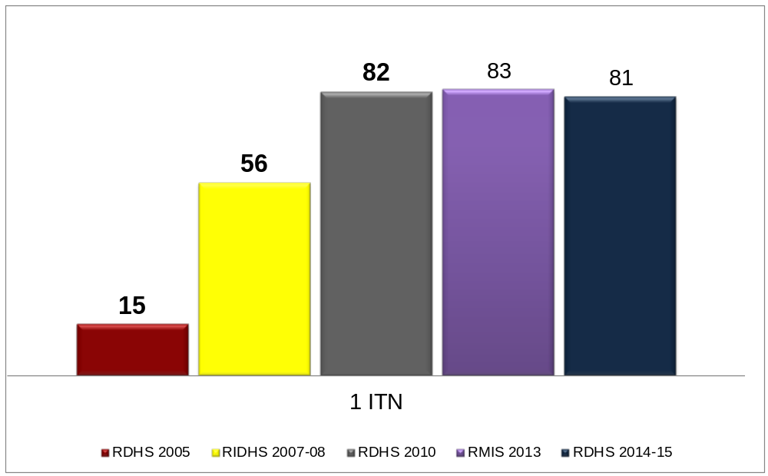
Possession of Mosquito Net
Percent of households with at least one ITN

Slide 21
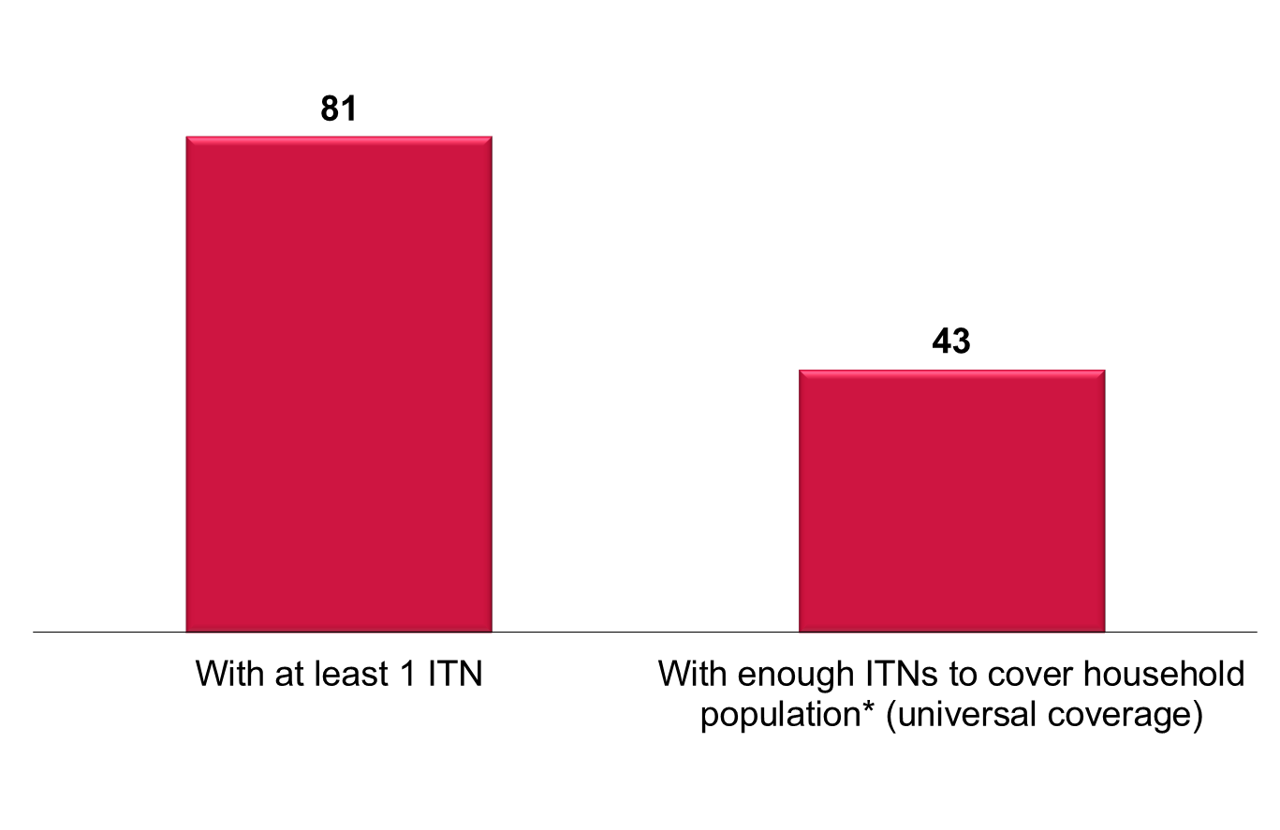
Ownership of and Universal Coverage of ITNs
Percent of households
*Assuming one ITN covers 2 people
Notes:
While 81% of households own at least one ITN, only 43% of households have enough ITNs to cover each household member, assuming one ITN is used by two people.

Slide 22
Thank You

