Slide 1


Decoding the Dollars: A Python-Based Analysis of Global Salary Trends
Exploratory Data Analysis (EDA) of the Modern Job Market
Presenter: Nissy Jiju

Slide 2


Introduction & Objective
The Goal: To identify the core drivers of compensation in job market.
Key Questions
>Job Title: Which roles pay the most and least?
>Experience: How does salary grow with years?
>Education: Do Bachelor, Master, PhD earn differently?
>Skills: Do technical skills or certifications boost pay?
>Industry: Which industries set the highest salaries?
>Does company size make a difference?
>Location: Which countries/regions offer top salaries?
>Work Mode: Is remote work paid more than hybrid/on‑site?

Slide 3
The Tech Stack
Language: Python
Environment: Jupyter Notebook.
Libraries Used:
Pandas & NumPy: Data cleaning and manipulation.
Matplotlib & Seaborn: For static, high-fidelity visualizations.

Slide 4
PROJECT STEPS
Dataset Loading & Initial Overview
Data Pre-processing
○ Handling missing values
○ Removing duplicates
○ Correcting data types
○ Creating derived columns
○ Filtering or aggregating data
3. Exploratory Data Analysis (EDA)
4. Visualizations
5. Insight Generation and Report

Slide 5
1. Dataset Overview
Size: 250,000 rows × 15 columns
Key Features: Job title, experience years, education level, skills count, industry, company size, location, remote work, certifications, salary
Data Quality: Minor missing values handled, duplicates removed, derived features created (salary bands, experience groups, skill levels).

Slide 6
2. Summary of Data Pre‑processing
Cleaning: Filled missing values with median; removed duplicates
New Features: Salary range category, experience bracket
Filtering & Aggregation: Employee counts by job title; average salary by education
Current Dataset: 250,000 rows × 16 columns

Slide 7
3. Summary of EDA
Experience: Strongest driver of salary outcomes
Education: Significant boost, especially PhD/Master levels
Job Title & Company Size: Major differentiators in pay
Industry: Maxima vary, but averages remain flatter
Remote Work: Offers a slight premium across regions
Certifications & Skills: Add incremental value, but less impactful than experience or education
Outliers: Present at the high end, but do not distort overall trends
Correlation Matrix: Confirms logical relationships among predictors
Location: Critical factor — USA/Canada/UK lead, India lowest, Remote amplifies regional differences

Slide 8
4. Visualizations
1. Average Salary by Job Title – Bar plot
2. Salary Spread by Job Title – Box plot
3. Salary Distribution by Education Level – Violin plot
4. Salary by Education × Job Title – Subplot (catplot)
5. Salary Trend by Years of Experience – Line chart
6. Average Salary vs Skills Count – Line chart
7. Average Salary vs Certifications Count – Line chart
8. Average vs Max Salary by Industry – Bar plot
9. Average Salary by Company Size – Scatter plot
10. Salary by Work Mode across Locations – Bar plot
11. Average Salary Share by Location – Pie chart

Slide 9
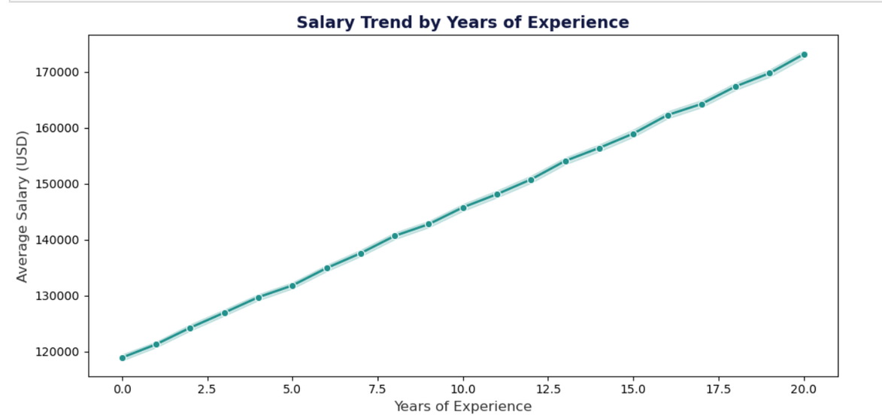
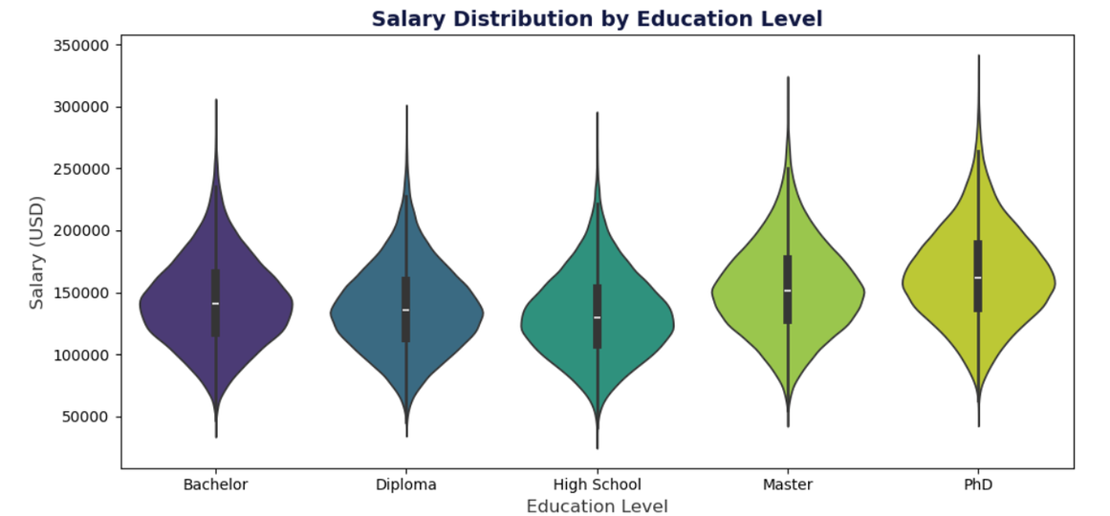
Experience & Education
Salary vs Experience: Clear upward trend (0 yrs ≈ $119k → 20 yrs ≈ $173k).
Salary vs Education: PhD ≈ $164k > Master ≈ $153k > Bachelor ≈ $142k.
Insight: Long‑term experience and advanced degrees are the strongest drivers of salary growth.

Slide 10
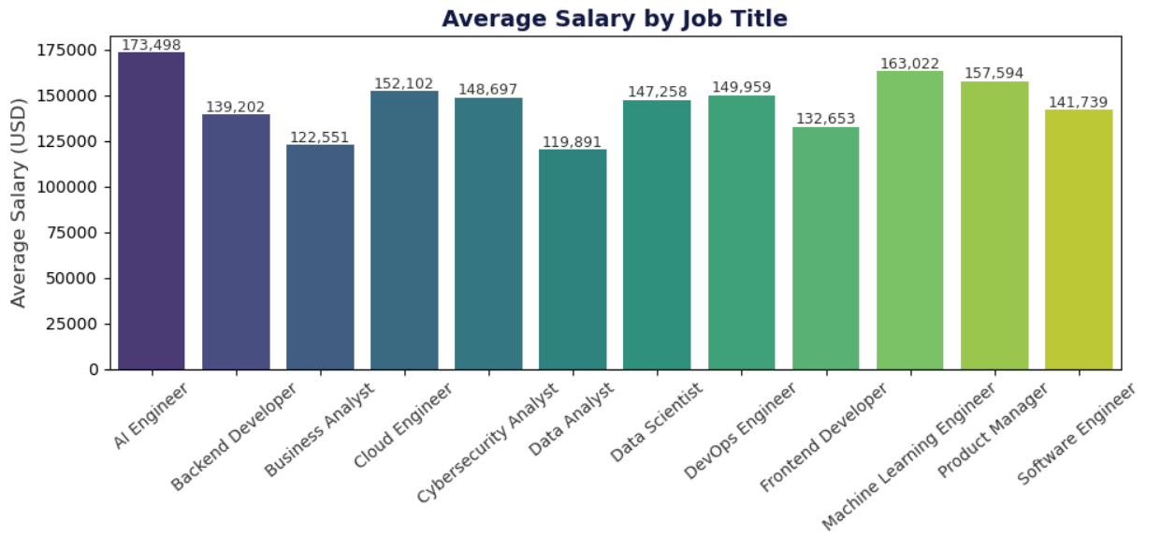
Job Titles
Highest Paid: AI Engineer, ML Engineer, Product Manager.
Lowest Paid: Data Analyst, Business Analyst.
Insight: Technical and leadership roles command higher compensation compared to analytical support roles.

Slide 11
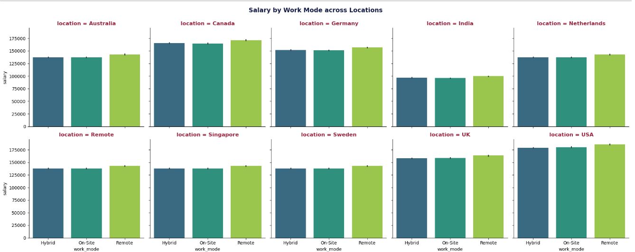
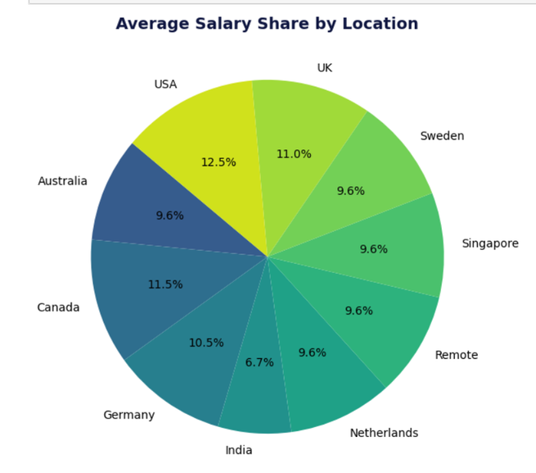
Location & Work Mode
Top Locations: USA (~$182k), Canada (~$167k), UK (~$160k).
Lowest: India (~$97k).
Work Mode: Remote consistently pays more across regions.
Insight: Geography and flexibility strongly influence salary outcomes.

Slide 12
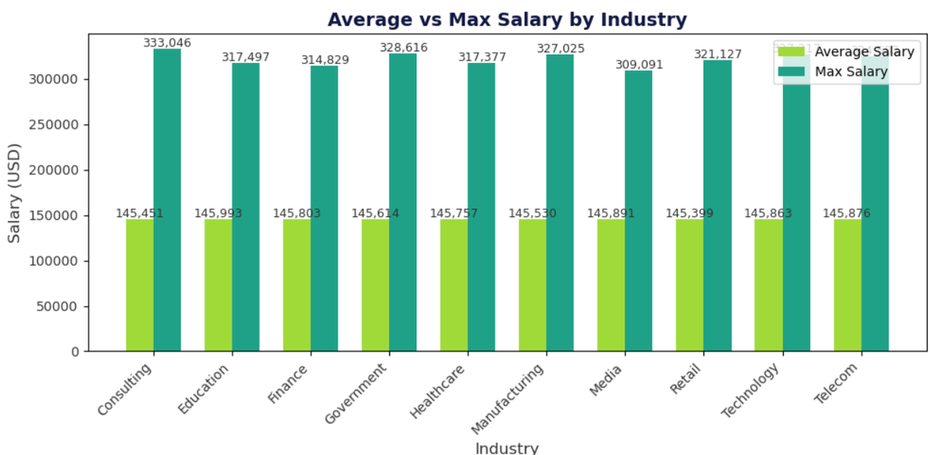
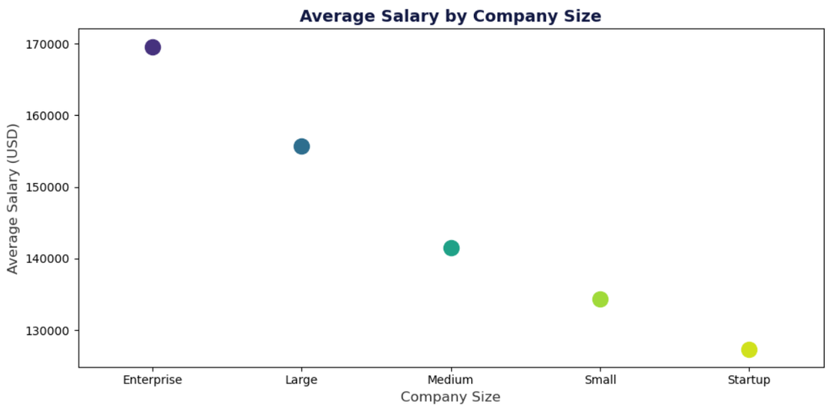
Industry & Company Size
Industry Max Salaries: Consulting ($333k), Government ($329k), Technology ($327k).
Company Size: Enterprise (~$170k) > Large (~$156k) > Startup (~$127k).
Insight: Big firms and certain industries set higher salary ceilings.

Slide 13
Significant Insights
Education matters everywhere: Advanced degrees boost pay across all job titles, not just technical ones.
Upskilling pays off: Adding more skills and certifications directly translates into higher compensation.
Experience pays steadily: Salaries rise consistently with tenure, with significant gains after 10+ years of experience.
Remote work premium: Remote positions consistently outpace hybrid and on‑site roles in salary.
Industry ceiling effect: While averages are similar, certain industries allow standout performers to earn far above the norm.
Company size advantage: Enterprise firms lead in pay, reinforcing the stability and resources of larger organizations.

Slide 14
Recommendations / Next Steps
For professionals:
Invest in advanced degrees, certifications, and continuous skill development to maximize earning potential.
For recruiters/companies:
Emphasize remote flexibility and upskilling opportunities to attract top talent.

Slide 15
NISSY JIJU
THANK YOU
GitHub:https://github.com/NISSYJIJU
-
nissyjijugr8@gmail.com

