Slide 1
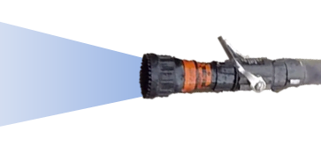
Room A
Room B
Room C

