Slide 1
Mayday! Mayday!: Investigating the Performance of Radio Cables in High Temperature Environments
Shelley Jin
Advisor: Michelle Donnelly
Engineering Laboratory, Fire Research Division, Fire Fighting Technology Group

Slide 2
Introduction
Technology constantly advancing
Greater use of electronic devices
PASS
SCBA
Thermal Imaging
Radios

Slide 3
Existing Standards
Current official standards on radio performance:
NFPA1221 8.3.5.4: “Mobile radios and associated equipment shall be manufactured for the environment in which they are to be used”
NFPA1221 8.3.6.2: “Portable radios shall be manufactured for the environment in which they are to be used and shall be of a size and construction to allow their operation with one hand

Slide 4
What is “environment”?

Slide 5
Current Situation
NFPA1802 radio code in development
Research directly contributing
Test current equipment
Examine performance
Recommend requirements/testing methods

Slide 6
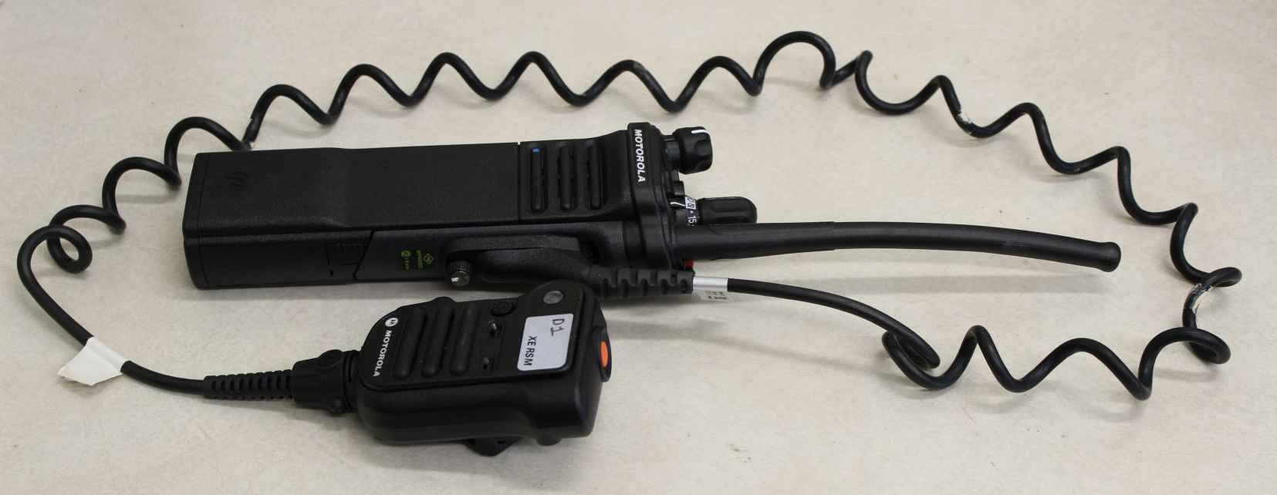
Project Scope
Looking specifically at radio cables
Protected radios resilient
Cable = weakest link?

Slide 7
Thermal classes
Thermal Class | Max Time (min) | Max Temp (ºC/ºF) | Max Flux (kW/m²)
I | 25 | 100/212 | 1
II | 15 | 160/320 | 2
III | 5 | 260/500 | 10
IV | <1 | >260/500 | >10

Slide 8
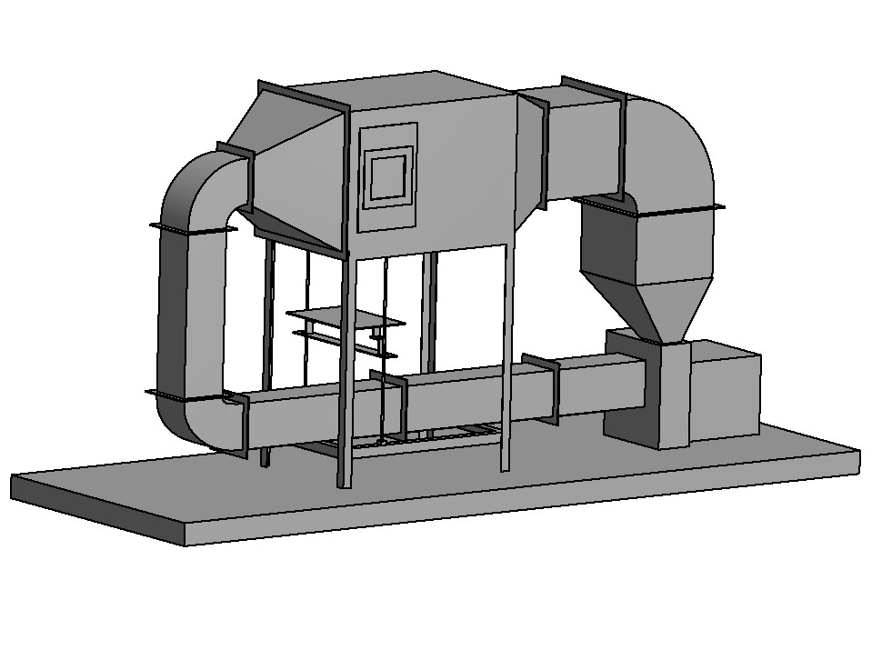
Flow Loop
Testing Chamber
8’2” or ~2.5m tall
Heater
Loading Platform
Blower

Slide 9
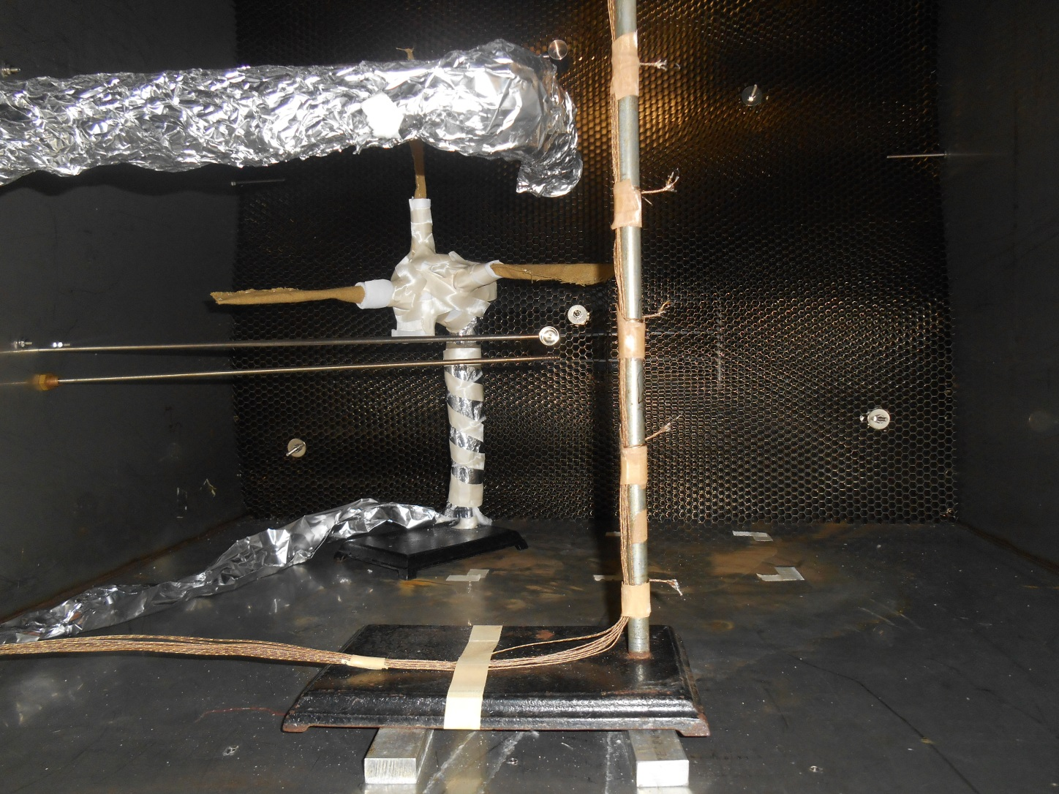
Chamber Instrumentation
Heat Flux Gauge
Thermocouple Tree
Bi-directional Velocity Probe
Radio Signal
Transmitter

Slide 10
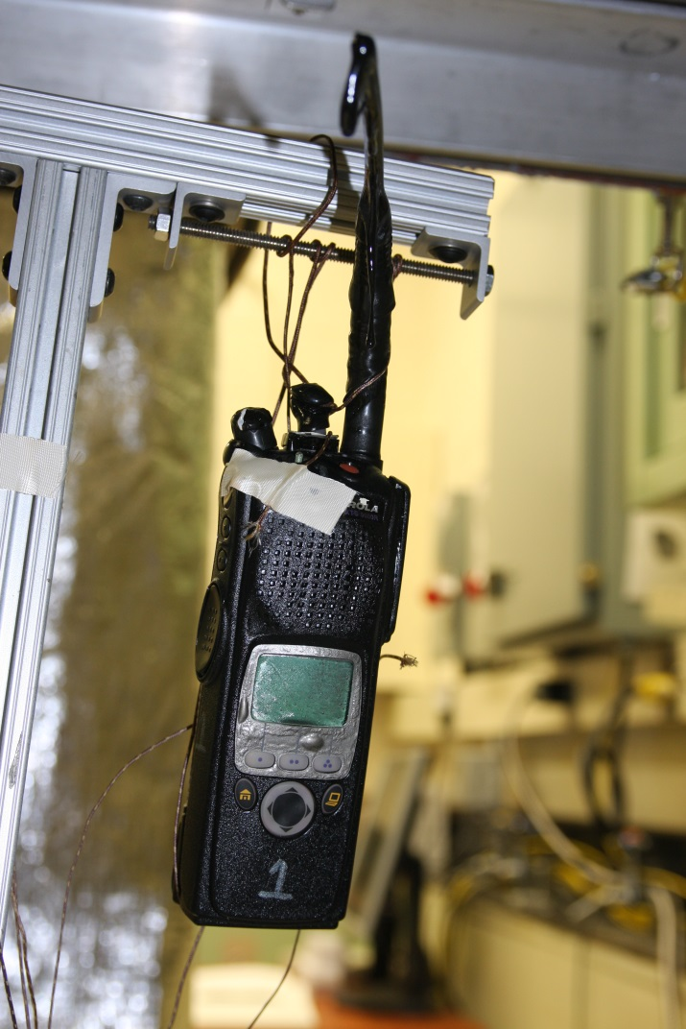
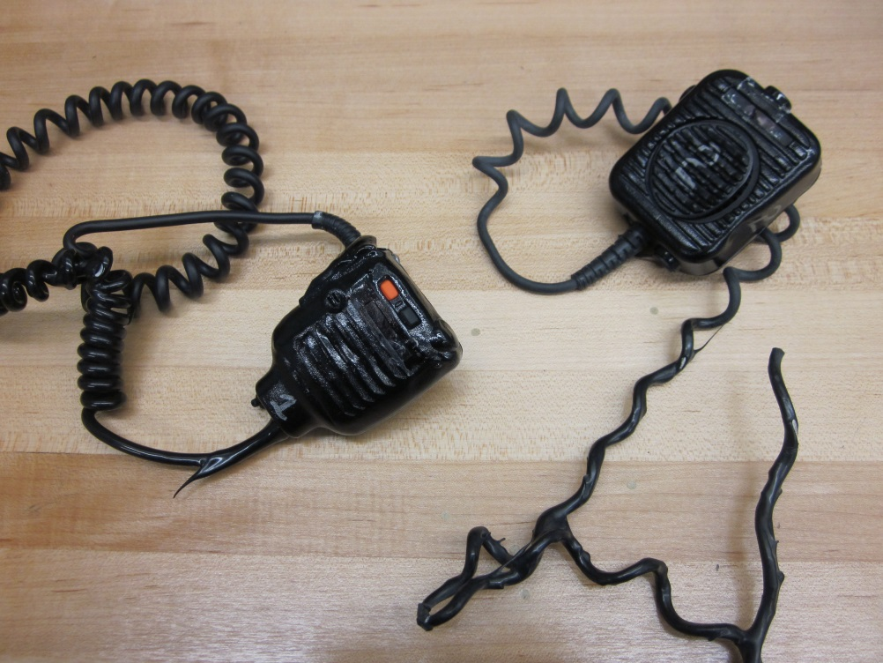
Previous Tech Tests

Slide 11
Cables Tested
Tested three cable types: B, D, X
D & X: same year & manufacturer
D: standard temperatures
X: extreme temperatures
B: different manufacturer
Expected Performance: X>D>B

Slide 12
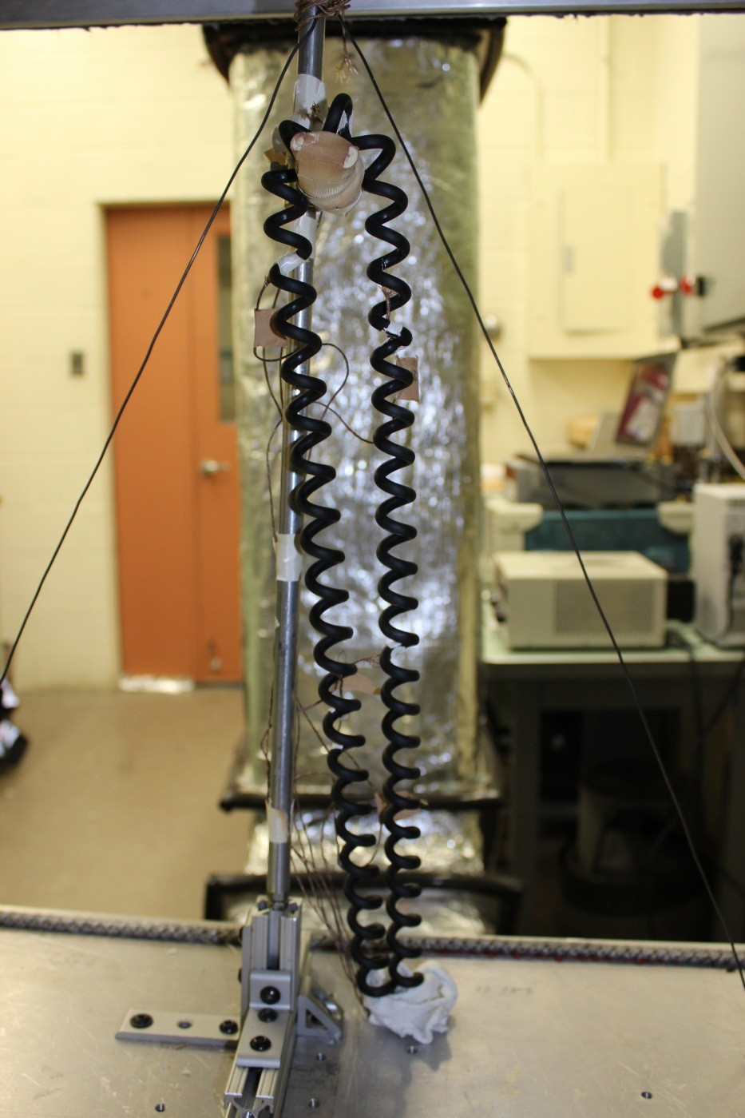
Cable Testing Setup
*
*
2 TC at each *
One touching, one in air
*

Slide 13
Results
Type |  | Class II | Class III
B | 1 | Passed | Failed 88 sec in
 | 2 | Passed | Failed 128 sec in
 | 3 | N/A | Failed 175 sec in
D | 1 | N/A | Failed 168 sec in
 | 2 | Passed | Failed 165-180 sec in
X | 1 | N/A | Passed
 | 2 | Passed | Passed
Note: performed a baseline Class I Test for B1

Slide 14
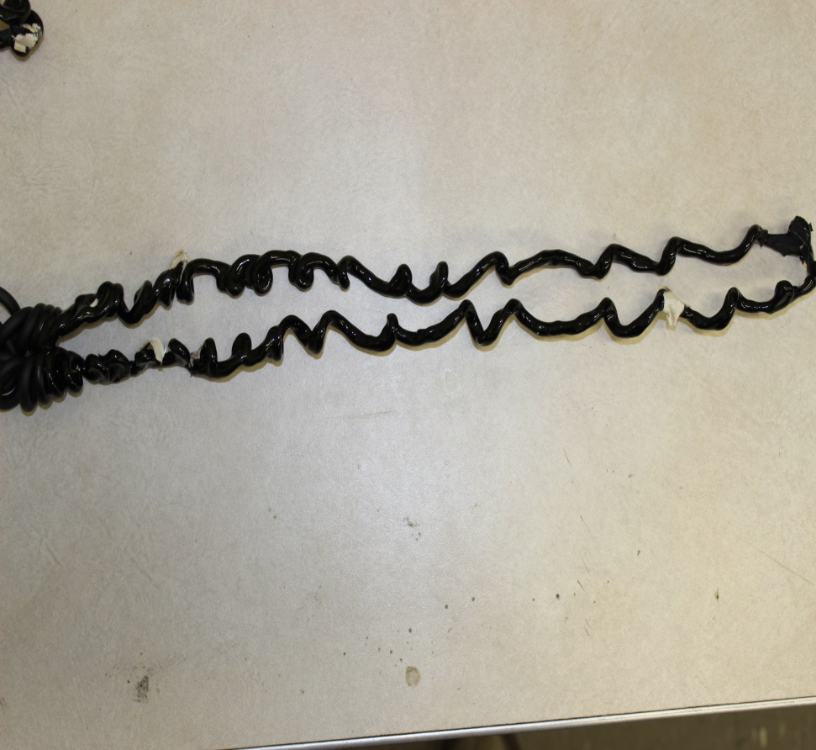
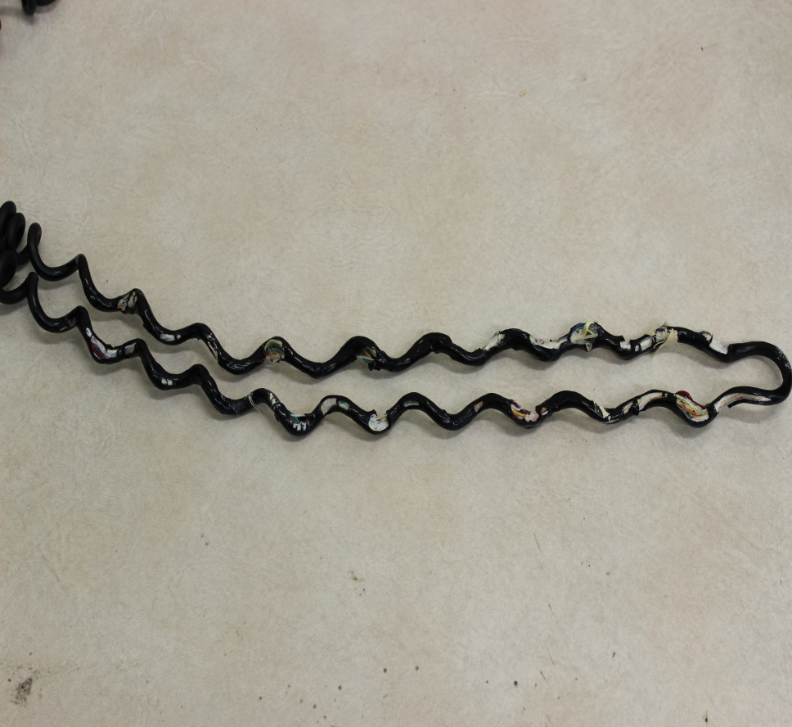
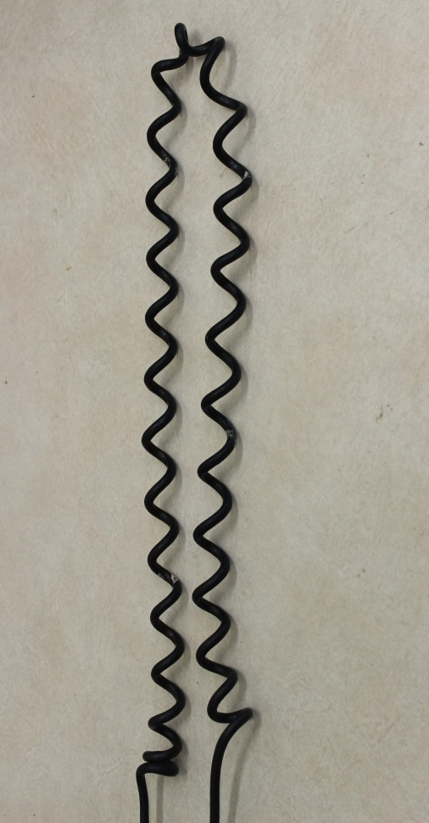
Cable Comparisons
Cable B
Cable D
Cable X

Slide 15
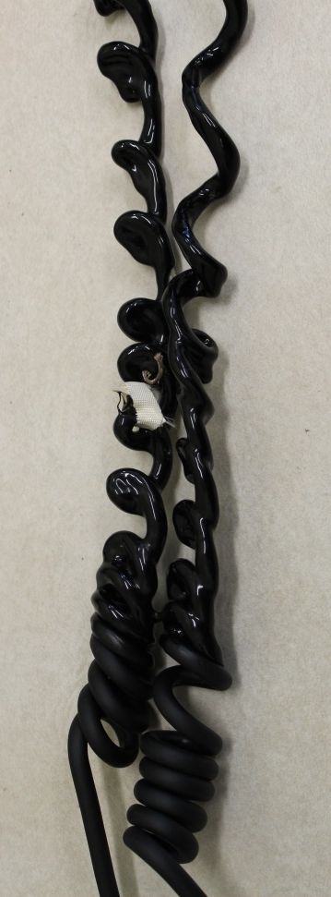
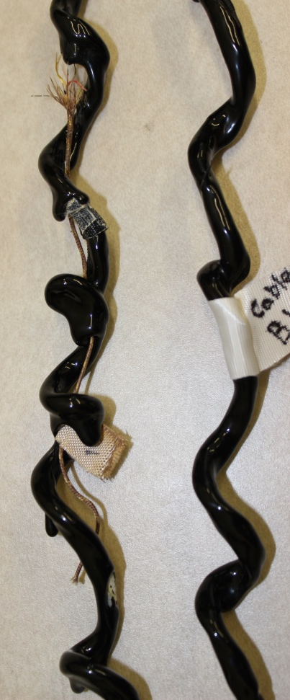
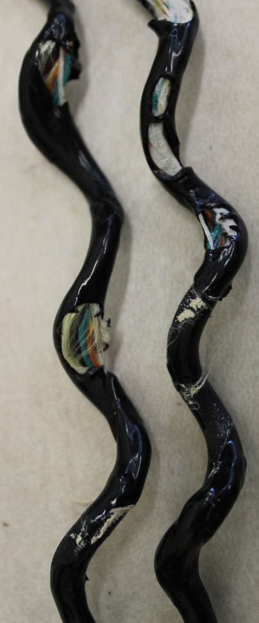
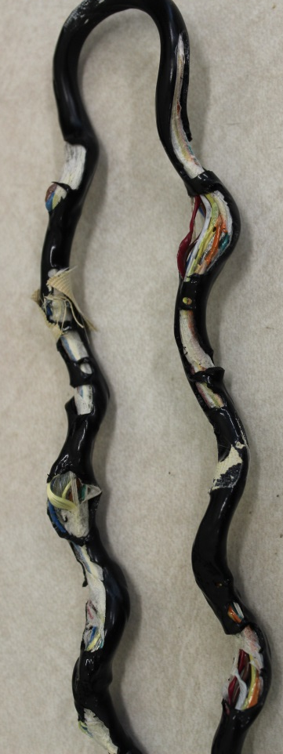
Close Up of Damage
Cable B
Cable D

Slide 16
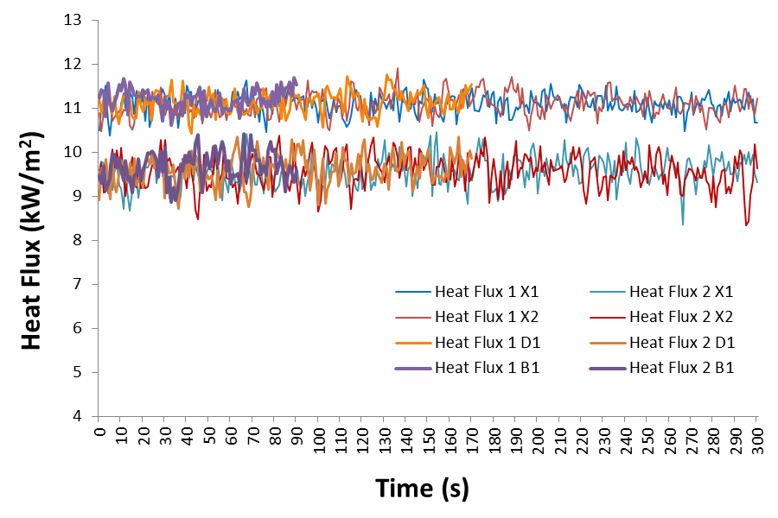
Testing Chamber—Heat Flux
Relative Standard Deviation for tests ~3%

Slide 17
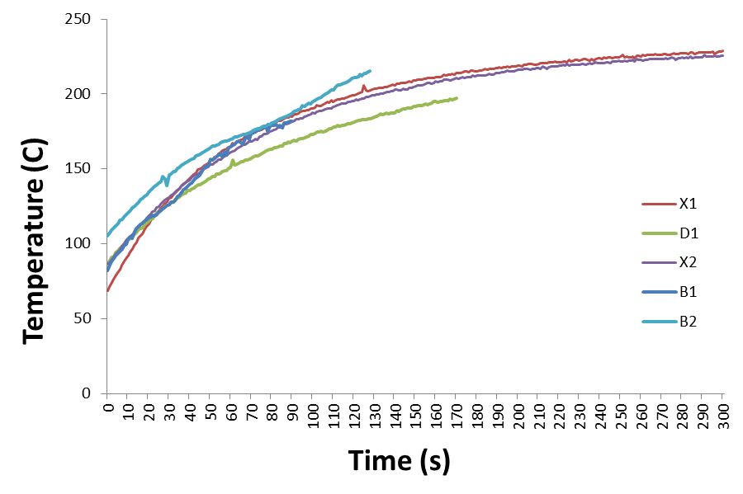
Cable Temperatures

Slide 18
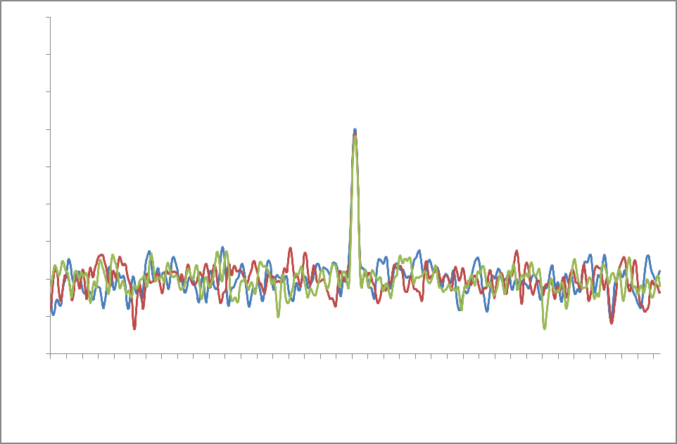
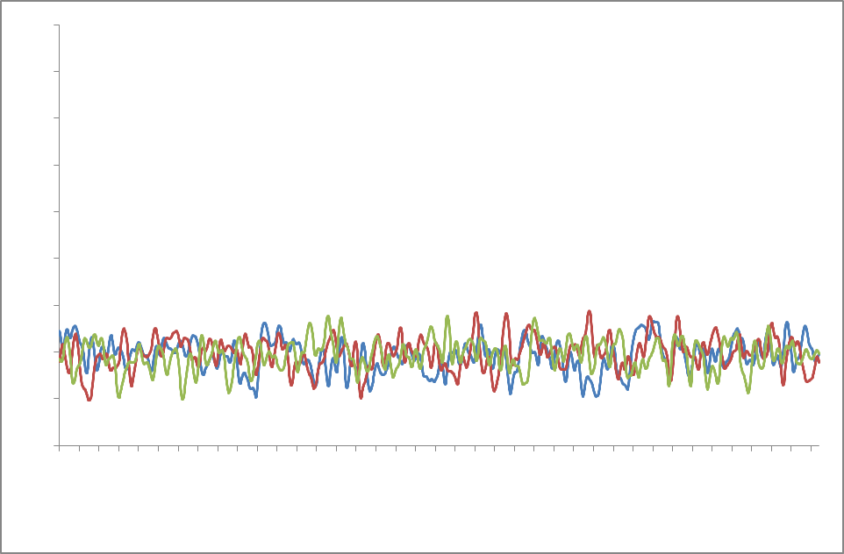
Regular Radio Behavior
On
Off

Slide 19
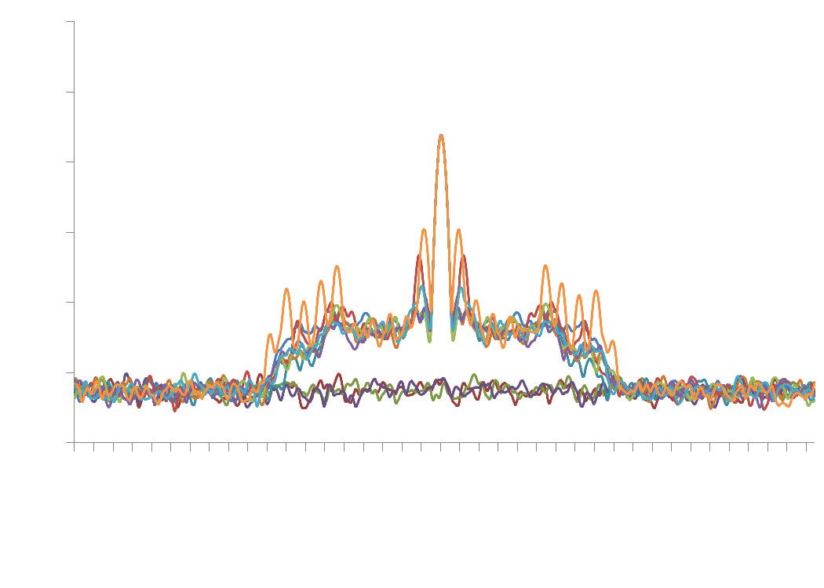
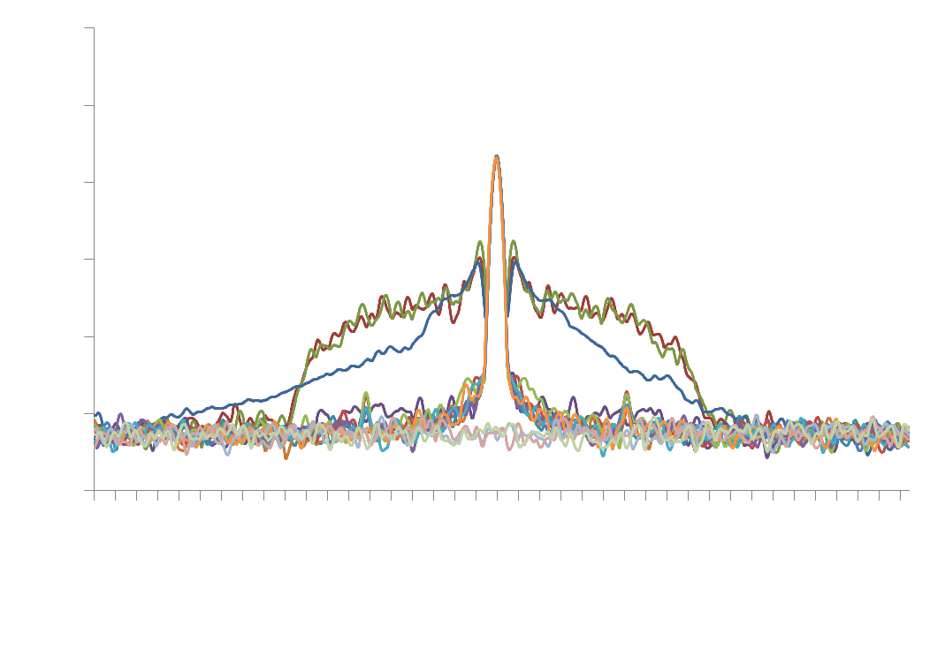
Abnormal Radio Signal
Control
Cable B2

Slide 20
Conclusions
Mixed performance with current equipment
Meeting extreme temperature performance feasible
Recommend NFPA1802 Committee to include Thermal Class III testing
Flow loop produces repeatable test environment

Slide 21
Future Plans
Test different soak conditions
Examine speaker microphone
Introduce moisture—observe humidity

