Slide 1
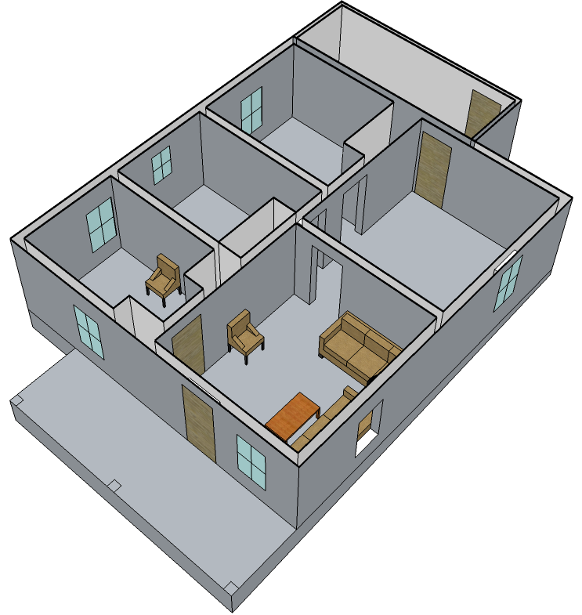

Impact of Venting the Living Room Window
214 Folsom St. Experiment 1
Rear Bedroom
At 7 ft: 300°F → 300°F
At 1 ft: 100°F → 100°F
Kitchen
At 7 ft: 400°F → 450°F
At 1 ft: 100°F → 100°F
Middle Bedroom
At 7 ft: 300°F → 300°F
At 1 ft: 100°F → 100°F
7 kW/m² → 5 kW/m²
Living Room
At 7 ft: 600°F → 700°F
At 1 ft: 200°F → 200°F
Front Bedroom
At 7 ft: 120°F → 120°F
At 1 ft: 70°F → 70°F
At 3 ft: 20% O₂ → 20% O₂
1% CO₂ → 1% CO₂
0% CO → 0% CO
0 kW/m² → 0 kW/m²
Bidirectional Flow
(Both Inlet and Outlet)

Slide 2
Impact of Exterior Attack through Living Room Window with no other Ventilation
214 Folsom St. Experiment 1
~ 30 seconds of water
Rear Bedroom
At 7 ft: 300°F → 250°F
At 1 ft: 100°F → 100°F
Kitchen
At 7 ft: 450°F → 300°F
At 1 ft: 100°F → 100°F
Middle Bedroom
At 7 ft: 300°F → 250°F
At 1 ft: 100°F → 100°F
5 kW/m² → 4 kW/m²
Living Room
At 7 ft: 700°F → 100°F
At 1 ft: 200°F → 70°F
Front Bedroom
At 7 ft: 120°F → 120°F
At 1 ft: 70°F → 70°F
At 3 ft: 20% O₂ → 20% O₂
1% CO₂ → 1% CO₂
0% CO → 0% CO
0 kW/m² → 0 kW/m²
Bidirectional Flow
(Both Inlet and Outlet)
Exterior Water Application

Slide 3
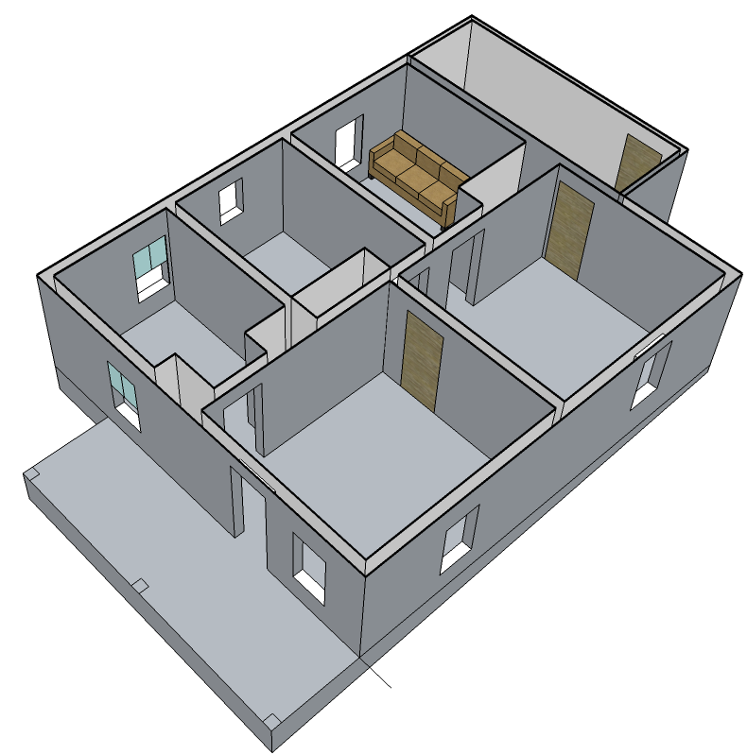
Impact of Venting the
Middle (Target) Bedroom Window
214 Folsom St. Experiment 2
Rear (Burn) Bedroom
Middle (Target) Bedroom
At 7 ft: 1700 °F → 1600 °F
At 1 ft: 1700 °F → 1600 °F
At 7 ft: 400 °F → 500 °F
At 1 ft: 150 °F → 150 °F
Kitchen
At 7 ft: 800 °F → 1000 °F
At 1 ft: 200 °F → 200 °F

Slide 4
Impact of Exterior Attack through
Rear Bedroom Window
214 Folsom St. Experiment 2
~ 1 min. 20 sec of water
Exterior Water Application
Rear (Burn) Bedroom
Middle (Target) Bedroom
At 7 ft: 1600 °F → 400 °F
At 1 ft: 1600 °F → 400°F
At 7 ft: 500 °F → 150 °F
At 1 ft: 150 °F → 100 °F
Kitchen
At 7 ft: 1000 °F → 150 °F
At 1 ft: 200 °F → 50 °F

Slide 5
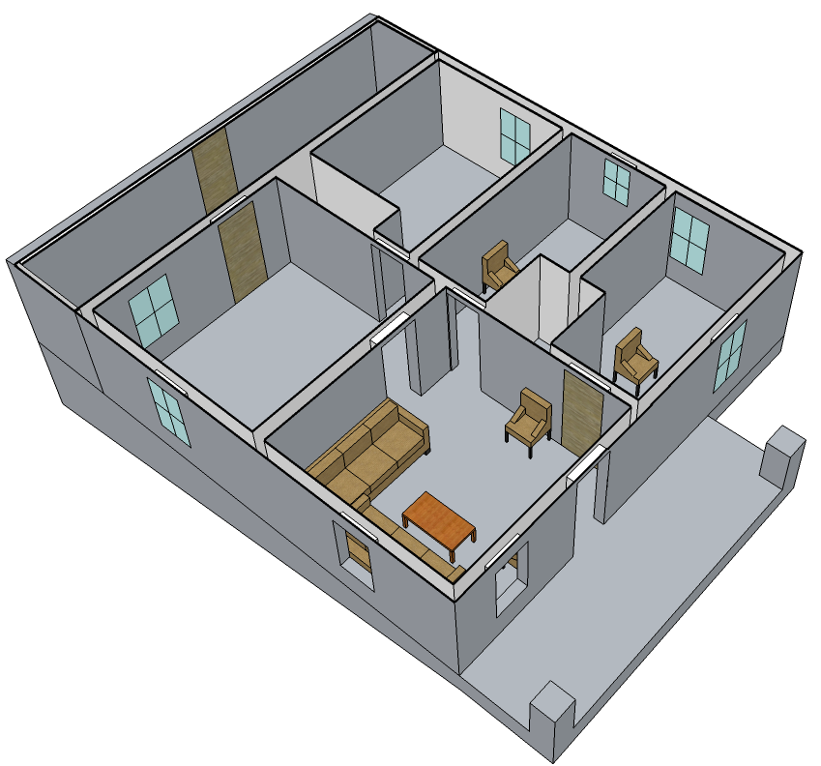
Impact of Opening the Front Door
215 Folsom St. Experiment 1
Middle Bedroom
Rear Bedroom
At 7 ft: 600 °F → 700 °F
At 1 ft: 200 °F → 300 °F
At 3 ft: 4 kW/m² →
4 kW/m²
At 7 ft: 70 °F → 75 °F
At 1 ft: 50 °F → 50 °F
Front Bedroom
At 7 ft: 80 °F → 90 °F
At 1 ft: 50 °F → 50 °F
At 3 ft: 20% O₂ → 20% O₂
0% CO₂ → 0% CO₂
0% CO → 0% CO
3 kW/m² → 3 kW/m²
Door Knob Inside Room:
100 °F → 200 °F
Door Knob Exposed to Fire:
700 °F → 1200 °F
Kitchen
At 7 ft: 500 °F → 700 °F
At 1 ft: 200 °F → 300 °F
Living Room
At 7 ft: 1100 °F → 1400 °F
At 1 ft: 400 °F → 300 °F

Slide 6

Impact of Exterior Water through the Front Door
215 Folsom St. Experiment 1
~ 75 seconds of water
Rear Bedroom
Middle Bedroom
At 7 ft: 75 °F → 75 °F
At 1 ft: 50 °F → 50 °F
At 7 ft: 700 °F → 200 °F
At 1 ft: 300 °F → 100 °F
At 3 ft: 4 kW/m² →
1 kW/m²
Front Bedroom
At 7 ft: 90 °F → 80 °F
At 1 ft: 50 °F → 50 °F
At 3 ft: 20% O₂ → 20% O₂
0% CO₂ → 0% CO₂
0% CO → 0% CO
3 kW/m² → 1 kW/m²
Door Knob Inside Room:
200 °F → 100 °F
Door Knob Exposed to Fire:
1200 °F → 300 °F
Kitchen
At 7 ft: 700 °F → 200 °F
At 1 ft: 300 °F → 100 °F
Living Room
Exterior Water Application
At 7 ft: 1400 °F → 200 °F
At 1 ft: 300 °F → 70 °F

Slide 7
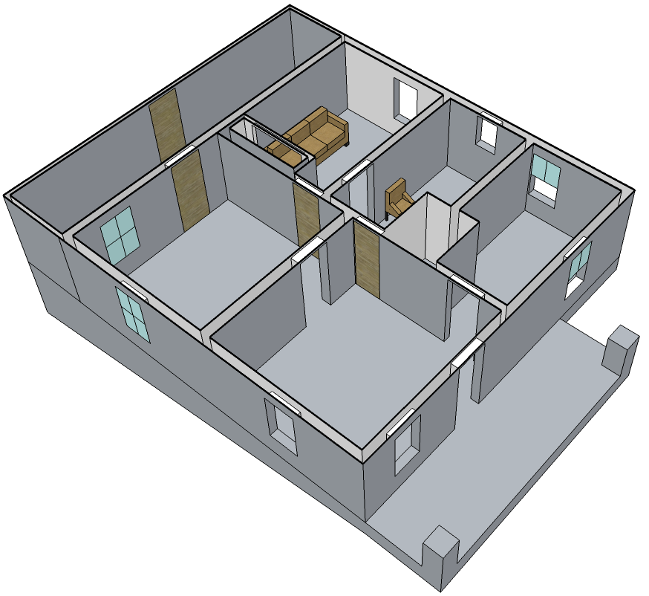
Impact of Venting the
Rear (Burn) Bedroom Window
215 Folsom St. Experiment 2
Rear (Burn) Bedroom
Middle (Target) Bedroom
At 7 ft: 1100 °F → 1500 °F
At 1 ft: 600 °F → 1500 °F
At 7 ft: 600 °F → 600 °F
At 1 ft: 300 °F → 300 °F

Slide 8
Impact of Fog Nozzle Suppression through
Rear (Burn) Bedroom Window
215 Folsom St. Experiment 2
~ 10 seconds
Exterior Water Application
Rear (Burn) Bedroom
At 7 ft: 1500 °F → 2300 °F
At 1 ft: 1500 °F → 100 °F
Middle (Target) Bedroom
At 7 ft: 600 °F → 700 °F
At 1 ft: 300 °F → 300 °F

Slide 9
Impact of Fog Nozzle Suppression through
Rear (Burn) Bedroom Window
215 Folsom St. Experiment 2
Additional ~ 50 seconds
Exterior Water Application
Rear (Burn) Bedroom
Middle (Target) Bedroom
At 7 ft: 2300 °F → 600 °F
At 1 ft: 100 °F → 100 °F
At 7 ft: 700 °F → 200 °F
At 1 ft: 300 °F → 100 °F

Slide 10
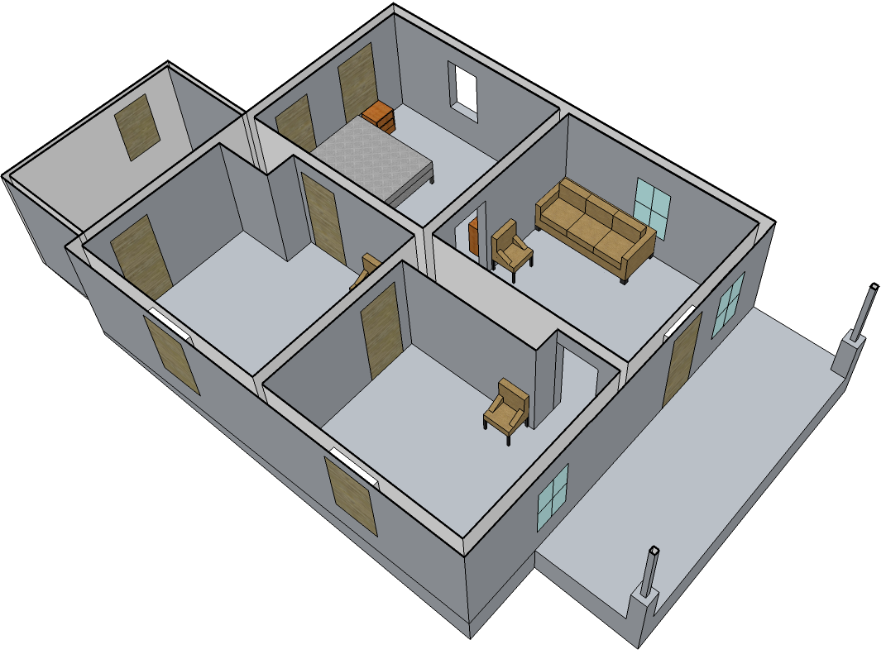
Impact of Venting the Burn Room Window
218 Folsom St. Experiment 1
Burn Room
At 7 ft: 1000°F → 700°F
At 1 ft: 200°F → 100°F
Rear Bedroom
At 7 ft: 90°F → 90°F
At 1 ft: 50°F → 50°F
At 3 ft: 0 kW/m² → 0 kW/m²
Front Bedroom
Living Room
At 7 ft: 350°F → 250°F
At 1 ft: 100°F → 100°F
At 3 ft: 5 kW/m² → 5 kW/m²
At 7 ft: 600°F → 350 °F
At 1 ft: 100 °F → 100°F

Slide 11
Impact of Exterior Attack through Burn Room Window with no other Ventilation
218 Folsom St. Experiment 1
~ 2 minutes of water
Exterior Water Application
Burn Room
At 7 ft: 700°F → 100°F
At 1 ft: 100°F → 50°F
Rear Bedroom
At 7 ft: 90°F → 100°F
At 1 ft: 50°F → 70°F
At 3 ft: 0 kW/m² → 0 kW/m²
Front Bedroom
Living Room
At 7 ft: 250°F → 150°F
At 1 ft: 100°F → 100°F
At 3 ft: 5 kW/m² → 1 kW/m²
At 7 ft: 350°F → 150 °F
At 1 ft: 100 °F → 100°F

Slide 12
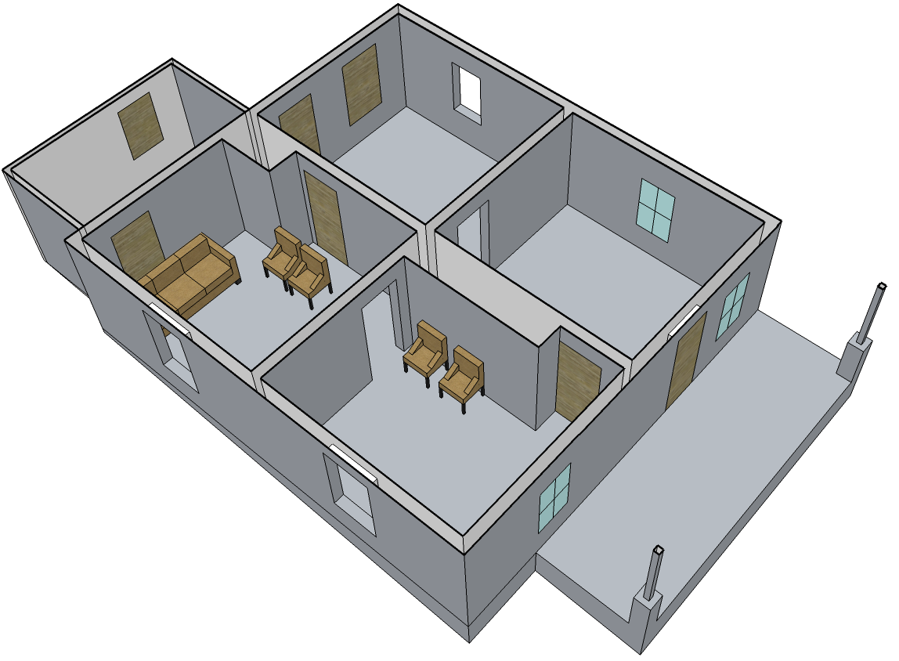
Impact of Venting the
Front (Target) Bedroom Window
218 Folsom St. Experiment 2
Rear Bedroom
At 7 ft: 500 °F → 1200 °F
At 1 ft: 100 °F → 500 °F
Front Bedroom
At 7 ft: 300 °F → 600 °F
At 1 ft: 100 °F → 200 °F

Slide 13
Impact of Venting the
Rear (Burn) Bedroom Window
218 Folsom St. Experiment 2
Rear Bedroom
At 7 ft: 1200 °F → 1600 °F
At 1 ft: 500 °F → 1100 °F
Front Bedroom
At 7 ft: 600°F → 700°F
At 1 ft: 200°F → 200°F

Slide 14
Impact of Exterior Attack through
Rear (Burn) Bedroom Window
218 Folsom St. Experiment 2
~ 10 sec of water
Rear Bedroom
At 7 ft: 1600 °F → 1300 °F
At 1 ft: 1100 °F → 1100 °F
Front Bedroom
At 7 ft: 700°F → 800°F
At 1 ft: 200°F → 300°F
Exterior Water Application

Slide 15
Impact of Exterior Attack through
Rear (Burn) Bedroom Window
218 Folsom St. Experiment 2
Additional ~ 1 min. 30 sec of water
Front Bedroom
At 7 ft: 800°F → 200°F
At 1 ft: 300°F → 100°F
Exterior Water Application

Slide 16
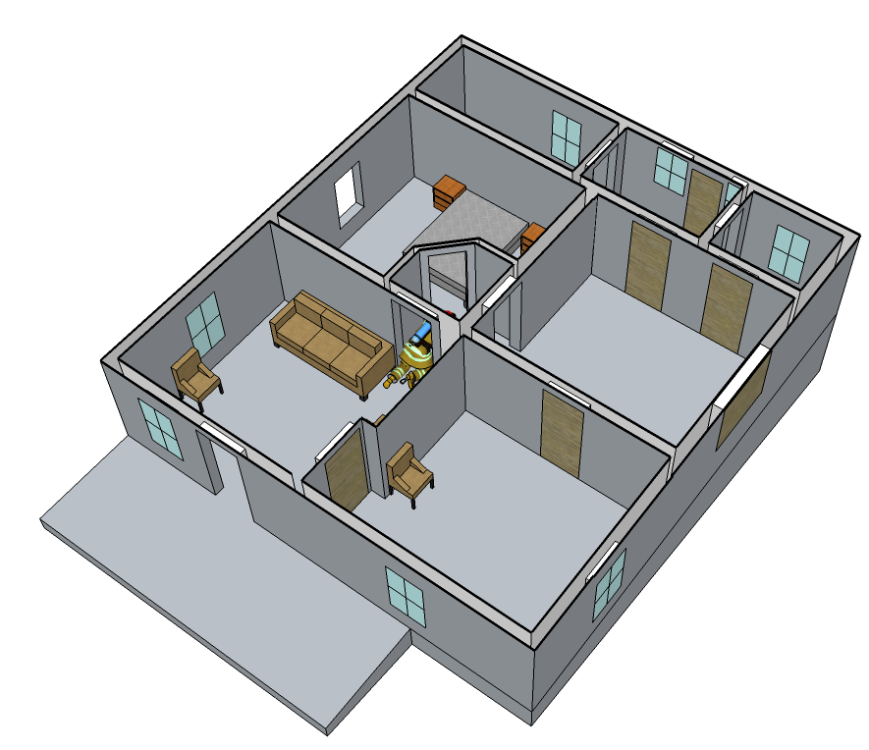
Impact of Opening the Front Door
219 Folsom St. Experiment 1
Rear Bedroom
At 7 ft: 200 °F → 1100 °F
At 1 ft: 50 °F → 300°F
Kitchen
At 7 ft: 100°F → 500°F
At 1 ft: 50°F → 100°F
At 3 ft: 20% O₂ → 12% O₂
0% CO₂ → 8% CO₂
0% CO → 1% CO
0 kW/m² → 4 kW/m²
Living Room
At 7 ft: 100°F → 500°F
At 1 ft: 50°F → 100°F
Front Bedroom
At 7 ft: 55°F → 60°F
At 1 ft: 50°F → 50°F
At 3 ft: 0 kW/m² → 0 kW/m²
Turnout Gear
At 3 ft: 100°F → 550°F
0 kW/m² → 12 kW/m²

Slide 17
Impact of Venting the Bedroom Window
219 Folsom St. Experiment 1
Rear Bedroom
Kitchen
At 7 ft: 1100 °F → 1600 °F
At 1 ft: 300 °F → 1600°F
At 7 ft: 500°F → 600°F
At 1 ft: 100°F → 100°F
At 3 ft: 12% O₂ → 4% O₂
8% CO₂ → 8% CO₂
1% CO → 3% CO
4 kW/m² → 5 kW/m²
Living Room
At 7 ft: 500°F → 600°F
At 1 ft: 100°F → 100°F
Front Bedroom
At 7 ft: 60°F → 65°F
At 1 ft: 50°F → 50°F
At 3 ft: 0 kW/m² → 0 kW/m²
Turnout Gear
At 3 ft: 550°F → 800°F
12 kW/m² → 30 kW/m²

Slide 18
Impact of Interior Water Application
219 Folsom St. Experiment 1
~ 65 seconds of water
Rear Bedroom
Kitchen
At 7 ft: 1600 °F → 100 °F
At 1 ft: 1600 °F → 100 °F
At 7 ft: 600 °F → 200 °F
At 1 ft: 100 °F → 75 °F
At 3 ft: 4% O₂ → 17% O₂
8% CO₂ → 3% CO₂
3% CO → 1% CO
5 kW/m² → 0 kW/m²
Living Room
Interior Water Application
At 7 ft: 600 °F → 150 °F
At 1 ft: 100 °F → 50 °F
Front Bedroom
At 7 ft: 65 °F → 63 °F
At 1 ft: 50 °F → 50 °F
At 3 ft: 0 kW/m² → 0 kW/m²
Turnout Gear
At 3 ft: 800°F → 150°F
30 kW/m² → 0 kW/m²

Slide 19
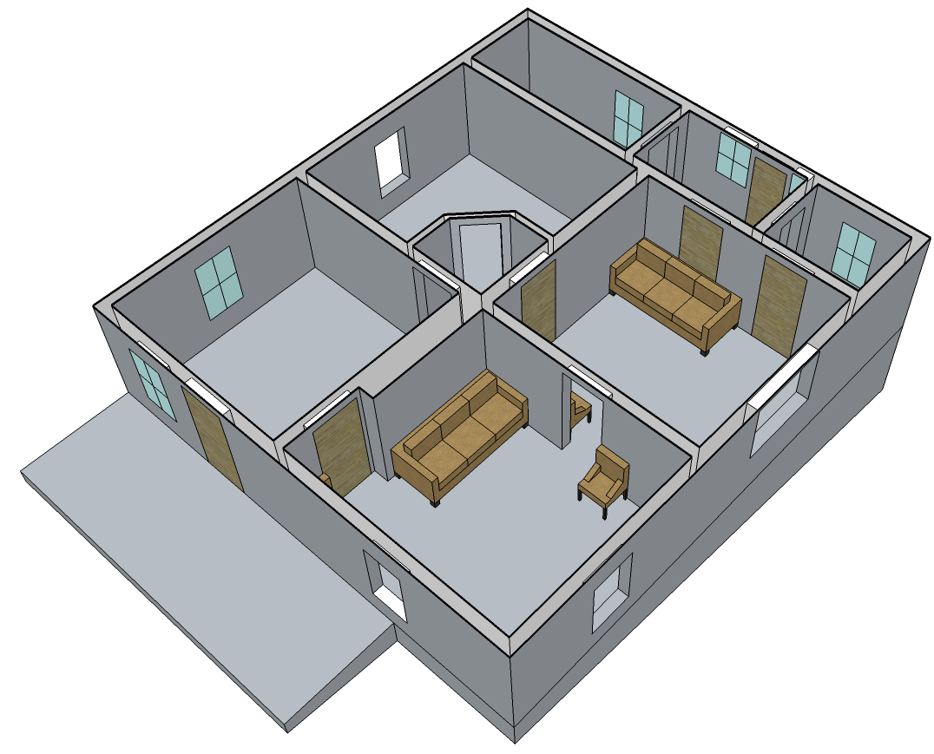
Impact of Venting the Kitchen Window
219 Folsom St. Experiment 2
Open Bedroom
At 7 ft: 600 °F → 1100 °F
At 1 ft: 200 °F → 200 °F
Closed Bedroom
At 7 ft: 70 °F → 90°F
At 1 ft: 50 °F → 50°F
Burn Room
At 7 ft: 1100 °F → 1300°F
At 1 ft: 200°F → 400°F

Slide 20
Impact of Venting the Front Window
219 Folsom St. Experiment 2
Open Bedroom
At 7 ft: 1100 °F → 1100 °F
At 1 ft: 200 °F → 300 °F
Closed Bedroom
At 7 ft: 90 °F → 100°F
At 1 ft: 50 °F → 50°F
Burn Room
At 7 ft: 1300 °F → 1800°F
At 1 ft: 400°F → 1800°F

Slide 21
Impact of Exterior attack though the
Front Bedroom Window
219 Folsom St. Experiment 2
~ 60 seconds of water
Open Bedroom
At 7 ft: 1100 °F → 900 °F
At 1 ft: 300 °F → 200 °F
Closed Bedroom
At 7 ft: 100°F → ~100 °F
At 1 ft: 50 °F → 50 °F
Burn Room
At 7 ft: 1800°F → 100°F
At 1 ft: 1800°F → 100°F
Exterior Water Application

Slide 22
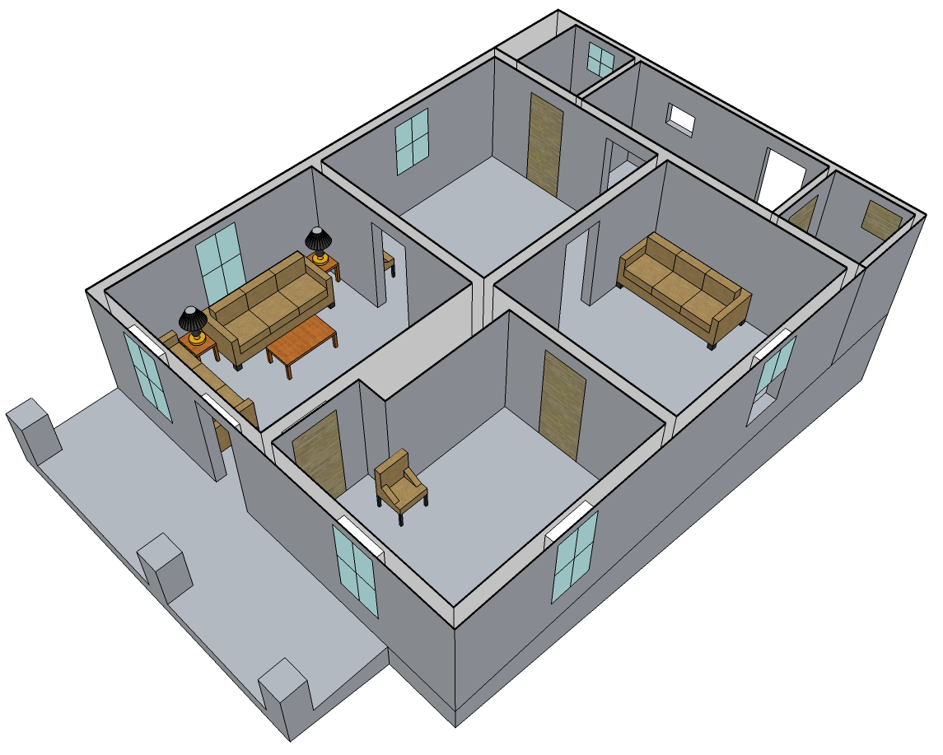
Legacy Sofa vs. Modern Sofa
225 Folsom St. Experiment
Living Room
Rear Bedroom
After ~ 4 min.
At 7 ft: 50 °F → 900 °F
At 1 ft: 50 °F → 1400 °F
After ~ 6 min.
At 7 ft: 50 °F → 150 °F
At 1 ft: 50 °F → 50 °F
Notes:
Check ventilation

Slide 23
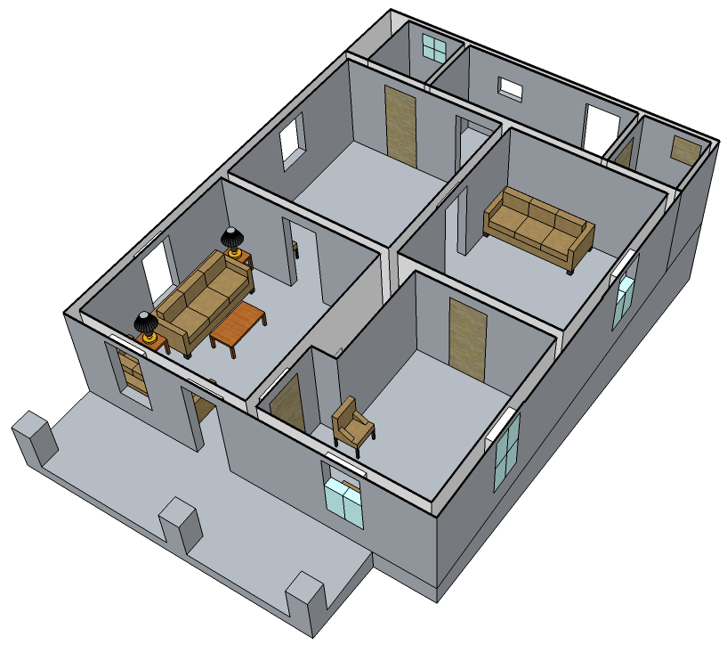
Impact of Exterior attack though the Front Door
225 Folsom St. Experiment
~ 60 seconds of water
Rear Bedroom
At 7 ft: 800 °F → 200 °F
At 1 ft: 200 °F → 50 °F
Living Room
At 7 ft: 1700 °F → 300 °F
At 1 ft: 1700 °F → 200 °F
Front Bedroom
At 7 ft: 100 °F → 80°F
At 1 ft: 70 °F → 75°F
Exterior Water Application

Slide 24
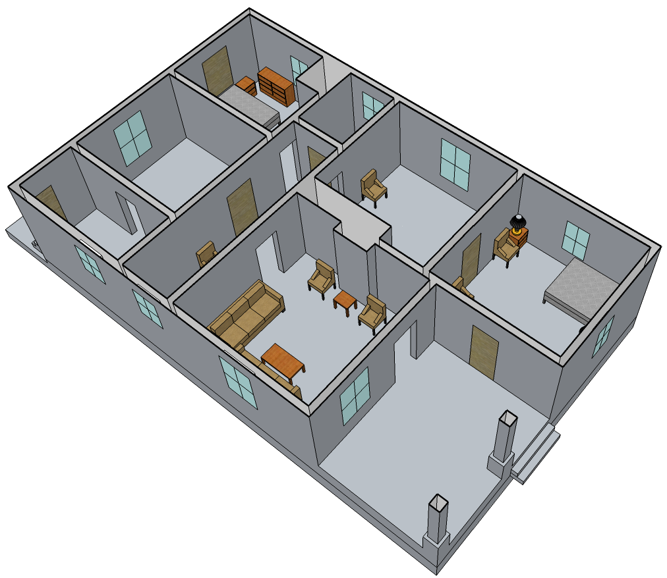

Impact of Sprinkler Activation
226 Folsom St. Experiment 1
Sprinkler activated at 1 min. 15 sec.
After 25 sec. of water flow
Sprinkler Application
Front Bedroom
At 7 ft: 225 °F → 80 °F
At 1 ft: 70 °F → 70 °F

Slide 25
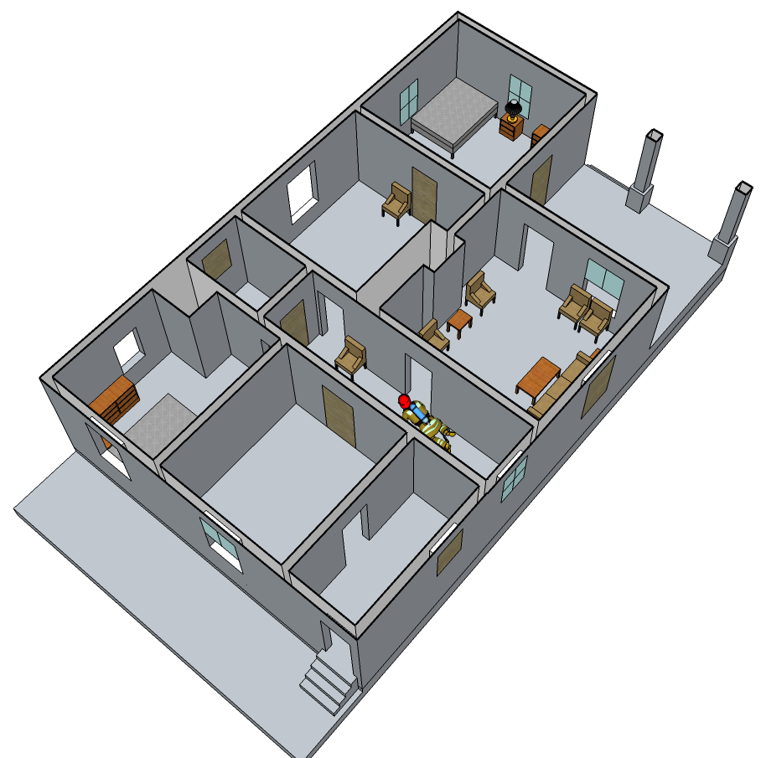
Impact of Venting Middle Bedroom Window
226 Folsom St. Experiment 2
Closed Front Bedroom
At 7 ft: 67°F → 67°F
At 1 ft: 62°F → 62°F
Open Middle Bedroom
Living Room
At 7 ft: 450°F → 1000°F
At 1 ft: 70°F → 150°F
At 3 ft: 3% O₂ → 14% O₂
9% CO₂ → 6% CO₂
3% CO → 1% CO
At 7 ft: 700°F → 100°F
At 1 ft: °F → 70°F
Turnout Gear
At 7 ft: 500°F → 300°F
At 1 ft: 100°F → 100°F
Open Rear Bedroom
Closed Rear Bedroom
At 7 ft: 1500°F → 1600°F
At 1 ft: 1600°F → 1700°F
At 7 ft: 90°F → 70°F
At 1 ft: 70°F → 70°F

Slide 26
Impact of Exterior Water through
Ignition Room Window
226 Folsom St. Experiment 2
~ 60 seconds of water
Closed Front Bedroom
At 7 ft: 67°F → 63°F
At 1 ft: 62°F → 55°F
Living Room
Exterior Water Application
At 7 ft: 700°F → 100°F
At 1 ft: °F → 70°F
Open Middle Bedroom
At 7 ft: 1000°F → 250°F
At 1 ft: 150°F → 70°F
Turnout Gear
At 7 ft: 500°F → 300°F
At 1 ft: 100°F → 100°F
Open Rear Bedroom
At 7 ft: 1600°F → 1200°F
At 1 ft: 1700°F → 1200°F

Slide 27
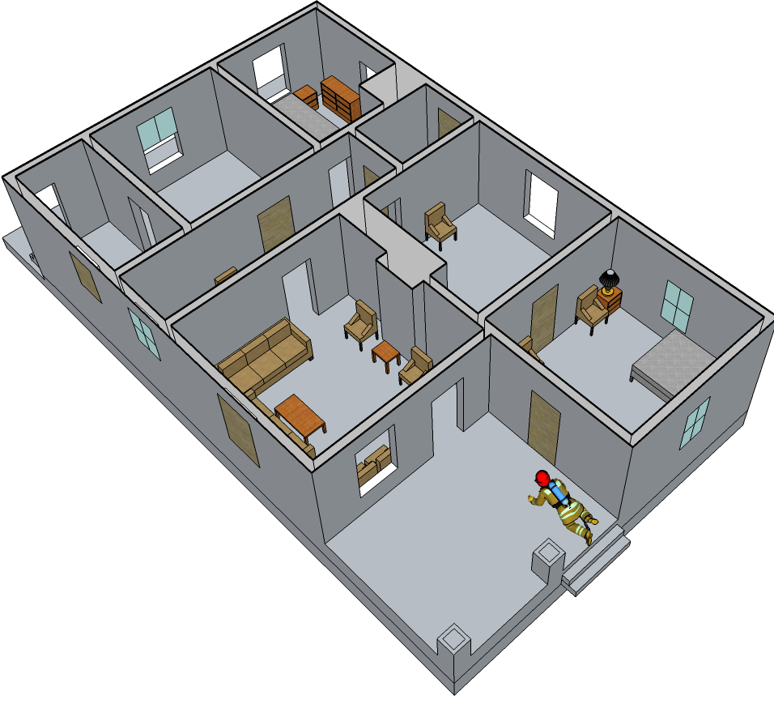
Impact of CAF through Front Door
226 Folsom St. Experiment 3
~ 20 seconds of water
Turnout Gear
Exterior:
At 3 ft: 1300°F → 400°F
5 kW/m² → 17 kW/m²
Interior:
At 3 ft: 1300°F → 400°F
Living Room
At 7 ft: 1400°F → 750°F
At 1 ft: 1400°F → 750°F
Exterior CAF Application

Slide 28
Impact of CAF through Front Door
226 Folsom St. Experiment 3
~ 40 seconds of water
Turnout Gear
Exterior:
At 3 ft: 400°F → 700°F
17 kW/m² → 0 kW/m²
Living Room
At 7 ft: 750°F → 500°F
At 1 ft: 750°F → 400°F
Exterior CAF Application

Slide 29
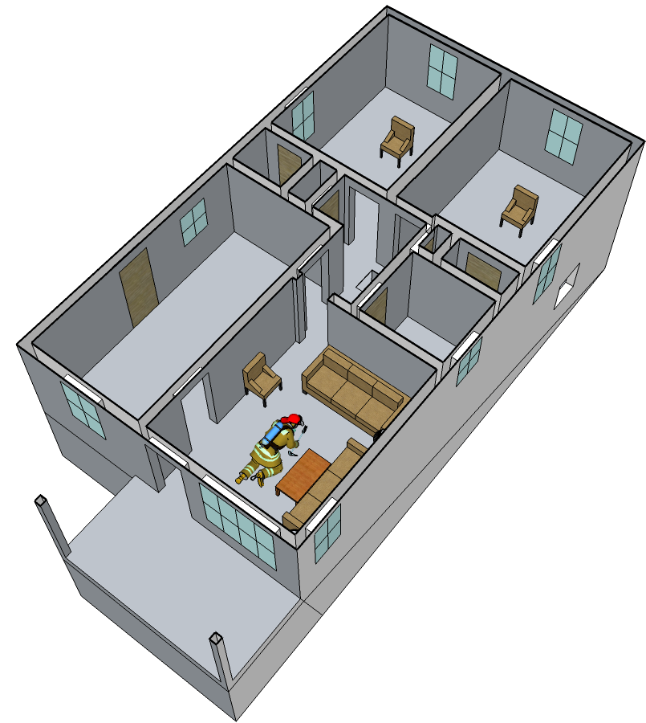
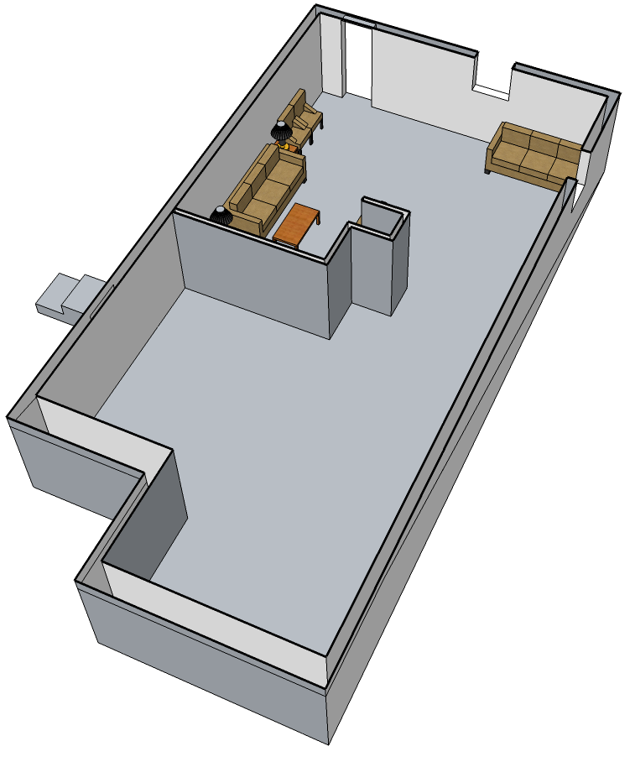

Impact of Exterior Attack through Basement Door
227 Folsom St. Experiment
~ 60 seconds of water
BC Bedroom
Exterior Water Application
At 7 ft: 400°F → 200°F
At 1 ft: 200°F → 150°F
CD Bedroom
Kitchen
At 7 ft: 350°F → 200°F
At 1 ft: 250°F → 150°F
Inlets
At 7 ft: 400°F → 200°F
At 1 ft: 250°F → 150°F
Living Room
At 7 ft: 400°F → 200°F
At 1 ft: 150°F → 100°F
Outlet
Basement
Turnout Gear
At 7 ft: 1800°F → 400°F
At 1 ft: 1800°F → 400°F
At 3 ft: 300°F → 200°F
3 kW/m² → 2 kW/m²

Slide 30
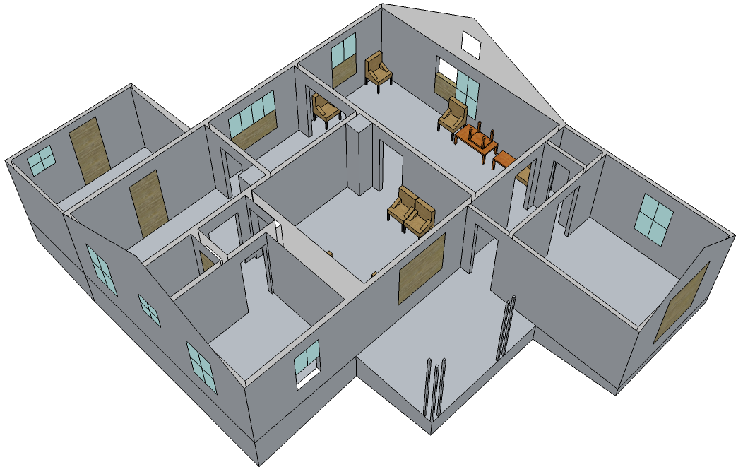

Impact of Exterior Attack through
The Side D Window
230 Folsom St. Experiment
~ 15 seconds of water
Exterior Water Application
Room 3
At 7 ft: 1700 °F → 700 °F
At 1 ft: 1700 °F → 700 °F
Room 2
At 7 ft: 900 °F → 800 °F
At 1 ft: 500 °F → 600 °F
Room 4
Room 1
At 7 ft: 600°F → 900°F
At 1 ft: 100°F → 100°F
At 7 ft: 700 °F → 650 °F
At 1 ft: 200 °F → 300 °F
Fire Room
At 7 ft: 1000 °F → 1000 °F
At 1 ft: 900 °F → 900 °F

Slide 31
Impact of Exterior Attack through
The Side D Window
230 Folsom St. Experiment
Additional ~ 25 seconds of water
Exterior Water Application
Room 3
At 7 ft: 700 °F → 100°F
At 1 ft: 700 °F → 100°F
Room 2
At 7 ft: 800 °F → 800 °F
At 1 ft: 600 °F → 400 °F
Room 4
Room 1
At 7 ft: 900°F → 600°F
At 1 ft: 100°F → 100°F
At 7 ft: 650 °F → 600 °F
At 1 ft: 300 °F → 100 °F
Fire Room
At 7 ft: 1000 °F → 1100 °F
At 1 ft: 900 °F → 700 °F

