Slide 1
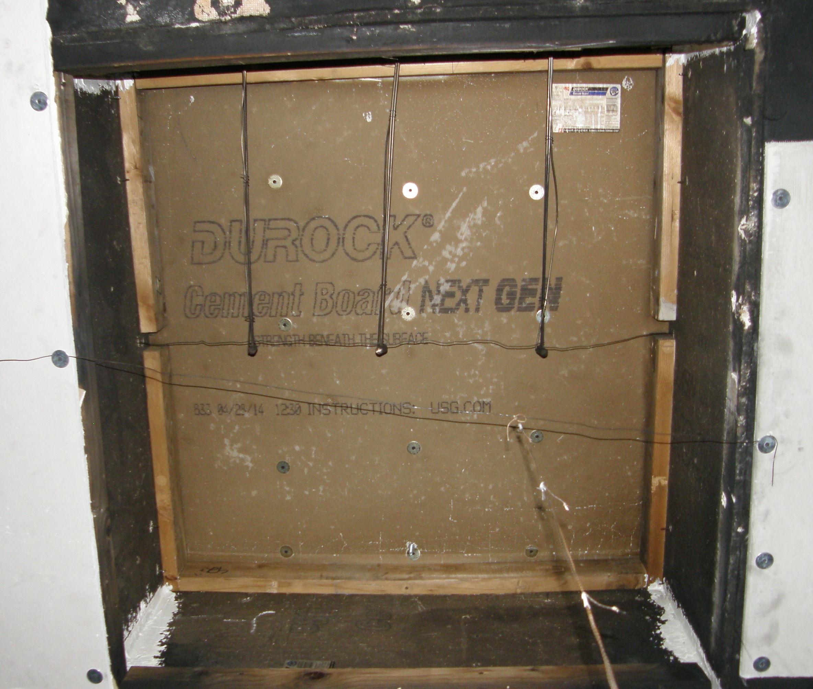
0.3 m (1 ft)
0.6 m (2 ft)
0.9 m (3 ft)

Slide 2
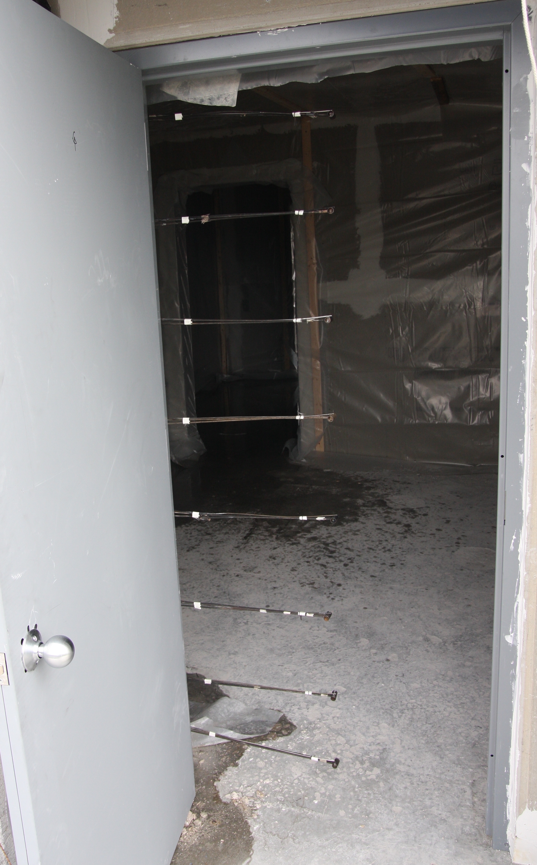
0.02 m (0.5 ft)

