Slide 1
PXI Hands On

Slide 2



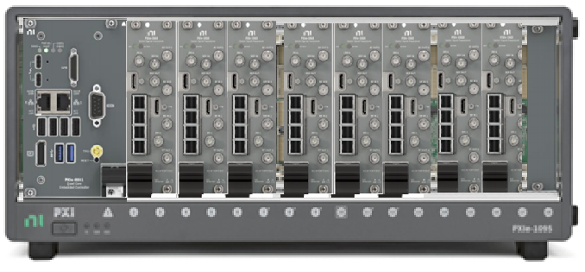
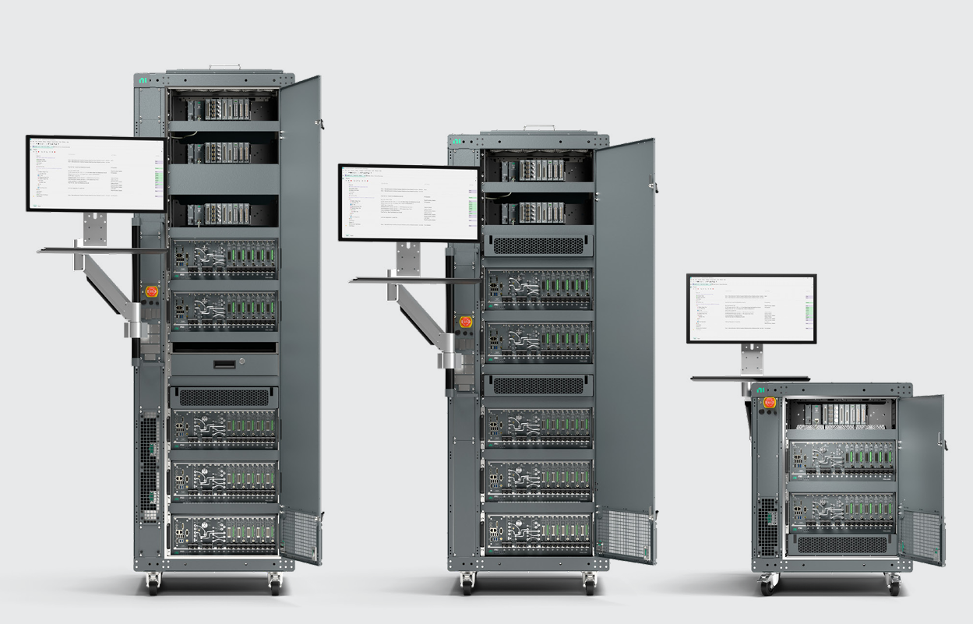


NI’s Offerings for Device Validation
Software
Hardware
Systems
LabVIEW
Python
TestStand
InstrumentStudio
SystemLink
Modular, Fast, Industry leading Performance, Lowest TCO
Fully Assembled Racks for High Volume Characterization
AI Ready T&M Software

Slide 3
Sizzling Hot Demos on the Floor !
@WT486 till 4:30pm
Demo title | Description
Bring ATE-Class SoC Debug to the Lab | Replay ATE scan patterns using PXI digital, SMU and scope instrumentation to accelerate lab-based debug and validation.
6G RF Characterisation & Parallel Test | Explore parallel RF measurements using synchronised PXI instrumentation to reduce characterisation time.
Multi-Rail SoC Power & Performance Analysis | Analyse dynamic power behaviour across multiple SoC power rails with high-channel-count PXI instrumentation.
Parallel Dual-PA Validation with a Dual-Channel VST | See parallel RF validation using the PXIe-5860 dual-channel VST.
PXI Multi-Site Production Test | Follow an end-to-end workflow from manual test through automation, debugging, reporting and parallel execution using TestStand, InstrumentStudio, Python and LabVIEW.
Vibe Coding Station with Nigel AI | See how Nigel AI can support measurement code generation, test sequencing, contextualised data logging and analysis, taking an RF amplifier test workflow from initial code through to a production-ready TestStand sequence.
15U Integrated Platform for Automated Test | Discover a compact integrated ATE platform combining instrumentation, power, cooling and system management.
Cool NI SWAGs
AI Coding Station

Slide 4
From Sleep Current to Brownout
Hands-On Power Rail Characterization with PXI
A guided seminar using synchronized source, measurement, and stimulus instruments
Presenter| Title
90-minute PXI hands-on seminar
NI CUSTOMER CONFIDENTIAL

Slide 5
SESSION OVERVIEW
Today’s Exercises
1
2
3
4
Measure
Observe
Correlate
Stress
Sleep current
Dynamic current
Rail Droop and Current
Ripple + brownout
Platform
Hands-on
Context
PXI architecture, data movement, clocks, and triggers
Four exercises in InstrumentStudio and DIAdem
SMU, scope, AWG, and scalable rail-monitoring portfolios
NI CUSTOMER CONFIDENTIAL
2
Notes:
Set expectations: this is a guided lab, not a comprehensive product seminar. Keep transitions tight.
[Sources]
Internal workshop structure supplied by Charlie Knapp.
[/Sources]

Slide 6
BRIEF INTRODUCTION
NI and PXI: Software-Connected Test
Modular instrumentation
Software-defined workflow
System-level coordination
Mix source, measurement, switching, digital, RF, and stimulus modules
Select only the performance needed
Expand without rebuilding the bench
Interactive setup in InstrumentStudio
Automation through LabVIEW, Python, C#, and C/C++
Data capture, analysis, and reporting
Shared timing and trigger resources
High-bandwidth PCI Express data movement
One chassis for mixed-instrument workflows
NI CUSTOMER CONFIDENTIAL
3
Notes:
Keep this slide under two minutes. The goal is to establish the platform vocabulary used throughout the lab.
[Sources]
NI, “An Overview of the PXI Platform,” https://www.ni.com/en/shop/pxi/overview-pxi.html
[/Sources]

Slide 7
PXI OVERVIEW
PXI Platform: Chassis, Controller, Instruments, Software
SOFTWARE
CONTROLLER
CHASSIS
INSTRUMENTS
InstrumentStudio
Python · C# · LabVIEW
Embedded or remote PC
Processing + data movement
Power · cooling · PCIe
Timing + trigger backplane
SMU · scope · AWG · DAQ
Digital · RF · switching
A PXI system is assembled around the measurement problem, then coordinated in software.
NI CUSTOMER CONFIDENTIAL
4
Notes:
Describe the chassis as the shared mechanical, electrical, communication, and synchronization backbone.
[Sources]
NI, “An Overview of the PXI Platform,” https://www.ni.com/en/shop/pxi/overview-pxi.html
[/Sources]

Slide 8
PXI OVERVIEW
Backplane Synchronization: Make Different Instruments Act as One
SMU
Source + measure
Common reference clocks
Low-skew chassis clocks reduce relative drift between compatible modules.
PXI
BACKPLANE
SCOPE
Acquire Ch 0 + Ch 1
Shared trigger lines
Route events such as a scope edge or GPIO pulse across instruments.
AWG
Generate disturbance
Repeatable timing
Align stimulus and acquisition to compare cause and effect.
NI CUSTOMER CONFIDENTIAL
5
Notes:
In Exercise 3, the scope exports an edge trigger to PXI_TRIG0. In Exercise 4, GPIO10 becomes the cleaner system trigger for the SMU, scope, and AWG.
[Sources]
NI, “PXI and PXI Express Clock and Trigger Signals,” https://www.ni.com/docs/en-US/bundle/pcie-pxie-6357/page/pxie-signals.html
NI, “Using PXI Timing and Triggering Functionality,” https://www.ni.com/en/support/documentation/supplemental/18/using-pxi-timing-and-triggering-functionality.html
Internal Exercise 3 and Exercise 4 documents.
[/Sources]

Slide 9
DUT OVERVIEW
The DUT: A Repeatable Transient Load
Bluetooth bursts induce power rail transients
ESP32-C6
DevKitC-1
BLE advertising creates a clean, repeatable change in current demand.
3.3 V rail access
BLE firmware
GPIO10 trigger
Sleep
Burst
Droop
Near-idle current between events
Short current transients during advertising
Rail response to dynamic current demand
RF is the load event
No BLE protocol knowledge is required.
NI CUSTOMER CONFIDENTIAL
6
Notes:
The DevKit integrates Wi-Fi, Bluetooth LE, Zigbee, and Thread. For this seminar, BLE is simply a repeatable stimulus to the 3.3 V power rail.
[Sources]
Internal Introduction document.
Espressif ESP32-C6 DevKitC-1 User Guide, pages 3–7.
[/Sources]

Slide 10
DUT OVERVIEW
Four Exercises, One characterization flow
01
Sleep current
SMU
Measure a low-current state
02
Advertising current
SMU
Observe dynamic bursts
03
Rail correlation
+ Scope
Align current and voltage
04
Brownout
+ AWG
Inject ripple and stress the rail
NI CUSTOMER CONFIDENTIAL
7
Notes:
Each exercise adds one capability while preserving the earlier measurement context.
[Sources]
Internal Exercise 1–4 documents.
[/Sources]

Slide 11
SYSTEM SETUP
NI CUSTOMER CONFIDENTIAL
8
Notes:
Confirm wiring against the physical kit before the session. J5 is used to separate the module current path on the DevKit; GPIO10 is the Exercise 4 trigger.
[Sources]
Internal Introduction and Exercise 3–4 documents.
Espressif ESP32-C6 DevKitC-1 User Guide, current measurement and pin-layout sections.
[/Sources]

Slide 12
HANDS-ON
Exercise 1: Measure Sleep Current
PXI SMU
What you will do
OBJECTIVE
1
Open the SMU panel in InstrumentStudio
Measure the DUT’s quietest operating state
2
Source the 3.3 V rail on Channel 0
3
Flash the deep-sleep firmware
4
Adjust the current range and observe the low-current state
Use the exercise guide for detailed settings and screenshots.
NI CUSTOMER CONFIDENTIAL
9
Notes:
The guide expects sleep current in the 10–20 µA range. Do not collapse the source current limit below what is required to keep the DUT operating.
[Sources]
Internal Exercise 1 document.
[/Sources]

Slide 13
HANDS-ON
Exercise 2: Observe Dynamic Current
PXI SMU
What you will do
OBJECTIVE
1
Increase current-limit headroom before enabling BLE
Use the SMU to power the DUT and monitor current transients
2
Flash the beacon firmware
3
Switch from charting to waveform mode
4
Capture the repeating groups of current transients
Use the exercise guide for detailed settings and screenshots.
NI CUSTOMER CONFIDENTIAL
10
Notes:
The guide instructs attendees to set a 500 mA current limit before BLE packet generation and to use approximately a 25 ms capture window.
[Sources]
Internal Exercise 2 document.
[/Sources]

Slide 14
INSTRUMENT CONTEXT
NI PXI SMUs: Source and Measure in One Instrument
SYSTEM SMUs
4-CHANNEL SMUs
HIGH-DENSITY SMUs
High precision
Higher voltage/current
Pulsed operation
Parallel rails
Compact density
Per-channel control
12 or 24 channels
Scalable bias and test
Parallel DUT workflows
Common value: simultaneous voltage/current measurement • hardware timing • InstrumentStudio + NI-DCPower
NI CUSTOMER CONFIDENTIAL
11
Notes:
Connect the hands-on experience to the larger portfolio. Avoid model-specific dependence because seminar kits may use different 3 A-capable SMUs.
[Sources]
NI, “What Are NI PXI Source Measure Units?,” https://www.ni.com/en/shop/electronic-test-instrumentation/source-measure-units/what-are-source-measure-units.html
NI PXI SMU Product Flyer, https://www.ni.com/pdf/product-flyers/pxi-source-measure-units.pdf
[/Sources]

Slide 15
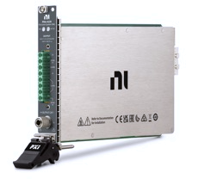
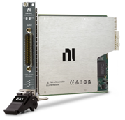
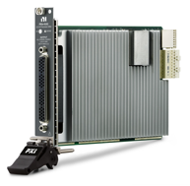
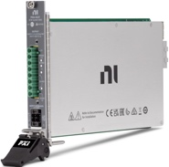
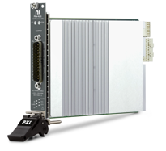
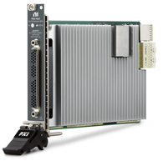
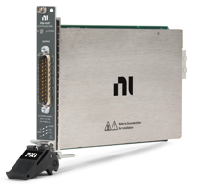
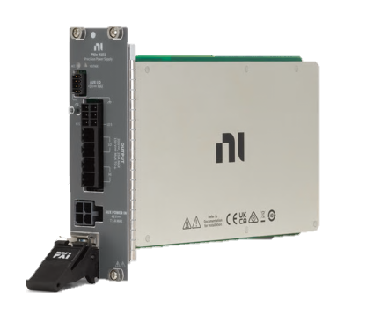
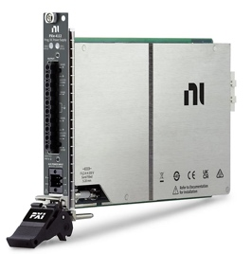
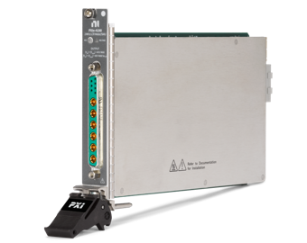
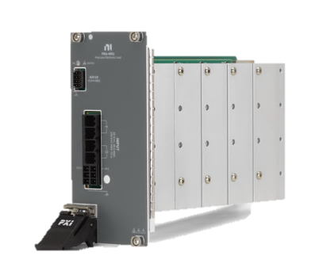
HANDS-ON
NI PXI DC Power Products Overview
High-Performance Source Measure Units, Power Supplies, E-loads, & LCR Meters
PXIe-413x: 1-ch SMUs
PXIe-414x: 4-ch SMUs
PXIe-416x: 12 & 24-ch SMUs
3 A & 60 V or 1 A & 200 V, 40 W DC
Up to 10 A, 500 W pulsing
Up to 10 fA sensitivity
Up to 3 A, 24 V per channel
24 W per channel, 40 W total
Up to 100 fA sensitivity
Up to 100 mA, 24 V per channel
Up to 2.4 W DC per channel, 28.8 total
Up to 10 pA sensitivity
PXIe-415x: 300 W Power Supply & E-Load
PXIe-411x: 2-ch Power Supplies
PXIe-4190: 1-ch LCR Meter & SMU
Supply up to 25A/20V or 10A/60V, 300 W
Sink up to 40A/60V, 300 W
Up to 1 µV, 10 nA resolution
1 A & 60 V or 6 A & 10 V per channel
60 W per channel, 120 W total
Up to 2 mV, 34 µA resolution
LCR: 2 MHz, 7.07 Vrms, 40 V DC bias
SMU: Up to 40 V, 100 mA, 4 W
fF-class C meas. & fA-class I meas.
NI CUSTOMER CONFIDENTIAL
9
Notes:
The guide expects sleep current in the 10–20 µA range. Do not collapse the source current limit below what is required to keep the DUT operating.
[Sources]
Internal Exercise 1 document.
[/Sources]

Slide 16
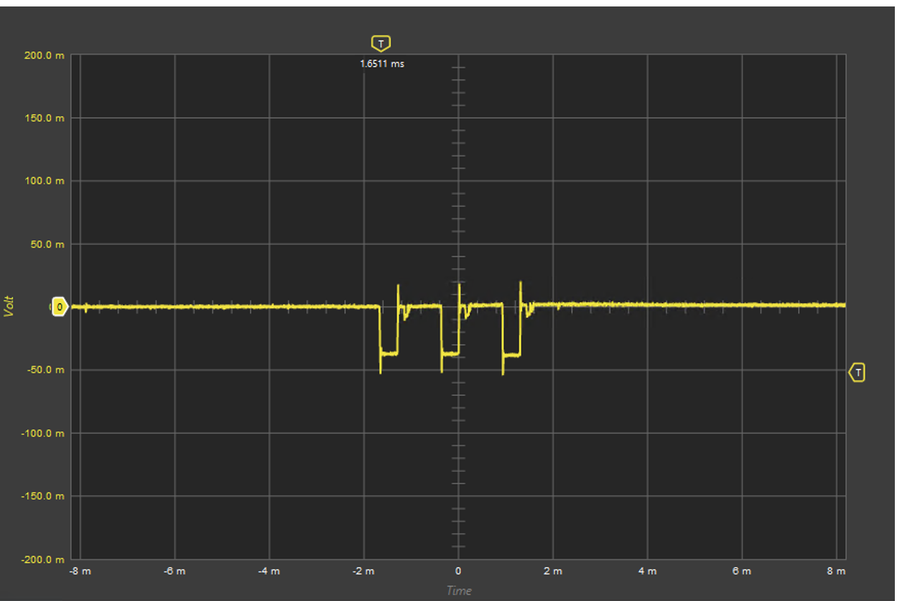
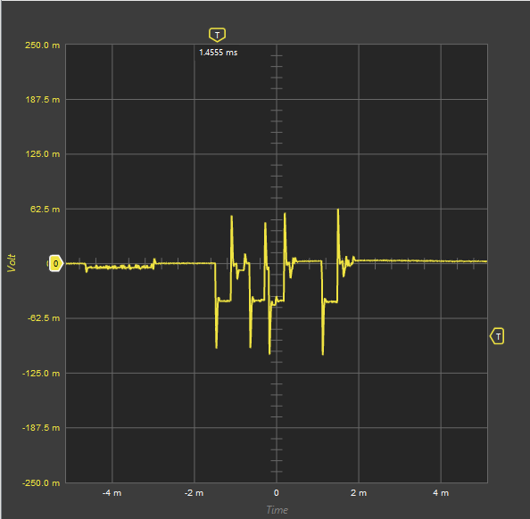
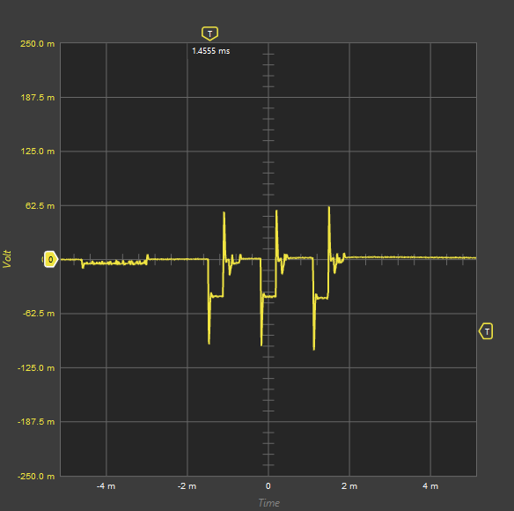
HANDS-ON
Complications of a Cellular Test Environment
Home Office (Consistent from run-run)
Qualcomm WT_686
1
2
NI CUSTOMER CONFIDENTIAL
9
Notes:
The guide expects sleep current in the 10–20 µA range. Do not collapse the source current limit below what is required to keep the DUT operating.
[Sources]
Internal Exercise 1 document.
[/Sources]

Slide 17
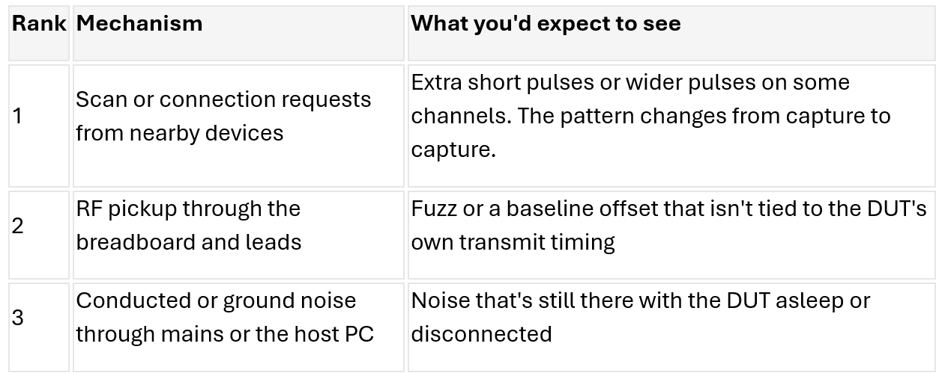
HANDS-ON
Causes, ranked by likelihood
NI CUSTOMER CONFIDENTIAL
9
Notes:
The guide expects sleep current in the 10–20 µA range. Do not collapse the source current limit below what is required to keep the DUT operating.
[Sources]
Internal Exercise 1 document.
[/Sources]

Slide 18
HANDS-ON
Exercise 3: Correlate Rail Voltage and Current
PXI SCOPE + SMU
What you will do
OBJECTIVES
1
Scope Channel 0: capture the 3.3 V rail
Use the Scope for high speed, simultaneous capture of rail voltage and current
Export and analyze data
2
Scope Channel 1: measure the 0.1 Ω shunt
3
Use a falling-edge trigger and averaging
4
Export the trigger to PXI_TRIG0 and analyze captured data
Use the exercise guide for detailed settings and screenshots.
NI CUSTOMER CONFIDENTIAL
12
Notes:
The guide uses AC coupling on Channel 0 to make the transient easier to resolve, averaging on the low-amplitude shunt waveform, and TDMS export to DIAdem for zoomed analysis.
[Sources]
Internal Exercise 3 document.
[/Sources]

Slide 19
INSTRUMENT CONTEXT
NI PXI Oscilloscopes: Time Resolution Where It Matters
BANDWIDTH
SAMPLE RATE
RESOLUTION
Match the fastest signal feature
Resolve transient shape and timing
Balance detail, noise, and speed
CHANNELS
MEMORY
FPGA OPTIONS
Scale synchronized acquisition
Capture longer windows or more records
Add real-time or custom processing
NI CUSTOMER CONFIDENTIAL
13
Notes:
For the lab, only Channel 0 and Channel 1 are assumed. The physical system may use any compatible scope with at least two channels.
[Sources]
NI, “What Are NI PXI Oscilloscopes?,” https://www.ni.com/en/shop/electronic-test-instrumentation/oscilloscopes/what-are-oscilloscopes.html
NI PXI Oscilloscopes Product Flyer, https://www.ni.com/pdf/product-flyers/oscilloscopes.pdf
[/Sources]

Slide 20
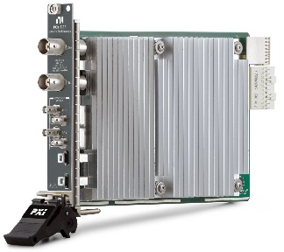
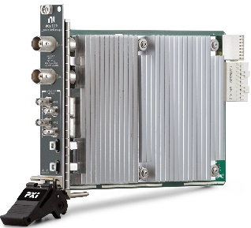
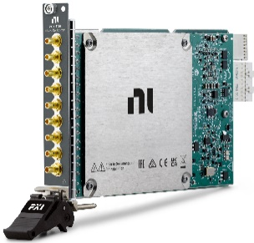
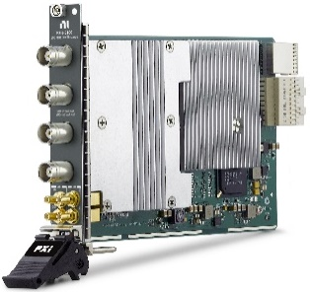
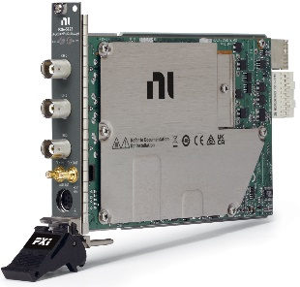
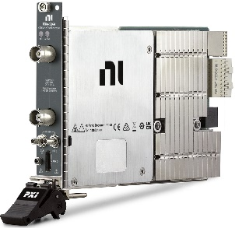
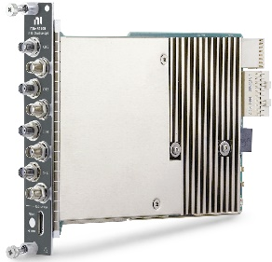
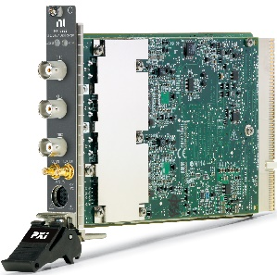
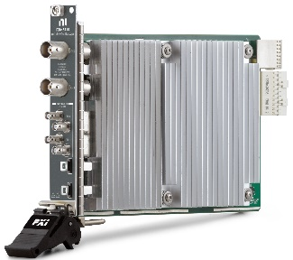
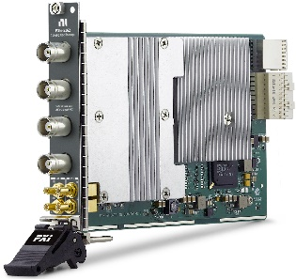
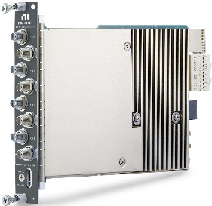
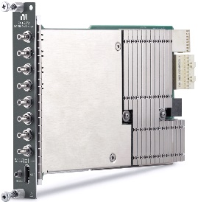
PXI Oscilloscopes
Integration & synchronization with other instrument types
High-channel-count systems (up to 136 channels in 4U of rack space)
Debug monitoring and control support in InstrumentStudio™ software
Programmable FPGA options for custom triggers or in-line processing
Higher onboard memory options than comparable boxes
8 bit Oscilloscopes
“Optimized for cost or speed”
2 channels
100 MHz – 5 GHz
10 & 12 bit Oscilloscopes
“Optimized for speed & resolution”
2-8 channels
60 MHz – 1.5 GHz
14 bit Oscilloscopes
“High-resolution”
2-8 channels
6 – 400 MHz
24 bit Oscilloscope
“Flexible resolution”
PXIe-5110
100 MHz
1 GS/s
2 channels
PXIe-5111
350 MHz
3 GS/s
2 channels
PXIe-5105
60 MHz, 60 MS/s
12 bits, 8 channels
PXIe-5160
500 MHz, 2.5 GS/s
10 bits,
2/4 channels
PXIe-5122
100 MHz
100 MS/s
2 channels
PXIe-5164*
400 MHz
1 GS/s
2 channels
PXIe-5170*
100 MHz
250 MS/s
4/8 channels
PXI-5922
6 MHz
500 kS/s
2 channels
PXIe-5113
500 MHz
3 GS/s
2 channels
PXIe-5162
1.5 GHz, 5 GS/s
10 bits,
2/4 channels
PXIe-5171*
250 MHz
250 MS/s
8 channels
PXIe-5172*
100 MHz
250 MS/s
4/8 channels
*Programmable FPGA

Slide 21
HANDS-ON
Exercise 4: Inject Ripple and Observe Brownout
PXI AWG + SCOPE + SMU
What you will do
OBJECTIVE
1
Flash firmware that drives GPIO10 before each burst
Induce and investigate DUT brownout behavior
2
Use Synchronize scope, SMU, and AWG to a single trigger
3
Load a finite 7 kHz “ripple” waveform from file onto the Arb
4
Monitor rail response and serial output with increasing ripple amplitude
Use the exercise guide for detailed settings and screenshots.
NI CUSTOMER CONFIDENTIAL
14
Notes:
The arbitrary waveform capability is required because the exercise reads a known-length waveform from a CSV file. The ripple is AC-coupled onto the rail, so generator gain is not equal to observed rail ripple.
[Sources]
Internal Exercise 4 document.
[/Sources]

Slide 22
INSTRUMENT CONTEXT
NI PXI Waveform Generators: Controlled, Repeatable Stimulus
STANDARD FUNCTIONS
ARBITRARY WAVEFORMS
SYNCHRONIZED GENERATION
Quickly generate sine, square, triangle, ramp, pulse, or clock-like signals.
Replay user-defined signals from memory or streams. Sequence and script complex stimulus.
Coordinate triggers and timing with scopes, SMUs, digitizers, and digital instruments.
NI CUSTOMER CONFIDENTIAL
15
Notes:
Tie the portfolio back to the hands-on task: Exercise 4 needs arbitrary waveform playback, trigger synchronization, and controlled amplitude adjustment.
[Sources]
NI, “What Are NI PXI Waveform Generators?,” https://www.ni.com/en/shop/electronic-test-instrumentation/waveform-generators/what-are-waveform-generators.html
NI Waveform Generators Portfolio, https://www.ni.com/en/shop/hardware-portfolio/instruments/waveform-generators.html
[/Sources]

Slide 23
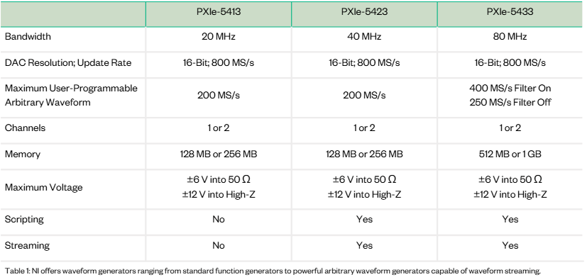
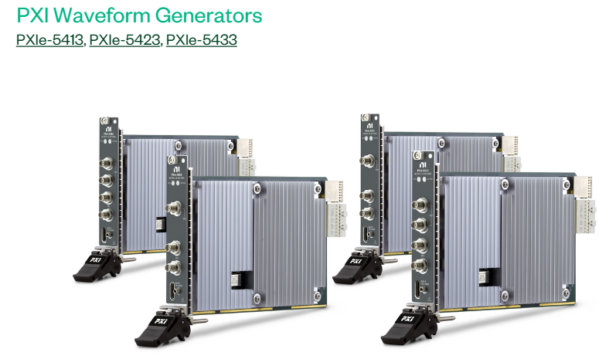
HANDS-ON
NI CUSTOMER CONFIDENTIAL
14
Notes:
The arbitrary waveform capability is required because the exercise reads a known-length waveform from a CSV file. The ripple is AC-coupled onto the rail, so generator gain is not equal to observed rail ripple.
[Sources]
Internal Exercise 4 document.
[/Sources]

Slide 24
SYSTEM OPTIMIZATION
Scale Rail Monitoring with PXIe-4309 and PXIe-4311
Use specialized instruments where their capability creates the most value.
PXIe-4309
PXIe-4311
COMPLEMENTARY PXI
32 channels
Flexible resolution
Best fit for lower-speed, high-resolution rail monitoring
32 simultaneous channels
Higher-speed dynamic rail capture
On-module power calculation option
SMU: source, sink, precision
Scope: highest time resolution
AWG: controlled analog stimulus
Design toward the right mix of channel density, performance, and cost.
NI CUSTOMER CONFIDENTIAL
16
Notes:
Position these modules as scalable rail-monitoring building blocks, not universal replacements for SMUs, scopes, or AWGs.
[Sources]
Internal Power & Performance Validation Solution deck.
[/Sources]

Slide 25
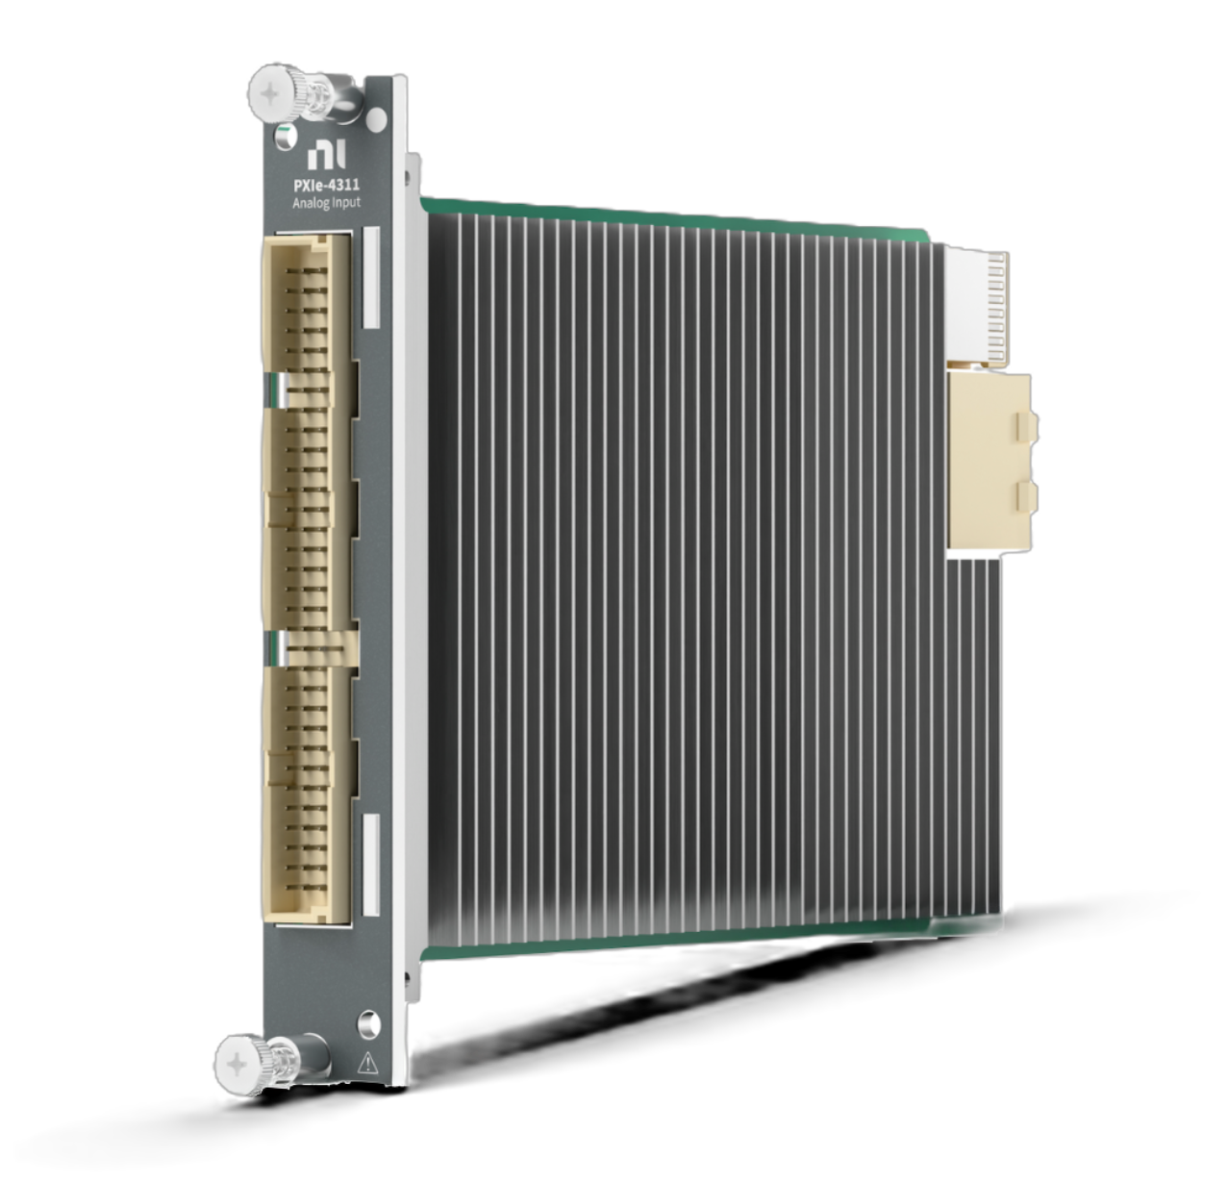
PXIe-4311 Flexible Resolution Analog Input Module
Now Available
Complements & extends NI’s Power & Performance Portfolio
Highlights
The PXIe-4311 combines high-speed simultaneously sampled data acquisition with optional DMM-like signal conditioning techniques for high-resolution at lower sample rates
Highly Flexible Analog Input Module for Power & Performance Validation
of CPUs, GPUs, AI accelerators, SoCs, MCUs, FPGAs, and PCB assemblies
32 Simultaneously Sampled Channels with a ±150 mV range, 0-6 V and 0-25 V Input Ranges
optimized for positive voltage and shunt-resistor-based current measurements
Capture Fast-Changing Signals with 800 kHz Bandwidth & High Sample Rates
up to 4 MS/s for 32 channels
Excellent Noise Rejection with Advanced Averaging & Anti-Aliasing Filters
for up to 22-bits of resolution at lower sampling rates (e.g. ~5 µV resolution at 100 kS/s)
Conveniently Compatible with Existing Cables & Terminal Blocks
from PXIe-4309 flexible-resolution analog input module for simplified migration options
PXIe-4311
32-ch, ±150 mV, 0-6V & 0-25V ranges
Up to 4 MS/s, Up to 22-Bit
Flexible Resolution Analog Input Module
For Power & Performance Validation
NI P&P:
Hardware
Connectivity
Software
Measurements
Notes:
Starting with the PXIe-4311, NI’s latest and most powerful P&P DAQ module, which released in June of 2026
This module comes packed with 32 ADC’s with flexible ranges that are optimized for capturing both low-voltages for shunt currents and higher voltages on power rails, up to 25 V
We’ve enabled you to capture faster transients and bursty workloads with this module by enabling a sample rate up to 4 MS/s on all 32 channels of the instrument
Conveniently, this instrument runs on the same DAQmx driver as our existing DAQ cards, so it comes ready to be dropped into any existing system and work right away, minimizing disruption to your tests. It is also conveniently pin-to-pin compatible with the 4309, meaning if you already use the 4309, you can port your connector blocks directly to the 4311

Slide 26
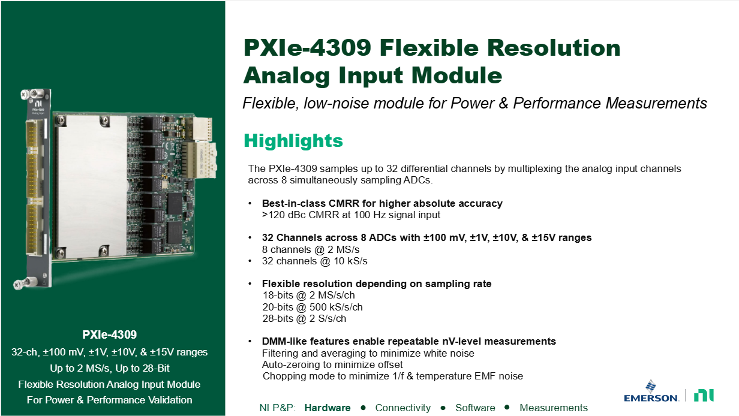

Slide 27
SYSTEM OPTIMIZATION
Choose the Right Instrument for Each Job
Need
Best starting point
Why
Source or sink a rail
PXI SMU
Controlled power + simultaneous V/I measurement
Capture the fastest transient
PXI scope
Bandwidth, sample rate, triggering, deep memory
Apply a controlled disturbance
PXI AWG
Standard or arbitrary stimulus with trigger control
Monitor many rails
PXIe-4309 / PXIe-4311
High density with synchronized voltage and shunt inputs
NI CUSTOMER CONFIDENTIAL
17
Notes:
Use this as the bridge from the exercise-specific instruments to a scalable station architecture.
[Sources]
Internal Power & Performance Validation Solution deck.
[/Sources]

Slide 28
WRAP-UP
What You Practiced
MEASURE
OBSERVE
CORRELATE
Low-current sleep state
Dynamic current bursts
Current demand and rail droop
SYNCHRONIZE
STRESS
SCALE
Scope, SMU, AWG, and DUT events
Injected ripple and brownout behavior
Purpose-built instruments for each need
Next: apply the same PXI building blocks to your own DUT, rails, and validation workflow.
NI CUSTOMER CONFIDENTIAL
18
Notes:
Leave time for final questions and direct attendees to any adjacent demo-room activities when those slides are added.
[Sources]
Internal seminar design.
[/Sources]

Slide 29
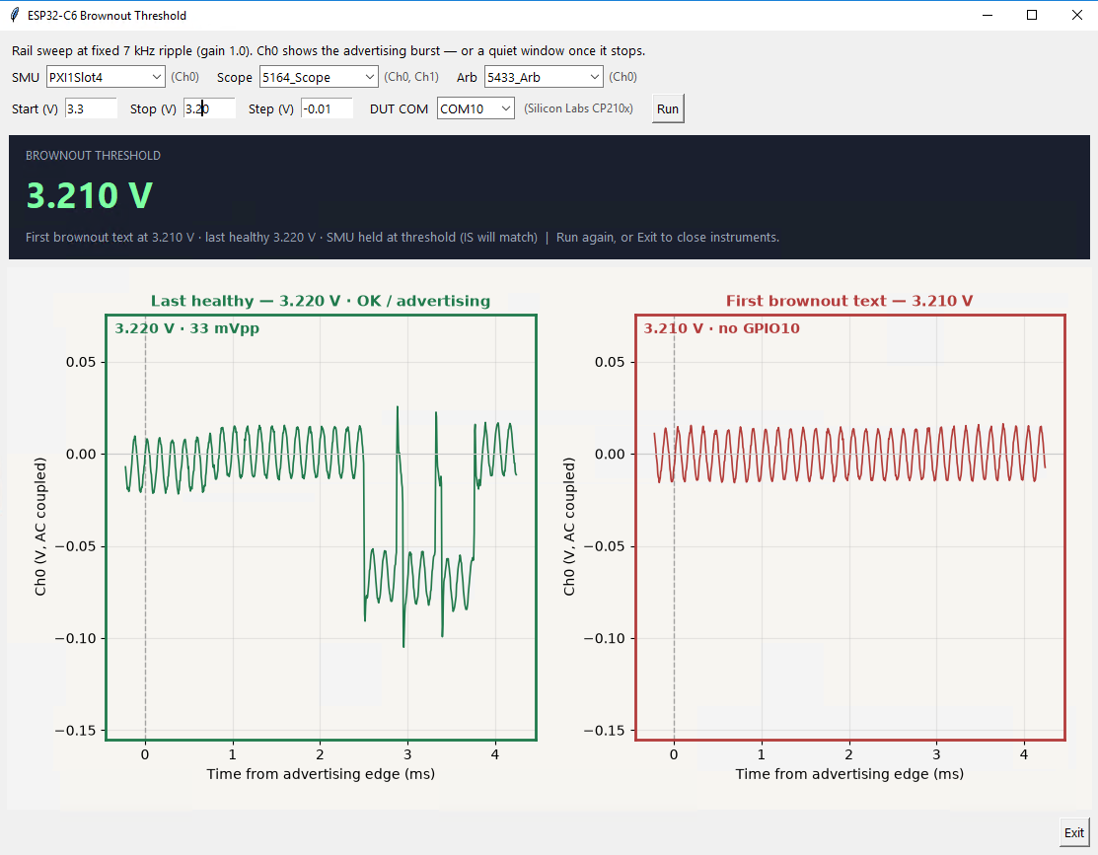
Brownout Automation Demo
Vibe-coded in Python
Fixed ripple
Sweep Rail Voltage, Hi to Lo
Record first brownout instance
NI CUSTOMER CONFIDENTIAL
8
Notes:
Confirm wiring against the physical kit before the session. J5 is used to separate the module current path on the DevKit; GPIO10 is the Exercise 4 trigger.
[Sources]
Internal Introduction and Exercise 3–4 documents.
Espressif ESP32-C6 DevKitC-1 User Guide, current measurement and pin-layout sections.
[/Sources]

Slide 30
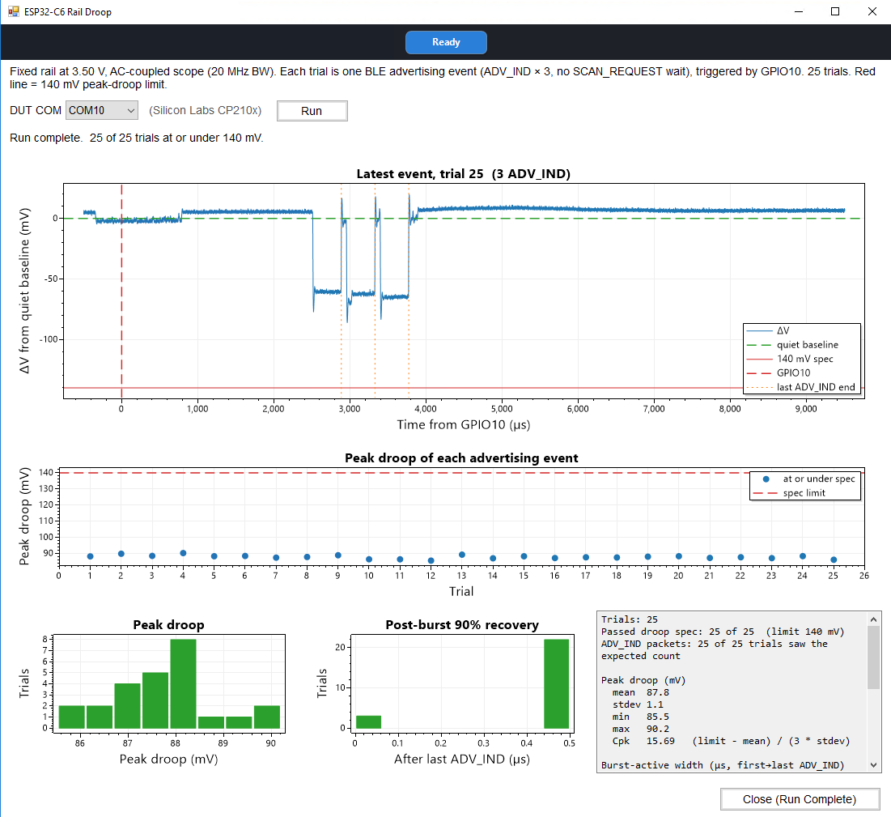
Droop Statistics Demo
Vibe-coded in C#
Capture 25 bursts
Check droop and recovery time against limits
Return statistics
NI CUSTOMER CONFIDENTIAL
8
Notes:
Confirm wiring against the physical kit before the session. J5 is used to separate the module current path on the DevKit; GPIO10 is the Exercise 4 trigger.
[Sources]
Internal Introduction and Exercise 3–4 documents.
Espressif ESP32-C6 DevKitC-1 User Guide, current measurement and pin-layout sections.
[/Sources]

