Slide 1

HealthHome
Submission by BlitzHacks
Brought to you by: https://GoogleSlidesThemes.com

Slide 2
Team Details
Team Name: BlitzHacks
Topic Chosen: HealthTech
Team Members: Athul Joseph, Sanandh Kumar M
Nazim Jabir, Joel Mathew Cherian
Project Idea: Decentralized Medical Record Exchange System
along with Medical Assistance Features for
patients

Slide 3
Problem at hand
Patient’s medical records are usually scattered across the multiple healthcare providers with whom the patient is registered. Medical records, in most parts of the world, are still stored in old fashioned files and very little of this data is digitized. This system is fails in many aspects few of which are as follows:
Difficulty in transfer of Records between providers: For records from one healthcare provider have to be shifted to the other, say when a patient switches providers, patients have to put in a request which often takes a considerable amount of time to process before it reaches the other provider. This task of shifting records is time consuming and laborious.

Slide 4
Problem at hand
2. Need for Digitization: Physical records can be lost easily and are difficult to transfer, hence digitization of records is very important. However, with digitization comes the need to build a secure network where patients records cannot be hacked or accessed by unauthorised individuals. aborious.
3. Need for a Patient Centric System: Medical records are the property of the individuals to whom they belong. Hence patients should be able to choose who can access and view these records.
4. Need for a User Interface to access Medical Records: There needs to be an easy to use User interface to access medical records. This interface could contain other features that help assist patients in their treatment.

Slide 5
Proposed Solution
To build a truly Patient Centered Information Exchange System while ensuring security, we decided to leverage the security provided by blockchain networks to create a Decentralized App (Dapp) where a patients has complete control over their medical records.
Our solution consists of two components
Building a smart contract that when deployed on a blockchain allows for secure transfer of medical records while ensuring security and privacy.
Building a Dapp for both patients and healthcare providers. The Dapp allows to place requests for records and view records. The Dapp on the patients side is equipped with personal assistant features that help patients maintain their health.

Slide 6
Component: Blockchain
Blockchain technology is most simply defined as a decentralized, distributed ledger that records the provenance of a digital asset. This system can’t be tampered with because, more than 50 % of the network should be compromised by hackers to change the data. We have written a smart contract that defines the laws of information exchange on the blockchain, the code is available in the team folder.

Slide 7
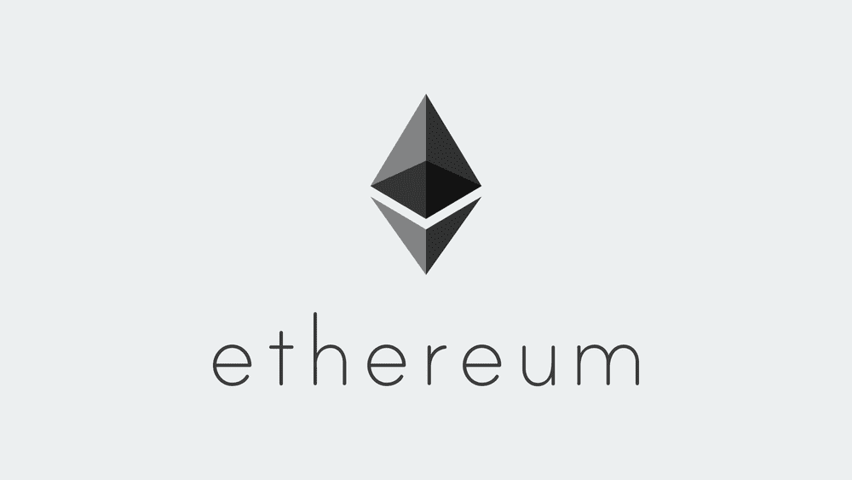
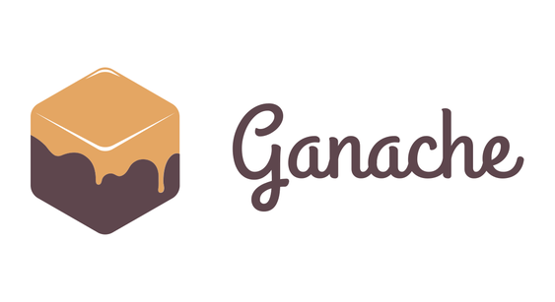
Implementation
In reality our smart contract would be deployed on the ethereum blockchain where the Dapp can access it.
For the hackathon however, we are simulating a blockchain with ganache. We have port forwarded this so that our Dapp can access it and call the smart contract.

Slide 8
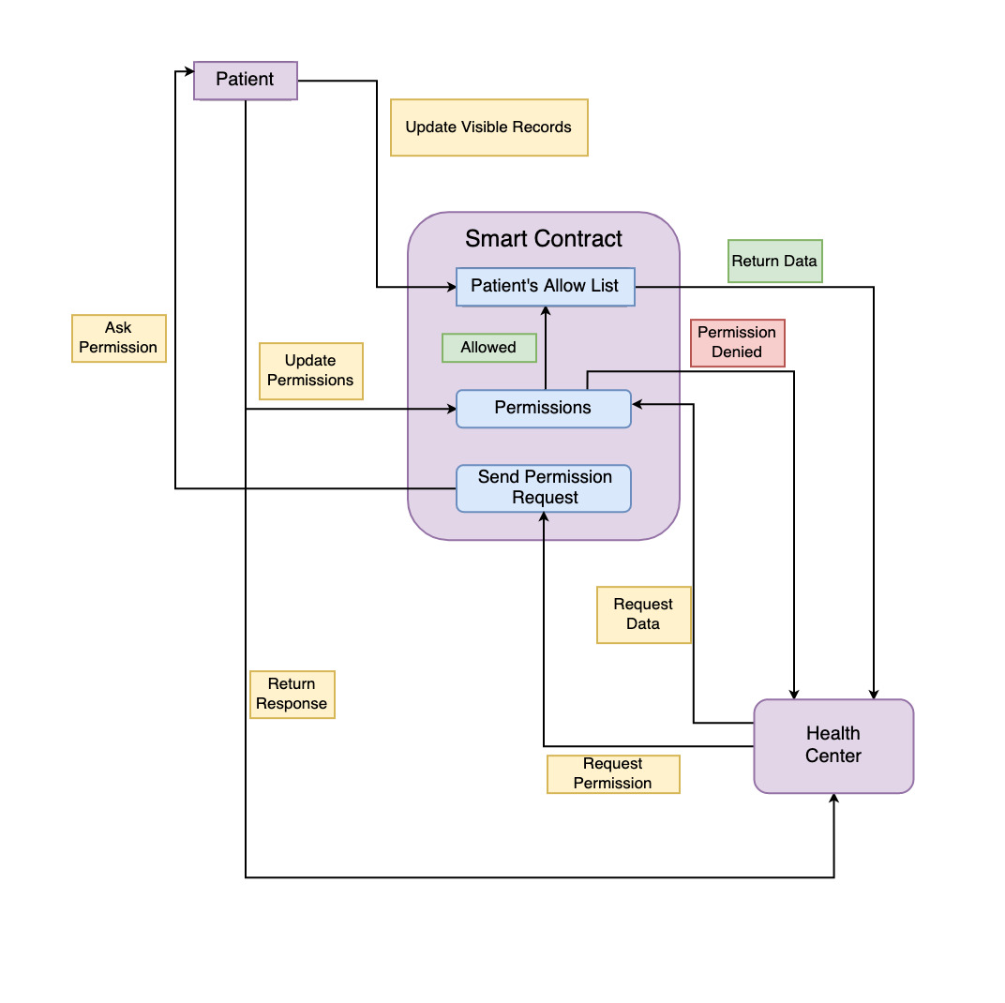
Smart Contract
If a health centre needs to access the a patient's record, it has to ask for permission from the patient. The patient can decide to make which all records are visible (to each health centre).
When a patient approves the request by the health centre , it will be update in the smart contract, and when the health centre request for the records, only those records which it has permission to view will be returned.
Our prototype structure for the smart contract is given in a diagramatic representation on the right, you may find our code in the team folder.

Slide 9
Component: Dapp
The Dapp has two interfaces for two types of users:
1. Patient Interface: Once patients log into their accounts, they can access all their medical records, through a simple UI. The patients UI has a scanner that can scan Healthcare providers QR code and provide them access to the records that they would like the healthcare provider to see. The patient Interface will also have certain medical assistance features, to show how functionality can be easily integrated with the data obtained from the blockchain.
2. Healthcare Provider Interface: Each Healthcare Provider has a unique QR code, this is the qr representation of Healthcare providers public address on blockchain, patients can scan this to grant permissions to Healthcare Providers to access patient records. The UI also allows for the viewing of these records.

Slide 10
Medical Assistance Features
1. Scheduler and Reminder: Can be used to schedule and remind patients of doctors appointments, medicine intake or daily calorie consumption targets.
2. Nutrition: This app include diet and calorie calculator.So that the user can plan their diet such that their diet does not exceed a certain amount of calorie

Slide 11
Putting it all together
Healthcare, like most other industries, has undergone a rapid transformation, thanks to advancements in technology. Its high time to adopt implementations such as blockchain to help make our Medical documents secure. Medical assistance features along with a decentralized record system, as we have proposed, creates a truly functional and patient centric information exchange system for patients and providers everywhere.

