Slide 1
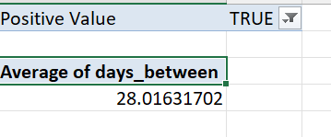
Q.1 Average lead time between the request date and the completion date
This gives the average days between request date and the completion date. Here the values is filtered to True value, since there are some missing values in the work date. From this we can conclude that on average a work finishes on 28 days.

Slide 2
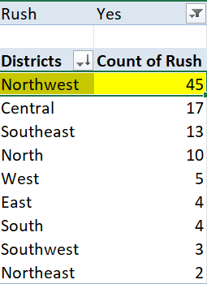
Q2. District with the Highest Number of Rush Jobs
From this data it is clear that the Northwest district has more rush jobs. So we can infer more about the data by knowing the jobs and why it needs to be done so quickly to get further analysis and insights

Slide 3
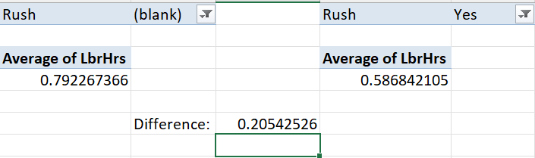
Q3. Difference between average labour hours during rush jobs and non rush jobs
On the left side we have the average hours taken for rush jobs and on the right side we have the average hours taken for non rush jobs. It is evident that avg lbr hours for rush jobs is higher than avg lbr hours of non rush jobs. It has a difference of 0.295 hrs extra time.

Slide 4
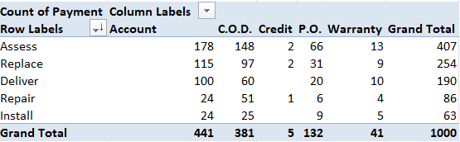
Q4. Distribution of Payment Types Over Services
The above data shows the distribution of payment types over services. It has been clearly shown that Both Account and C.O.D are widely used across all services being the highest and the second highest respectively. In all services Credit is used very less followed by Warranty.

Slide 5
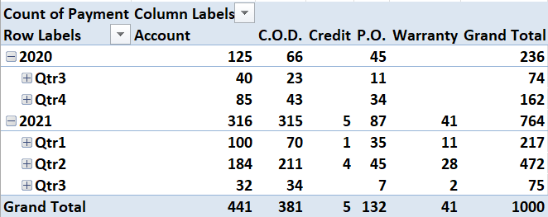
Q.5 Trends of Payment Type Distribution Over Time
From the above table and chart we can see the distribution of payment type over time. It is noted that the C.O.D payment type has been steadily increasing through out the time period. The P.O payment type has remained the same throughout the year without any noticeable changes. The WARRANTY payment type is on the decline while ACCOUNT has a gradual increase and CREDIT has a slight increase.

Slide 6

Q.6 Relationship between number of tech and cost of parts
From the correlation formula it is seen that there is a direct positive correlation also from the graph it is observed that the higher the number of techs the higher the cost of parts is. So they are positively correlated and when one increases the other could increase too.

Slide 7
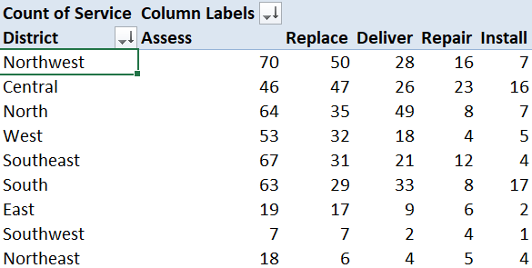
Q.7 Common Type of Service requested in each district
From the data we can observe that the common type of service requested by each district.

Slide 8
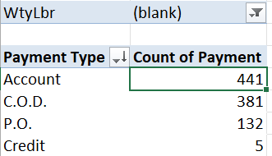
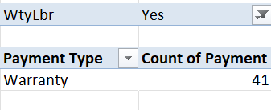
Q.8 Difference in Distribution of payment types for work orders with warranty labour and without warranty labour
From the above data it is clear that people with no wtylabr has more payment types Compared to people without those have wtylbr. People with wtylbr have only warranty payment type.

Slide 9
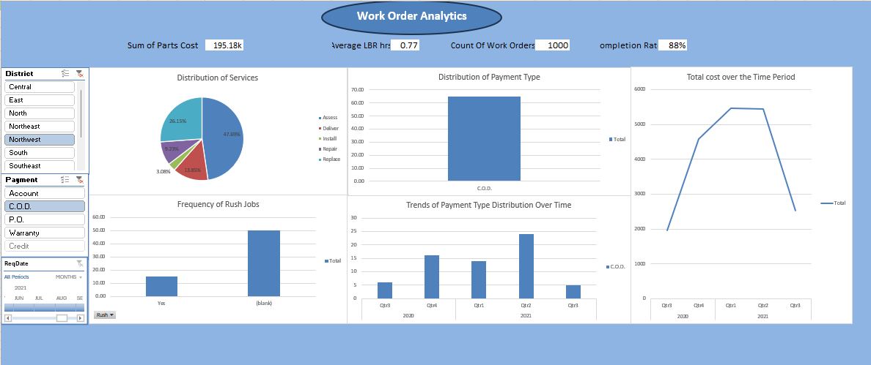
Q.9 DashBoard

Slide 10
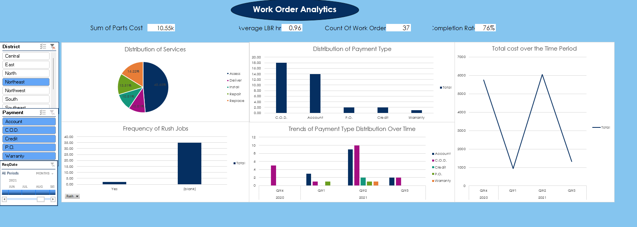
Dynamic working

