Slide 1
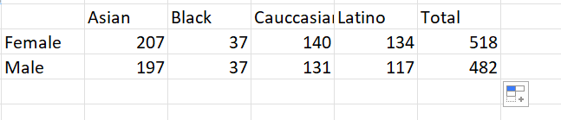
Task1
DISTRIBUTION OF ETHINC OVER GENDER
From the data we can observe the distribution of fender ethnicity in the company.
It could be observed that black male and females are same. With Asians dominating the company

Slide 2
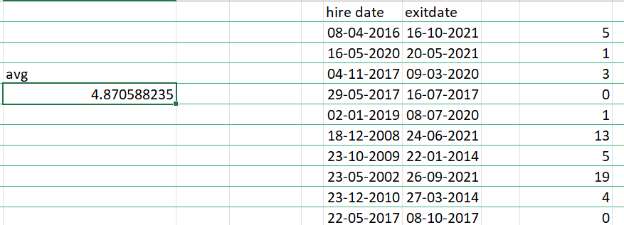
Task2 avg employees working before exit
From here it is observed that on average employees work for 4.8 years approximately 5 years

Slide 3
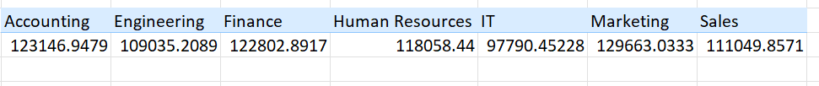
Task3 Average salary difference in departments
The average salary for each departments are shown. There are significant differences. IT has very low salary compared to all other.

Slide 4
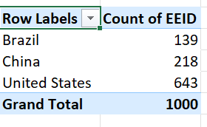
Task4 highest number of employees
From this it is evident that US has the highest number of employees then china and then Brazil.

Slide 5
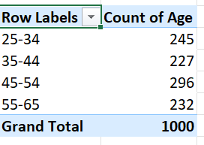
Task 5 common age range
From this it is clear that most people are between the range 45-54 and less people are in 35-44

Slide 6
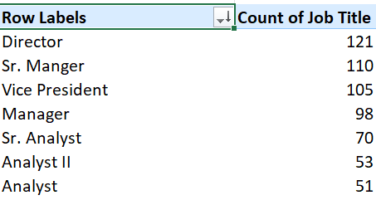
Task 7 Most occurring job titles
The director job title appears more frequently in the dataset indicating that there are many directors

Slide 7
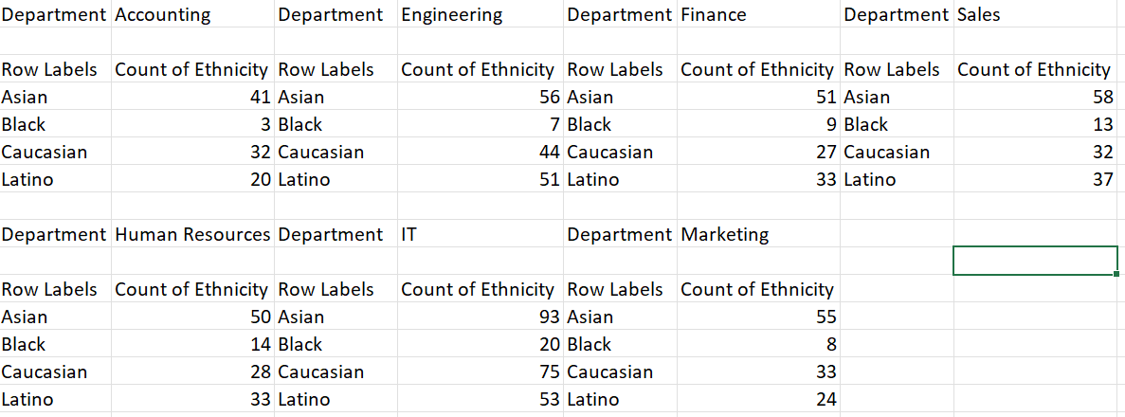
Task9 Diversity of departments
From here we can see the distributions of ethnicity across each departments. Blacks are very low in every Departments. While Asians are high. IT overall has a distributed ethnicity compared to others. With human resources taking second place

Slide 8
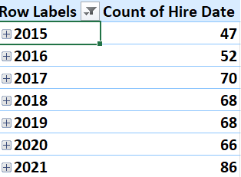
Task 10 Trend of hiring over the past few years
This data shows the total hires over the past few years from 2015 to 2021 and it has been seen that over the years the company has increased the total number of employees by hiring more. It also stayed the same over the years 2018 and 2019

Slide 9
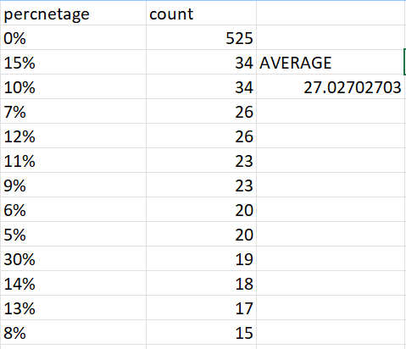
Task 6 average bonus
This is the average bonus percentages given to employees. It can be clear that most employees get 12%,11%,7% bonus percentage AS THE COUNT AVERAGE IS 27. THE PERCENTAE COUNT VALUES THAT ARE IN THIS VALUES AREAVERAGE

Slide 10
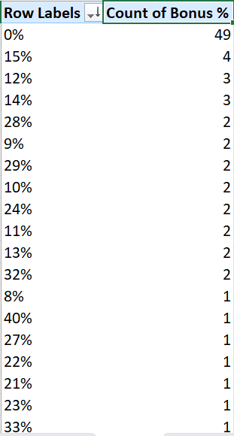
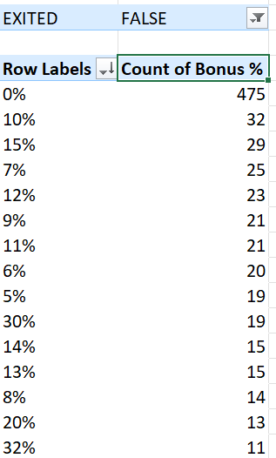
Task 8
Primary reasons cited for employees are higher packeage in other company, work life balance etc. IT IS ALSO FOUND THAT BONUS PERCENTAGE IS LOW.

