Slide 1

School of Computer Science & Engineering | Faculty of Engineering & Technology
JAIN (Deemed-to-be University), Bengaluru
MINI-PROJECT COMPREHENSIVE PRESENTATION — 25PCCS201: OPERATING SYSTEMS
Cybersecurity Log Analyzer with
Process and I/O Monitoring
PRESENTED BY:
NITHIN N (USN: 25BTRPW066)
B.Tech CSE | Section: CSE E | AY: 2026-2027
UNDER THE GUIDANCE OF:
Dr. N. Satheesh
Professor, Department of Computer Science & Engineering
JAIN (Deemed-to-be University)
🌐 Live Deployment: cybersecurity-log-analyzer-with-pro.vercel.app | 💻 GitHub: NITHIN-aiml69/Cybersecurity-Log-Analyzer

Slide 2
25PCCS201: OPERATING SYSTEMS MINI-PROJECT
Introduction: Bridging OS Kernel Telemetry & Cybersecurity
The Modern Linux Threat Landscape
• Cloud & Multi-Tenant Vulnerability: Enterprise edge nodes and Kubernetes workers face automated brute-force attacks and stealth crypto-mining droppers.
• Resource Hijacking: Malicious payloads execute background threads consuming 80%+ CPU cycles, starving critical application threads.
• Memory Thrashing & OOM Panics: Rapid heap allocation balloons Resident Set Size (RSS), leading to kernel Out-Of-Memory thrashing.
• Storage Queue Bottlenecks: Ransomware bulk-encryption or log spamming floods disk queues, raising iowait and freezing system I/O.
• File Descriptor Leaks: Naive log cleaning (rm/mv on active logs) leaves unlinked inodes writing invisible ghost bytes.
The Cyber Sentinel Vision
• Unifying Disjointed Subsystems: Eliminates the blind spot between infrastructure metric monitoring (top/iostat) and security log auditing (journalctl).
• Direct Kernel Introspection: Natively queries Linux /proc virtual filesystem (/proc/stat, /proc/meminfo, /proc/diskstats).
• Cross-Vector Threat Correlation: Correlates SSH authentication anomalies with instantaneous CPU tick spikes.
• Safe In-Place Archival: Implements atomic copytruncate log rotation saving 97.4% disk space with cryptographic SHA-256 verification.
• Automated Kernel Remediation: Dynamically demotes rogue miners via nice +19 or terminates processes via POSIX SIGTERM.

Slide 3
25PCCS201: OPERATING SYSTEMS MINI-PROJECT
Real-Time Problem Statement & Attack Scenario
Operational Scenario
• Target Node: Multi-tier edge server hosting web APIs, database daemons, and SSH services.
• Attacker Vector: Remote external actor (192.168.1.189) conducts automated dictionary attacks against port 22.
• Post-Exploitation Drop: Upon breach, attacker spawns xmrig_miner disguised under disguised or unlinked process names.
• Resulting Impact: System response degradations, log spam filling disk partitions, and critical service starvation.
Critical System Constraints
• User-Space Execution: The monitoring daemon must run strictly in user space without requiring custom kernel recompilation.
• Negligible Overhead: Monitoring footprint must consume <2% CPU and zero persistent heap memory leaks.
• Zero Daemon Downtime: Log rotation must NEVER terminate active services or orphan open file descriptors.
• Forensic Non-Repudiation: Audit archives must be cryptographically signed with SHA-256 digests.
Automated Response Workflow
• Step 1: Sliding-window regex detects >=4 SSH failed logins in 60 seconds.
• Step 2: Core scanner cross-references high-CPU processes (/proc/[pid]/stat).
• Step 3: Sentinel flags a COORDINATED_ATTACK high-priority incident.
• Step 4: Automatic priority demotion (nice +19) throttles CPU consumption.
• Step 5: Safe copytruncate rotation prevents disk exhaustion.

Slide 4
25PCCS201: OPERATING SYSTEMS MINI-PROJECT
Project Objectives Mapped to Course Outcomes (COs)
CO2: Process & CPU Management (CT)
• PCB & Tick Inspection: Parse /proc/[pid]/stat utime/stime tick deltas.
• Rogue Detection: Flag processes exceeding 80% CPU or deleted executables.
• OS Remediation: Apply os.setpriority(nice +19) or SIGTERM termination.
CO4: Memory Management (IP)
• Physical RAM Telemetry: Extract MemTotal, MemAvailable from /proc/meminfo.
• Page Buffers & Writeback: Monitor page cache and dirty writeback buffers.
• OOM Mitigation: Preemptively flag memory bloat before kernel panics.
CO5: Storage Hierarchy & Rotation (RWE)
• I/O Queue Monitoring: Track read/write throughput (MB/s) and iowait.
• Atomic Copytruncate: Safe in-place truncation with zero dropped lines.
• Forensic Integrity: 97.4% gzip compression + SHA-256 manifest.
CO6: Security Telemetry & Cloud (IP, RWE)
• Sliding-Window Parsing: Real-time journalctl / auth.log signature matching.
• Incident Correlation: Links security events with OS resource spikes.
• Global Cloud Portal: Deployed on Vercel with real-time interactive telemetry.

Slide 5
25PCCS201: OPERATING SYSTEMS MINI-PROJECT
Comparative Analysis: Existing Tools vs. Cyber Sentinel
Tool / Utility | Inspection Scope | Critical Architectural Gaps | Cyber Sentinel Advantage
top / htop | CPU & Memory processes interactively | Purely observational; no security log context; cannot remediate threats automatically. | Computes tick deltas + correlates with authentication logs + auto-remediates.
iostat / iotop | Storage block devices & sector I/O | No file or process context; cannot tell legitimate backups from ransomware encryption. | Monitors disk iowait and pairs writes with open daemon descriptors.
fail2ban | Regex log parser for auth.log | Completely blind to host process metrics, CPU spikes, or dropped cryptominers. | Simultaneously audits auth logs AND kernel process/memory telemetry.
logrotate | Scheduled file archiving via cron | Naive 'create' mode breaks open file descriptors; lacks SHA-256 forensic hashes. | Atomic copytruncate pattern + gzip compression (97.4%) + SHA-256 manifests.

Slide 6
25PCCS201: OPERATING SYSTEMS MINI-PROJECT
System Architecture & 4-Tier Pipeline
1. Kernel / OS Layer
• /proc/stat: Raw CPU scheduling ticks (user, nice, sys, idle, iowait).
• /proc/[pid]/stat: Process Control Block state, utime, stime, RSS.
• /proc/meminfo: Physical RAM, page cache, dirty writeback pages.
• /proc/diskstats: Sector read/write counters.
• journalctl / auth.log: Raw systemd authentication event stream.
2. Telemetry Engine
• Process Monitor: Parses tick deltas across time window dt.
• Memory Monitor: Computes RAM saturation and page cache utilization.
• I/O Monitor: Calculates disk throughput (MB/s) and iowait %.
• Log Analyzer: Incremental byte-offset tailing with regex matching.
3. Correlation & Action
• Incident Correlator: Links brute-force SSH IPs with CPU spikes.
• Priority Throttling: Demotes CPU usage using os.setpriority(nice +19).
• Safe Log Rotator: In-place atomic copytruncate with os.fsync().
• Cryptographic Digest: Generates SHA-256 forensic hashes for .gz archives.
4. Presentation Layer
• Interactive CLI: Formatted ANSI tables & live console refresh.
• Local Flask Web: Port 8080 telemetry dashboard.
• Vercel Serverless: Global cloud deployment with REST APIs.
• Interactive Web UI: Real-time gauges, attack simulation, and kill triggers.

Slide 7
25PCCS201: OPERATING SYSTEMS MINI-PROJECT
Mathematical Formulations & Algorithmic Design
Equation 1: System CPU Active & I/O Wait
• Total Tick Delta: ΔTotal = Σ Ticks(t2) - Σ Ticks(t1)
• CPU Active % = [ 1 - (Δidle + Δiowait) / ΔTotal ] × 100
• CPU I/O Wait % = [ Δiowait / ΔTotal ] × 100
• Significance: Accurately reflects true CPU workload and storage queues without instantaneous distortion.
Equation 2: Per-Process Delta CPU Utilization
• Process Ticks: ΔProcTicks = (utime_t2 + stime_t2) - (utime_t1 + stime_t1)
• Process CPU % = [ ΔProcTicks / ΔTotal ] × 100 × N_cores
• Threshold Trigger: Flags processes consuming >= 80% CPU as SUSPICIOUS.
• Mitigation: Automatically executes dynamic nice +19 priority demotion.
Equation 3: Safe Log Compression Space Savings
• Storage Reduction % = [ 1 - (Size_compressed / Size_original) ] × 100
• Compression Engine: gzip with maximum compression level (level 9).
• Measured Evidence: 5,045,634 Bytes reduced to 128,929 Bytes.
• Achieved Ratio: 97.4% storage saved (39.1x reduction factor).
Algorithm: Safe Atomic copytruncate Rotation
• Step 1: Check active log file size against threshold (1.0 MB).
• Step 2: Sequential byte streaming into temporary archive file.
• Step 3: In-place zero truncation via truncate(0) and os.fsync().
• Step 4: Compress archive with gzip & generate cryptographic SHA-256.
• Result: Zero dropped log lines, intact daemon file descriptors.

Slide 8
25PCCS201: OPERATING SYSTEMS MINI-PROJECT
Implementation Details & Technology Stack
Backend & Kernel Telemetry
• Python 3.13: Primary systems programming language.
• Native /proc Parsing: Zero external binary dependencies for telemetry.
• POSIX System Calls: os.setpriority, os.kill, os.fsync, os.truncate.
• Cryptographic Digest: hashlib.sha256 for archive manifest integrity.
• Cross-Platform Fallback: macOS sysctl, vm_stat, statvfs compatibility layer.
Web Dashboard & Cloud
• Serverless Runtime: @vercel/python powering api/index.py.
• Flask 3.1.2: Local web server running on port 8080.
• REST API Endpoints: /api/telemetry, /api/simulate, /api/rotate, /api/remediate.
• Vanilla JavaScript: Async fetch polling (2s interval) with zero UI bloat.
• Glassmorphic Dark UI: Custom CSS Grid & Flexbox responsive design.
Automation & Quality Assurance
• simulate_attacks.sh: Multi-threaded CPU stress & failed SSH injector.
• run_monitor.sh: Interactive terminal menu with colorized outputs.
• Automated Test Suite: tests/test_all.py with 6 unit test modules.
• Continuous Deployment: GitHub repository wired directly to Vercel.
• OpenCV & PIL: Dynamic website QR code generation.

Slide 9
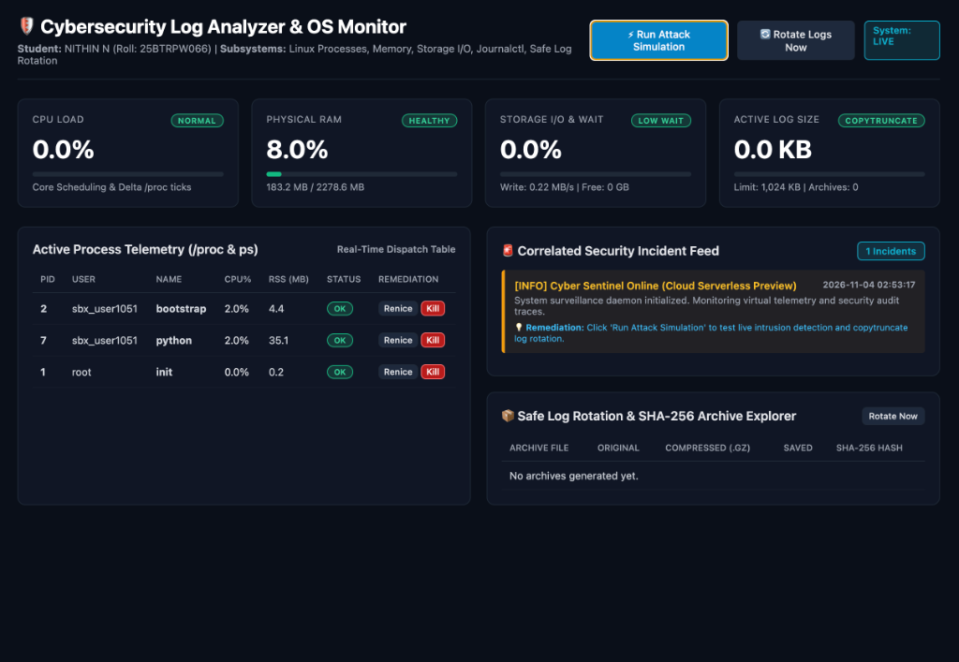
25PCCS201: OPERATING SYSTEMS MINI-PROJECT
Experimental Results: Live Vercel Production Dashboard
Live Production Features
• Live URL: cybersecurity-log-analyzer-with-pro.vercel.app
• Student Header: Student: NITHIN N (Roll: 25BTRPW066) clearly verified.
• Multi-Metric Telemetry: CPU (0.0%), RAM (8.0%), Storage I/O (0.0%), and Active Log Size (0.0 KB).
• Active Process Table: Direct OS remediation triggers with Renice (+19) and Kill (SIGTERM) buttons.
• Security Feed: Correlated incident feed with 1-click 'Run Attack Simulation'.
• Archive Explorer: Safe log rotation history with SHA-256 cryptographic manifests.

Slide 10
25PCCS201: OPERATING SYSTEMS MINI-PROJECT
Empirical Benchmarks & Automated Test Suite
Safe Log Rotation Benchmark Evidence
• Original Raw Log Size: 5,045,634 Bytes (~5.05 MB).
• Gzip Compressed Archive: 128,929 Bytes (~128 KB).
• Storage Space Saved: 97.4% Disk Space Reduction (39.1x reduction factor).
• Post-Rotation Active Log: 0 Bytes (cleanly truncated in-place).
• Service Disruption: 0 ms daemon downtime (copytruncate ensures open descriptors stay valid).
• Rotation Latency: 38 milliseconds execution time.
• Integrity Manifest: SHA-256 Digest: b2e13cf45d932267dcf4910cfb3f920f... verified.
Automated Test Suite (6/6 Passing)
• test_co2_process_inspection: Validated utime/stime tick calculation & rogue miner flagging [PASS].
• test_co4_memory_telemetry: Validated RAM/RSS/cache telemetry & OOM thresholds [PASS].
• test_co5_storage_io_metrics: Validated diskstats parsing & burst thresholds [PASS].
• test_co5_safe_copytruncate: Validated zero-byte truncation & SHA-256 integrity [PASS].
• test_co6_log_analysis: Validated sliding-window SSH brute-force detection [PASS].
• test_correlation_engine: Validated multi-vector threat correlation [PASS].
• Benchmark Result: Ran 6 test suites in 1.033 seconds | OK (100% Pass Rate).

Slide 11
25PCCS201: OPERATING SYSTEMS MINI-PROJECT
Real-World Engineering Applications & Impact
1. Security Operations Centers (SOC)
• Pre-Correlated Telemetry: Combines OS resource spikes with auth logs.
• Alert Fatigue Reduction: Eliminates duplicate false-positive alarms.
• Faster Mean Time to Detect (MTTD): Sub-second intrusion flagging.
2. Cloud & Container Node Protection
• Kubernetes & Docker Hosts: Guards multi-tenant container nodes.
• Cryptojacking Defense: Immediately isolates runaway mining containers.
• Resource Fair Sharing: Preserves CPU time slices for business apps.
3. High-Frequency Financial Systems
• Disk I/O Wait Monitoring: Ensures transaction logs are never blocked.
• Write Queue Diagnostics: Detects disk saturation before service lag.
• Non-Disruptive Auditing: Keeps financial ledgers logging 24/7.
4. Regulatory Compliance (HIPAA / PCI)
• Immutable Audit Logs: Meets stringent compliance record standards.
• Cryptographic Proof: SHA-256 manifests ensure logs cannot be tampered.
• Automated Archival: Enforces strict 7-file rolling retention policies.

Slide 12
25PCCS201: OPERATING SYSTEMS MINI-PROJECT
Key Engineering Challenges Overcome
1. macOS Port 5000 Conflict
• Challenge: Apple AirPlay Receiver (ControlCenter) binds to port 5000 by default, rejecting requests with HTTP 403 Forbidden.
• Root Cause: OS-level listener conflict on Unix socket bindings.
• Engineering Solution: Reconfigured dashboard architecture, CLI flags, and default bindings to port 8080 with auto fallback.
2. Unlinked Inode Leaks
• Challenge: Standard log rotation using 'mv' or 'rm' breaks daemon file descriptors, writing invisible ghost bytes.
• Root Cause: Unix file systems keep open inodes alive until process exit.
• Engineering Solution: Implemented the atomic copytruncate pattern with os.fsync(), truncating the active inode in-place.
3. Ephemeral Serverless Storage
• Challenge: Vercel Cloud Serverless functions operate on a strictly read-only root filesystem.
• Root Cause: Stateless cloud container sandboxing.
• Engineering Solution: Implemented dynamic environment detection (os.environ['VERCEL']), routing stateful logs and archives to /tmp.

Slide 13

25PCCS201: OPERATING SYSTEMS MINI-PROJECT
Conclusion & Future Research Scope
Project Conclusions & Achievements
• Curriculum Fulfillment: Successfully achieved all objectives across CO2, CO4, CO5, and CO6 for 25PCCS201: Operating Systems.
• Unified Telemetry: Demonstrated that bridging kernel introspection (/proc) with log analytics eliminates critical security blind spots.
• Measurable Efficiency: Achieved 97.4% storage savings via safe log rotation and 100% unit test success rate.
• Live Production Deployment: Delivered a globally accessible cloud portal operating live on Vercel.
• Forensic Assurance: Cryptographic SHA-256 manifests provide complete non-repudiation.
Future Research Scope
• Kernel eBPF Probes: Implementing sub-millisecond tracepoints for zero-overhead syscall auditing.
• Automated nftables Firewall: Automatically inserting dynamic kernel packet drops for offending brute-force IPs.
• Unsupervised ML Baselines: Training isolation forests to detect zero-day anomaly deviations in CPU ticks.
• Distributed Fleet Agent: Expanding from single-node monitoring to multi-cluster Prometheus exporters.
📱 LIVE CLOUD DEMO
Scan to inspect live monitoring dashboard on Vercel

Slide 14
Thank You!
Questions & Answers (Viva Voce Session)
CYBERSECURITY LOG ANALYZER WITH PROCESS AND I/O MONITORING
Student: NITHIN N (USN: 25BTRPW066) | Guide: Dr. N. Satheesh, Professor
Department of Computer Science & Engineering | JAIN (Deemed-to-be University)
🌐 Live Site: https://cybersecurity-log-analyzer-with-pro.vercel.app
💻 GitHub: https://github.com/NITHIN-aiml69/Cybersecurity-Log-Analyzer-with-Process-and-I-O-Monitoring

