Slide 1

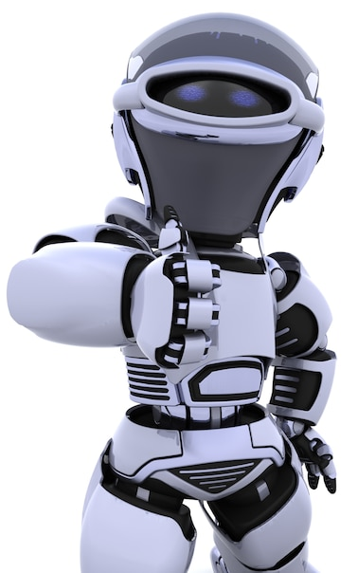
Artificial Intelligence – 30 Days Challenge
Object Tracking Based on Colour | Overview on Hue Saturation Value & Basic syntax
DAY 6 / 30

Slide 2
Announcement
Attendance link will be shared at the end of the session
Minimum 25 Days Attendance required to receive your FREE E-CERTIFICATE (with same mobile number & email id)

Slide 3
Prerequisites for this Course
Be ready with Sufficient Data
Laptop with Good Internet
No basic knowledge is required.
Note & Pen

Slide 4
Object Detection and Tracking Based on Colour
Object detection and tracking are the task that is important and challenging such as video surveillance and vehicle navigation.
Image processing is a method of extracting some useful information by converting image into digital inform by performing some operations on it.

Slide 5
Installing Libraries
pyautogui: pip install pyautogui

Slide 6
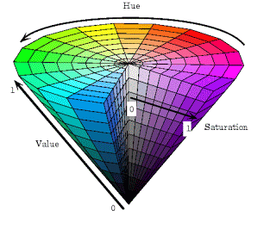
HSV Value
HSL and HSV are alternative representations of the RGB color model, designed in the 1970s by computer graphics researchers to more closely align with the way human vision perceives color-making attributes
HSV Color Space. The HSV color space (hue, saturation, value) is often used by people who are selecting colors (e.g., of paints or inks) from a color wheel or palette, because it corresponds better to how people experience color than the RGB color space does.

Slide 7
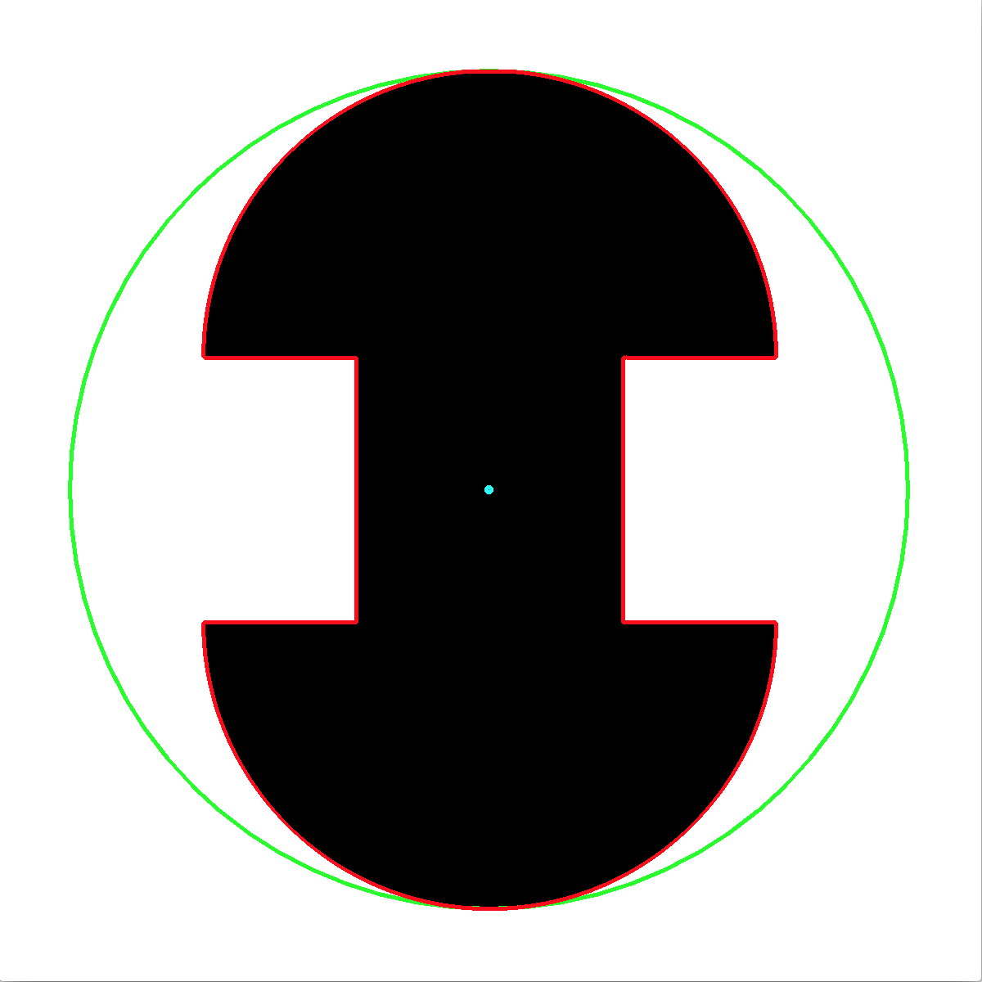
BGR to HSV.
#dst = cv2.cvtColor(src, cv2.COLOR_BGR2HSV)
hsv = cv2.cvtColor(blurred, cv2.COLOR_BGR2HSV)
Minimum Enclosing Circle
#((x, y), radius) = cv2.minEnclosingCircle(countourArea)
((x, y), radius) = cv2.minEnclosingCircle(c)

Slide 8

Moments to find center of the Area
Image moments help you to calculate some features like center of mass of the object, area of the object etc.
#var = cv2.moments(contourArea)
M = cv2.moments(c)
center = (int(M["m10"] / M["m00"]), int(M["m01"] / M["m00"]))

Slide 9
Drawing Circle
# cv2.circle(src, (x,y), int(radius),colour,thickness)
cv2.circle(frame, (int(x), int(y)), int(radius), (0, 255, 255), 2)
#cv2.circle(frame, center, 5, (0, 0, 255), -1)
cv2.circle(frame, center, 5, (0, 0, 255), -1)

Slide 10
Block Diagram – Workflow of Color Object Tracking
Reading frame from camera
Pre-processing Image
Finding contours
Drawing Minimum enclosing circle
Finding centre of contour Area
Drawing circle & centre
Direction based on radius & Position

Slide 11
Ready For Hands On

Slide 12

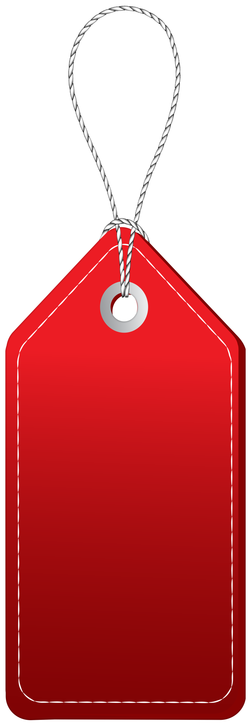
Solution - Internship
30 Day Recorded Video Lectures
20+ Projects Source code & datasets
Bonus Task, Assignments
Technical Material(PPT, Mindmap)
200 AI Interview Questions
Private VIP Community
Rs.1,00,000
E-Certificate For Internship
Rs.1,999
Daily Live Q&A Session
Private VIP Whatsapp Group
Lifetime Course Validity

Slide 13



Rs.1,999
Rs.999

Slide 14




THANK YOU☺
Join our What’s app Community group
novitechresearchanddevelopment

Slide 15

Post Your Attendance

Slide 16
Q & A Session?

