Slide 1

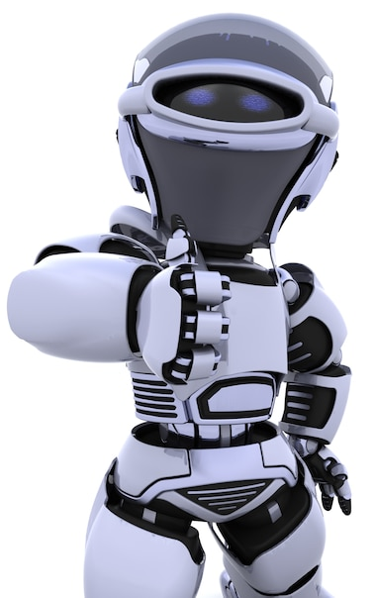
Artificial Intelligence – 30 Days Challenge - ENGLISH
Introduction & its application | Overview on CV Libraries & Installation|
Basic CV Programs
DAY 3 / 30

Slide 2


Computer
Vision
Intro | Libraries | Basic programs

Slide 3


Basic programs on Computer Vision

Slide 4
Read, Show & Write an Image
import numpy as np
import cv2
img = cv2.imread(‘sample2.jpg') cv2.imshow(‘show',img)
cv2.imwrite(‘photo.jpg',img)
cv2.waitKey(0)
cv2.destroyAllWindows()

Slide 5
Converting Color Image to Greyscale Image
import cv2
image = cv2.imread(‘sample1.png’)
greyImage = cv2.cvtColor(image, cv2.COLOR_BGR2GRAY)
cv2.imwrite('gray_image.png', greyImage)
cv2.imshow(‘Color_image',image)
cv2.imshow(‘Grey_image', greyImage)

Slide 6
Image Properties
Import cv2
img = cv2.imread(‘sample2.jpg’)
print (img.shape) #(342, 548, 3)
print (img.size) #562248

Slide 7




THANK YOU☺
Join our What’s app Community group
novitechresearchanddevelopment

