Slide 1

Analyzing Electric Vehicle Adoption and Performance
DATA 603 Platforms for Big Data Processing
University of Maryland Baltimore County
ALEKHYA TENTU – XX77459
SRIDHAR SURLA - MI20695
NITHIN KUMAR BRAHAMADEVARA –SF43377

Slide 2




INTRODUCTION
1
2
3
4
This project analyzes the adoption and performance of electric vehicles (EVs), focusing on environmental impacts, technological advancements, and market dynamics, contributing to global climate change mitigation through sustainable transportation.
Utilizing extensive datasets from primary sources like data.gov and supplementary data from Kaggle, our analysis covers trends over the past decade, capturing shifts in technology, policy, and consumer behavior affecting EV adoption.
The study highlights the environmental benefits of EVs, examines the impact of technological progress on vehicle accessibility, and provides insights that help inform policymakers and business strategies to support and accelerate the EV market's growth.
The project also explores the economic implications of increased EV adoption, analyzing potential cost savings and market opportunities, which could influence consumer decisions and policy formulations in the energy and automotive sectors.

Slide 3







Objectives and Importance
Technological Progress
Examine developments in EV technology, especially in battery life and charging infrastructure, enhancing vehicle accessibility and practicality.
Environmental Sustainability
Economic Impact
Explore potential cost savings for EV owners and analyze market opportunities that influence the automotive industry.
Contribute to reducing greenhouse gas emissions and improving air quality through increased EV adoption.
Predictive Modeling
Stakeholder Insights
Utilize predictive modeling techniques to understand and forecast EV characteristics such as electric range, market pricing, and consumer adoption patterns.
Provide policymakers with data-driven insights for developing effective environmental and economic strategies. Assist businesses in aligning with emerging market trends. Enable consumers to make informed decisions based on the environmental and economic impacts of EVs.
Project Aim
Significance for Stakeholders
Analyze the adoption and performance of electric vehicles (EVs), focusing on technological advancements, environmental impacts, and market dynamics.
Highlight the critical role of the study in aiding policymakers, business leaders, and consumers. Emphasize the project’s contribution to sustainable transportation discourse.

Slide 4

Project Steps
Data Collection: Gathered relevant EV data from primary sources (data.gov) and supplementary sources (Kaggle).
Feature Engineering: Explore feature engineering techniques to improve model accuracy and performance.
01
05
Data Cleaning and Preprocessing: Cleansed and prepared datasets for analysis, addressing missing values and inconsistencies.
Advanced Model Training: Implement advanced machine learning algorithms for enhanced predictive modeling.
02
06
Exploratory Data Analysis (EDA): Conducted EDA to understand key patterns, distributions, and correlations in the EV data.
Model Evaluation and Validation: Evaluate and validate models using appropriate metrics to ensure reliability and accuracy.
03
07
Initial Model Training: Trained initial machine learning models for predicting electric range, base MSRP, and clean fuel eligibility.
Insights Generation: Extract actionable insights from the models to inform policy decisions, infrastructure planning, and consumer awareness.
04
08

Slide 5
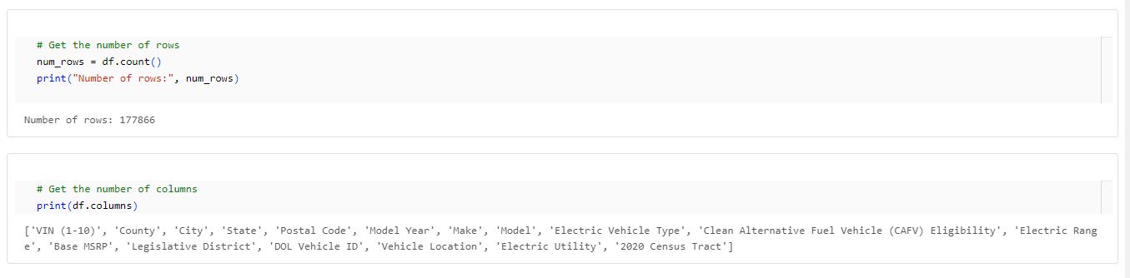
Data Collection
Data Collection: Gathered extensive datasets from primary sources like data.gov and supplementary sources such as Kaggle.

Slide 6
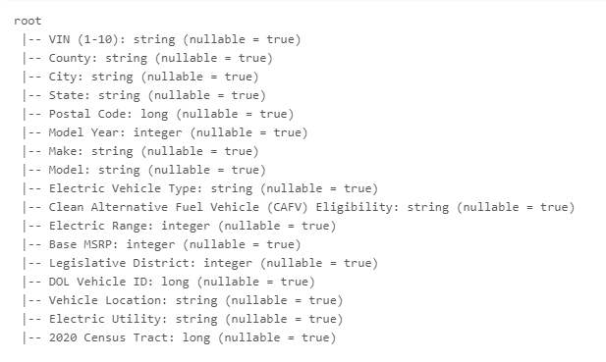
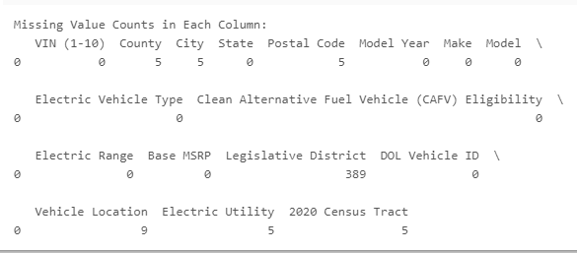
Data Cleaning and Preprocessing
Data Cleaning: Removed duplicates, filled missing values, and corrected inconsistencies to enhance data reliability.

Slide 7
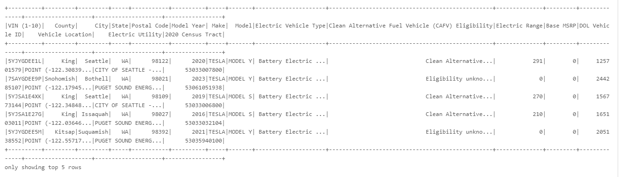
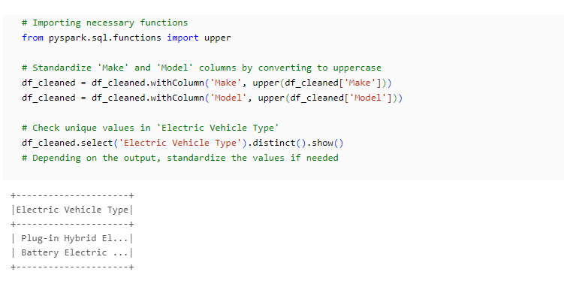

Slide 8
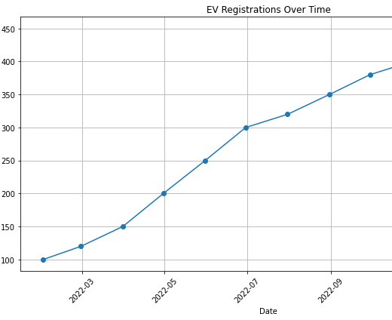
Exploratory Data Analysis (EDA)
Purpose of EDA: To explore large-scale datasets on EV adoption and performance, revealing key market trends and consumer behaviors. Conducted Exploratory Data Analysis (EDA) to gain insights into the electric vehicle (EV) dataset.
Data Visualization: Generated various plots and charts to visualize trends, distributions, and correlations in the data.
Registration Trends: Visualized changes in EV registrations over time to identify adoption patterns.

Slide 9
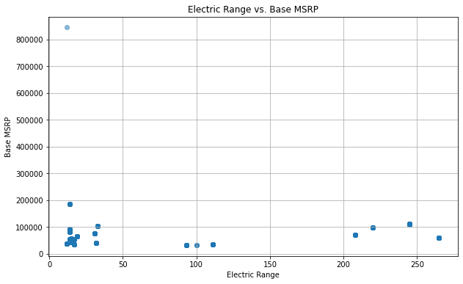
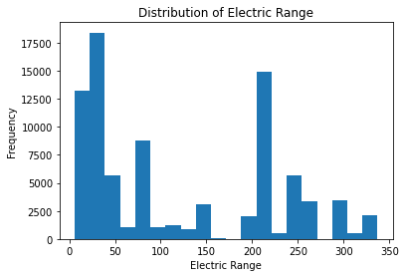
2. Electric Range and Base MSRP Analysis:
Histogram of Electric Range: Visualize electric range distribution among EVs.
Scatter Plot of Electric Range vs. Base MSRP: Analyze the relationship between electric range and pricing.
Box Plot of Electric Range by Make: Compare electric range across vehicle makes.

Slide 10
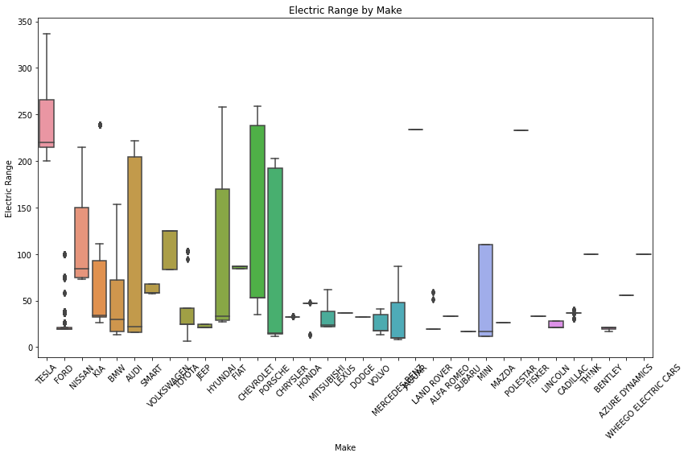

Slide 11
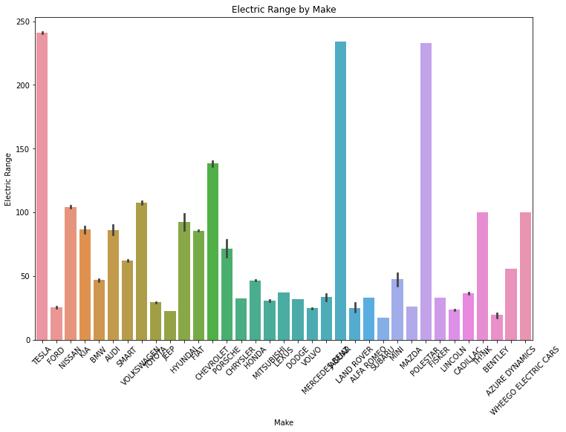
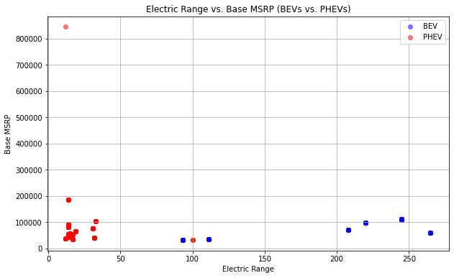
3. Geographic Variations and EV Registrations:
Scatter Plot of Electric Range vs. Base MSRP for BEVs and PHEVs: Explore differences between BEVs and PHEVs in terms of electric range and pricing.
Bar Chart of Electric Range by Make: Depict the distribution of electric range across vehicle makes.

Slide 12
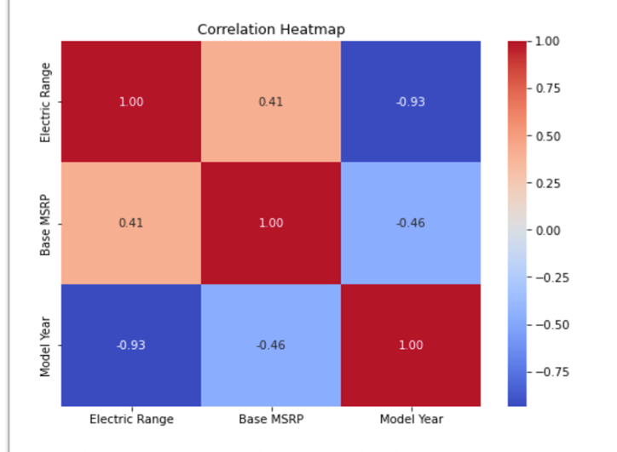
4. Correlation Matrix Heatmap:
We generated a correlation matrix heatmap to visualize the correlations between 'Electric Range', 'Base MSRP', and other relevant variables in our dataset.

Slide 13
Trends And Insights
Regional Variations in EV Adoption: Leveraged geographic analysis to identify regional variations in EV adoption rates. Provides insights into the geographic distribution of EV popularity and consumer preferences.
Extreme Electric Range Values: Noted extreme electric range values across various model years. Highlighted models with both the highest and lowest electric ranges. Offers insights into the range capabilities of different EV models and market preferences.
Clean Fuel Eligibility Trends: Observed trends in clean fuel eligibility among electric vehicles. Suggests a significant presence of clean fuel options in the EV market.
Model Year and Legislative District Analysis: Analyzed the distribution and trends related to model years and legislative districts. Offers insights into the diversity and distribution of EV models across different regions.
Increasing EV Registrations: Identified a consistent upward trend in EV registrations over time. Indicates a growing acceptance and adoption of electric vehicles among consumers.

Slide 14
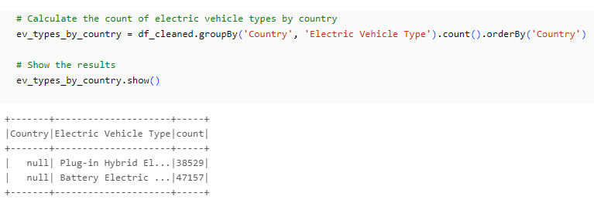
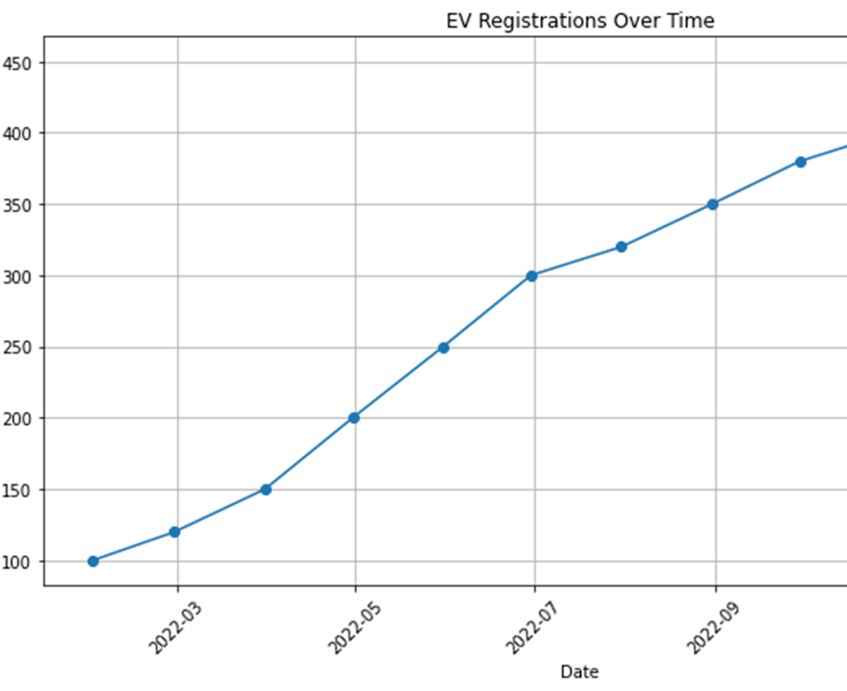


Slide 15
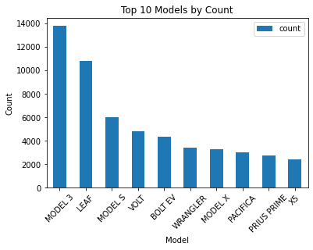
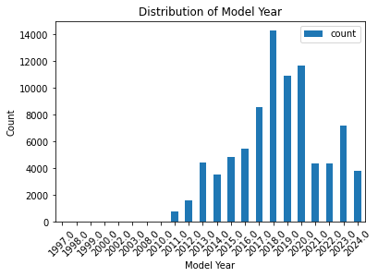
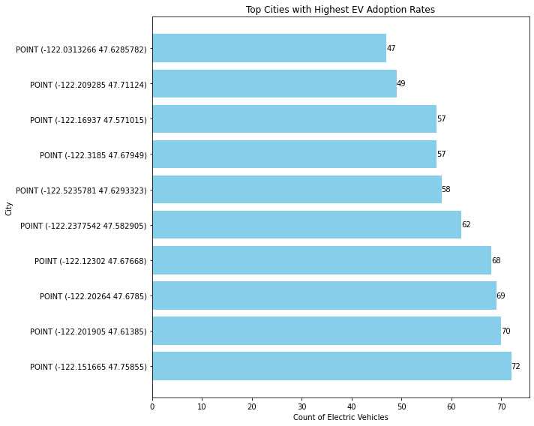
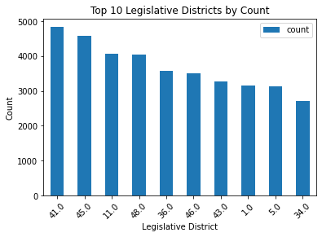

Slide 16
Key Insights from Exploratory Data Analysis
Average Electric Range by State:
Highest Average Electric Range: Alexandria County with an average of 326.0 miles.
Lowest Average Electric Range: Richmond County with an average of NaN miles (data unavailable).
Top Cities with Highest EV Adoption Rates:
Seattle: 29,447 registered electric vehicles.
Bellevue: 8,931 registered electric vehicles.
Redmond: 6,478 registered electric vehicles.
Vancouver: 6,193 registered electric vehicles.
Bothell: 5,863 registered electric vehicles.
Electric Vehicle Type Distribution by Country:
Plug-in Hybrid Electric Vehicles (PHEVs): 38,656 registered vehicles.
Battery Electric Vehicles (BEVs): 47,260 registered vehicles.
Model Year and Make Analysis:
Highest Average Electric Range by Model Year:
2024 models: Dodge with an average of 32.0 miles.
2023 models: Hyundai with an average of 31.21 miles.
Unique Model Years: 22
Unique Models: 95
Correlation Matrix Heatmap:
Displayed correlations between electric range, base MSRP, and other variables, indicating the strength and direction of relationships.
Additional Insights:
Trends in EV Registrations over Time: Identified adoption patterns and market shifts.
Highest Electric Range by Model Year:
2013 models: Ford with an electric range of 76.0 miles.
2020 models: Porsche with an electric range of 156.01 miles.
Highly Correlated Variables: Include highly correlated variables from the correlation matrix heatmap.
Highest Correlations:
Electric Range and Model Year: Correlation coefficient of -0.93 (strong negative correlation).
Base MSRP and Model Year: Correlation coefficient of -0.46 (moderate negative correlation).
Electric Range and Base MSRP: Correlation coefficient of 0.41 (moderate positive correlation).

Slide 17
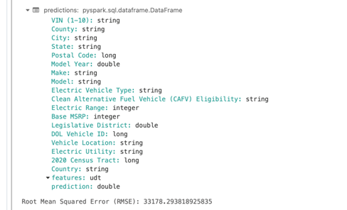
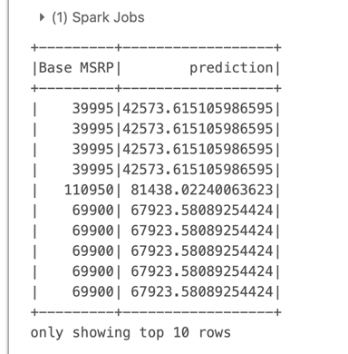
Initial Model Training
Linear Regression Model for Base MSRP Prediction
Features Used: Electric Range Model Year
Model Training: Trained a Linear Regression model using the selected features to predict Base MSRP.
Evaluation: Evaluated the model using Root Mean Squared Error (RMSE). RMSE: 33,178.29
Sample Predictions: Showcased actual Base MSRP and predicted values from the model.

Slide 18
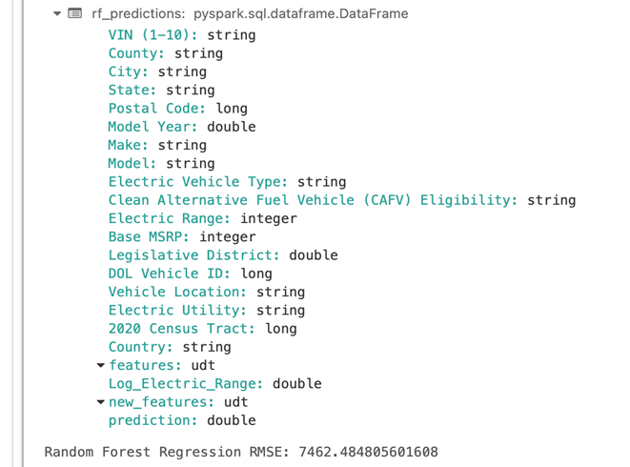
Random Forest Regression Model for Base MSRP Prediction
Feature Engineering:
Created a new feature by taking the logarithm of 'Electric Range' to improve model performance.
Features Used:
Logarithm of Electric Range
Model Year
Model Training:
Trained a Random Forest Regression model using the engineered feature and Model Year to predict Base MSRP.
Number of Trees: 100
Max Depth: 5
Evaluation:
Evaluated the Random Forest model using RMSE.
RMSE: 7,462.48

Slide 19
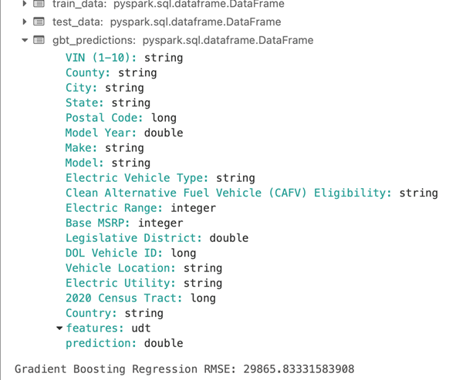
Gradient Boosting Regression Model
Features Used: Electric Range, Model Year
Model Training: Trained a Gradient Boosting Regression model.
Evaluation: Determined model performance through RMSE evaluation.
RMSE Value: Highlighted the RMSE value obtained from the model.

Slide 20
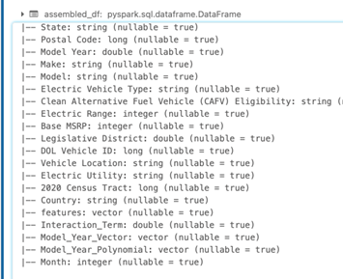
Feature Engineering
Introduction to Feature Engineering:
Importance of feature engineering in improving model performance.
Interaction Terms:
Created an interaction term by multiplying 'Model Year' and 'Electric Range' to capture potential combined effects.
Polynomial Features:
Utilized Polynomial Expansion to generate polynomial features from 'Model Year' to capture nonlinear relationships.
Temporal Features:
Extracted the month from the 'Model Year' column to incorporate temporal information into the model.
Updated DataFrame Schema:
Displayed the updated schema of the Data Frame after feature engineering.

Slide 21
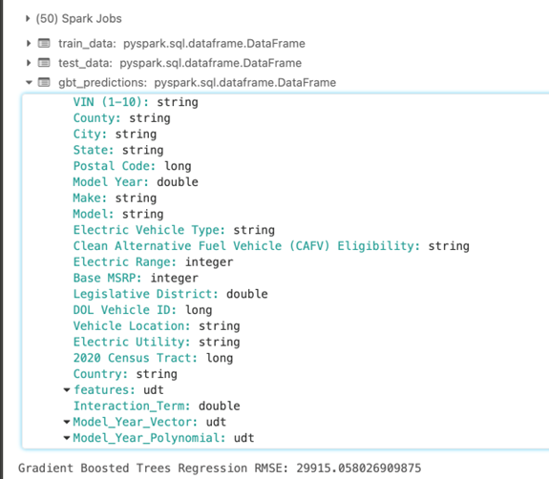
Advanced Modeling
Gradient Boosted Trees Model
Model Training:
Utilized Gradient Boosted Trees (GBT) regression model for prediction.
Features: Interaction Term, Model Year Polynomial, Month.
Target Variable: Base MSRP.
Data split into training and testing sets.
Evaluation:
Evaluated the model using Root Mean Squared Error (RMSE).
RMSE: 29,915.06.
Insights:
Despite feature engineering, the initial GBT model showed a considerable RMSE.

Slide 22
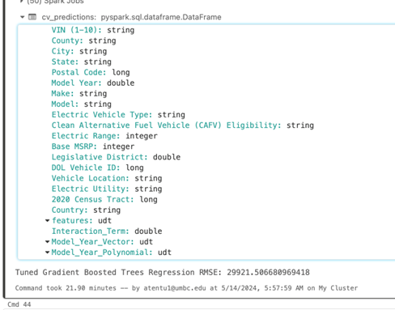
Hyperparameter Tuning
Cross-Validation and Grid Search
Conducted cross-validation with 3 folds for hyperparameter tuning.
Grid search over maxDepth and maxIter parameters.
Objective: Improve model performance.
Tuned Model Evaluation
Evaluated the tuned model using RMSE.
Tuned RMSE: 29,921.51.
Conclusion
Hyperparameter tuning slightly improved the model's performance, but significant enhancement is required for better predictions.

Slide 23
Model Evaluation and Metrics
Root Mean Squared Error (RMSE) Comparison:
Linear Regression RMSE: 33,178.29
Random Forest Regression RMSE: 7,462.48
Gradient Boosted Trees RMSE: 29,915.06
Tuned Gradient Boosted Trees RMSE: 29,921.51
Insights:
Random Forest Regression outperforms other models with the lowest RMSE.
Gradient Boosted Trees models, both initial and tuned, show similar RMSE values, indicating the need for further optimization.

Slide 24
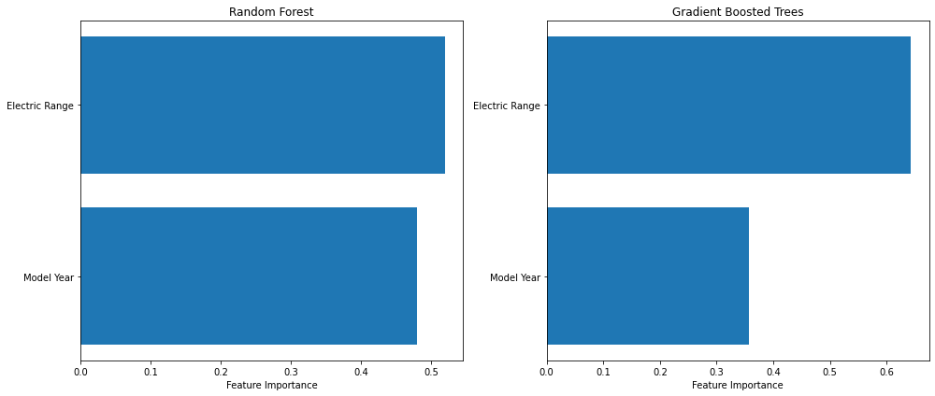
Insightful Analysis
Both Random Forest and Gradient Boosted Trees models highlight 'Electric Range' as the most influential feature on Base MSRP.
While Random Forest performs slightly better in terms of RMSE, both models demonstrate similar feature importance patterns.
Further analysis is recommended for refining the models and identifying opportunities for practical implementation in various domains.

Slide 25




Future Scope
Looking ahead, our analysis opens up several avenues for future exploration and innovation:
Advanced Modeling Techniques:
Data Enrichment:
Expanding our dataset to include a broader range of features such as battery technology, charging infrastructure, and government incentives can provide a more holistic understanding of electric vehicle pricing dynamics.
A
Incorporating deep learning algorithms and ensemble methods can further improve the accuracy and predictive power of our models.
B
Collaborating with industry stakeholders, including automakers, policymakers, and energy providers, can facilitate data sharing and insights generation, driving innovation and informed decision-making in the electric vehicle ecosystem.
Conducting consumer surveys and sentiment analysis can provide valuable insights into consumer preferences and perceptions related to electric vehicle pricing, informing marketing strategies and product development efforts.
C
D
Industry Collaboration:
Consumer Insights

Slide 26



Conclusion
Feature Importance: Electric Range emerges as the most influential factor in determining Base MSRP, highlighting its critical role in pricing strategies.
Model Performance: Our models, including Linear Regression, Random Forest, and Gradient Boosted Trees, demonstrate varying levels of accuracy in predicting Base MSRP.
Through comprehensive modeling and analysis, we've gained valuable insights into the dynamics of electric vehicle pricing. Key findings include:
Future Directions: By leveraging advanced modeling techniques and expanding our dataset, we can further enhance the accuracy and robustness of our models. Additionally, exploring additional features such as battery capacity and charging infrastructure could provide deeper insights into pricing dynamics.

Slide 27
Link to Project Code https://databricks-prod-cloudfront.cloud.databricks.com/public/4027ec902e239c93eaaa8714f173bcfc/8551504759852583/2953886869151219/4755327300798458/latest.html

Slide 28
References
Kumar, R. R., & Alok, K. (2020, April 1). Adoption of electric vehicle: A literature review and prospects for sustainability. Journal of Cleaner Production. https://doi.org/10.1016/j.jclepro.2019.119911
Sierzchula, W., Bakker, S., Maat, K., & Van Wee, B. (2014, May 1). The influence of financial incentives and other socio-economic factors on electric vehicle adoption. Energy Policy. https://doi.org/10.1016/j.enpol.2014.01.043
Bhattacharyya, S. S., & Thakre, S. (2020, October 5). Exploring the factors influencing electric vehicle adoption: an empirical investigation in the emerging economy context of India. Foresight. https://doi.org/10.1108/fs-04-2020-0037
Egbue, O., & Long, S. (2012, September 1). Barriers to widespread adoption of electric vehicles: An analysis of consumer attitudes and perceptions. Energy Policy. https://doi.org/10.1016/j.enpol.2012.06.009
Foley, B., Degirmenci, K., & Yigitcanlar, T. (2020, November 4). Factors Affecting Electric Vehicle Uptake: Insights from a Descriptive Analysis in Australia. Urban Science. https://doi.org/10.3390/urbansci4040057

