Slide 1
HTML 5…
Roshan Fernandes, Dept of CSE, NMAMIT, Nitte

Slide 2
HTML5 is the latest standard for HTML
It was specially designed to deliver rich content without the need for additional plugins
HTML5 is also cross-platform. It is designed to work whether you are using a PC, or a Tablet, a Smartphone, or a Smart TV
Roshan Fernandes, Dept of CSE, NMAMIT, Nitte

Slide 3
A Minimum HTML5 Document…
<!DOCTYPE html>
<html>
<head>
<meta charset="UTF-8">
<title>Title of the document</title>
</head>
<body>
Content of the document......
</body>
</html>
Roshan Fernandes, Dept of CSE, NMAMIT, Nitte

Slide 4
HTML5 - New Features…
Some of the most interesting new features in HTML5 are:
  The <canvas> element for 2D drawing
  The <video> and <audio> elements for media playback
  Support for local storage
  New content-specific elements, like <article>, <footer>, <header>, <nav>, <section>
  New form controls, like calendar, date, time, email, url, search
Roshan Fernandes, Dept of CSE, NMAMIT, Nitte

Slide 5
Browser Support for HTML5…
All major browsers (Chrome, Firefox, Internet Explorer, Safari, Opera) support the new HTML5 elements and APIs, and continue to add new HTML5 features to their latest versions
Roshan Fernandes, Dept of CSE, NMAMIT, Nitte

Slide 6
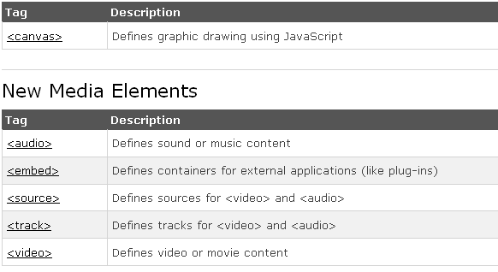

New Elements in HTML5…
Roshan Fernandes, Dept of CSE, NMAMIT, Nitte

Slide 7
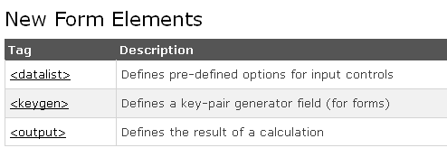
Roshan Fernandes, Dept of CSE, NMAMIT, Nitte

Slide 8
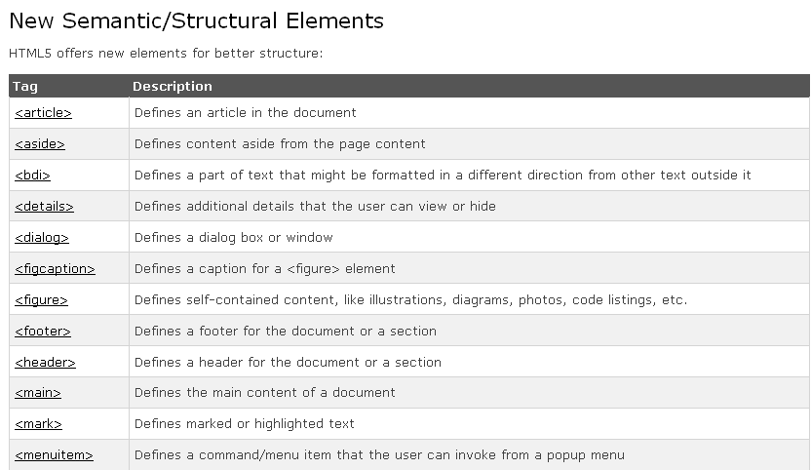
Roshan Fernandes, Dept of CSE, NMAMIT, Nitte

Slide 9
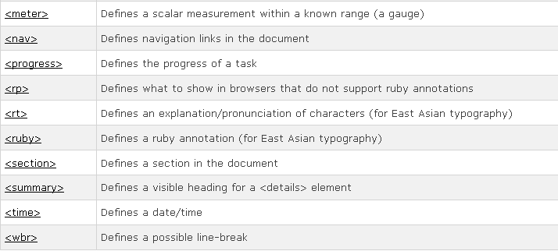
Roshan Fernandes, Dept of CSE, NMAMIT, Nitte

Slide 10
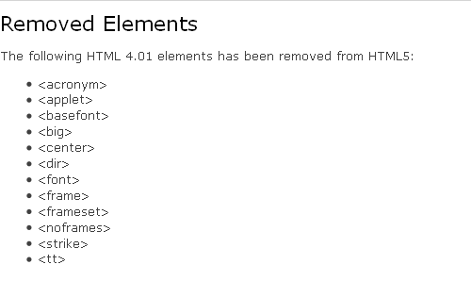
Roshan Fernandes, Dept of CSE, NMAMIT, Nitte

Slide 11
HTML5 Semantic Elements…
A semantic element clearly describes its meaning to both the browser and the developer
Examples of non-semantic elements: <div> and <span> - Tells nothing about its content
Examples of semantic elements: <form>, <table>, and <img> - Clearly defines its content
Roshan Fernandes, Dept of CSE, NMAMIT, Nitte

Slide 12
New Semantic Elements in HTML5…
Many of existing web sites today contains HTML code like this: <div id="nav">, <div class="header">, or <div id="footer">, to indicate navigation links, header, and footer
HTML5 offers new semantic elements to clearly define different parts of a web page
Roshan Fernandes, Dept of CSE, NMAMIT, Nitte

Slide 13
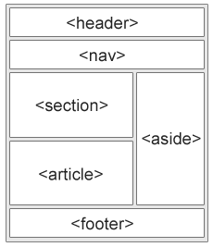
<header>
<nav>
<section>
<article>
<aside>
<figure>
<figcaption>
<footer>
<details>
<summary>
<mark>
<time>
Roshan Fernandes, Dept of CSE, NMAMIT, Nitte

Slide 14
HTML5 <header> Element…
The <header> element specifies a header for a document or section
The <header> element should be used as a container for introductory content
You can have several <header> elements in one document
Roshan Fernandes, Dept of CSE, NMAMIT, Nitte

Slide 15
HTML5 <section> Element…
The <section> element defines a section in a document
Example: (Refer Ex1.html)
<section>
<h1>WWF</h1>
<p>The World Wide Fund for Nature (WWF) is....</p>
</section>
Roshan Fernandes, Dept of CSE, NMAMIT, Nitte

Slide 16
HTML5 <article> Element…
The <article> element specifies independent, self-contained content
Examples of where an <article> element can be used:
  Forum post
  Blog post
  News story
  Comment
Roshan Fernandes, Dept of CSE, NMAMIT, Nitte

Slide 17
Example (Refer Ex2.html)
<article>
<h1>Internet Explorer 9</h1>
<p>Windows Internet Explorer 9 (abbreviated as IE9) was released to the public on March 14, 2011 at 21:00 PDT.....</p>
</article>
Roshan Fernandes, Dept of CSE, NMAMIT, Nitte

Slide 18
HTML5 <nav> Element…
The <nav> element defines a set of navigation links
The <nav> element is intended for large blocks of navigation links. However, not all links in a document should be inside a <nav> element!
Roshan Fernandes, Dept of CSE, NMAMIT, Nitte

Slide 19
Example:
<nav>
<a href="/html/">HTML</a>
<a href="/css/">CSS</a>
<a href="/js/">JavaScript</a>
<a href="/jquery/">jQuery</a>
</nav>
Roshan Fernandes, Dept of CSE, NMAMIT, Nitte

Slide 20
HTML5 <header> Element…
The <header> element specifies a header for a document or section
The <header> element should be used as a container for introductory content
You can have several <header> elements in one document
Roshan Fernandes, Dept of CSE, NMAMIT, Nitte

Slide 21
Refer Ex3.html
<article>
<header>
<h1>Internet Explorer 9</h1>
<p><time pubdate datetime="2011-03- 15"></time></p>
</header>
<p>Windows Internet Explorer 9 (abbreviated as IE9) was released to the public on March 14, 2011 at 21:00 PDT.....</p>
</article>
Roshan Fernandes, Dept of CSE, NMAMIT, Nitte

Slide 22
HTML5 <footer> Element…
The <footer> element specifies a footer for a document or section
A <footer> element should contain information about its containing element
A footer typically contains the author of the document, copyright information, links to terms of use, contact information, etc
You can have several <footer> elements in one document
Roshan Fernandes, Dept of CSE, NMAMIT, Nitte

Slide 23
Refer Ex4.html
<footer>
<p>Posted by: Hege Refsnes</p>
<p><time pubdate datetime="2012-03- 01"></time></p>
</footer>
Roshan Fernandes, Dept of CSE, NMAMIT, Nitte

Slide 24
HTML5 <figure> and <figcaption> Elements…
The <figure> tag specifies self-contained content, like illustrations, diagrams, photos, code listings, etc
The <figcaption> tag defines a caption for a <figure> element
The <figcaption> element can be placed as the first or last child of the <figure> element
Roshan Fernandes, Dept of CSE, NMAMIT, Nitte

Slide 25
  Refer Ex5.html
<figure>
<img src="img_pulpit.jpg" alt="The Pulpit Rock" width="304" height="228">
<figcaption>Fig1. - The Pulpit Pock, Norway.</figcaption>
</figure>
Roshan Fernandes, Dept of CSE, NMAMIT, Nitte

Slide 26
HTML5 Input Types…
HTML5 has several new input types for forms
These new features allow better input control and validation
    color
    date
    datetime
    datetime-local
    email
    month
    number
    range
    search
    tel
    time
    url
    week
Roshan Fernandes, Dept of CSE, NMAMIT, Nitte

Slide 27
Select your favorite color: <input type="color" name="favcolor">
Birthday: <input type="date" name="bday">
E-mail: <input type="email" name="email">
Birthday (month and year): <input type="month" name="bdaymonth">
Roshan Fernandes, Dept of CSE, NMAMIT, Nitte

Slide 28
Quantity (between 1 and 5): <input type="number" name="quantity" min="1" max="5">
Use the following attributes to specify restrictions:
  max - specifies the maximum value allowed
  min - specifies the minimum value allowed
  step - specifies the legal number intervals
  value - Specifies the default value
Roshan Fernandes, Dept of CSE, NMAMIT, Nitte

Slide 29
<input type="range" name="points" min="1" max="10">
Search Google: <input type="search" name="googlesearch">
Telephone: <input type="tel" name="usrtel">
Roshan Fernandes, Dept of CSE, NMAMIT, Nitte

Slide 30
Select a time: <input type="time" name="usr_time">
Add your homepage: <input type="url" name="homepage">
Select a week: <input type="week" name="week_year">
Refer Ex6.html
Roshan Fernandes, Dept of CSE, NMAMIT, Nitte

Slide 31
HTML5 New Form Elements…
HTML5 has the following new form elements:
  <datalist>
  <keygen>
  <output>
Roshan Fernandes, Dept of CSE, NMAMIT, Nitte

Slide 32
The <datalist> element specifies a list of pre-defined options for an <input> element
Use the <input> element's list attribute to bind it together with a <datalist> element
Refer Ex7.html
<input list="browsers">
<datalist id="browsers">
<option value="Internet Explorer">
<option value="Firefox">
<option value="Chrome">
<option value="Opera">
<option value="Safari">
</datalist>
Roshan Fernandes, Dept of CSE, NMAMIT, Nitte

Slide 33
The purpose of the <keygen> element is to provide a secure way to authenticate users
The <keygen> tag specifies a key-pair generator field in a form
When the form is submitted, two keys are generated, one private and one public
The private key is stored locally, and the public key is sent to the server
Roshan Fernandes, Dept of CSE, NMAMIT, Nitte

Slide 34
Refer Ex8.html
<form action="demo_keygen.asp" method="get">
Username: <input type="text" name="usr_name">
Encryption: <keygen name="security">
<input type="submit">
</form>
Roshan Fernandes, Dept of CSE, NMAMIT, Nitte

Slide 35
The <output> element represents the result of a calculation (like one performed by a script)
Refer Ex9.html
<form oninput="x.value=parseInt(a.value)+parseInt(b.value)">
0 <input type="range" id="a" value="50">100 +
<input type="number" id="b" value="50">=
<output name="x" for="a b"></output>
</form>
Roshan Fernandes, Dept of CSE, NMAMIT, Nitte

Slide 36
HTML5 New Form Attributes…
HTML5 has several new attributes for <form> and <input>
New attributes for <form>:
  autocomplete
  novalidate
Roshan Fernandes, Dept of CSE, NMAMIT, Nitte

Slide 37
New attributes for <input>:
    autocomplete
    autofocus
    form
    formaction
    formenctype
    formmethod
    formnovalidate
    formtarget
    height and width
    list
    min and max
    multiple
    pattern (regexp)
    placeholder
    required
    step
Roshan Fernandes, Dept of CSE, NMAMIT, Nitte

Slide 38
<form> / <input> autocomplete Attribute…
The autocomplete attribute specifies whether a form or input field should have autocomplete on or off
When autocomplete is on, the browser automatically complete values based on values that the user has entered before
It is possible to have autocomplete "on" for the form, and "off" for specific input fields, or vice versa
The autocomplete attribute works with <form> and the following <input> types: text, search, url, tel, email, password, datepickers, range, and color
Roshan Fernandes, Dept of CSE, NMAMIT, Nitte

Slide 39
Refer Ex10.html
<form action="demo_form.asp" autocomplete="on">
First name:<input type="text" name="fname"><br>
Last name: <input type="text" name="lname"><br>
E-mail: <input type="email" name="email" autocomplete="off"><br>
<input type="submit">
</form>
Roshan Fernandes, Dept of CSE, NMAMIT, Nitte

Slide 40
<form> novalidate Attribute…
The novalidate attribute is a boolean attribute
When present, it specifies that the form-data (input) should not be validated when submitted
<form action="demo_form.asp" novalidate>
E-mail: <input type="email" name="user_email">
<input type="submit">
</form>
Roshan Fernandes, Dept of CSE, NMAMIT, Nitte

Slide 41
<input> autofocus Attribute…
The autofocus attribute is a Boolean attribute
When present, it specifies that an <input> element should automatically get focus when the page loads.
First name:<input type="text" name="fname" autofocus>
refer Ex11.html
Roshan Fernandes, Dept of CSE, NMAMIT, Nitte

Slide 42
<input> form Attribute…
The form attribute specifies one or more forms an <input> element belongs to
To refer to more than one form, use a space-separated list of form id’s
Example:
<form action="demo_form.asp" id="form1">
First name: <input type="text" name="fname"><br>
<input type="submit" value="Submit">
</form>
Last name: <input type="text" name="lname" form="form1">
Roshan Fernandes, Dept of CSE, NMAMIT, Nitte

Slide 43
<input> formaction Attribute…
The formaction attribute specifies the URL of a file that will process the input control when the form is submitted
The formaction attribute overrides the action attribute of the <form> element
The formaction attribute is used with type="submit" and type="image"
Roshan Fernandes, Dept of CSE, NMAMIT, Nitte

Slide 44
Example:
<form action="demo_form.asp">
First name: <input type="text" name="fname"><br>
Last name: <input type="text" name="lname"><br>
<input type="submit" value="Submit"><br>
<input type="submit" formaction="demo_admin.asp"
value="Submit as admin">
</form>
Roshan Fernandes, Dept of CSE, NMAMIT, Nitte

Slide 45
<input> formmethod Attribute…
The formmethod attribute defines the HTTP method for sending form-data to the action URL
The formmethod attribute overrides the method attribute of the <form> element
The formmethod attribute can be used with type="submit" and type="image"
Roshan Fernandes, Dept of CSE, NMAMIT, Nitte

Slide 46
Example:
<form action="demo_form.asp" method="get">
First name: <input type="text" name="fname"><br>
Last name: <input type="text" name="lname"><br>
<input type="submit" value="Submit">
<input type="submit" formmethod="post" formaction="demo_post.asp"
value="Submit using POST">
</form>
Roshan Fernandes, Dept of CSE, NMAMIT, Nitte

Slide 47
<input> formtarget Attribute…
The formtarget attribute specifies a name or a keyword that indicates where to display the response that is received after submitting the form
The formtarget attribute overrides the target attribute of the <form> element
The formtarget attribute can be used with type="submit" and type="image"
Roshan Fernandes, Dept of CSE, NMAMIT, Nitte

Slide 48
Refer Ex12.html
<form action="demo_form.asp">
First name: <input type="text" name="fname"><br>
Last name: <input type="text" name="lname"><br>
<input type="submit" value="Submit as normal">
<input type="submit" formtarget="_blank"
value="Submit to a new window">
</form>
Roshan Fernandes, Dept of CSE, NMAMIT, Nitte

Slide 49
<input> min and max Attributes…
The min and max attributes specify the minimum and maximum value for an <input> element
The min and max attributes works with the following input types: number, range, date, datetime, datetime-local, month, time and week
Roshan Fernandes, Dept of CSE, NMAMIT, Nitte

Slide 50
Examples:
Enter a date before 1980-01-01:
<input type="date" name="bday" max="1979-12-31">
Enter a date after 2000-01-01:
<input type="date" name="bday" min="2000-01-02">
Quantity (between 1 and 5):
<input type="number" name="quantity" min="1" max="5">
Roshan Fernandes, Dept of CSE, NMAMIT, Nitte

Slide 51
<input> multiple Attribute…
The multiple attribute is a boolean attribute
When present, it specifies that the user is allowed to enter more than one value in the <input> element
The multiple attribute works with the following input types: email, and file
Select images: <input type="file" name="img" multiple>
Refer Ex13.html
Roshan Fernandes, Dept of CSE, NMAMIT, Nitte

Slide 52
<input> pattern Attribute…
The pattern attribute specifies a regular expression that the <input> element's value is checked against
The pattern attribute works with the following input types: text, search, url, tel, email, and password
Country code: <input type="text" name="country_code" pattern="[A-Za-z]{3}" title="Three letter country code">
Refer Ex14.html
Roshan Fernandes, Dept of CSE, NMAMIT, Nitte

Slide 53
<input> placeholder Attribute…
The placeholder attribute specifies a short hint that describes the expected value of an input field (e.g. a sample value or a short description of the expected format)
The short hint is displayed in the input field before the user enters a value
The placeholder attribute works with the following input types: text, search, url, tel, email, and password.
Roshan Fernandes, Dept of CSE, NMAMIT, Nitte

Slide 54
<input type="text" name="fname" placeholder="First name">
Refer Ex15.html
Roshan Fernandes, Dept of CSE, NMAMIT, Nitte

Slide 55
<input> required Attribute
The required attribute is a boolean attribute
When present, it specifies that an input field must be filled out before submitting the form.
The required attribute works with the following input types: text, search, url, tel, email, password, date pickers, number, checkbox, radio, and file
Refer Ex16.html
Username: <input type="text" name="usrname" required>
Roshan Fernandes, Dept of CSE, NMAMIT, Nitte

Slide 56
<input> step Attribute…
The step attribute specifies the legal number intervals for an <input> element
Example: if step="3", legal numbers could be -3, 0, 3, 6, etc.
The step attribute can be used together with the max and min attributes to create a range of legal values
The step attribute works with the following input types: number, range, date, datetime, datetime-local, month, time and week.
Roshan Fernandes, Dept of CSE, NMAMIT, Nitte

Slide 57
<input type="number" name="points" step="3">
Refer Ex16.html
Roshan Fernandes, Dept of CSE, NMAMIT, Nitte

Slide 58
HTML5 Canvas…
The HTML5 <canvas> element is used to draw graphics, on the fly, via scripting (usually JavaScript)
The <canvas> element is only a container for graphics. You must use a script to actually draw the graphics
Canvas has several methods for drawing paths, boxes, circles, text, and adding images
Roshan Fernandes, Dept of CSE, NMAMIT, Nitte

Slide 59
You can have multiple <canvas> elements on one HTML page
<canvas id="myCanvas" width="200" height="100"
style="border:1px solid #000000;">
</canvas>
Roshan Fernandes, Dept of CSE, NMAMIT, Nitte

Slide 60
HTML5 Video…
Before HTML5, videos could only be played with a plug-in (like flash). However, different browsers supported different plug-ins
HTML5 defines a new element which specifies a standard way to embed a video or movie on a web page: the <video> element
Roshan Fernandes, Dept of CSE, NMAMIT, Nitte

Slide 61
Refer Ex18.html
<video width="320" height="240" controls>
<source src="movie.mp4" type="video/mp4">
<source src="movie.ogg" type="video/ogg">
Your browser does not support the video tag.
</video>
Roshan Fernandes, Dept of CSE, NMAMIT, Nitte

Slide 62
The control attribute adds video controls, like play, pause, and volume.
You should also insert text content between the <video> and </video> tags for browsers that do not support the <video> element
The <video> element allows multiple <source> elements. <source> elements can link to different video files
Roshan Fernandes, Dept of CSE, NMAMIT, Nitte

Slide 63
HTML5 Audio…
HTML5 provides a standard for playing audio files
Refer Ex19.html
<audio controls>
<source src="horse.ogg" type="audio/ogg">
<source src="horse.mp3" type="audio/mpeg">
Your browser does not support the audio element.
</audio>
Roshan Fernandes, Dept of CSE, NMAMIT, Nitte

Slide 64
Further readings…
  HTML5 Geolocation…
  Drag and drop…
  Web storage…
Roshan Fernandes, Dept of CSE, NMAMIT, Nitte

Slide 65
Thank You …
Roshan Fernandes, Dept of CSE, NMAMIT, Nitte

