Slide 1
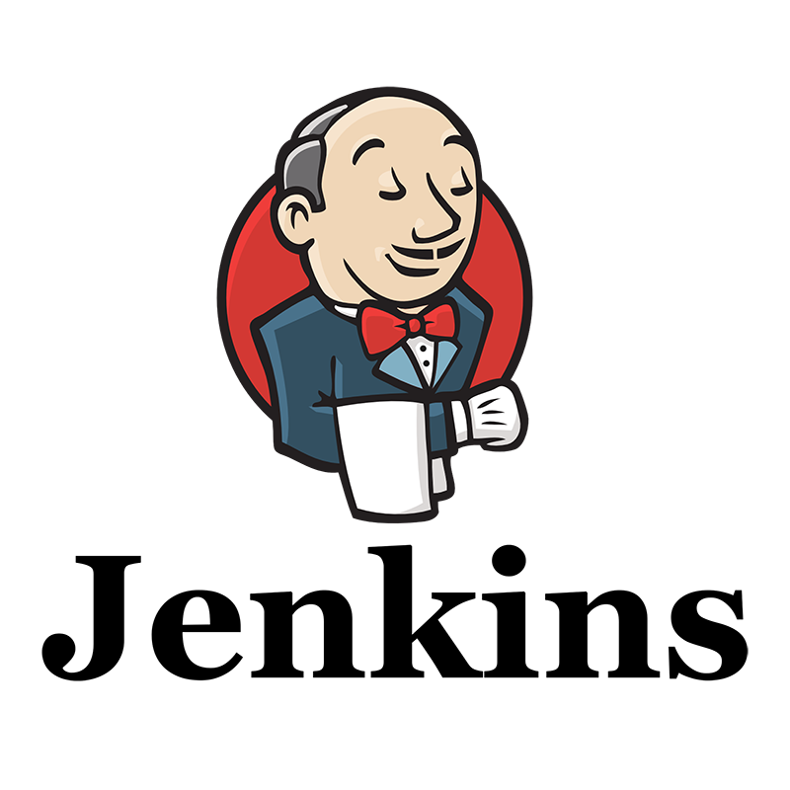
Introduction of Jenkins

Slide 2
Agenda
History of Jenkins?
What is Jenkins?
Advantages of Jenkins
Installation of Jenkins
Jenkins Master & Slave Architecture
Setup of Master & Slave

Slide 3
History Of Jenkins
The Jenkins project was started in 2004 (originally called Hudson) by Kohsuke Kawaguchi, while he worked for Sun Microsystems.
Little did Kawaguchi know that the future had something very special in store for him. At that time, Kawaguchi was involved in several development projects.
He didn’t like breaking the builds due to code failure. This made him look for something that could help him know whether the code will work or not before it is committed to the repository.

Slide 4
This curiosity led the way to the development of an automation server named Hudson.
In 2011, there was an infamous dispute between the independent Hudson open source community and Oracle, which now has Sun Microsystems under its umbrella.
Both Jenkins and Hudson continued to exist for a long time; however, Jenkins was the more preferred choice.
The Hudson project was shut down in January 2020. Jenkins is still active.

Slide 5
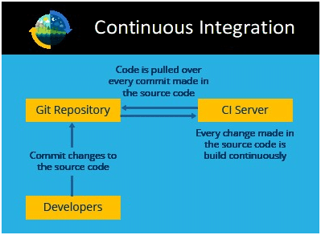
What is Jenkins?
Jenkins is an open-source automation tool written in Java with plugins built for Continuous Integration purposes.
Jenkins is used to build and test
your software projects continuously
making it easier for developers to
integrate changes to the project, and
making it easier for users to obtain a
fresh build.

Slide 6
It also allows you to continuously deliver your software by integrating with a large number of testing and deployment technologies.
Jenkins integrates development life-cycle processes of all kinds, including build, document, test, package, stage, deploy, static analysis and much more.
Jenkins achieves Continuous Integration with the help of plugins. Plugins allow the integration of various devops stages.
If you want to integrate a particular tool, you need to install the plugins for that tool. For example Git, Maven 2 project, Amazon EC2, HTML publisher, etc.

Slide 7
Advantages of Jenkins
It is an open-source tool with great community support.
Too easy to install.
It has 1000+ plugins to ease your work. If a plugin does not exist, you can code it and share it with the community.
It is free of cost.
It is built with Java and hence, it is portable to all the major platforms.

Slide 8
Installation of Jenkins
To install the Jenkins the Prerequisites are :
One EC2 Amazon Linux instance with internet access
Security Group with Port “8080” open for internet
Java v1.8.x
Below are the steps to install Jenkins :

Slide 9
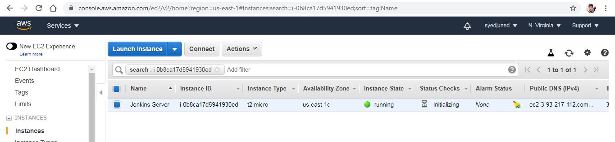
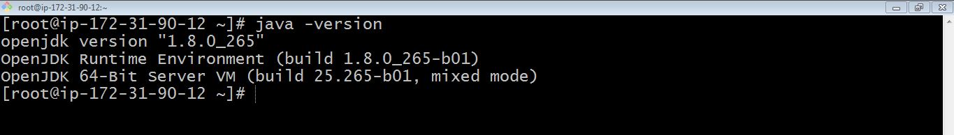
Launch an instance in Amazon Linux or Red hat or Ubuntu.
Now, Install Java. (yum install java-1.8*)
Java has been successfully installed.
Now, export the variables globally.

Slide 10
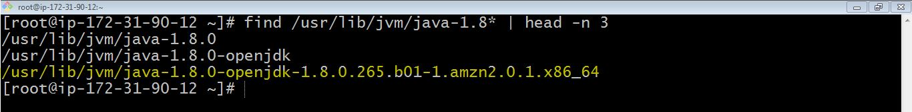
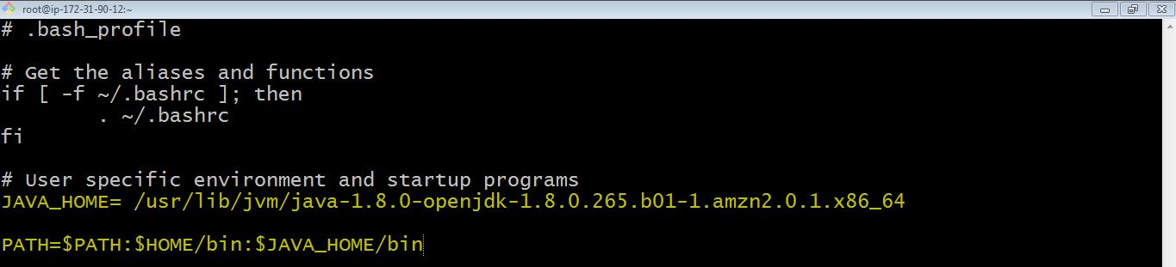
find /usr/lib/jvm/java-1.8* | head -n 3
To set it permanently update the.bash_profile.
After updating restart the bash profile (source ~/. bash_profile).

Slide 11
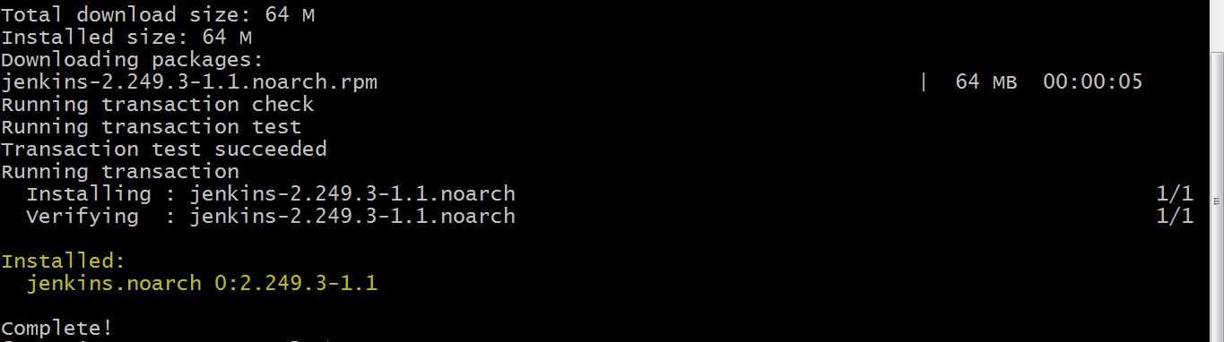
Java path has been succesfully exported.
Now Install Jenkins:
To install Jenkins follow the below steps:
Enter the wget command (wget -O /etc/yum.repos.d/jenkins.repo https://pkg.jenkins.io/redhat-stable/jenkins.repo)
Now import the rpm packages (rpm --import https://pkg.jenkins.io/redhat-stable/jenkins.io.key)
To install jenkins (yum -y install jenkins)

Slide 12
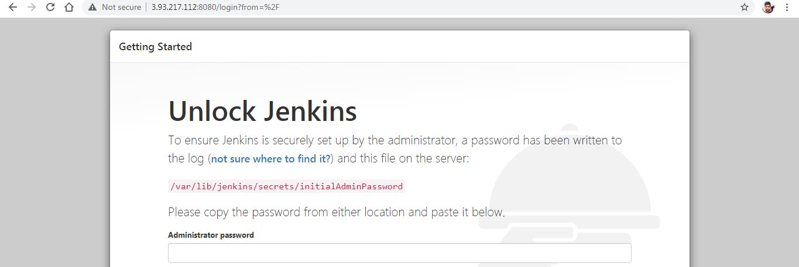
Jenkins has been successfully installed.
Now to start the service (systemctl start Jenkins)
Copy the public ip of your instance and paste in the web url with port number: 8080 to access the jenkins page.

Slide 13

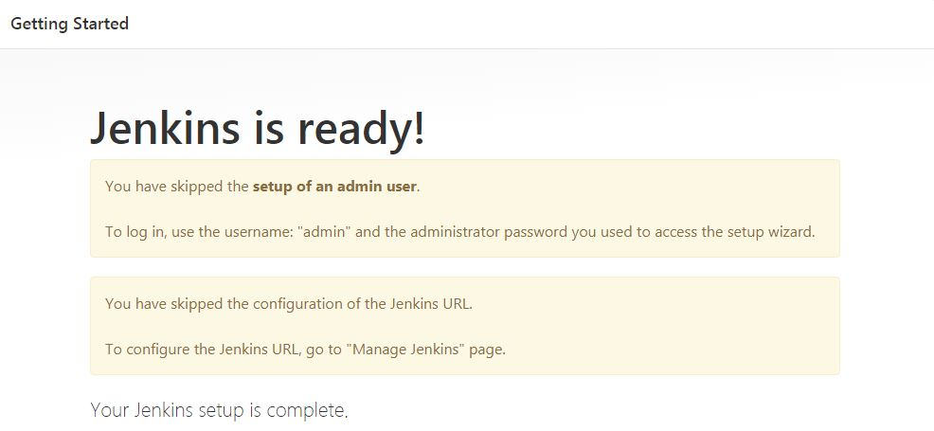
To view the password , enter the command( cat and copy the location)
Installation and setup of jenkins has completed.

Slide 14
Jenkins Master & Slave Architecture
Jenkins uses a Master-Slave architecture to manage distributed builds. In this architecture, Master and Slave communicate through TCP/IP protocol.
Jenkins Master :
Your main Jenkins server is the Master. The Master’s job is to handle :
Scheduling build jobs.
Dispatching builds to the slaves for the actual execution.
Monitor the slaves (possibly taking them online and offline as required).
Recording and presenting the build results.
A Master instance of Jenkins can also execute build jobs directly.

Slide 15
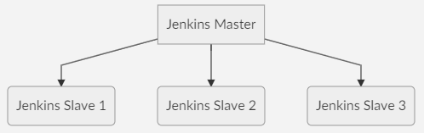
Jenkins Slave :
A Slave is a Java executable that runs on a remote machine. Following are the characteristics of Jenkins Slaves :
It hears requests from the Jenkins Master instance.
Slaves can run on a variety of operating systems.
The job of a Slave is to do as they are told to, which involves executing build jobs dispatched by the Master.
You can configure a project to always run on a particular Slave machine or a particular type of Slave machine, or simply let Jenkins pick the next available Slave.

Slide 16
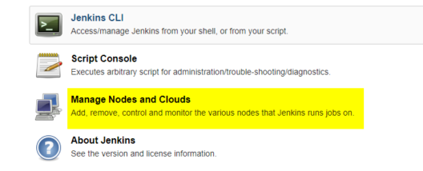
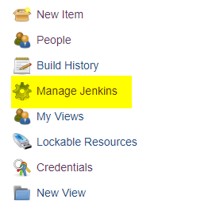
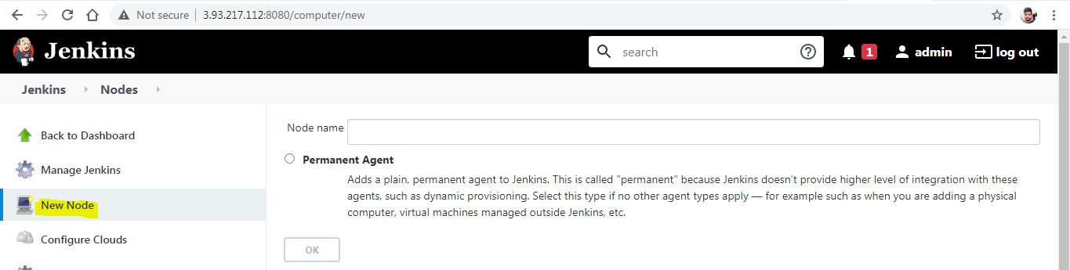
Steps to Configure Jenkins Master and Slave Nodes :
Go to the Manage Jenkins section and scroll down to the section of Manage Nodes
Click on New Node

Slide 17
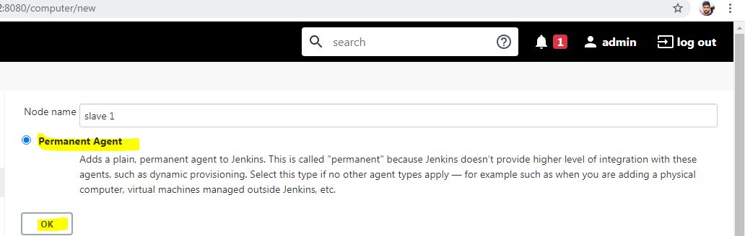
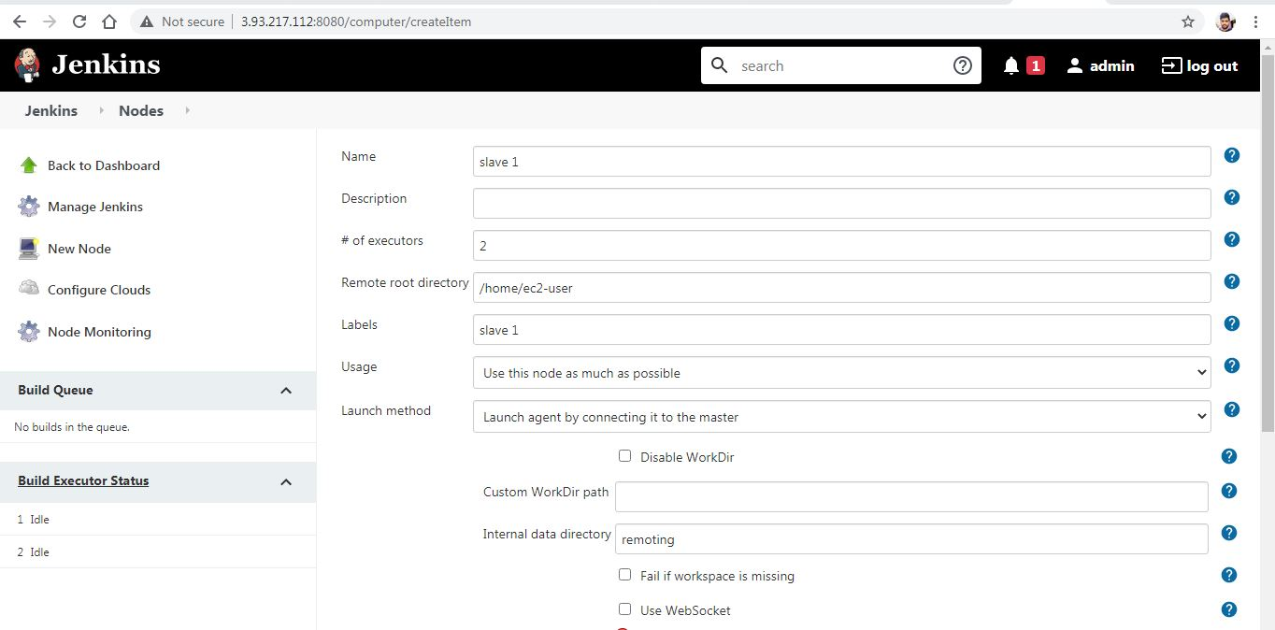
Give a name for the node, choose the Permanent Agent option and click on Ok.
Now enter the required information.

Slide 18
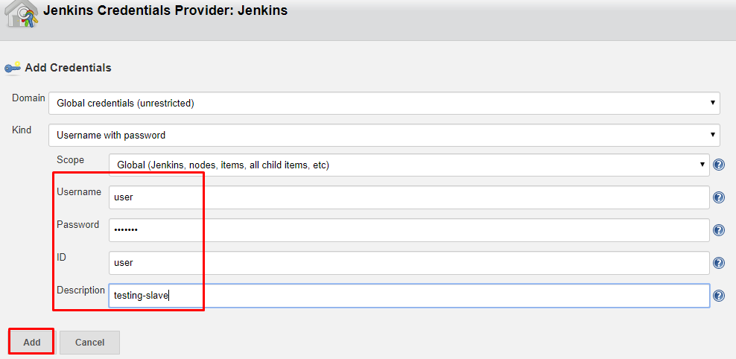
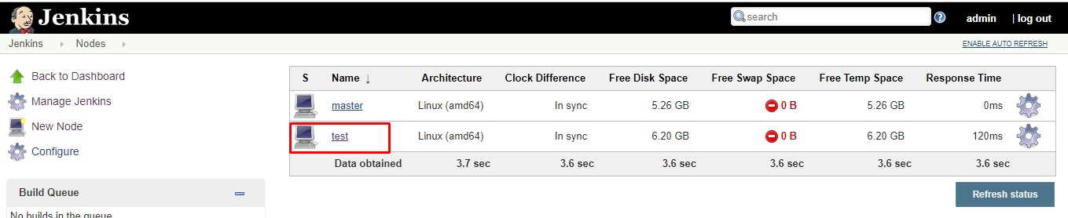
Select the Add button to add credentials and click Jenkins.
Enter Username, Password, ID, and Description.
Select the dropdown menu to add credentials in the Credentials field and then click on save button to save it.

Slide 19
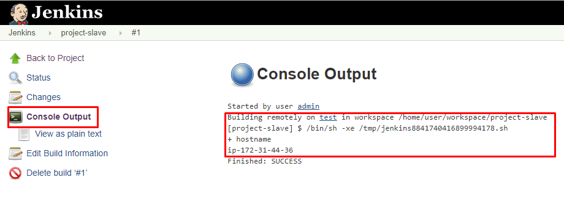
Creating a Freestyle Project and Running on The Slave Machine:
Click on Save and it will redirect to job's view page
On the left pane, click the Build Now button to execute your Pipeline.
We can verify the history of the executed build under the Build History by clicking the build number.
Click on the build number and select Console Output. Here you can see the executed job in the remote host and output.

