Slide 1

7COM1079-2022 Student Group No: Names of Student Attendees : Siddu Battu, Bhardwaj yadlapalli, Nithish babu Gangannari, Farhan Ahmad
1
Group Id: Name of Student Presenting:
Data Analysis – Crime and Socioeconomic Indicators: A Statistical Analysis Using R
Date:
Notes:
t’s good morning/afternoon to all of you. Today, we are going to showcase our visualization analysis of ‘Visualizing Crime and Unemployment’. Our group identification is Team Research and Development Project. Hello, i am [Your Name] and our presentation is planned for the October, 20, 2024. Let's dive in."

Slide 2
Introduction and Research Question
Introduction
Developing successful crime prevention plans and social policies requires examining the connection between socioeconomic variables, particularly unemployment, and crime rates.
Research Question
Does the state-level unemployment rate in the United States correlate with the total amount of violent crime?
Notes:
This presentation will be more about our considerations and investigations of the given visualizations. Where crime is considered along with aspects like unemployment, it becomes significant as this can give promising knowledge that will enhance crime fighting solutions. Our research question seeks to determine: “Is the level of Violent Crime Total related with the level of Unemployment Rate at the state level in United States of America?”

Slide 3
Dataset Overview
Dataset Description: Includes crime, population, and unemployment rates, analyzing US crime longitudinally by state.
Name of the dataset: crimebystatecombinedwithunemployment
Total number of rows: 1990
Variables
Dependent Variable: Violent Crime Total
Independent Variable: Unemployment Rate
Notes:
The list that is used in our analysis is called crimebystatecombinedwithunemployment. They include 520 rows of data. Thus, our dependent variable is the number of reported violent crime, while the independent variable is the unemployment rate, percentage of the labor force unemployed. Both variables are measured on an interval scale.” Slide 4: Data representation – Histogram

Slide 4
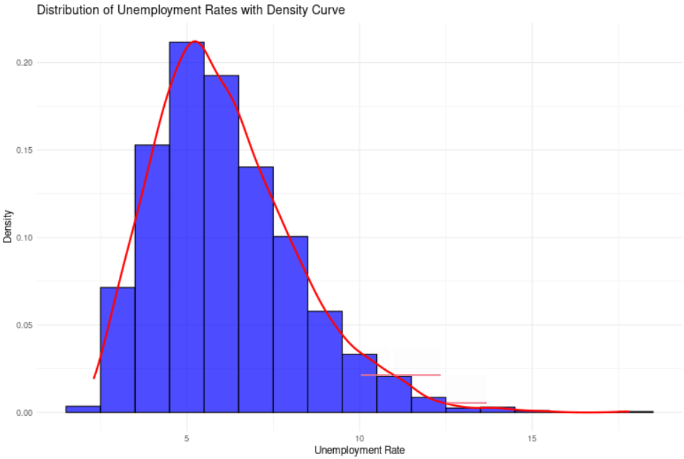
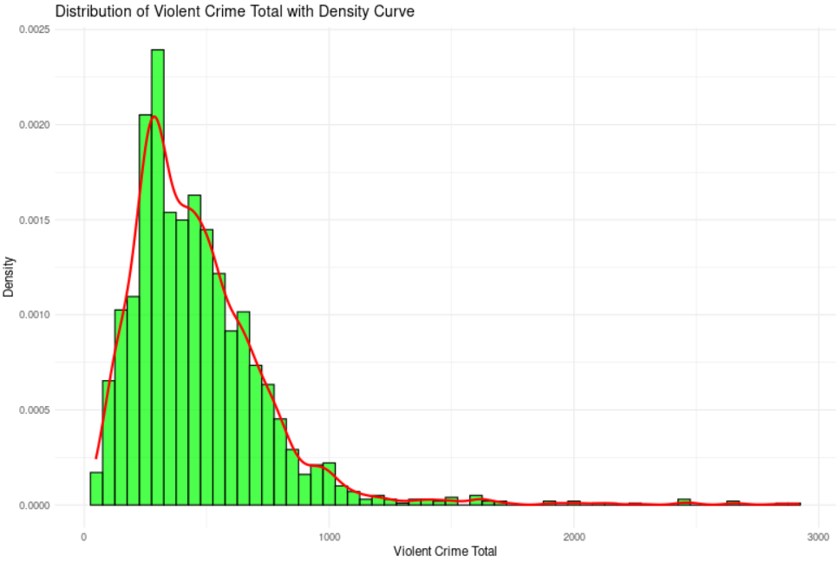
Data Visualization - Histogram
Interpretation
Unemployment Rate with Density Curve
Curve following data: This red line indicates the value of frequency in the histogram and tends to approximate the shape of the histogram.
Statistical Test: There is no statistical test presented but it will be possible to have this data from a non parametric test, namely Spearman correlation test.
Violent Crime Total with Density Curve
Curve following data: Nevertheless, the red line runs somewhat parallel to the shape of the data.
Statistical Test: Perhaps a non-parametric test such as the Spearman correlation could have been conducted.
Notes:
Here it is possible to find a Histogram for ‘Violent Crime Total’ and . The normal curve does not fit very well on the plotted density, since the distribution seems to be positively skewed. This means that for Spearman’s Rho, where the ability to test for population parameters is lacking, non-parametric tests have to be used. We have to check the normality before going for the parametric tests.”

Slide 5
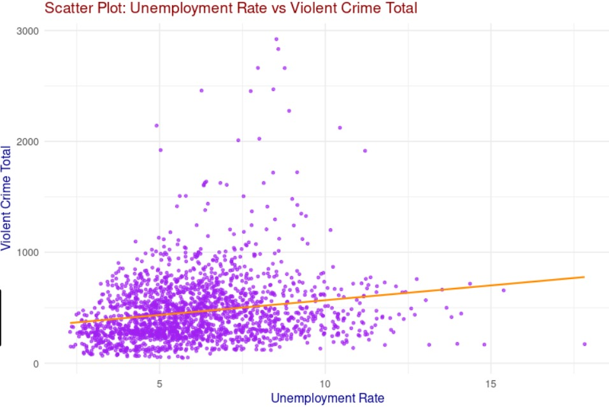
Data Visualization - Additional Chart
The scatterplot shows a positive spearman correlation, which may mean that the rate of violent crime rises in tandem with the unemployment rate. The most closely connected parameters are displayed in the heatmap.
Notes:
We have a scatterplot of ‘Unemployment Rate’ against ‘Violent Crime Total’. The scatterplot also depicts positive spearman correlation, this means that the two variables move in the same direction; one increases, the other also increases. This has the implication or possibility of a relationship. The heatmap which is depicted above shows other correlation factors.

Slide 6
Statistical Test Selection
Statistical Test Decision
Spearman correlation coefficient and a hypothesis test are used to examine the relationship between variables.
Justification for Selection
When normalcy assumptions are satisfied, this test can be used to ascertain the direction and strength of a linear relationship between two continuous variables. Non-parametric counterparts must be taken into account if the requirements are not fulfilled.
Notes:
In order to examine this type of relationship statistically, Pearson’s coefficient of correlation ‘R’ and hypothesis test based on it have been used. As was pointed out earlier this test is ideal for identifying the linear relationship between two interval variables.

Slide 7
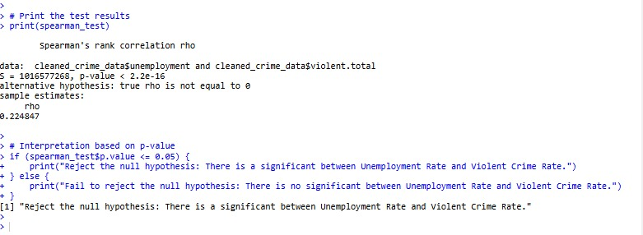
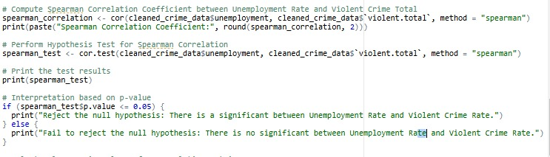
R Script and Results
Notes:
From the result: It’s below 0.05, which further confirms that there is a decent probability that there is a correlation between unemployment and violent crime. This implies that we have good reasons to say that the null hypothesis which is Ho can be rejected.

Slide 8
Conclusion and Implications
Conclusion
Existing unemployment rates are also positively related to violent crime rates though the distribution is not normal. The moderate correlation does point a relationship between both variables, therefore, could reject the null hypothesis.
Implications
These results suggest that, as such, the crime levels could be associated with economic instability, in terms of unemployment rates, if any. This comes as a call for social policy adjustments. This work can be extended to establish other socio-economic factors that can be used in gauging crime prevalence.
Notes:
Therefore, based on the data analysis done here we can note that there is a positive moderate relationship between unemployment andviolent crime rate. That could mean that violent crime might be associated with a high level of unemployment among the nation’s youth. This suggests that polices associated with economic insecurity can remove or at least alleviate crime factors. Maybe one should carry out more research on this aspect.”

